Slide 1
Chapter 1: Patterns of Motion and Equilibrium

Slide 2
This lecture will help you understand:
Aristotle on Motion
Galileo's Concept of Inertia
Mass—A Measure of Inertia
Net Force
The Equilibrium Rule
Support Force
Dynamic Equilibrium
The Force of Friction
Speed and Velocity
Acceleration

Slide 3
Aristotle on Motion
Aristotle classified motion into two kinds:
Natural motion—motion that is straight up or straight down
Violent motion—imposed motion resulting from an external push or pull

Slide 4
Galileo's Concept of Inertia
Italian scientist Galileo demolished Aristotle's assertions in early 1500s.
In the absence of a force, objects once set in motion tend to continue moving indefinitely.

Slide 5
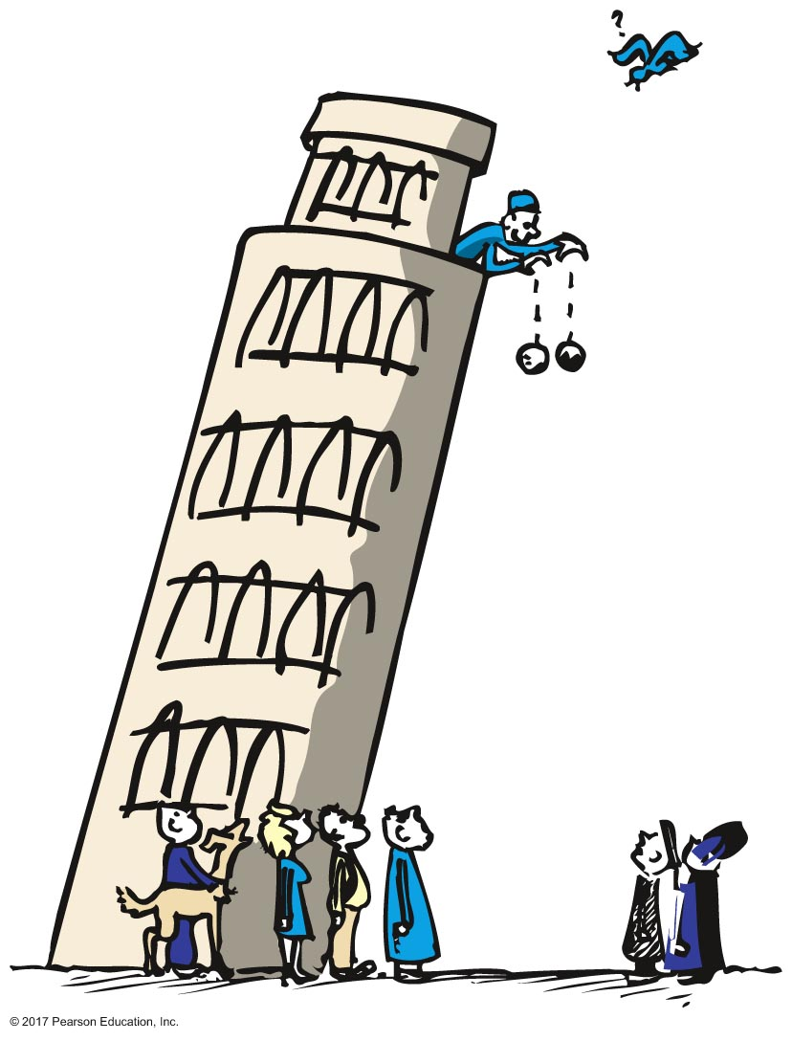
Galileo's Concept of Inertia
Legend of the Leaning Tower of Pisa:
Galileo showed that dropped objects fall to the ground at the same time when air resistance is negligible.

Slide 6
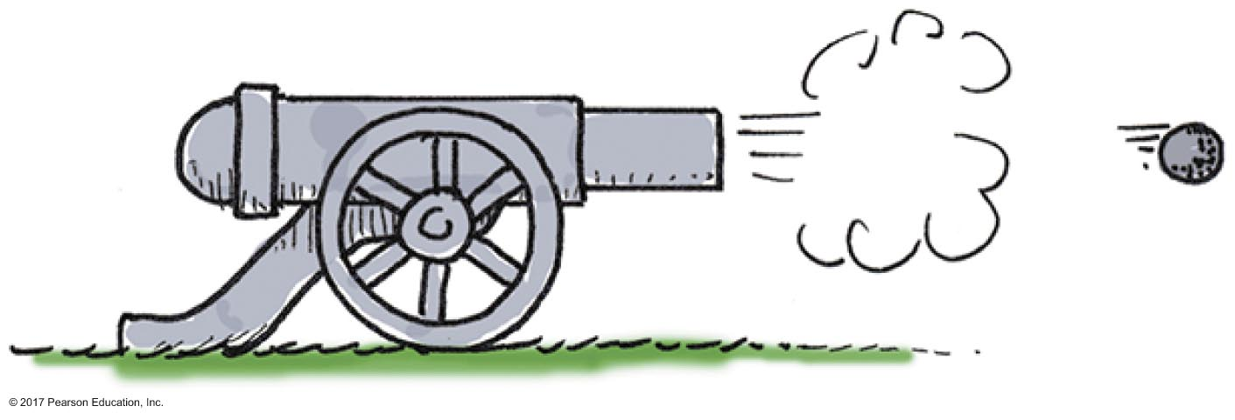
Galileo's Concept of Inertia
Discovery:
In the absence of friction, no force is necessary to keep a horizontally moving object moving.

Slide 7
Galileo's Concept of Inertia
Experiment:
Balls rolling down inclined planes and then up others tend to roll back up to their original heights.

Slide 8
Galileo's Concept of Inertia
Conclusion:
The tendency of a moving body to keep moving is natural—every material object resists change in its state of motion. This property of things to resist change is called inertia.

Slide 9
Galileo's Concept of Inertia CHECK YOUR NEIGHBOR
The use of inclined planes for Galileo's experiments helped him to
eliminate the acceleration of free fall.
discover the concept of energy.
discover the property called inertia.
discover the concept of momentum.
Notes:
C. discover the property called inertia.

Slide 10
Galileo's Concept of Inertia CHECK YOUR ANSWER
The use of inclined planes for Galileo's experiments helped him to
eliminate the acceleration of free fall.
discover the concept of energy.
discover the property called inertia.
discover the concept of momentum.
Explanation:
Note that inertia is a property of matter, not a reason for the behavior of matter.
Notes:
C. discover the property called inertia.

Slide 11
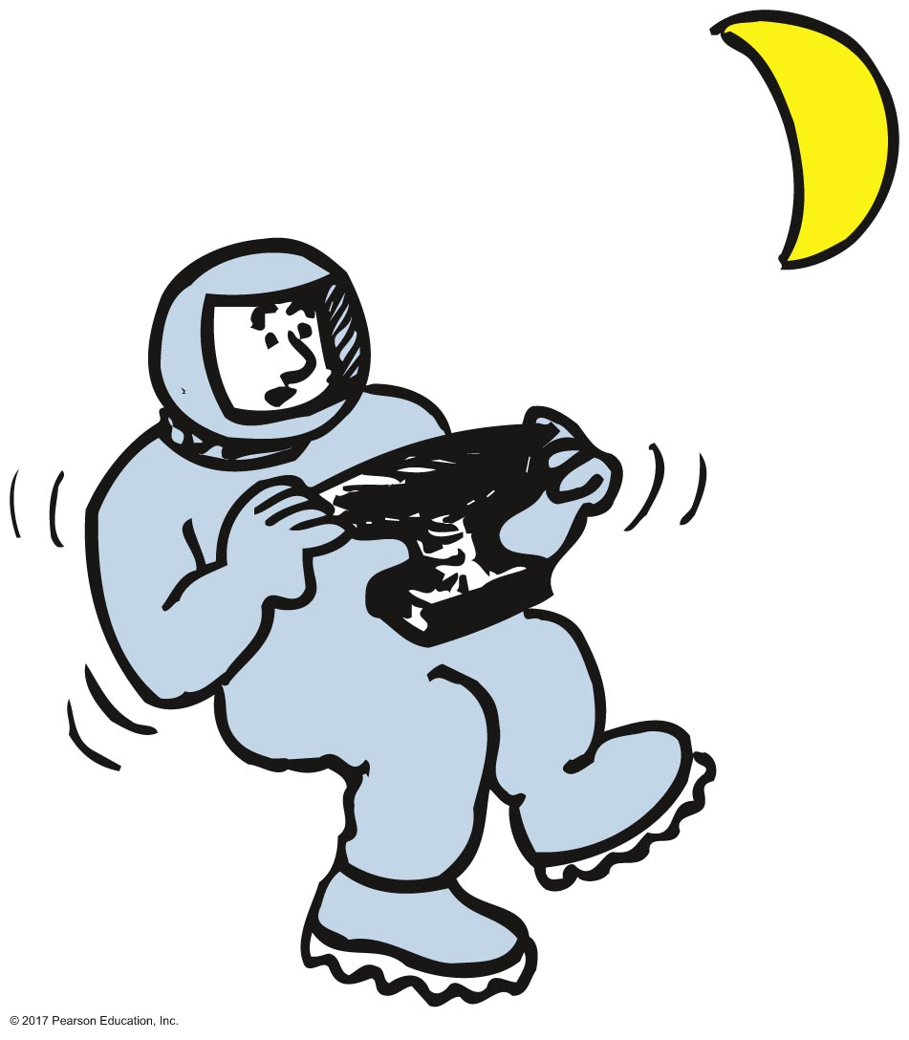
Mass—A Measure of Inertia
The amount of inertia possessed by an object depends on the amount of matter—the amount of material that composes it—its mass:
greater mass greater inertia
smaller mass smaller inertia

Slide 12
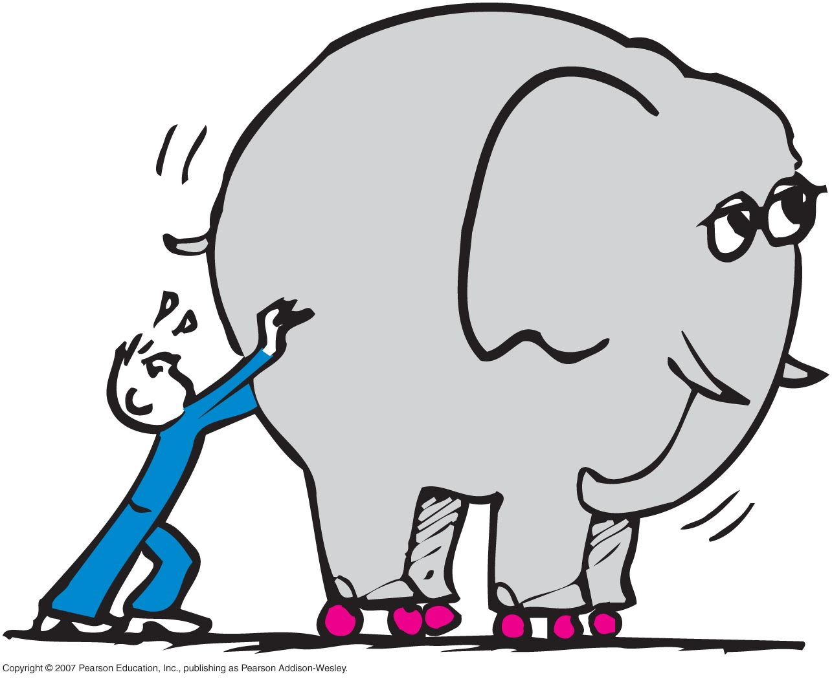
Mass—A Measure of Inertia
Mass
Quantity of matter in an object
Measure of inertia or sluggishness that an object exhibits in response to any effort made to start it, stop it, or change its state of motion in any way

Slide 13
Mass—A Measure of Inertia
Weight
Amount of gravitational pull on an object
Proportional to mass
Twice the mass twice the weight
Half the mass half the weight

Slide 14
Mass—A Measure of Inertia
Mass versus volume:
Mass involves how much matter an object contains
Volume involves how much space an object occupies

Slide 15
Mass—A Measure of Inertia CHECK YOUR NEIGHBOR
The concept of inertia mostly involves
mass.
weight.
volume.
density.
Notes:
A. mass.

Slide 16
Mass—A Measure of Inertia CHECK YOUR ANSWER
The concept of inertia mostly involves
mass.
weight.
volume.
density.
Explanation:
Anybody get this wrong? Check the title of this slide! :-)
Notes:
A. mass.

Slide 17
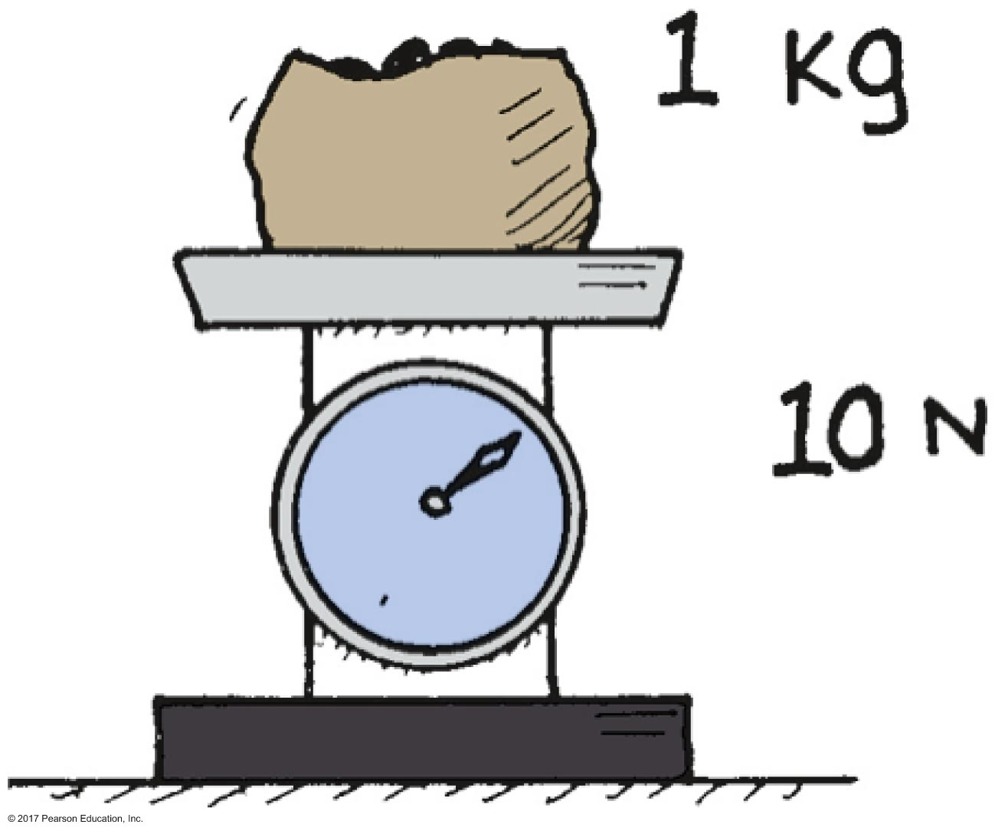
Mass—A Measure of Inertia
Kilogram
standard unit of measurement for mass
on Earth's surface, 1 kg of material weighs 10 newtons
away from Earth (on the Moon), 1 kg of material weighs less than 10 newtons

Slide 18
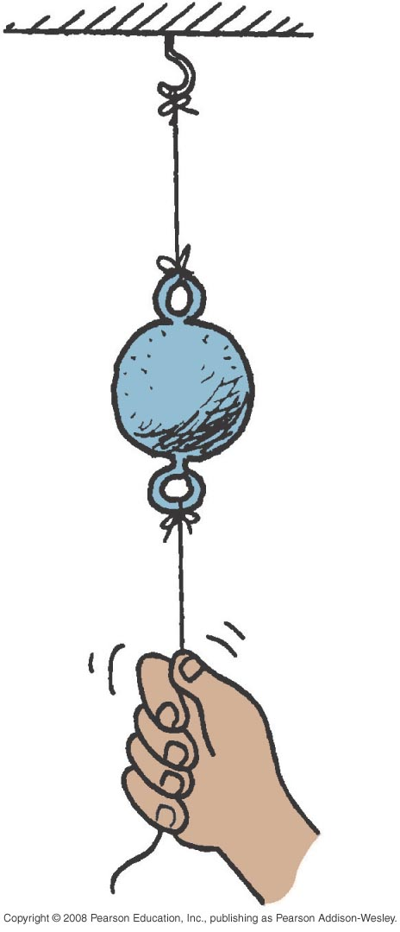
Mass—A Measure of Inertia CHECK YOUR NEIGHBOR
When the string is pulled down slowly, the top string breaks, which best illustrates the
weight of the ball.
mass of the ball.
volume of the ball.
density of the ball.
Notes:
A. weight of the ball.

Slide 19
Mass—A Measure of Inertia CHECK YOUR ANSWER
When the string is pulled down slowly, the top string breaks, which best illustrates the
weight of the ball.
mass of the ball.
volume of the ball.
density of the ball.
Explanation:
Tension in the top string is the pulling tension plus the weight of the ball, both of which break the top string.
Notes:
A. weight of the ball.

Slide 20
Mass—A Measure of Inertia CHECK YOUR NEIGHBOR
When the string is pulled down quickly, the bottom string breaks, which best illustrates the
weight of the ball.
mass of the ball.
volume of the ball.
density of the ball.
Notes:
B. mass of the ball.

Slide 21
Mass—A Measure of Inertia CHECK YOUR ANSWER
When the string is pulled down quickly, the bottom string breaks, which best illustrates the
weight of the ball.
mass of the ball.
volume of the ball.
density of the ball.
Explanation:
It is the "laziness" of the ball that keeps it at rest resulting in the breaking of the bottom string.
Notes:
B. mass of the ball.

Slide 22
Mass—A Measure of Inertia
Measure of compactness
Density is the measure of how much mass occupies a given space
Equation for density:
Density =
in grams per cubic centimeter or
kilograms per cubic meter

Slide 23
Mass—A Measure of Inertia CHECK YOUR NEIGHBOR
The density of 1 kilogram of iron is
less on the Moon.
the same on the Moon.
greater on the Moon.
All of the above.
Notes:
B. the same on the Moon.

Slide 24
Mass—A Measure of Inertia CHECK YOUR ANSWER
The density of 1 kilogram of iron is
less on the Moon.
the same on the Moon.
greater on the Moon.
All of the above.
Explanation:
Both mass and volume of 1 kilogram of iron is the same everywhere, so density is the same everywhere.
Notes:
B. the same on the Moon.

Slide 25
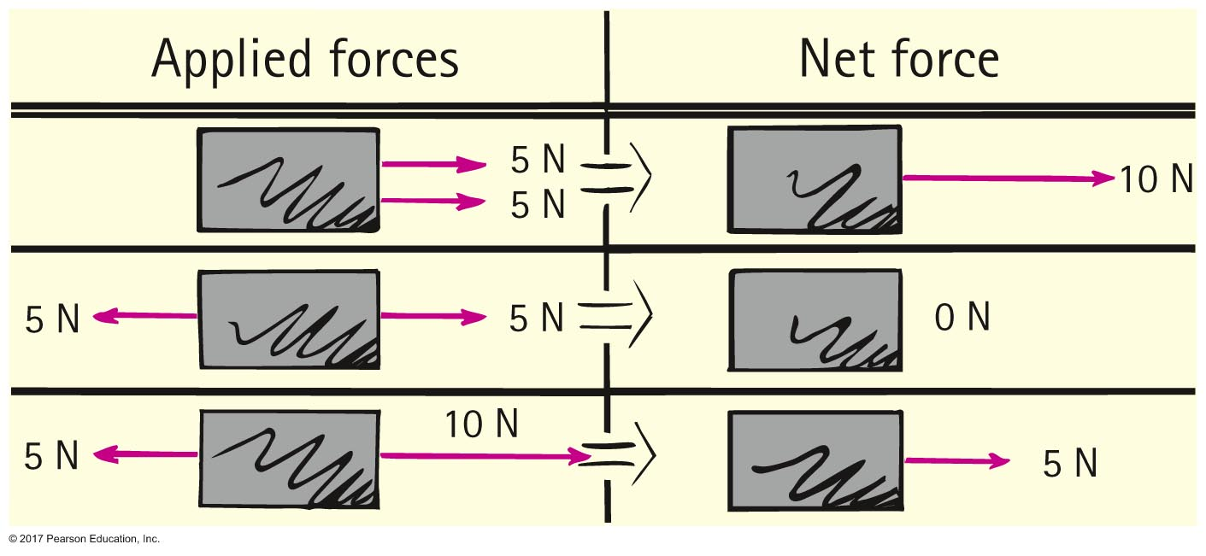
Net Force
Force
simply a push or a pull
Net force
combination of all forces that act on an object
changes an object's motion

Slide 26
Net Force CHECK YOUR NEIGHBOR
A cart is pushed to the right with a force of 15 N while being pulled to the left with a force of 20 N. The net force on the cart is
5 N to the left.
5 N to the right.
25 N to the left.
25 N to the right.
Notes:
A. 5 N to the left.

Slide 27
Net Force CHECK YOUR ANSWER
A cart is pushed to the right with a force of 15 N while being pulled to the left with a force of 20 N. The net force on the cart is
5 N to the left.
5 N to the right.
25 N to the left.
25 N to the right.
Notes:
A. 5 N to the left.

Slide 28
The Equilibrium Rule
The equilibrium rule:
The vector sum of forces acting on a non-accelerating object or system of objects equals zero.
Mathematical notation: ΣF = 0.

Slide 29
The Equilibrium Rule CHECK YOUR NEIGHBOR
The equilibrium rule, ΣF = 0, applies to
vector quantities.
scalar quantities.
Both of the above.
Neither of the above.
Notes:
A. vector quantities.

Slide 30
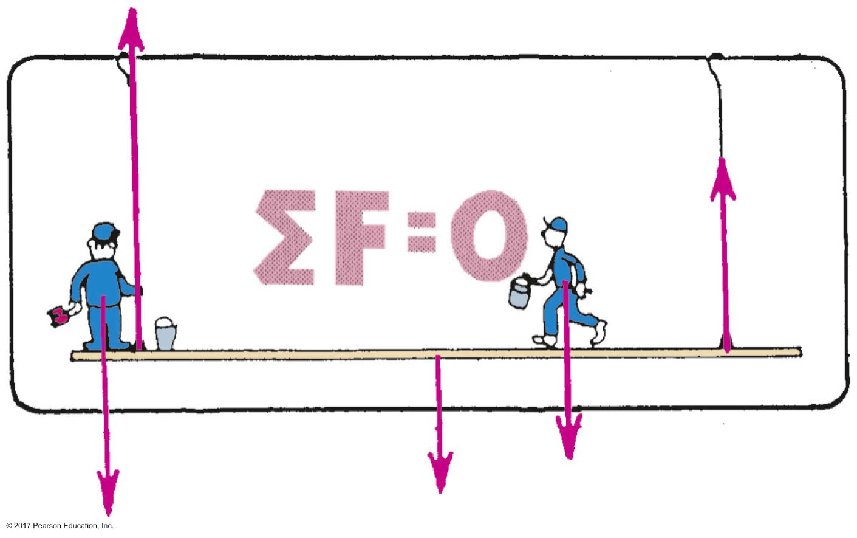
The Equilibrium Rule CHECK YOUR ANSWER
The equilibrium rule, ΣF = 0, applies to
vector quantities.
scalar quantities.
Both of the above.
Neither of the above.
Explanation:
Vector addition takes into account + and – quantities that can cancel to zero. Two forces (vectors) can add to zero, but there is no way that two masses (scalars) can add to zero.
Notes:
A. vector quantities.

Slide 31
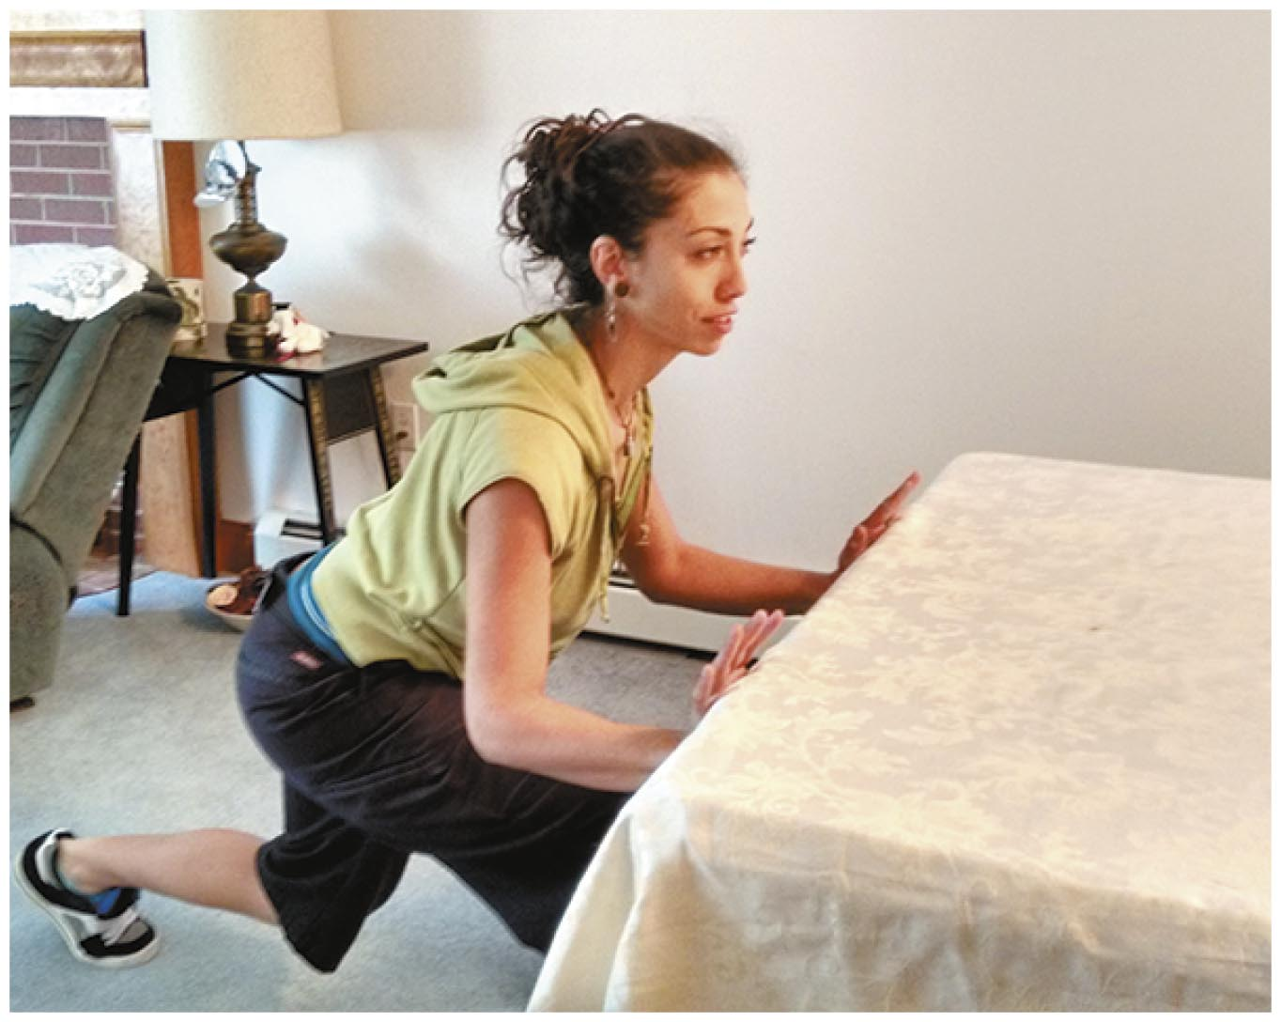
Dynamic Equilibrium
An object that moves at constant velocity is in equilibrium.
When two or more forces cancel to zero on a moving object, then the object is in equilibrium.

Slide 32
Dynamic Equilibrium CHECK YOUR NEIGHBOR
A bowling ball is in equilibrium when it
is at rest.
moves steadily in a straight-line path.
Both of the above.
None of the above.
Notes:
C. Both of the above.

Slide 33
Dynamic Equilibrium CHECK YOUR ANSWER
A bowling ball is in equilibrium when it
is at rest.
moves steadily in a straight-line path.
Both of the above.
None of the above.
Notes:
C. Both of the above.

Slide 34
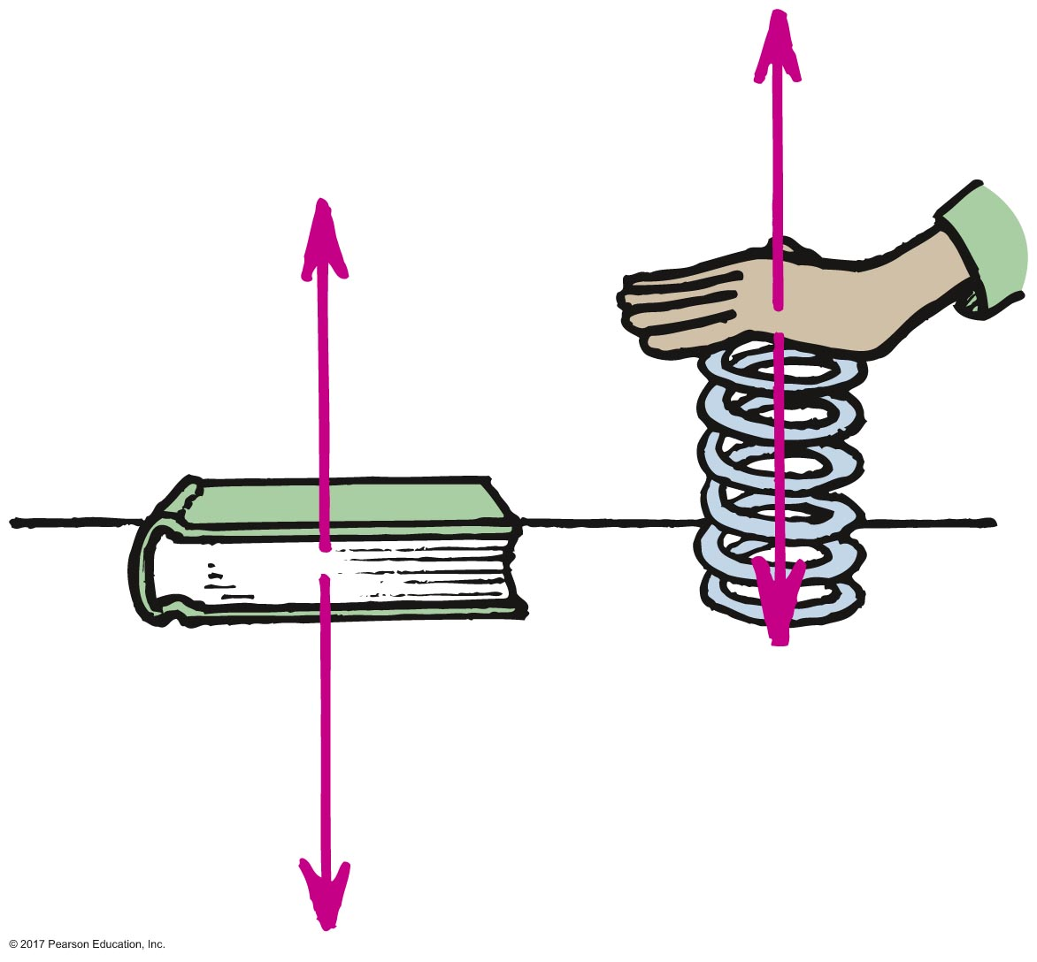
Support Force
Support force
is force that supports an object on the surface against gravity
is also normal force

Slide 35
Support Force CHECK YOUR NEIGHBOR
When you stand on two bathroom scales, with one foot on each scale and weight evenly distributed, each scale will read
your weight.
half your weight.
zero.
actually more than your weight.
Notes:
B. half your weight.

Slide 36
Support Force CHECK YOUR ANSWER
When you stand on two bathroom scales, with one foot on each scale and weight evenly distributed, each scale will read
your weight.
half your weight.
zero.
actually more than your weight.
Explanation:
You are at rest on the scales, so ΣF = 0. The sum of the two upward support forces is equal to your weight.
Notes:
B. half your weight.

Slide 37
The Force of Friction
Friction
the resistive force that opposes the motion or attempted motion of an object through a fluid or past another object with which it is in contact
always acts in a direction to oppose motion

Slide 38
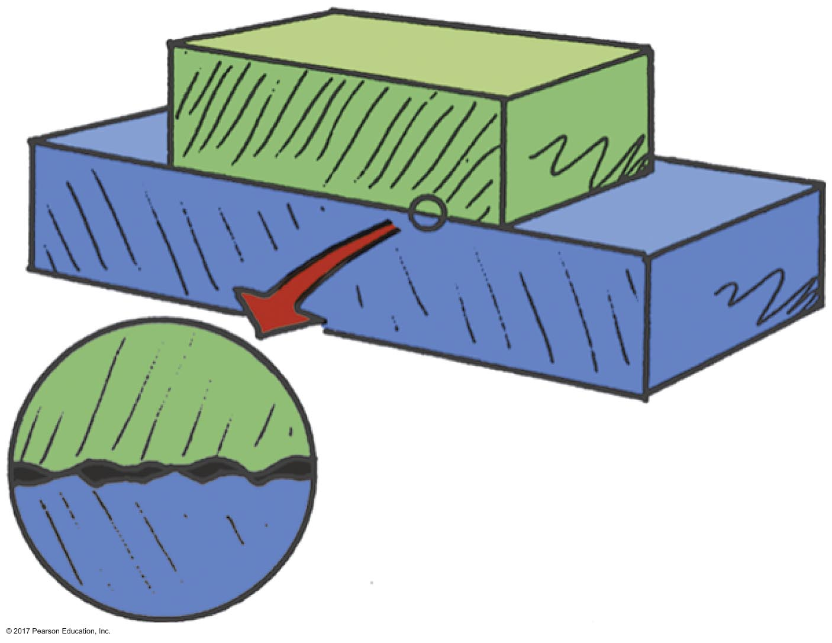
The Force of Friction
Friction (continued)
between two surfaces, the amount depends on the kinds of material and how much they are pressed together
due to surface bumps and also to the stickiness of atoms on the surfaces of the two materials

Slide 39
The Force of Friction CHECK YOUR NEIGHBOR
The force of friction can occur
with sliding objects.
in water.
in air.
All of the above.
Notes:
D. All of the above.

Slide 40
The Force of Friction CHECK YOUR ANSWER
The force of friction can occur
with sliding objects.
in water.
in air.
All of the above.
Explanation:
Friction can also occur for objects at rest. If you push horizontally on your book and it doesn't move, then friction between the book and the table is equal and opposite to your push.
Notes:
D. All of the above.

Slide 41
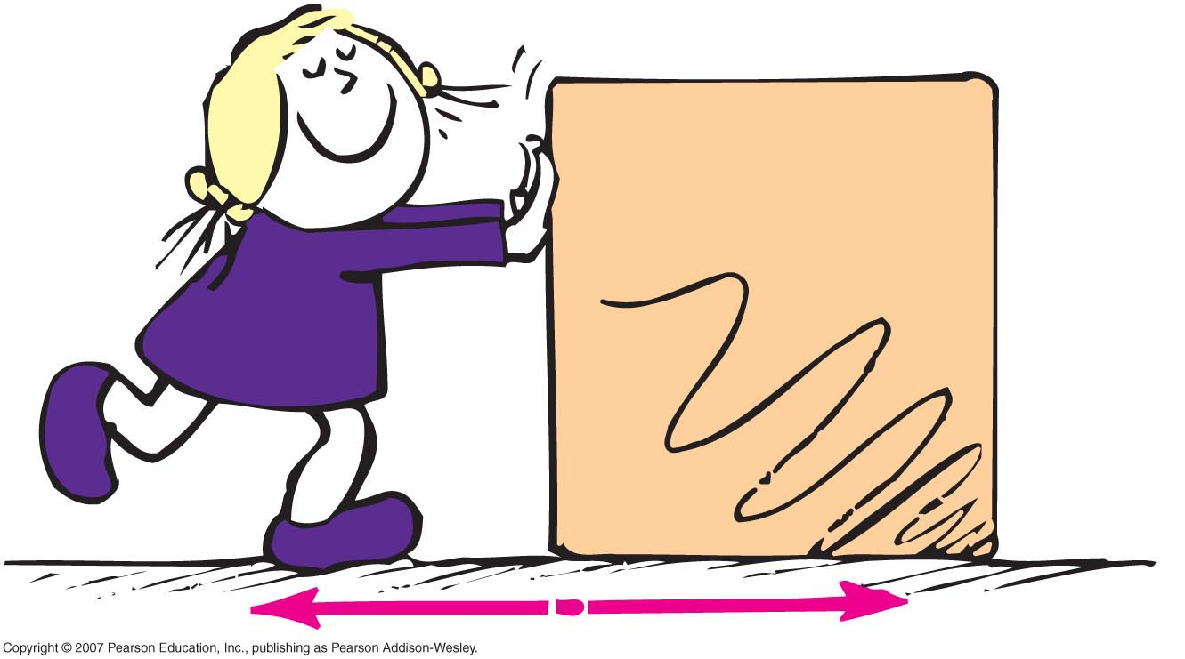
The Force of Friction CHECK YOUR NEIGHBOR
When Nellie pushes a crate across a factory floor at constant speed, the force of friction between the crate and the floor is
less than Nellie's push.
equal to Nellie's push.
equal and opposite to Nellie's push.
more than Nellie's push.
Notes:
C. equal and opposite to Nellie's push.

Slide 42
The Force of Friction CHECK YOUR ANSWER
When Nellie pushes a crate across a factory floor at constant speed, the force of friction between the crate and the floor is
less than Nellie's push.
equal to Nellie's push.
equal and opposite to Nellie's push.
more than Nellie's push.
Notes:
C. equal and opposite to Nellie's push.

Slide 43
The Force of Friction CHECK YOUR NEIGHBOR
When Nellie pushes a crate across a factory floor at an increasing speed, the amount of friction between the crate and the floor is
less than Nellie's push.
equal to Nellie's push.
equal and opposite to Nellie's push.
more than Nellie's push.
Notes:
A. less than Nellie's push.

Slide 44
The Force of Friction CHECK YOUR ANSWER
When Nellie pushes a crate across a factory floor at an increasing speed, the amount of friction between the crate and the floor is
less than Nellie's push.
equal to Nellie's push.
equal and opposite to Nellie's push.
more than Nellie's push.
Explanation:
The increasing speed indicates a net force greater than zero. Her push is greater than the friction force. The crate is not in equilibrium.
Notes:
A. less than Nellie's push.

Slide 45
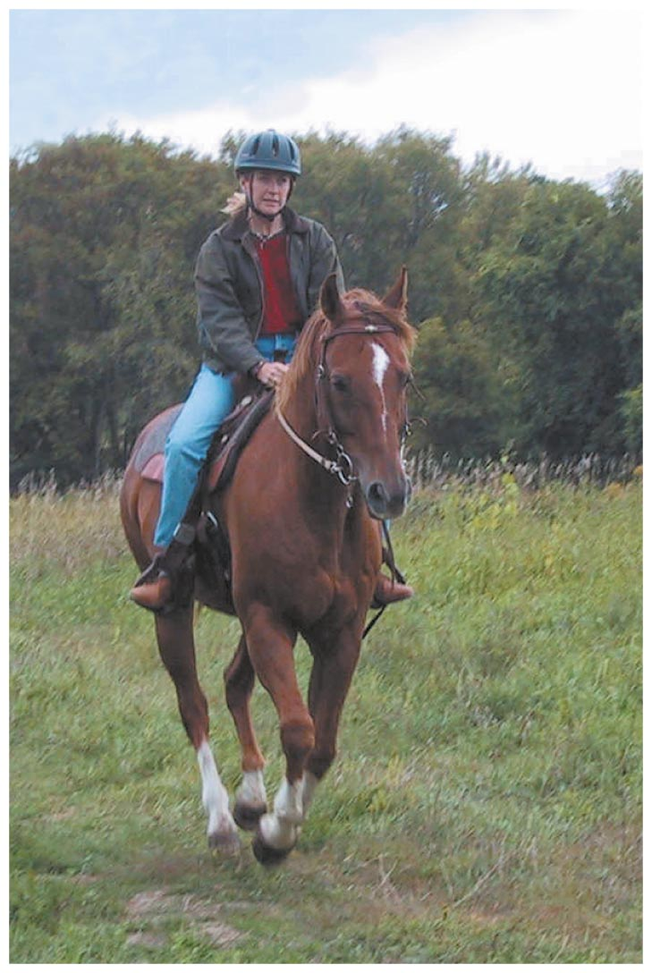
Speed and Velocity
Speed is described as the distance covered per amount of travel time
Equation for speed:
Speed =

Slide 46
Speed and Velocity
Average speed
is total distance traveled divided by travel time
equation:
average speed =
Instantaneous speed
is speed at any instant of time

Slide 47
Speed and Velocity CHECK YOUR NEIGHBOR
The average speed in driving 30 km in 1 hour is the same average speed as driving
30 km in one-half hour.
30 km in two hours.
60 km in one-half hour.
60 km in two hours.
Notes:
D. 60 km in two hours.

Slide 48
Speed and Velocity CHECK YOUR ANSWER
The average speed in driving 30 km in 1 hour is the same average speed as driving
30 km in one-half hour.
30 km in two hours.
60 km in one-half hour.
60 km in two hours.
Notes:
D. 60 km in two hours.

Slide 49
Motion is Relative
Everything is always moving.
At this moment, your speed relative to the Sun is about 100,000 kilometers per hour.
When we say a space shuttle travels at 30,000 kilometers per hour, we mean relative to the Earth.

Slide 50
Motion is Relative CHECK YOUR NEIGHBOR
A hungry bee sees a flower in a 5-m/s breeze. How fast and in what direction should the bee fly in order to hover above the flower?
It should fly toward the flower, then at 5 m/s into the breeze.
It should fly with the breeze at 5 m/s away from the flower.
The bee will not be able to fly in a 5-m/s breeze.
The bee will not be able to reach the flower.
Notes:
A. It should fly toward the flower, then at 5 m/s into the breeze.

Slide 51
Motion is Relative CHECK YOUR ANSWER
A hungry bee sees a flower in a 5-m/s breeze. How fast and in what direction should the bee fly in order to hover above the flower?
It should fly toward the flower, then at 5 m/s into the breeze.
It should fly with the breeze at 5 m/s away from the flower.
The bee will not be able to fly in a 5-m/s breeze.
The bee will not be able to reach the flower.
Explanation:
When just above the flower, it should fly at 5-m/s in order to hover at rest. This is why bees grip onto a flower to prevent from being blown off.
Notes:
A. It should fly toward the flower, then at 5 m/s into the breeze.

Slide 52
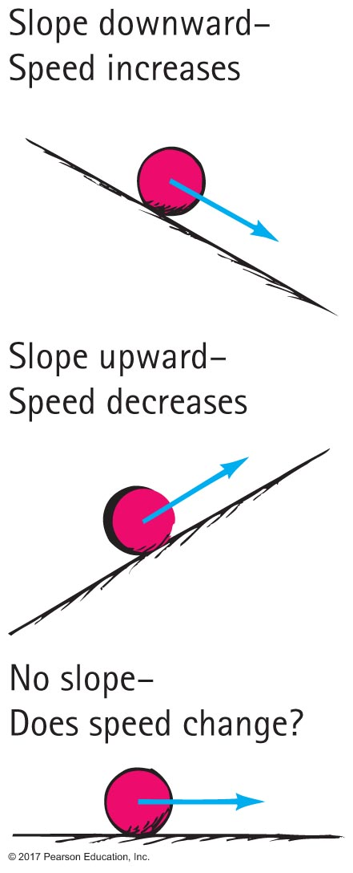
Acceleration
Galileo first formulated the concept of acceleration in his experiments with inclined planes.

Slide 53
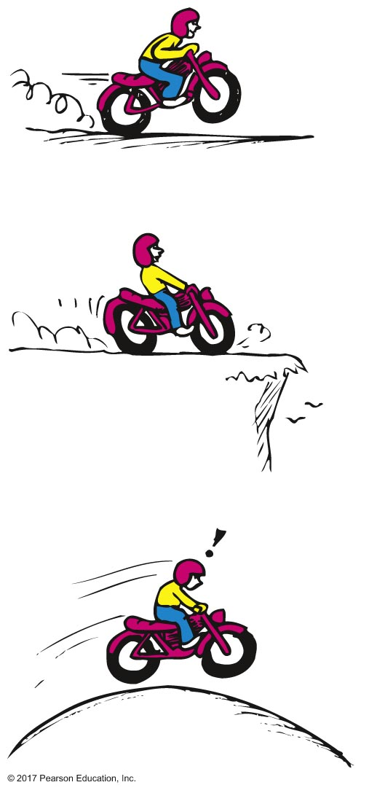
Acceleration
Acceleration is the rate at which velocity changes with time. The change in velocity may be in magnitude, in direction, or both.
Equation for acceleration:
Acceleration =

Slide 54
Acceleration CHECK YOUR NEIGHBOR
An automobile cannot maintain a constant speed when
accelerating.
rounding a curve.
Both of the above.
None of the above.
Notes:
C. Both of the above.

Slide 55
Acceleration CHECK YOUR ANSWER
An automobile cannot maintain a constant speed when
accelerating.
rounding a curve.
Both of the above.
None of the above.
Explanation:
When rounding a curve, the automobile is accelerating, for it is changing direction.
Notes:
C. Both of the above.

Slide 56
Acceleration CHECK YOUR NEIGHBOR
Acceleration and velocity are actually
much the same as each other.
rates, but for different quantities.
the same when direction is not a factor.
the same for free-fall situations.
Notes:
B. rates, but for different quantities.

Slide 57
Acceleration CHECK YOUR ANSWER
Acceleration and velocity are actually
much the same as each other.
rates, but for different quantities.
the same when direction is not a factor.
the same for free-fall situations.
Explanation:
Velocity is the rate at which distance changes with time; acceleration is the rate at which velocity changes with time.
Notes:
B. rates, but for different quantities.

Slide 58
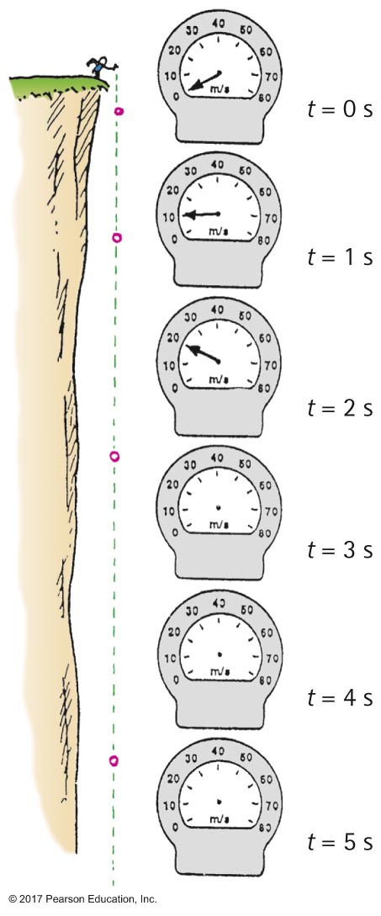
Acceleration
Free fall
When the only force acting on a falling object is gravity, (with negligible air resistance), the object is in a state of free fall.

Slide 59
Acceleration CHECK YOUR NEIGHBOR
If a falling object gains 10 m/s each second it falls, its acceleration is
10 m/s.
10 m/s per second.
Both of the above.
Neither of the above.
Notes:
B. 10 m/s per second.

Slide 60
Acceleration CHECK YOUR ANSWER
If a falling object gains 10 m/s each second it falls, its acceleration is
10 m/s.
10 m/s per second.
Both of the above.
Neither of the above.
Explanation:
It is common to express 10 m/s per second as 10 m/s/s, or 10 m/s².
Notes:
B. 10 m/s per second.

Slide 61
Acceleration CHECK YOUR NEIGHBOR
A free-falling object has a speed of 30 m/s at one instant. Exactly one second later its speed will be
the same.
35 m/s.
more than 35 m/s.
60 m/s.
Notes:
C. more than 35 m/s.

Slide 62
Acceleration CHECK YOUR ANSWER
A free-falling object has a speed of 30 m/s at one instant. Exactly one second later its speed will be
the same.
35 m/s.
more than 35 m/s.
60 m/s.
Explanation:
One second later its speed will be 40 m/s, which is more than 35 m/s.
Notes:
C. more than 35 m/s.

Slide 63
Acceleration CHECK YOUR NEIGHBOR
The distance fallen by a free-falling body
remains constant each second of fall.
increases each second when falling.
decreases each second when falling.
None of the above.
Notes:
B. increases each second when falling.

Slide 64
Acceleration CHECK YOUR ANSWER
The distance fallen by a free-falling body
remains constant each second of fall.
increases each second when falling.
decreases each second when falling.
None of the above.
Explanation:
See Table 1.2 for verification of this. Falling distance ~ time squared.
Notes:
B. increases each second when falling.

Slide 65
