Slide 1
Chapter 2: Newton's Laws of Motion

Slide 2
This lecture will help you understand:
Newton's First Law of Motion
Newton's Second Law of Motion
Forces and Interactions
Newton's Third Law of Motion
Summary of Newton's Three Laws

Slide 3
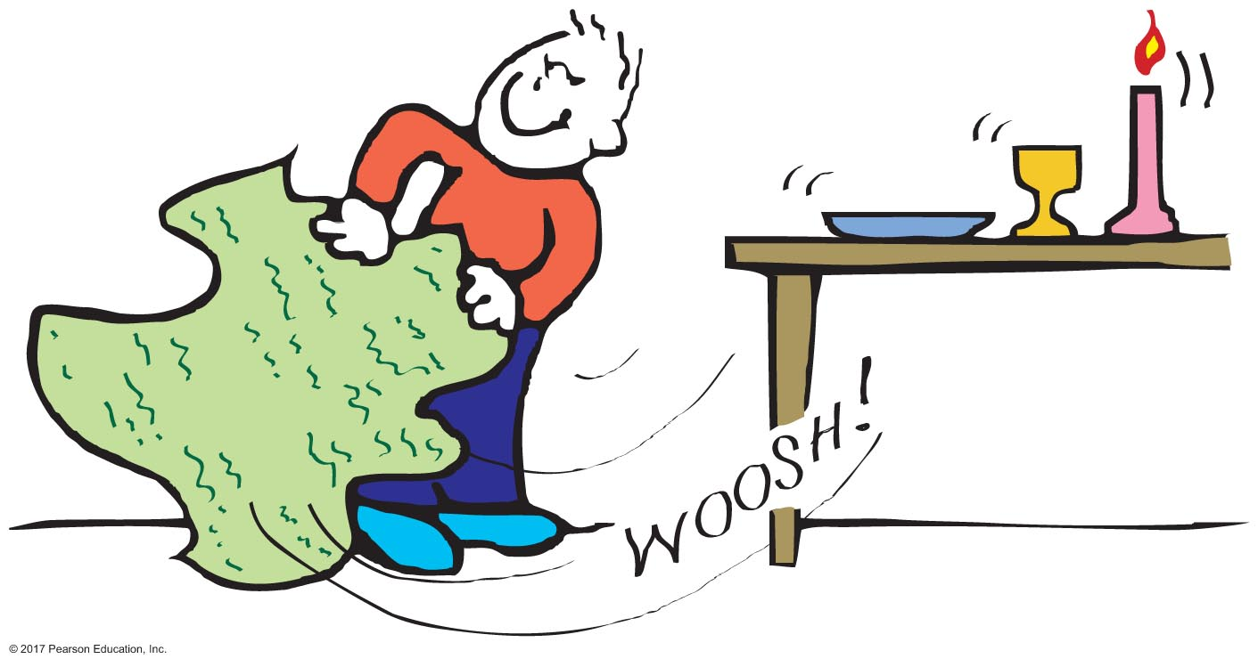
Newton's First Law of Motion
The law of inertia: (originating with Galileo)
Every object continues in a state of rest or of uniform speed in a straight line unless acted on by a nonzero force.

Slide 4
Newton's First Law of Motion CHECK YOUR NEIGHBOR
A sheet of paper can be quickly withdrawn from under a soft-drink can without the can toppling, because
gravity pulls harder on the can than on the paper.
the can has weight.
the can has inertia.
None of the above.
Notes:
C. the can has inertia.

Slide 5
Newton's First Law of Motion CHECK YOUR ANSWER
A sheet of paper can be quickly withdrawn from under a soft-drink can without the can toppling, because
gravity pulls harder on the can than on the paper.
the can has weight.
the can has inertia.
None of the above.
Notes:
C. the can has inertia.

Slide 6
Newton's First Law of Motion CHECK YOUR NEIGHBOR
If you swing a stone overhead in a horizontal circle and the string breaks, the tendency of the stone is to follow a
curved path.
straight-line path.
spiral path.
vertical path.
Notes:
B. straight-line path.

Slide 7
Newton's First Law of Motion CHECK YOUR ANSWER
If you swing a stone overhead in a horizontal circle and the string breaks, the tendency of the stone is to follow a
curved path.
straight-line path.
spiral path.
vertical path.
Notes:
B. straight-line path.

Slide 8
Examples of Inertia

Slide 9
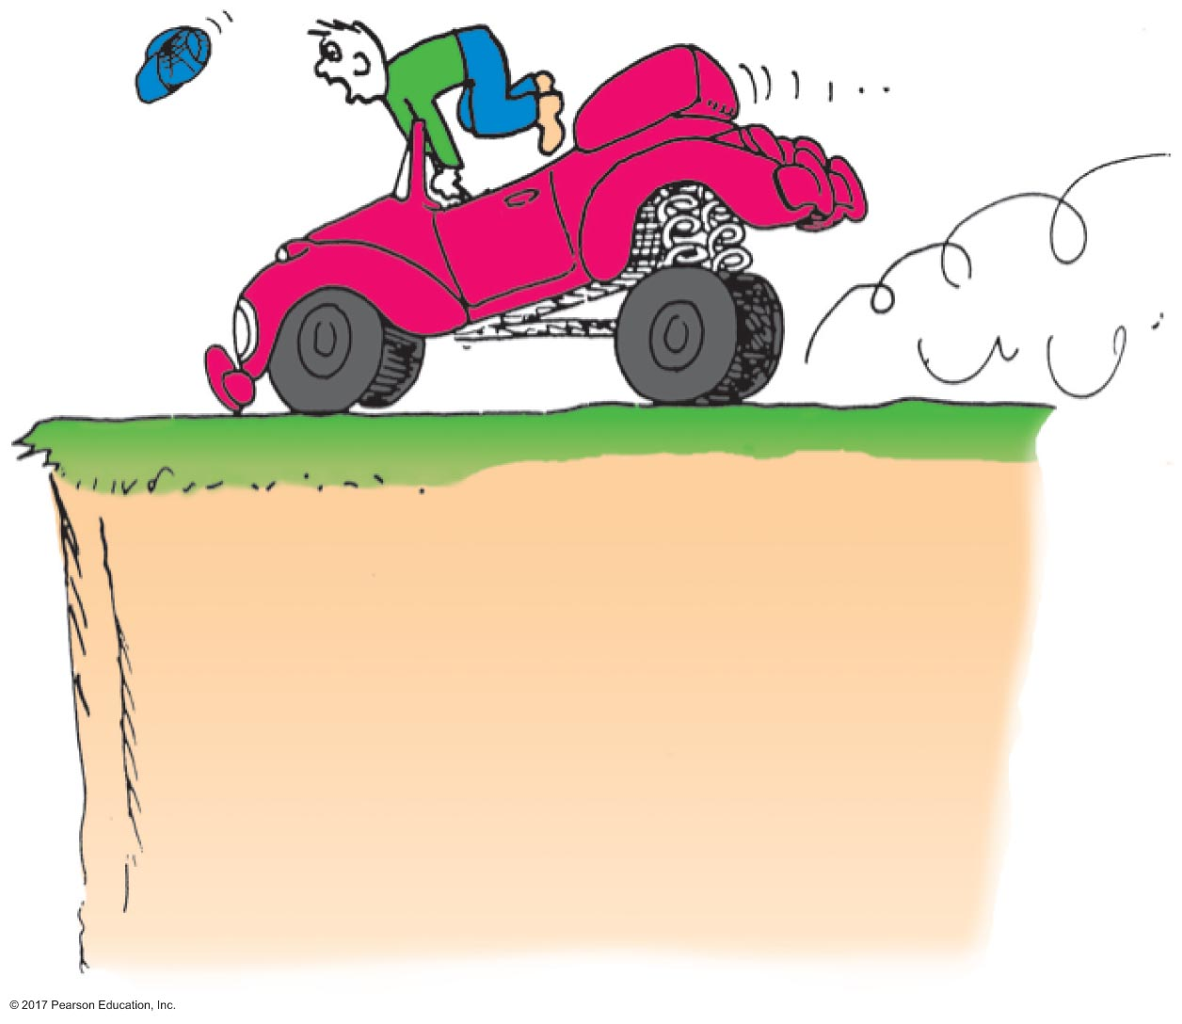
Inertia in Action
Rapid deceleration is sensed by the driver who lurches forward.
It is also an example of Newton's Second Law because no force stops the driver while the brakes stop the vehicle.

Slide 10
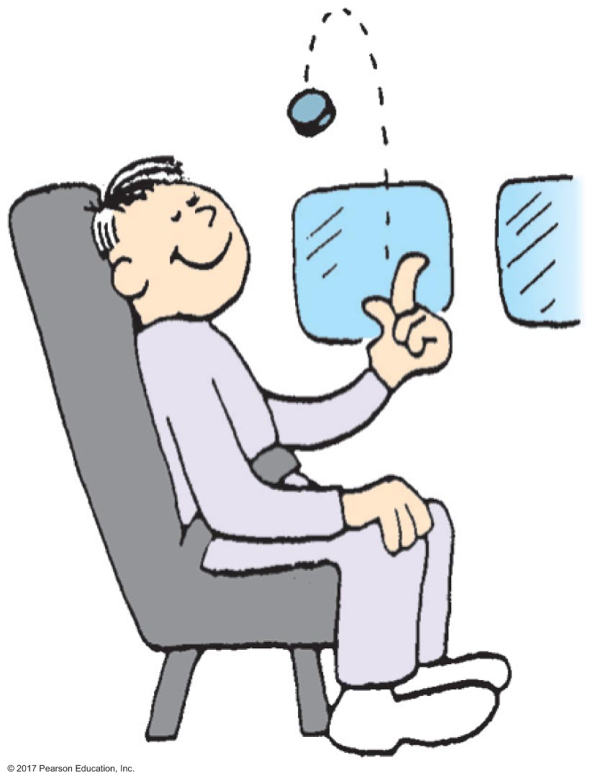
Inertia in Action
When you flip a coin in a high-speed airplane, it behaves as if the airplane were at rest.
The coin keeps up with you.

Slide 11
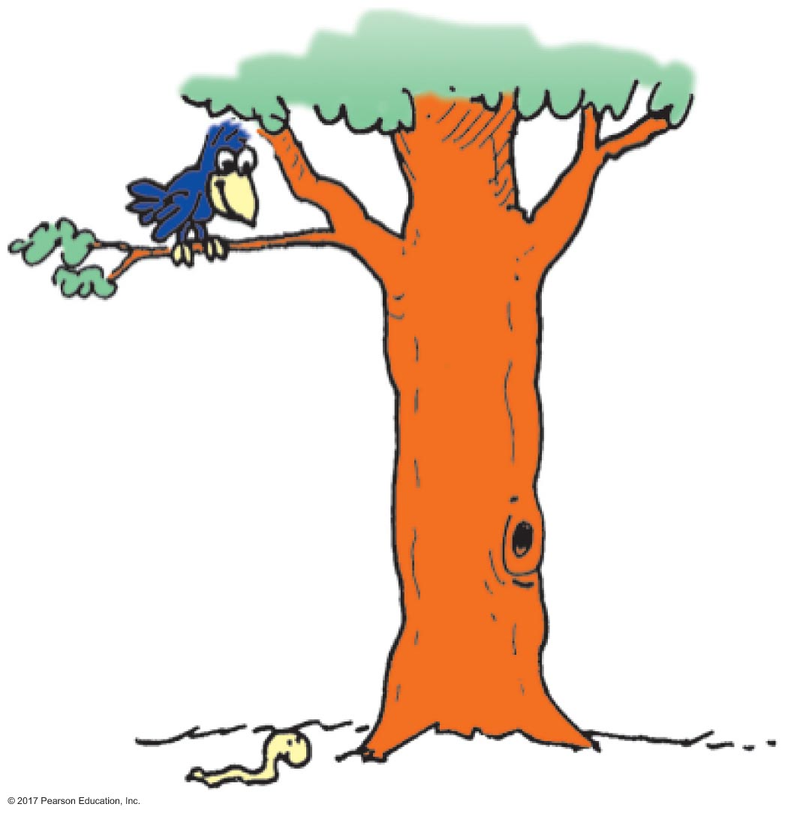
Inertia in Action
Can the bird drop down and catch the worm if the Earth moves at 30 km/s?

Slide 12
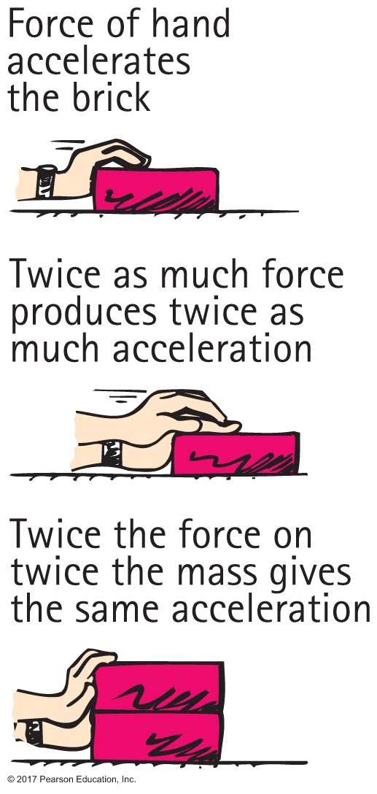
Newton's Second Law of Motion
The law of acceleration:
The acceleration produced by a net force on an object is directly proportional to the net force, is in the same direction as the net force, and is inversely proportional to the mass of the object.

Slide 13
Newton's Second Law of Motion
Newton's second law in equation form:
small net force, large mass small acceleration
large net force, small mass large acceleration

Slide 14
Newton's Second Law of Motion CHECK YOUR NEIGHBOR
Consider a cart pushed along a track with a certain force. If the force remains the same while the mass of the cart decreases to half, the acceleration of the cart
remains the same.
halves.
doubles.
changes unpredictably.
Notes:
C. doubles.

Slide 15
Newton's Second Law of Motion CHECK YOUR ANSWER
Consider a cart pushed along a track with a certain force. If the force remains the same while the mass of the cart decreases to half, the acceleration of the cart
remains the same.
halves.
doubles.
changes unpredictably.
Notes:
C. doubles.

Slide 16
Newton's Second Law of Motion CHECK YOUR NEIGHBOR
Push a cart along a track so twice as much net force acts upon it. If the acceleration remains the same, what is a reasonable explanation?
The mass of the cart doubled when the force doubled.
The cart experiences a force that it didn't before.
The track is not level.
Friction reversed direction.
Notes:
A. The mass of the cart doubled when the force doubled.

Slide 17
Newton's Second Law of Motion CHECK YOUR ANSWER
Push a cart along a track so twice as much net force acts upon it. If the acceleration remains the same, what is a reasonable explanation?
The mass of the cart doubled when the force doubled.
The cart experiences a force that it didn't before.
The track is not level.
Friction reversed direction.
Notes:
A. The mass of the cart doubled when the force doubled.

Slide 18
Newton's Second Law of Motion
When acceleration is g—free fall.
When the only force acting on a falling object is gravity, with negligible air resistance, the object is in free fall.
An object in free fall accelerates toward Earth at 10 m/s per second.

Slide 19
Newton's Second Law of Motion CHECK YOUR NEIGHBOR
At one instant an object in free fall has a speed of 40 m/s. Its speed one second later is
also 40 m/s.
45 m/s.
50 m/s.
none of the above.
Notes:
C. 50 m/s.

Slide 20
Newton's Second Law of Motion CHECK YOUR ANSWER
At one instant an object in free fall has a speed of 40 m/s. Its speed one second later is
also 40 m/s.
45 m/s.
50 m/s.
none of the above.
Explanation:
We assume the object is falling downward.
Notes:
C. 50 m/s.

Slide 21
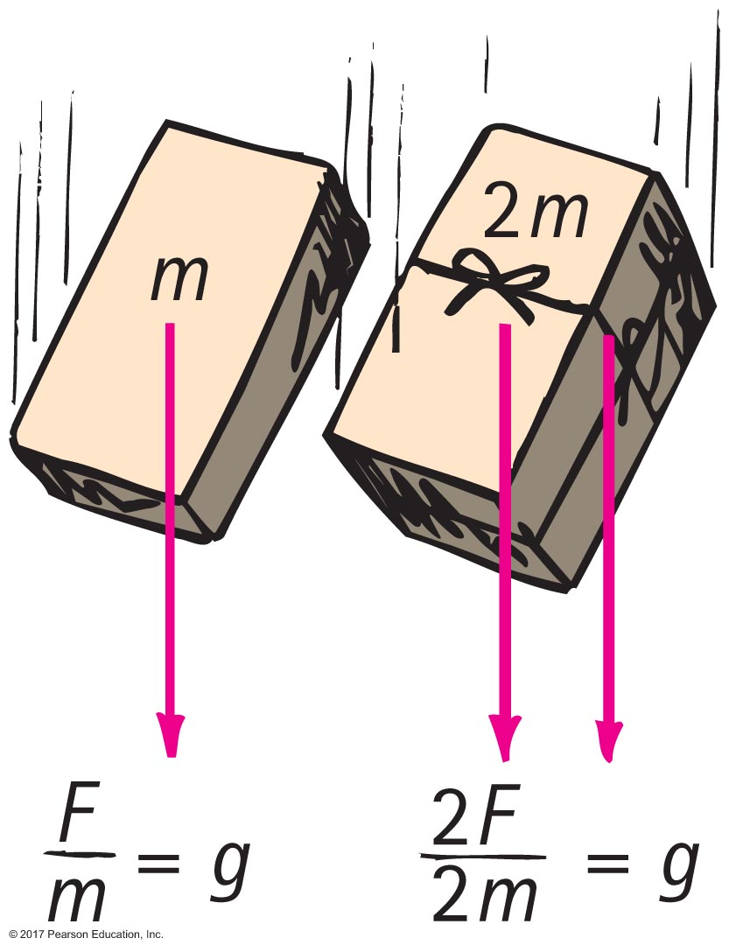
Newton's Second Law of Motion
When acceleration is g—free fall.
Twice the force on twice the mass same acceleration as half the force on half the mass.

Slide 22
Newton's Second Law of Motion CHECK YOUR NEIGHBOR
A 5-kg iron ball and a 10-kg iron ball are dropped from rest. For negligible air resistance, the acceleration of the heavier ball will be
less.
the same.
more.
undetermined.
Notes:
B. the same.

Slide 23
Newton's Second Law of Motion CHECK YOUR ANSWER
A 5-kg iron ball and a 10-kg iron ball are dropped from rest. For negligible air resistance, the acceleration of the heavier ball will be
less.
the same.
more.
undetermined.
Notes:
B. the same.

Slide 24
Newton's Second Law of Motion CHECK YOUR NEIGHBOR
A 5-kg iron ball and a 10-kg iron ball are dropped from rest. When the free-falling 5-kg iron ball reaches a speed of 10 m/s, the speed of the free-falling 10-kg iron ball is
less than 10 m/s.
10 m/s.
more than 10 m/s.
undetermined.
Notes:
B. 10 m/s.

Slide 25
Newton's Second Law of Motion CHECK YOUR ANSWER
A 5-kg iron ball and a 10-kg iron ball are dropped from rest. When the free-falling 5-kg iron ball reaches a speed of 10 m/s, the speed of the free-falling 10-kg iron ball is
less than 10 m/s.
10 m/s.
more than 10 m/s.
undetermined.
Notes:
B. 10 m/s.

Slide 26
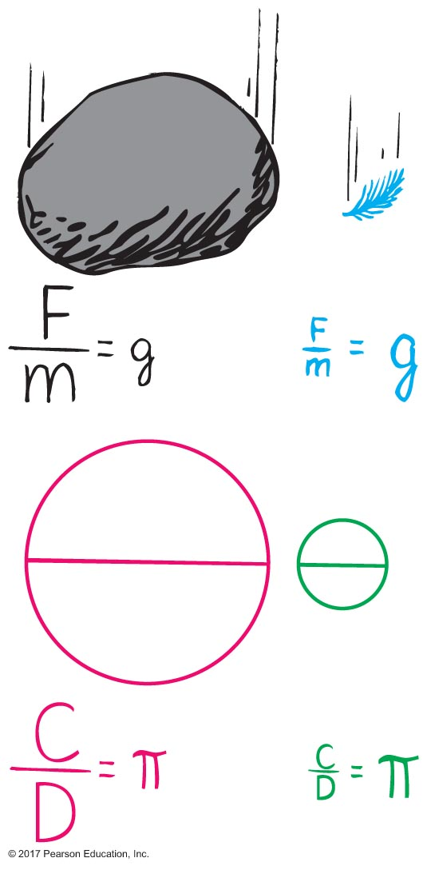
Newton's Second Law of Motion
When acceleration is g—free fall.
The ratio of weight to mass is the same for all falling objects in the same locality; hence, their accelerations are the same in the absence of air resistance.

Slide 27
Newton's Second Law of Motion
When acceleration is g—free fall.
Demonstration of a feather and a coin in a vacuum.
In a vacuum, a feather and a coin fall together at g—the acceleration due to gravity.

Slide 28
Newton's Second Law of Motion A situation to ponder…
When an air-filled glass tube containing a coin and a feather is inverted, the coin falls quickly to the bottom of the tube while the feather flutters to the bottom.

Slide 29
A situation to ponder… CHECK YOUR NEIGHBOR
When the air is removed by a vacuum pump and the activity is repeated,
the feather hits the bottom first, before the coin hits.
the coin hits the bottom first, before the feather hits.
both the coin and feather drop together side by side.
Not enough information.
Notes:
C. both the coin and feather drop together side by side.

Slide 30
A situation to ponder… CHECK YOUR ANSWER
When the air is removed by a vacuum pump and the activity is repeated,
the feather hits the bottom first, before the coin hits.
the coin hits the bottom first, before the feather hits.
both the coin and feather drop together side by side.
Not enough information.
Notes:
C. both the coin and feather drop together side by side.

Slide 31
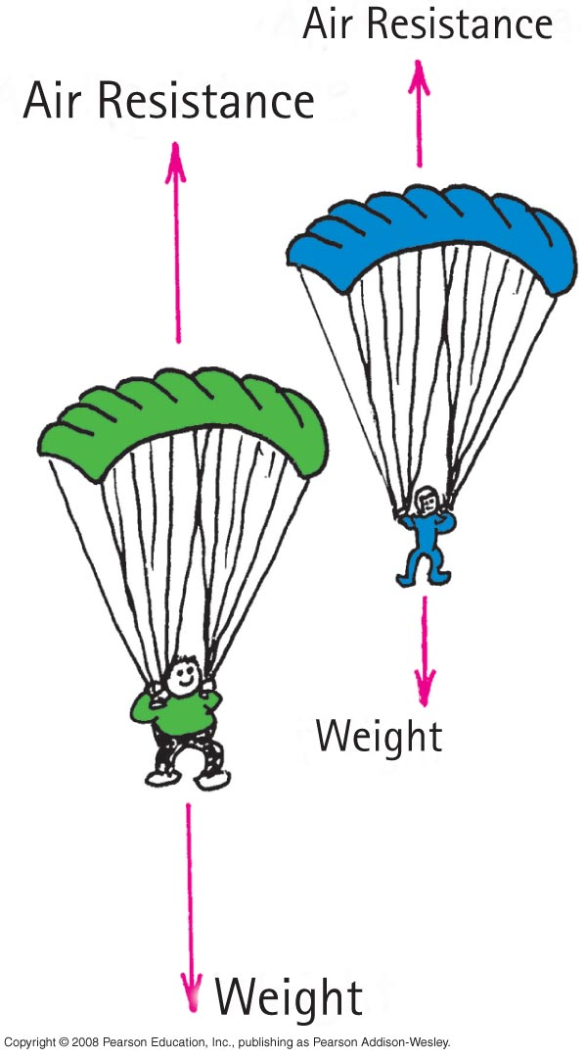
Newton's Second Law of Motion
When acceleration is less than g—non-free fall.
Non-free fall occurs when two forces act on a falling object
a force due to gravity acting downward
air resistance acting upward

Slide 32
Newton's Second Law of Motion CHECK YOUR NEIGHBOR
When a 20-N falling object encounters 5 N of air resistance, its acceleration of fall is
A. less than g.
B. more than g.
C. g.
D. terminated.
Notes:
A. less than g.

Slide 33
Newton's Second Law of Motion CHECK YOUR ANSWER
When a 20-N falling object encounters 5 N of air resistance, its acceleration of fall is
A. less than g.
B. more than g.
C. g.
D. terminated.
Explanation:
Acceleration of non-free fall is always less than g. Acceleration will actually be (20 N – 5 N)/2 kg = 7.5 N/kg = 7.5 m/s².
Notes:
A. less than g.

Slide 34
Newton's Second Law of Motion
When acceleration is less than g—non-free fall
as falling object gains speed, force exerted by surrounding air increases
force of air resistance may continue to increase until it equals the weight
at this point, net force is zero and no further acceleration
object has reached terminal velocity—continues falling at constant velocity with no acceleration

Slide 35
Newton's Second Law of Motion CHECK YOUR NEIGHBOR
If a 50-N person is to fall at terminal speed, the air resistance needed is
less than 50 N.
50 N.
more than 50 N.
None of the above.
Notes:
B. 50 N.

Slide 36
Newton's Second Law of Motion CHECK YOUR ANSWER
If a 50-N person is to fall at terminal speed, the air resistance needed is
less than 50 N.
50 N.
more than 50 N.
None of the above.
Explanation:
Then ΣF = 0 and acceleration = 0.
Notes:
B. 50 N.

Slide 37
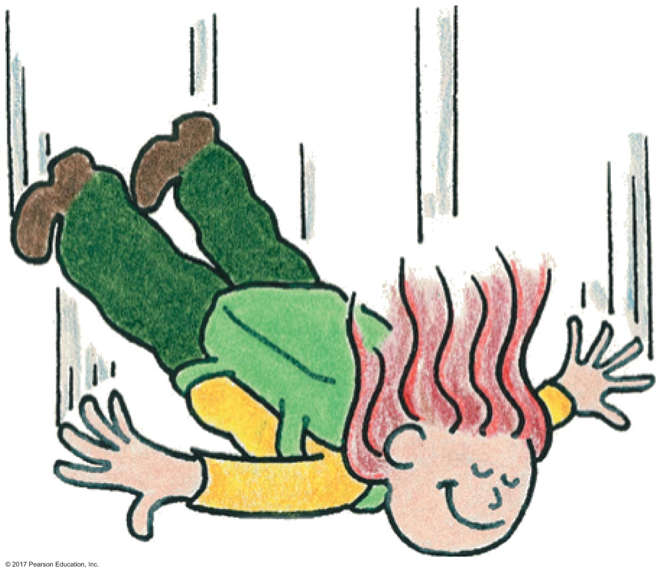
Newton's Second Law of Motion CHECK YOUR NEIGHBOR
As a skydiver falls faster and faster through the air, air resistance
increases.
decreases.
remains the same.
Not enough information.
Notes:
A. increases.

Slide 38
Newton's Second Law of Motion CHECK YOUR ANSWER
As a skydiver falls faster and faster through the air, air resistance
increases.
decreases.
remains the same.
Not enough information.
Notes:
A. increases.

Slide 39
Newton's Second Law of Motion CHECK YOUR NEIGHBOR
As a skydiver continues to fall faster and faster through the air, net force
increases.
decreases.
remains the same.
Not enough information.
Notes:
B. decreases.

Slide 40
Newton's Second Law of Motion CHECK YOUR ANSWER
As a skydiver continues to fall faster and faster through the air, net force
increases.
decreases.
remains the same.
Not enough information.
Notes:
B. decreases.

Slide 41
Newton's Second Law of Motion CHECK YOUR NEIGHBOR
As a skydiver continues to fall faster and faster through the air, her acceleration
increases.
decreases.
remains the same.
Not enough information.
Notes:
B. decreases.

Slide 42
Newton's Second Law of Motion CHECK YOUR ANSWER
As a skydiver continues to fall faster and faster through the air, her acceleration
increases.
decreases.
remains the same.
Not enough information.
Notes:
B. decreases.

Slide 43
Newton's Second Law of Motion A situation to ponder…
Consider a heavy and light person with same-size parachutes jumping together from the same altitude.

Slide 44
A situation to ponder… CHECK YOUR NEIGHBOR
Who will reach the ground first?
The light person.
The heavy person.
Both at the same time.
Not enough information.
Notes:
B. The heavy person.

Slide 45
A situation to ponder… CHECK YOUR ANSWER
Who will reach the ground first?
The light person.
The heavy person.
Both at the same time.
Not enough information.
Explanation:
The heavier person has a greater terminal velocity. Do you know why?
Notes:
B. The heavy person.

Slide 46
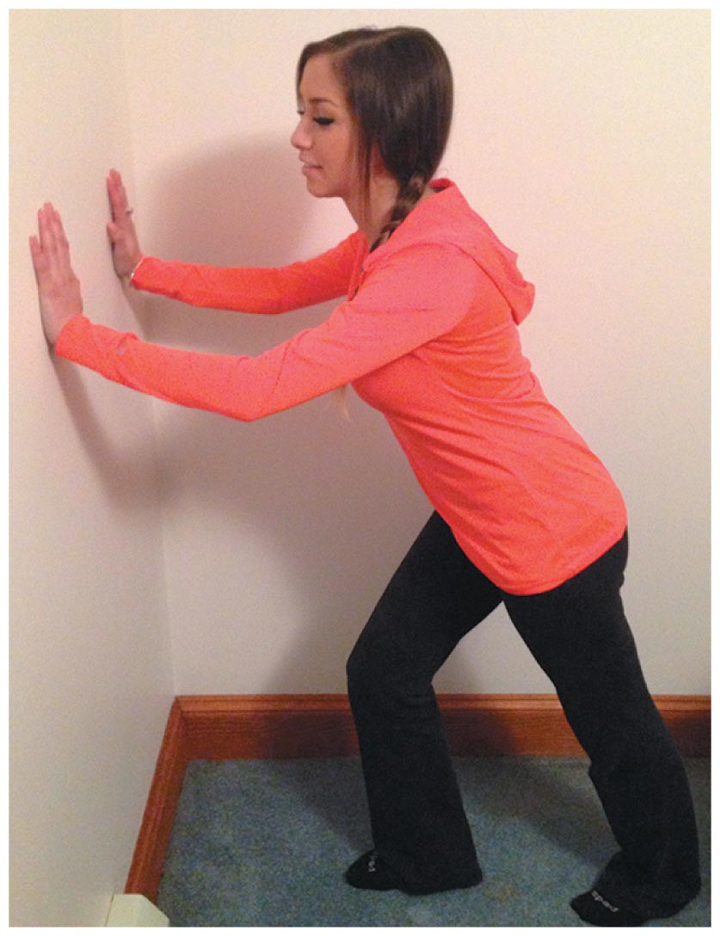
Forces and Interactions
Force is simply a push or a pull.
Interaction occurs between one thing and another.
Example:
When you push against a wall, you're interacting with the wall.

Slide 47
Newton's Third Law of Motion
Law of action and reaction:
Whenever one object exerts a force on a second object, the second object exerts an equal and opposite force on the first.
Example:
When your hand presses on the wall, the wall simultaneously presses on your hand. Hand and wall press on each other with equal and opposite forces.

Slide 48
Newton's Third Law of Motion
Action and reaction forces
one force is called the action force; the other force is called the reaction force
are copairs of a single interaction
neither force exists without the other
are equal in strength and opposite in direction
always act on different objects

Slide 49
Newton's Third Law of Motion CHECK YOUR NEIGHBOR
A soccer player kicks a ball with 1500 N of force. The ball exerts a reaction force against the player's foot of
somewhat less than 1500 N.
1500 N.
somewhat more than 1500 N.
None of the above.
Notes:
B. 1500 N.

Slide 50
Newton's Third Law of Motion CHECK YOUR ANSWER
A soccer player kicks a ball with 1500 N of force. The ball exerts a reaction force against the player's foot of
somewhat less than 1500 N.
1500 N.
somewhat more than 1500 N.
None of the above.
Notes:
B. 1500 N.

Slide 51
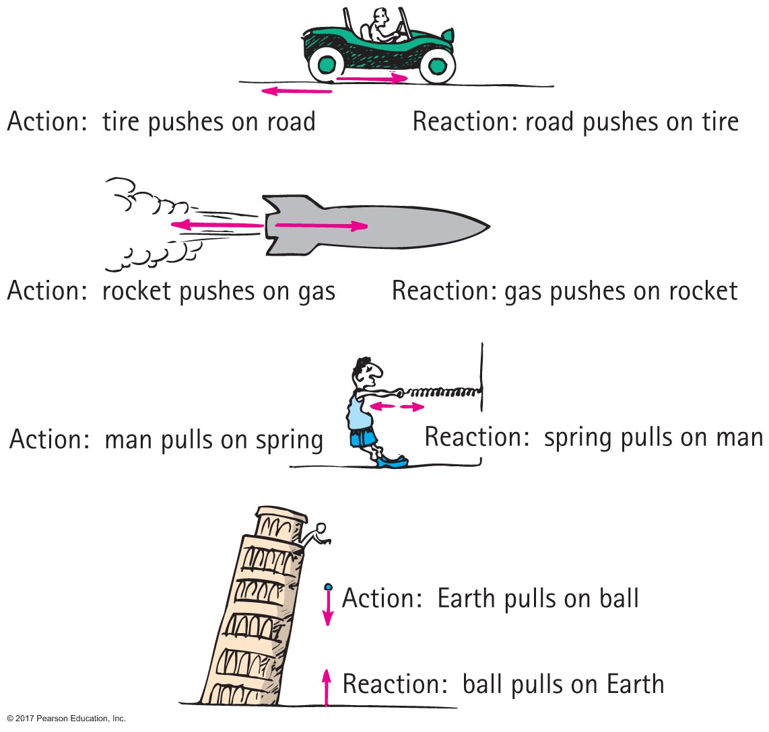
Newton's Third Law of Motion
Simple rule to identify action and reaction:
Action—object A exerts a force on object B.
Reaction—object B exerts a force on object A.

Slide 52
Newton's Third Law of Motion CHECK YOUR NEIGHBOR
When you step off a curb, Earth pulls you downward. The reaction to this force is
a slight air resistance.
nonexistent in this case.
you pull Earth upward.
None of the above.
Notes:
C. you pull Earth upward.

Slide 53
Newton's Third Law of Motion CHECK YOUR ANSWER
When you step off a curb, Earth pulls you downward. The reaction to this force is
a slight air resistance.
nonexistent in this case.
you pull Earth upward.
None of the above.
Notes:
C. you pull Earth upward.

Slide 54
Newton's Third Law of Motion
Action and reaction on different masses:
If the same force is applied to two objects of different masses,
greater mass object small acceleration
smaller mass object large acceleration

Slide 55
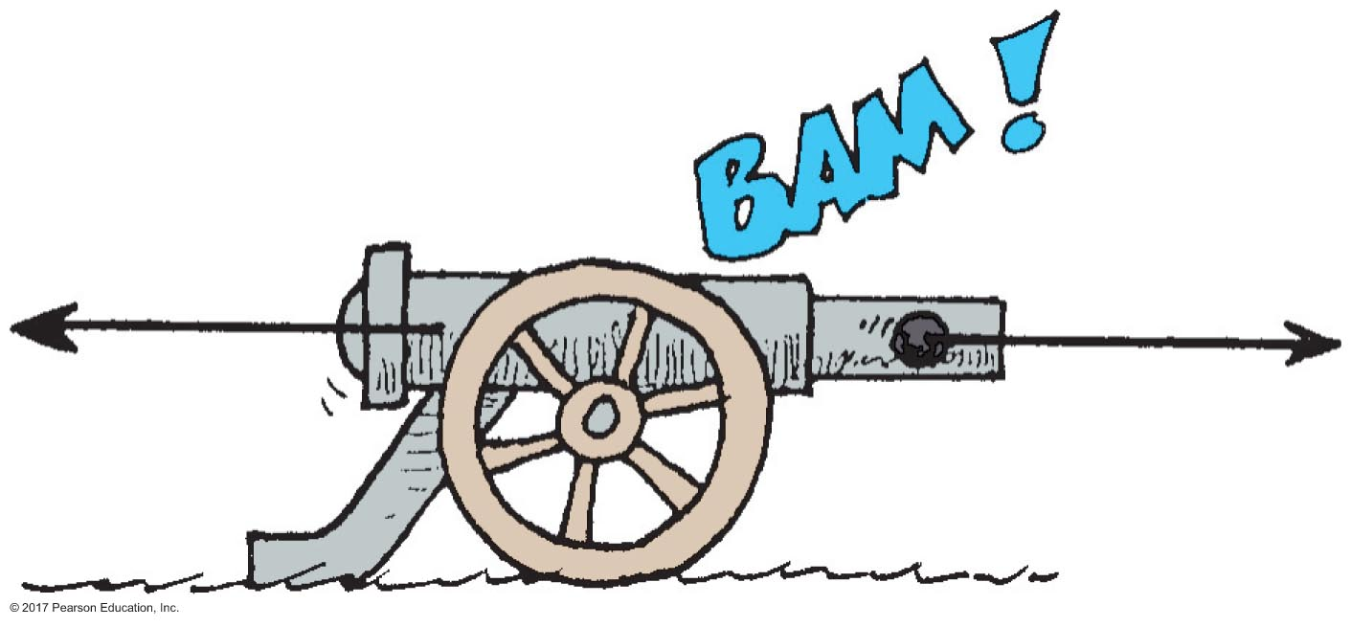
Newton's Third Law of Motion CHECK YOUR NEIGHBOR
When a cannon is fired, the accelerations of the cannon and cannonball are different, because the
forces don't occur at the same time.
forces, although theoretically are the same, in practice aren't the same.
masses are different.
ratios of force to mass are the same.
Notes:
C. masses are different.

Slide 56
Newton's Third Law of Motion CHECK YOUR ANSWER
When a cannon is fired, the accelerations of the cannon and cannonball are different, because the
forces don't occur at the same time.
forces, although theoretically are the same, in practice aren't the same.
masses are different.
ratios of force to mass are the same.
Notes:
C. masses are different.

Slide 57
Newton's Third Law of Motion A situation to ponder…
Consider a high-speed bus colliding head-on with an innocent bug. The force of impact splatters the unfortunate bug over the windshield.
Notes:
Put the correct answer here including the letter designation.

Slide 58
A situation to ponder… CHECK YOUR NEIGHBOR
Which is greater, the force on the bug or the force on the bus?
Bug.
Bus.
Both are the same.
Cannot say.
Notes:
C. Both are the same.

Slide 59
A situation to ponder… CHECK YOUR ANSWER
Which is greater, the force on the bug or the force on the bus?
Bug.
Bus.
Both are the same.
Cannot say.
Explanation:
Although the forces are equal in magnitude, the effects are very different. Do you know why?
Notes:
C. Both are the same.

Slide 60
Newton's Third Law of Motion CHECK YOUR NEIGHBOR
Two people of equal mass on slippery ice push off from each other. Will both move at the same speed in opposite directions?
Yes.
Yes, but only if both push equally.
No.
No, unless acceleration occurs.
Notes:
A. Yes.

Slide 61
Newton's Third Law of Motion CHECK YOUR ANSWER
Two people of equal mass on slippery ice push off from each other. Will both move at the same speed in opposite directions?
Yes.
Yes, but only if both push equally.
No.
No, unless acceleration occurs.
Explanation:
However they push, the result is equal-magnitude forces on equal masses, which produce equal accelerations and, therefore, equal changes in speed.
Notes:
A. Yes.

Slide 62
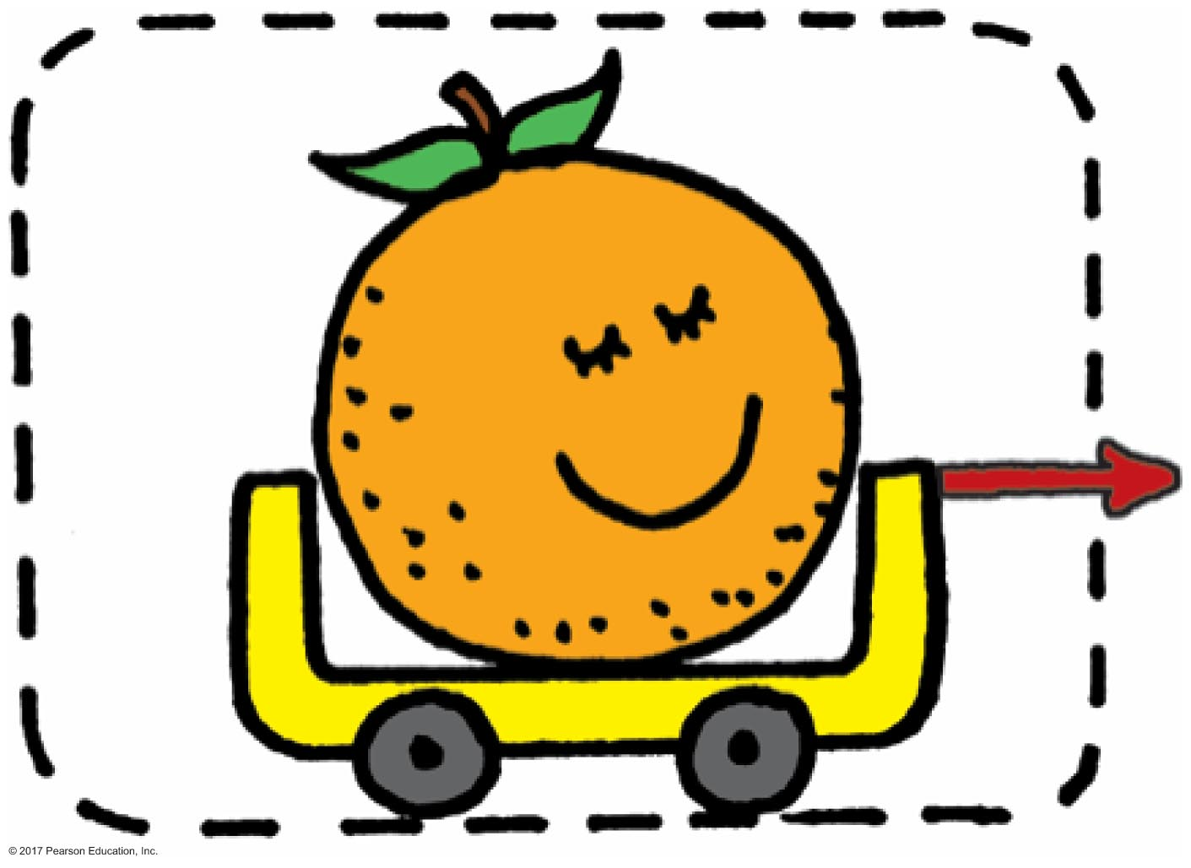
Newton's Third Law of Motion
Defining your system
consider a single enclosed orange
applied external force causes the orange to accelerate in accord with Newton's second law
action and reaction pair of forces is not shown

Slide 63
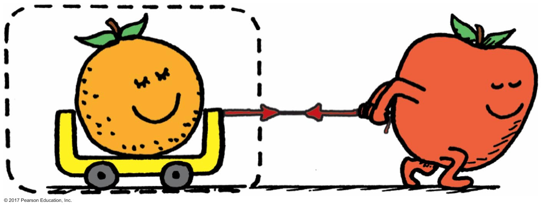
Newton's Third Law of Motion
Consider the orange and the apple pulling on it
action and reaction do not cancel (because they act on different things)
external force by apple accelerates the orange

Slide 64
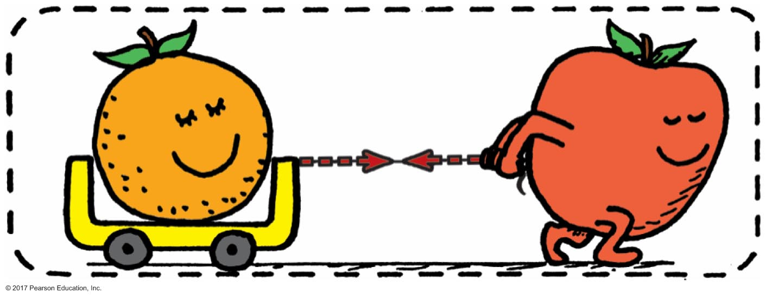
Newton's Third Law of Motion
Consider a system comprising both the orange and the apple
the apple is no longer external to the system
force pair is internal to system, which doesn't cause acceleration
action and reaction within the system cancel
with no external forces, there is no acceleration of system

Slide 65
Newton's Third Law of Motion
Consider the same system, but with external force of friction on it
same internal action and reaction forces (between the orange and apple) cancel
a second pair of action-reaction forces (between the apple's feet and the floor) exists

Slide 66
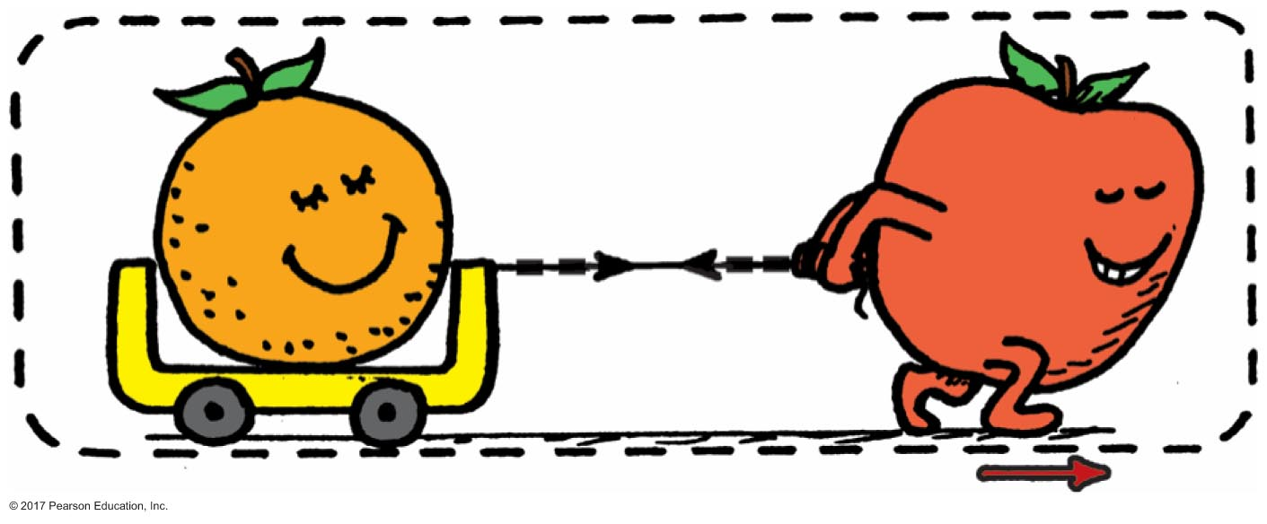
Newton's Third Law of Motion
one of these acts by the system (apple on the floor) and the other acts on the system (floor on the apple)
external frictional force of floor pushes on the system, which accelerates
second pair of action and reaction forces do not cancel

Slide 67
Newton's Third Law CHECK YOUR NEIGHBOR
When lift equals the weight of a helicopter, the helicopter
climbs down.
climbs up.
hovers in midair.
None of the above.
Notes:
C. hovers in midair.

Slide 68
Newton's Third Law CHECK YOUR ANSWER
When lift equals the weight of a helicopter, the helicopter
climbs down.
climbs up.
hovers in midair.
None of the above.
Notes:
C. hovers in midair.

Slide 69
Newton's Third Law CHECK YOUR NEIGHBOR
When lift is greater, the helicopter
climbs down.
climbs up.
hovers in midair.
None of the above
Notes:
B. climbs up.

Slide 70
Newton's Third Law CHECK YOUR ANSWER
When lift is greater, the helicopter
climbs down.
climbs up.
hovers in midair.
None of the above
Notes:
B. climbs up.

Slide 71
Newton's Third Law CHECK YOUR NEIGHBOR
A bird flies by
flapping its wings.
pushing air down so that the air pushes it upward.
hovering in midair.
inhaling and exhaling air.
Notes:
B. pushing air down so that the air pushes it upward.

Slide 72
Newton's Third Law CHECK YOUR ANSWER
A bird flies by
flapping its wings.
pushing air down so that the air pushes it upward.
hovering in midair.
inhaling and exhaling air.
Notes:
B. pushing air down so that the air pushes it upward.

Slide 73
Newton's Third Law CHECK YOUR NEIGHBOR
Slightly tilted wings of airplanes deflect
oncoming air downward to produce lift.
oncoming air upward to produce lift.
Both of these.
Neither of these.
Notes:
A. oncoming air downward to produce lift.

Slide 74
Newton's Third Law CHECK YOUR ANSWER
Slightly tilted wings of airplanes deflect
oncoming air downward to produce lift.
oncoming air upward to produce lift.
Both of these.
Neither of these.
Explanation:
When a wing diverts air downward, it exerts a downward force on the air. The air simultaneously exerts an upward force on the wing. The vertical component of this upward force is lift. (The horizontal component is drag.)
Notes:
A. oncoming air downward to produce lift.

Slide 75
Newton's Third Law CHECK YOUR NEIGHBOR
Compared with a light-weight glider, a heavier glider would have to push air
downward with greater force.
downward with the same force.
downward with less force.
none of the above
Notes:
A. downward with greater force.

Slide 76
Newton's Third Law CHECK YOUR ANSWER
Compared with a light-weight glider, a heavier glider would have to push air
downward with greater force.
downward with the same force.
downward with less force.
none of the above
Explanation:
The force on the air deflected downward must equal the weight of the glider.
Notes:
A. downward with greater force.

