Slide 1
Chapter 4: Gravity, Projectiles, and Satellites

Slide 2
This lecture will help you understand:
The Universal Law of Gravity
The Inverse-Square Law: Gravity and Distance
Weight and Weightlessness
Universal Gravitation
Projectile Motion
Fast-Moving Projectiles—Satellites
Circular Satellite Orbits
Elliptical Orbits
Escape Speed

Slide 3
The Legend of the Falling Apple
Newton was not the first to discover gravity. Newton discovered that gravity is universal.
Legend—Newton, sitting under an apple tree, realized that the force between Earth and the apple is the same as that between moons and planets and everything else.

Slide 4
The Fact of the Falling Moon
In ancient times, Aristotle and others believed that stars, planets, and the Moon moved in divine circles, free from forces of Earth.

Slide 5
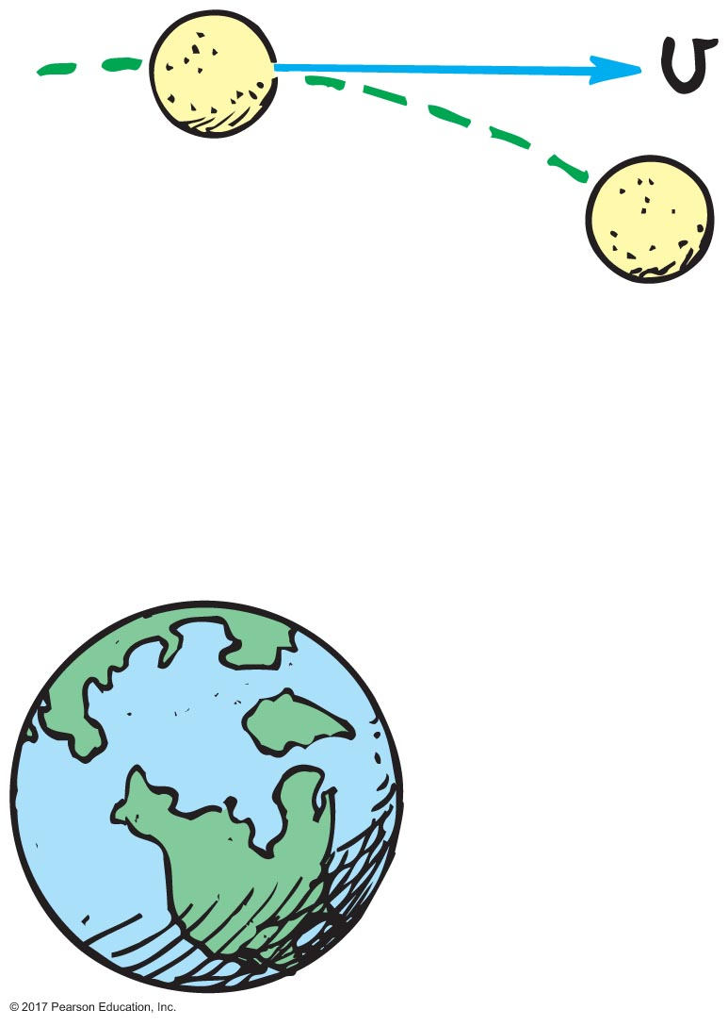
The Fact of the Falling Moon
We now know that the Moon falls around Earth in the sense that it falls beneath the straight line it would follow if no force acted on it.
The Moon maintains a tangential velocity, which ensures a nearly circular motion around and around Earth rather than into it. This path is similar to the paths of planets around the Sun.

Slide 6
The Universal Law of Gravity
Newton's Law of Universal Gravitation
Every body in the universe attracts every other body with a mutually attracting force.
For two bodies, this force is directly proportional to the product of their masses and inversely proportional to the square of the distance separating them,
m₁m₂
F = G
d ²

Slide 7
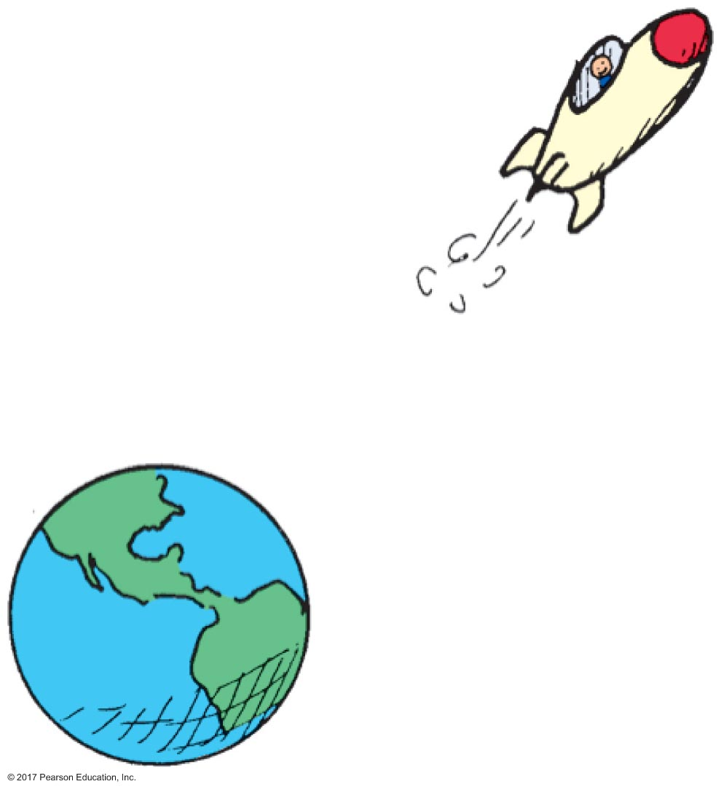
The Universal Law of Gravity
Newton discovered that gravity is universal.
Every mass pulls on every other mass.

Slide 8
The Universal Law of Gravity CHECK YOUR NEIGHBOR
Newton's most celebrated synthesis is of
earthly and heavenly laws.
weight on Earth and weightlessness in outer space.
masses and distances.
the paths of tossed rocks and the paths of satellites.
Notes:
A. earthly and heavenly laws.

Slide 9
The Universal Law of Gravity CHECK YOUR ANSWER
Newton's most celebrated synthesis is of
earthly and heavenly laws.
weight on Earth and weightlessness in outer space.
masses and distances.
the paths of tossed rocks and the paths of satellites.
Comment:
This synthesis provided hope that other natural phenomena followed universal laws, and ushered in the Age of Enlightenment.
Notes:
A. earthly and heavenly laws.

Slide 10
Newton's Law of Universal Gravity
m₁m₂
The greater m₁ and m₂ the greater the force of attraction between them.
The greater the distance of separation d, the weaker is the force of attraction—weaker as the inverse square of the distance between their centers.
F = G
d ²

Slide 11
The Inverse-Square Law: Gravity and Distance
Inverse-square law:
relates the intensity of an effect to the inverse square of the distance from the cause
The greater the distance from Earth, the less the gravitational force on an object.
No matter how great the distance, gravity approaches, but never reaches, zero.
1
distance²
Intensity ≈

Slide 12
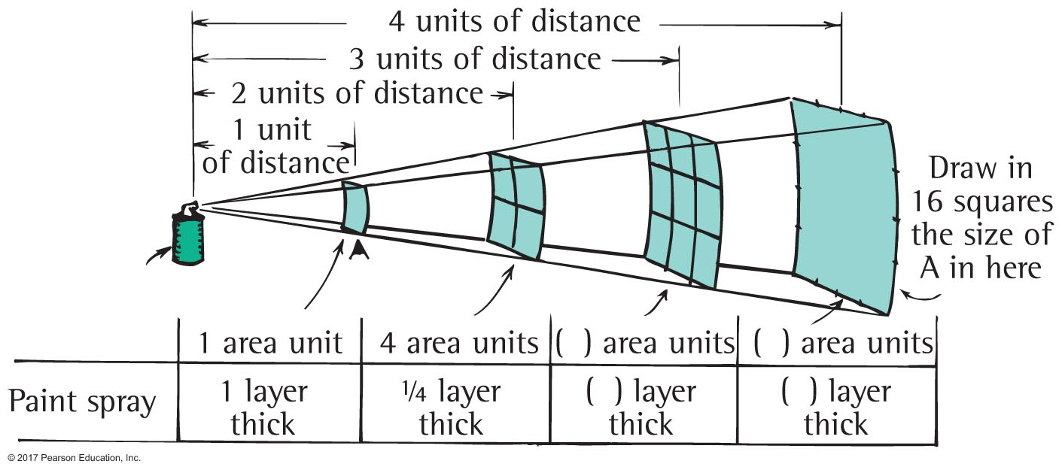
Inverse-Square Law

Slide 13
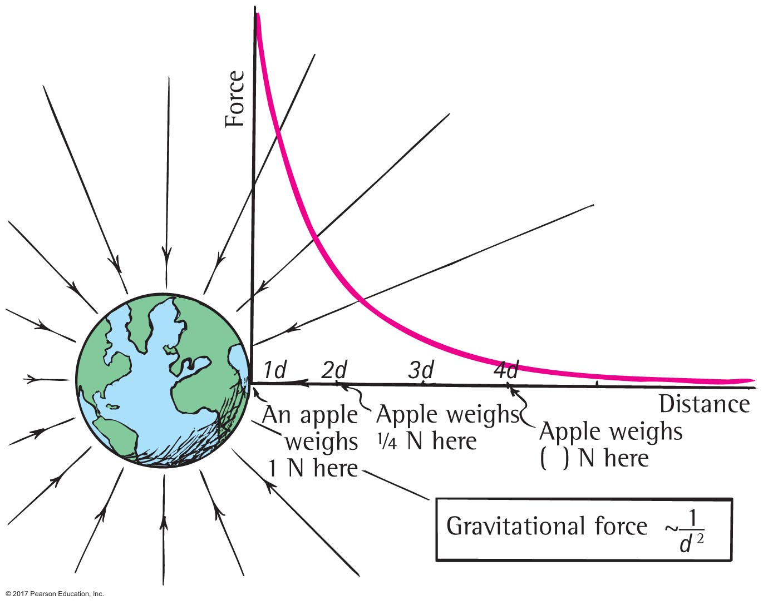
Inverse-Square Law

Slide 14
The Inverse-Square Law: Gravity and Distance CHECK YOUR NEIGHBOR
The force of gravity between two planets depends on their
masses and distance apart.
planetary atmospheres.
rotational motions.
All of the above.
Notes:
A. masses and distance apart.

Slide 15
The Inverse-Square Law: Gravity and Distance CHECK YOUR ANSWER
The force of gravity between two planets depends on their
masses and distance apart.
planetary atmospheres.
rotational motions.
All of the above.
Explanation:
The equation for gravitational force,
cites only masses and distances as variables. Rotation and atmospheres are irrelevant.
m₁m₂
F = G
d ²
Notes:
A. masses and distance apart.

Slide 16
The Inverse-Square Law: Gravity and Distance CHECK YOUR NEIGHBOR
If the masses of two planets are each somehow doubled, the force of gravity between them
doubles.
quadruples.
reduces by half.
reduces by one quarter.
Notes:
B. quadruples.

Slide 17
The Inverse-Square Law: Gravity and Distance CHECK YOUR ANSWER
If the masses of two planets are each somehow doubled, the force of gravity between them
doubles.
quadruples.
reduces by half.
reduces by one quarter.
Explanation:
Note that both masses double, so double × double = quadruple.
Notes:
B. quadruples.

Slide 18
The Universal Law of Gravity CHECK YOUR NEIGHBOR
If the mass of one planet is somehow doubled, the force of gravity between it and a neighboring planet would
doubles.
quadruples.
reduces by half.
reduces by one quarter.
Notes:
A. double.

Slide 19
The Universal Law of Gravity CHECK YOUR ANSWER
If the mass of one planet is somehow doubled, the force of gravity between it and a neighboring planet would
doubles.
quadruples.
reduces by half.
reduces by one quarter.
Explanation:
Let the equation guide your thinking: Note that if one mass doubles, the force between them doubles.
m₁m₂
d ²
F = G
Notes:
A. double.

Slide 20
The Universal Gravitational Constant, G
G is the proportionality constant in Newton's law of gravitation.
G has the same magnitude as the gravitational force between two 1-kg masses that are 1 meter apart:
6.67 × 10^{–11} N.
So G = 6.67 × 10^{–11} N • m²/kg².
F = 6.67 × 10^{–11} N • m²/kg²(m₁ × m₂)/d²

Slide 21
The Universal Gravitational Constant, G CHECK YOUR NEIGHBOR
The universal gravitational constant, G, which links force to mass and distance, is similar to the familiar constant
π.
B. g.
acceleration due to gravity.
speed of uniform motion.
Notes:
A. π.

Slide 22
The Universal Gravitational Constant, G CHECK YOUR ANSWER
The universal gravitational constant, G, which links force to mass and distance, is similar to the familiar constant
π.
B. g.
acceleration due to gravity.
speed of uniform motion.
Explanation:
Just as π relates the circumference of a circle to its diameter, G relates force to mass and distance.
Notes:
A. π.

Slide 23
Weight and Weightlessness
Weight
is the force exerted against a supporting floor or weighing scale.
Weightlessness
is a condition wherein a support force is lacking—free fall, for example.

Slide 24
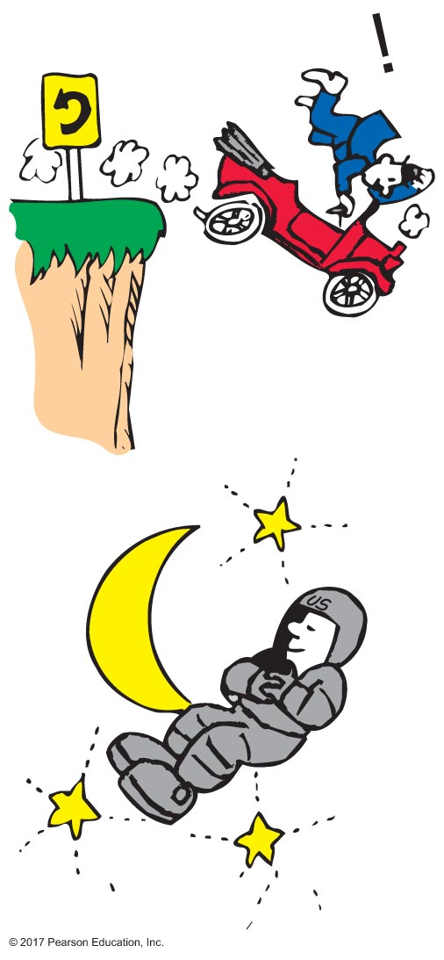
Weight and Weightlessness
Example of weightlessness:
No support force.
An astronaut is weightless because he or she is not supported by anything. The body responds as if gravity forces were absent, and this gives the sensation of weightlessness.

Slide 25
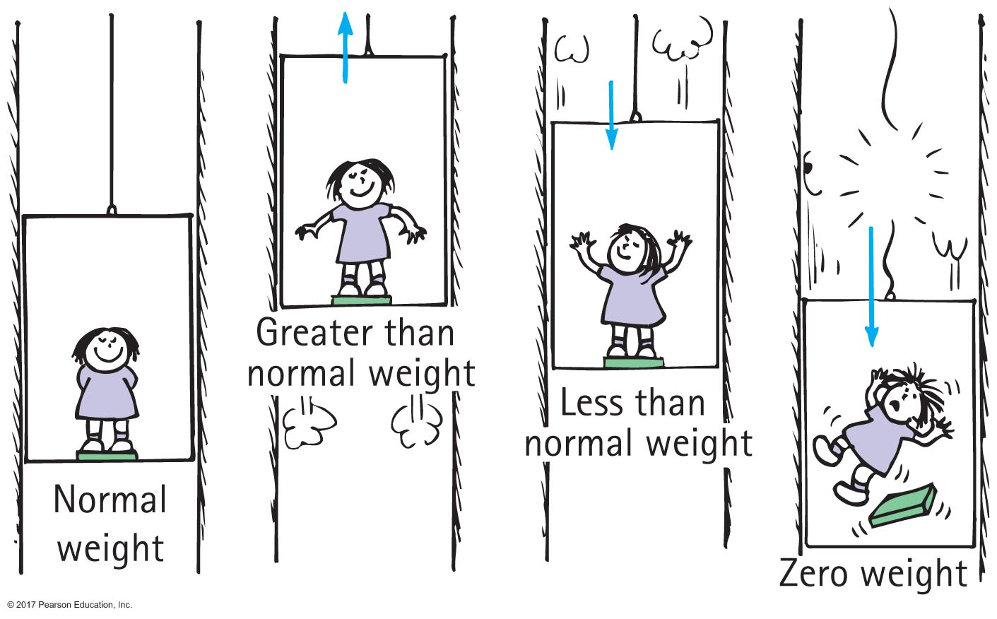
Weight and Weightlessness

Slide 26
Weight and Weightlessness CHECK YOUR NEIGHBOR
When an elevator accelerates upward, your weight reading on a scale is
greater.
less.
zero.
the normal weight.
Notes:
A. greater.

Slide 27
Weight and Weightlessness CHECK YOUR ANSWER
When an elevator accelerates upward, your weight reading on a scale is
greater.
less.
zero.
the normal weight.
Explanation:
The support force pressing on you is greater, so you weigh more.
Notes:
A. greater.

Slide 28
Weight and Weightlessness CHECK YOUR NEIGHBOR
When an elevator accelerates downward, your weight reading is
greater.
less.
zero.
the normal weight.
Notes:
B. less.

Slide 29
Weight and Weightlessness CHECK YOUR ANSWER
When an elevator accelerates downward, your weight reading is
greater.
less.
zero.
the normal weight.
Explanation:
The support force pressing on you is less, so you weigh less. Question: Would you weigh less in an elevator that moves downward at constant velocity?
Notes:
B. less.

Slide 30
Weight and Weightlessness CHECK YOUR NEIGHBOR
When the elevator cable breaks, the elevator falls freely so your weight reading is
greater.
less.
zero.
the normal weight.
Notes:
C. zero.

Slide 31
Weight and Weightlessness CHECK YOUR ANSWER
When the elevator cable breaks, the elevator falls freely so your weight reading is
greater.
less.
zero.
the normal weight.
Explanation:
There is still a downward gravitational force acting on you, but gravity is not felt as weight because there is no support force. So your weight is zero.
Notes:
C. zero.

Slide 32
Weight and Weightlessness CHECK YOUR NEIGHBOR
If you weigh yourself in an elevator, you'll weigh more when the elevator
moves upward.
moves downward.
accelerates upward.
All of the above.
Notes:
C. accelerates upward.

Slide 33
Weight and Weightlessness CHECK YOUR ANSWER
If you weigh yourself in an elevator, you'll weigh more when the elevator
moves upward.
moves downward.
accelerates upward.
All of the above.
Explanation:
The support provided by the floor of an elevator is the same whether the elevator is at rest or moving at constant velocity. Only accelerated motion affects weight.
Notes:
C. accelerates upward.

Slide 34
Projectile Motion
Projectile
is any object that moves through the air or through space under the influence of gravity.
Curved path of projectile (parabola)
Example:
A stone thrown horizontally curves downward due to gravity.

Slide 35
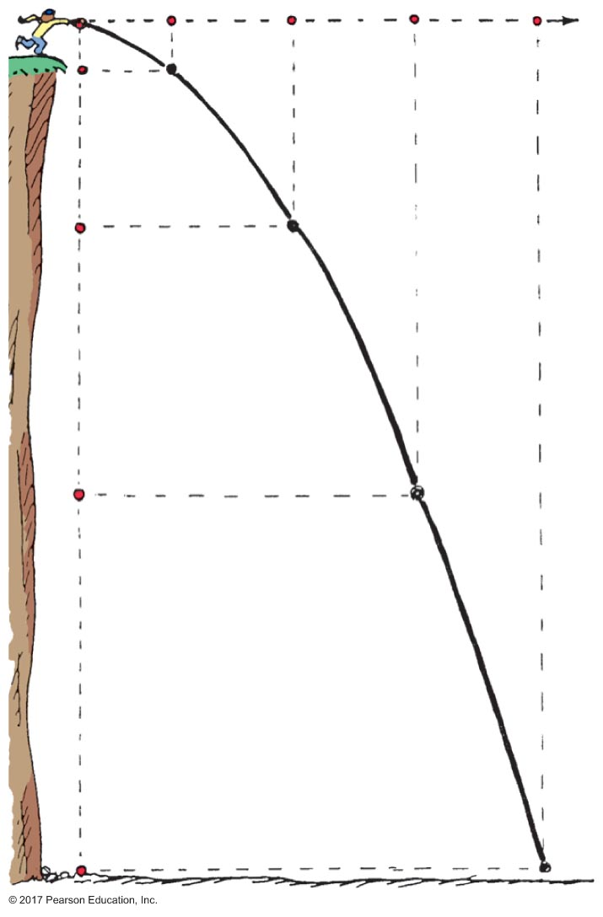
Projectile Motion
Projectile curves as a result of these components:
constant motion horizontally
accelerated motion vertically

Slide 36
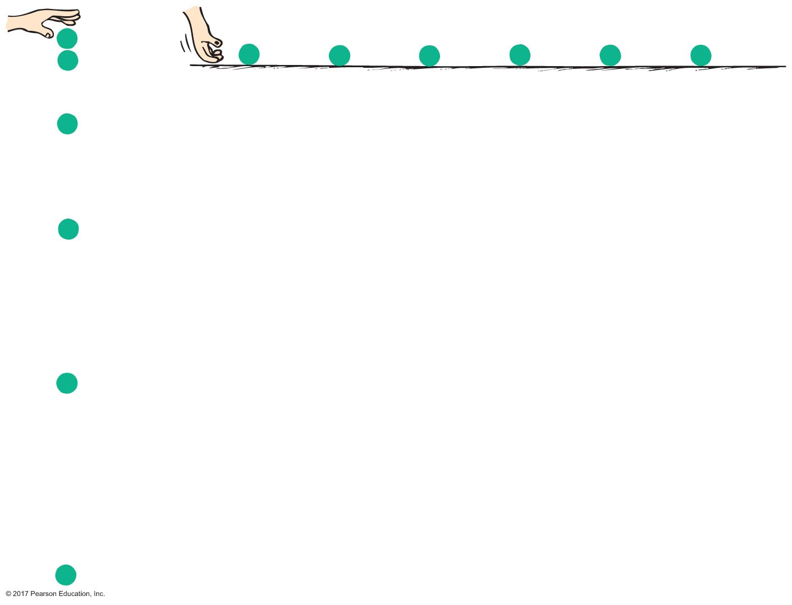
Projectile Motion
Projectile motion is a combination of
a horizontal component and a vertical component

Slide 37
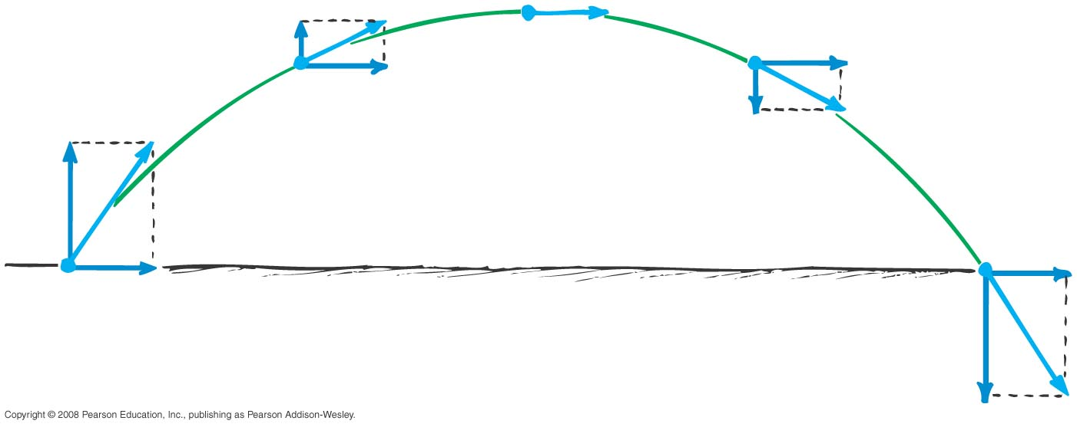
Projectile Motion
Parabola
Note that only the vertical velocity component changes with time. The horizontal component remains constant.

Slide 38
Projectile Motion CHECK YOUR NEIGHBOR
The velocity of a typical projectile can be represented by horizontal and vertical components. Assuming negligible air resistance, the horizontal component along the path of the projectile
increases.
decreases.
remains the same.
Not enough information.
Notes:
C. remains the same.

Slide 39
Projectile Motion CHECK YOUR ANSWER
The velocity of a typical projectile can be represented by horizontal and vertical components. Assuming negligible air resistance, the horizontal component along the path of the projectile
increases.
decreases.
remains the same.
Not enough information.
Explanation:
Because there is no force horizontally, no horizontal acceleration occurs.
Notes:
C. remains the same.

Slide 40
Projectile Motion CHECK YOUR NEIGHBOR
When no air resistance acts on a fast-moving baseball, its acceleration is
downward, g.
due to a combination of constant horizontal motion and accelerated downward motion.
opposite to the force of gravity.
centripetal.
Notes:
A. downward, g.

Slide 41
Projectile Motion CHECK YOUR ANSWER
When no air resistance acts on a fast-moving baseball, its acceleration is
downward, g.
due to a combination of constant horizontal motion and accelerated downward motion.
opposite to the force of gravity.
centripetal.
Notes:
A. downward, g.

Slide 42
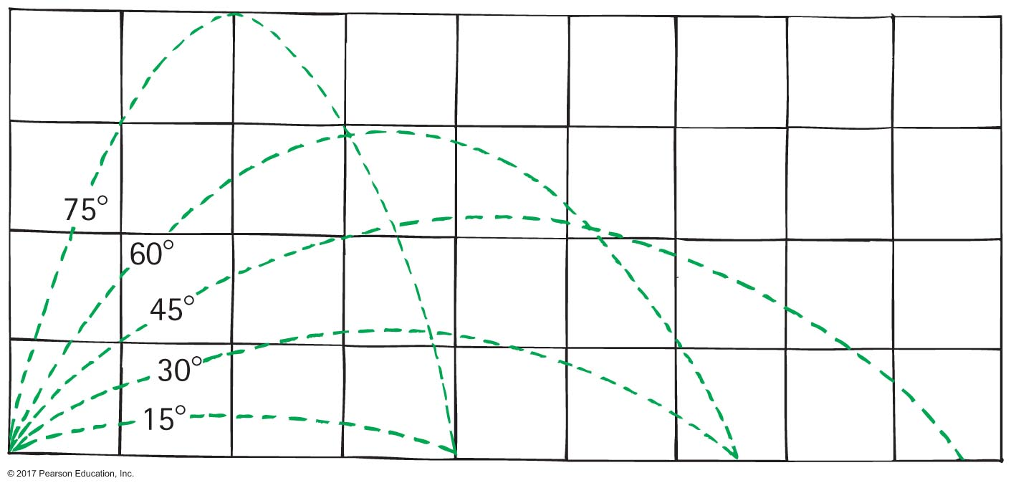
Projectile Altitude and Range
For equal launching speeds, the same range is obtained from two different projection angles—a pair that add up to 90º.
Example: Same range occurs for a 75º launch and a 15º launch of the same initial

Slide 43
Projectile Motion CHECK YOUR NEIGHBOR
A ball tossed at an angle of 30º with the horizontal will go as far downrange as one tossed at the same speed at an angle of
45º.
60º.
75º.
None of the above.
Notes:
B. 60°.

Slide 44
Projectile Motion CHECK YOUR ANSWER
A ball tossed at an angle of 30º with the horizontal will go as far downrange as one tossed at the same speed at an angle of
45º.
60º.
75º.
None of the above.
Explanation:
Same initial-speed projectiles have the same range when their launching angles add up to 90º. Why this is true involves a bit of trigonometry—which in the interest of time, we'll not pursue here.
Notes:
B. 60°.

Slide 45
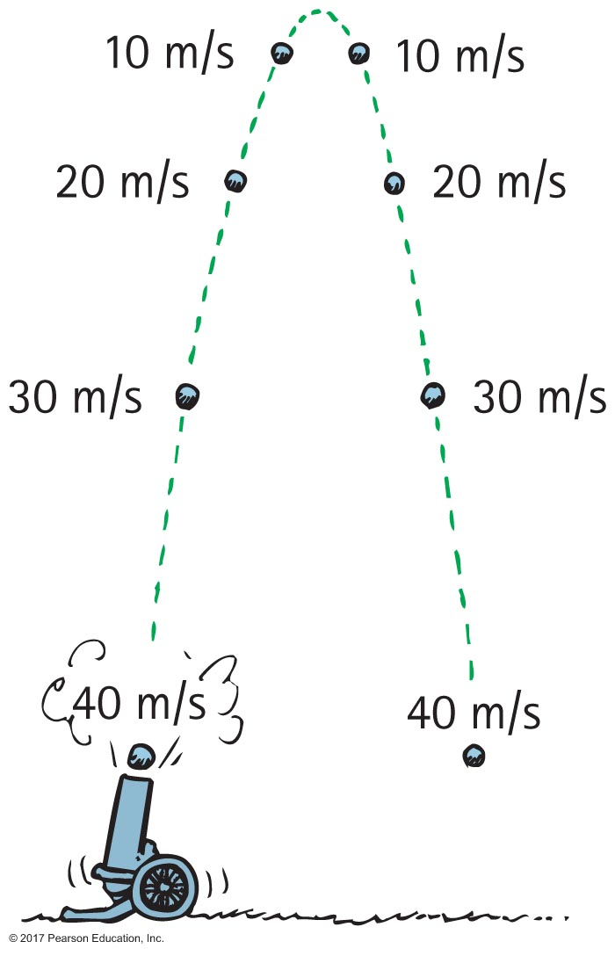
The Effect of Air Resistance on Projectiles
With air resistance, both range and altitude are decreased
Without air resistance, the speed lost going up is the same as the speed gained while coming down.

Slide 46
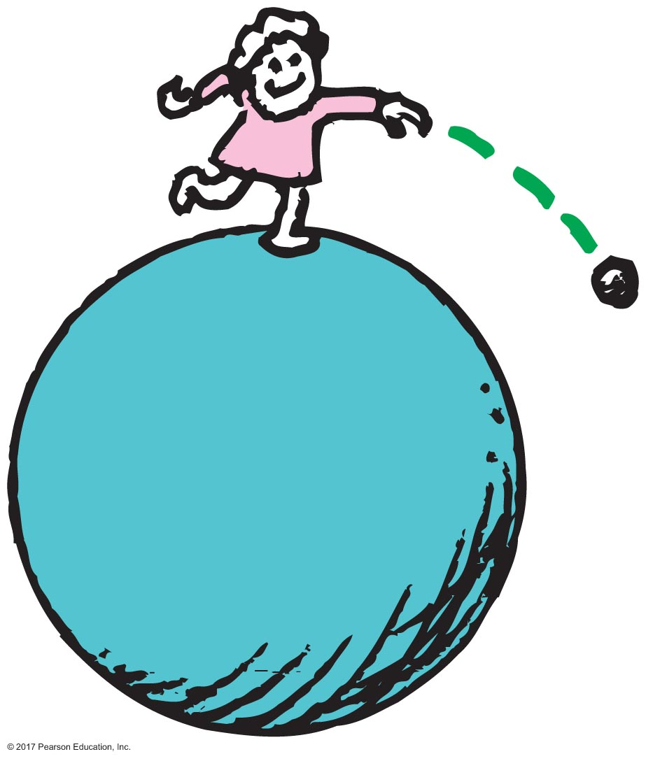
Fast-Moving Projectiles—Satellites
Satellite
is any projectile moving fast enough to fall continually around the Earth.
To become an Earth satellite, the projectile's horizontal velocity must be great enough for its trajectory to match Earth's curvature.

Slide 47
Fast-Moving Projectiles—Satellites
The Earth's curvature drops a vertical distance of 5 meters for each 8000 m tangent to the surface. So to orbit Earth, a projectile must travel 8000 m in the time it takes to fall 5 m.

Slide 48
Fast-Moving Projectiles—Satellites CHECK YOUR NEIGHBOR
As the ball leaves the girl's hand, one second later it will have fallen
10 meters.
5 meters below the dashed line.
less than 5 meters below the straight-line path.
None of the above.
Notes:
B. 5 meters below the dashed line.

Slide 49
Fast-Moving Projectiles—Satellites CHECK YOUR ANSWER
As the ball leaves the girl's hand, one second later it will have fallen
10 meters.
5 meters below the dashed line.
less than 5 meters below the straight-line path.
None of the above.
Comment:
Whatever the speed, the ball will fall a vertical distance of 5 meters below the dashed line.
Notes:
B. 5 meters below the dashed line.

Slide 50
Fast-Moving Projectiles—Satellites CHECK YOUR NEIGHBOR
When you toss a projectile sideways, it curves as it falls. It will be an Earth satellite if the curve it makes
matches the curved surface of Earth.
results in a straight line.
spirals out indefinitely.
None of the above.
Notes:
A. matches the curved surface of Earth.

Slide 51
Fast-Moving Projectiles—Satellites CHECK YOUR ANSWER
When you toss a projectile sideways, it curves as it falls. It will be an Earth satellite if the curve it makes
matches the curved surface of Earth.
results in a straight line.
spirals out indefinitely.
None of the above.
Explanation:
For an 8-km tangent, Earth curves downward 5 m. So, a projectile traveling horizontally at 8 km/s will fall 5 m in that time and follow the curve of the Earth.
Notes:
A. matches the curved surface of Earth.

Slide 52
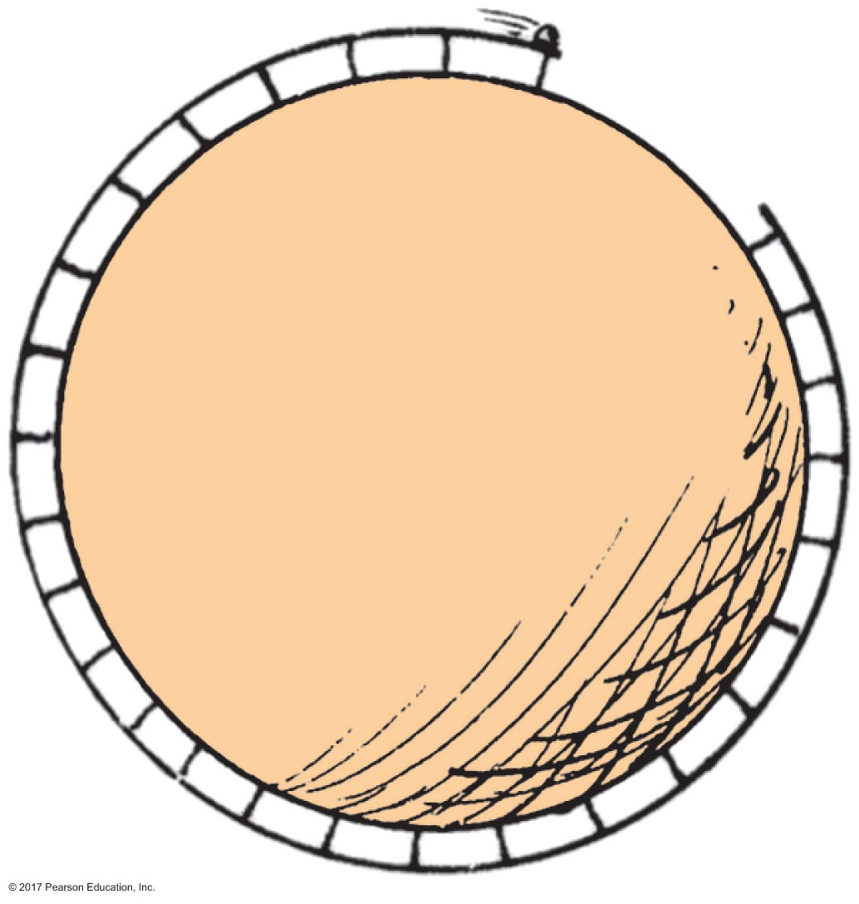
Circular Satellite Orbits
Elevated bowling alley: What speed will allow the bowling ball to clear the gap?

Slide 53
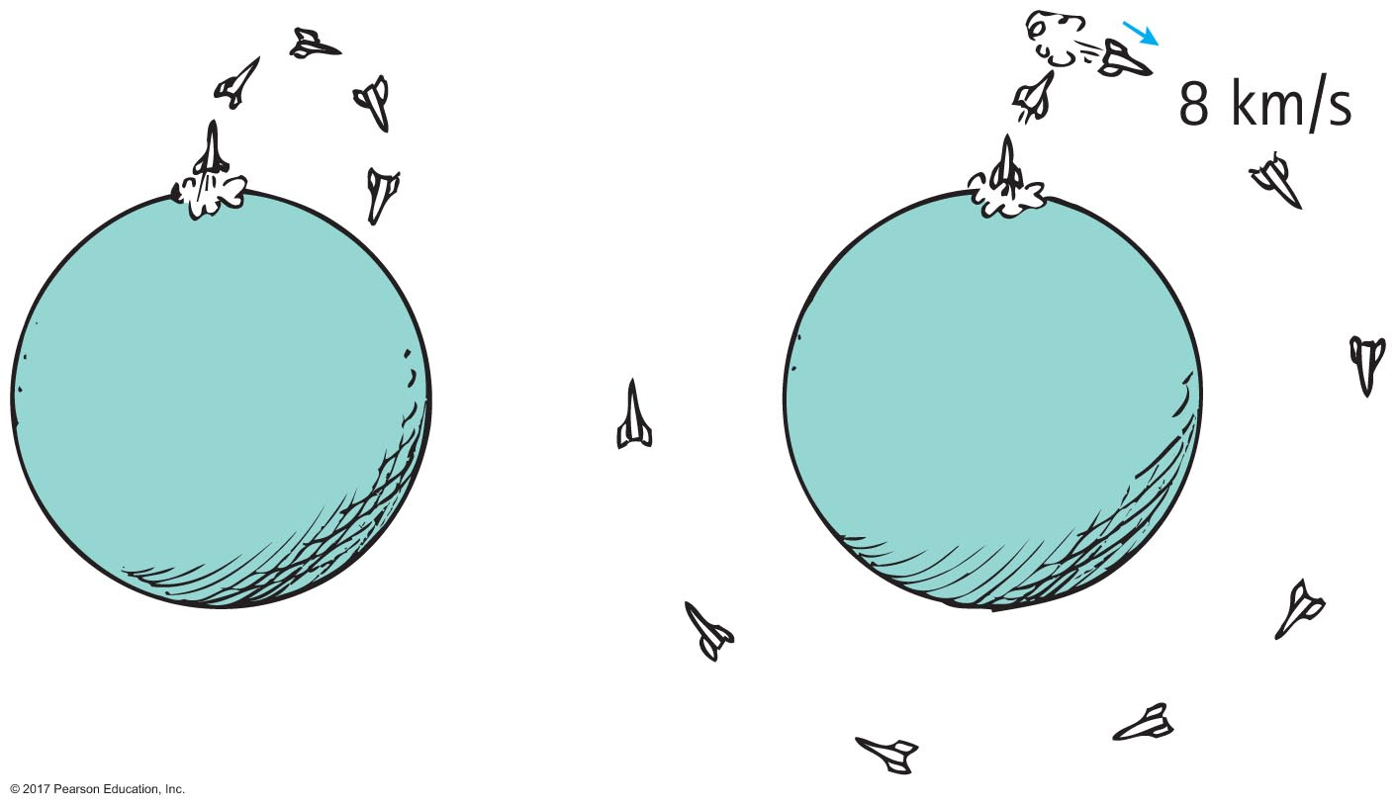
Circular Satellite Orbits
A payload into orbit requires control over
direction of rocket
initially, rocket is fired vertically, then tipped
once above the atmosphere, the rocket is aimed horizontally
speed of rocket
payload is given a final thrust to orbital speed of 8 km/s to fall around Earth and become an Earth satellite

Slide 54
Circular Satellite Orbits
Positioning
beyond Earth's atmosphere, where air resistance is almost totally absent
Example: Space shuttles are launched to altitudes of 150 km or more, to be above air drag. (Are they above Earth's gravitational field? NO!)

Slide 55
Satellite Motion CHECK YOUR NEIGHBOR
When a satellite travels at constant speed, the shape of its path is
a circle.
an ellipse.
an oval that is almost elliptical.
a circle with a square corner, as seen throughout your book.
Notes:
A. a circle.

Slide 56
Satellite Motion CHECK YOUR ANSWER
When a satellite travels at constant speed, the shape of its path is
a circle.
an ellipse.
an oval that is almost elliptical.
a circle with a square corner, as seen throughout your book.
Notes:
A. a circle.

Slide 57
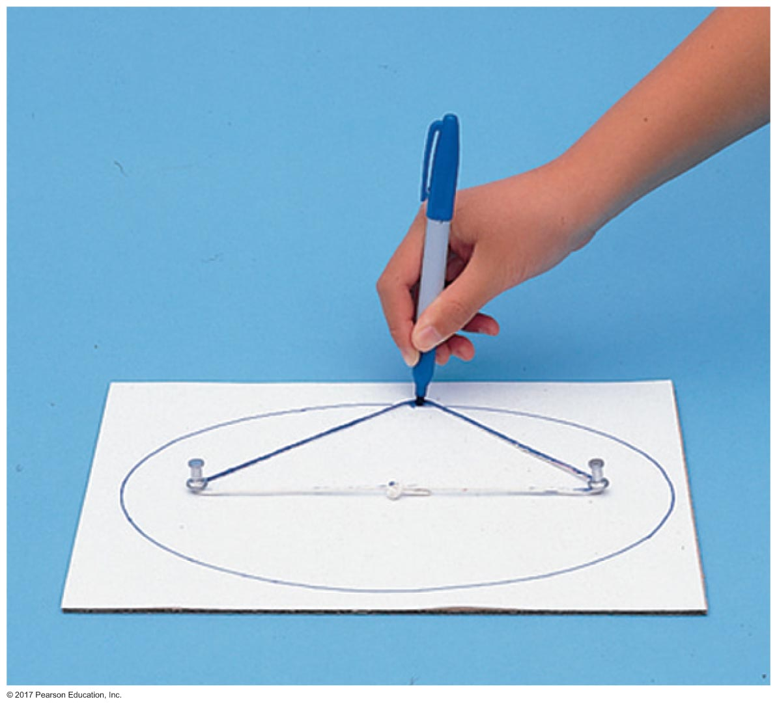
Elliptical Orbits
Ellipse
The oval path followed by a satellite. The closed path taken by a point that moves in such a way that the sum of its distances from two fixed points (called foci) is constant.

Slide 58
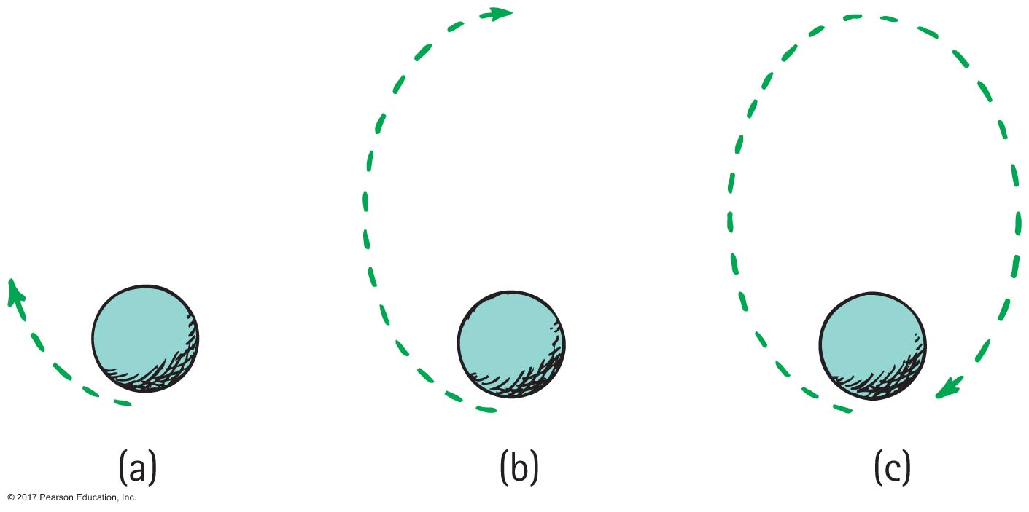
Elliptical Orbits
Elliptical orbit
speed of satellite varies
initially, if speed is greater than needed for circular orbit, satellite overshoots a circular path and moves away from Earth
satellite loses speed and then regains it as it falls back toward Earth
it rejoins its original path with the same speed it had initially
procedure is repeated

Slide 59
Elliptical Orbits CHECK YOUR NEIGHBOR
The speed of a satellite in an elliptical orbit
varies.
remains constant.
acts at right angles to its motion.
All of the above.
Notes:
A. varies.

Slide 60
Elliptical Orbits CHECK YOUR ANSWER
The speed of a satellite in an elliptical orbit
varies.
remains constant.
acts at right angles to its motion.
All of the above.
Notes:
A. varies.

Slide 61
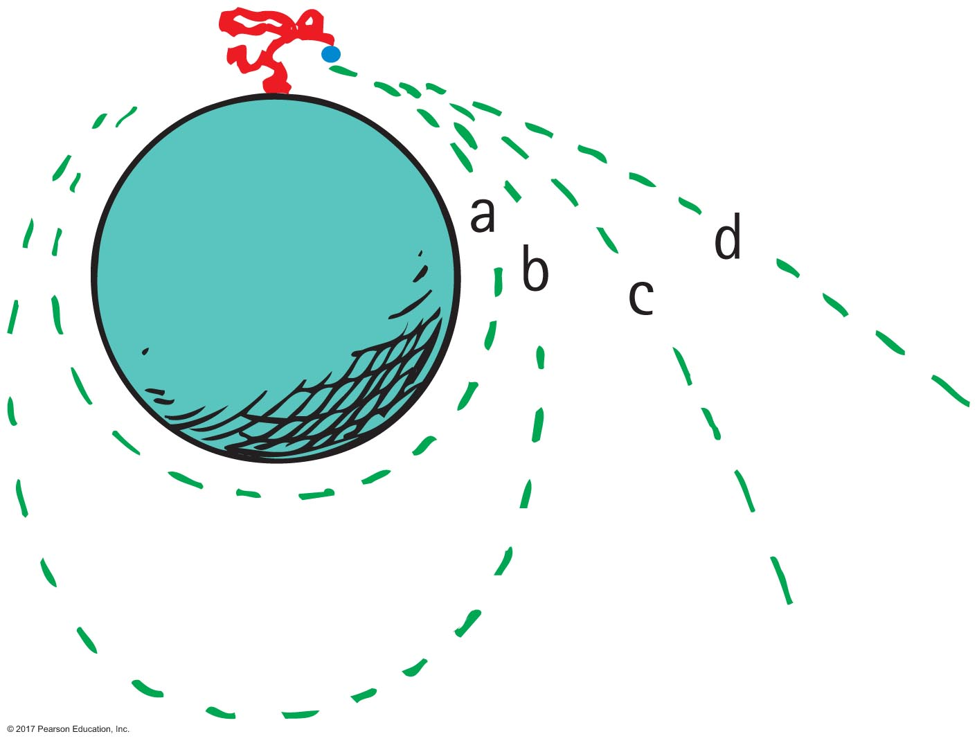
Escape Speed
Escape speed
the initial speed that an object must reach to escape gravitational influence of Earth
11.2 kilometers per second from Earth's surface
Escape velocity
is escape speed when direction is involved

Slide 62
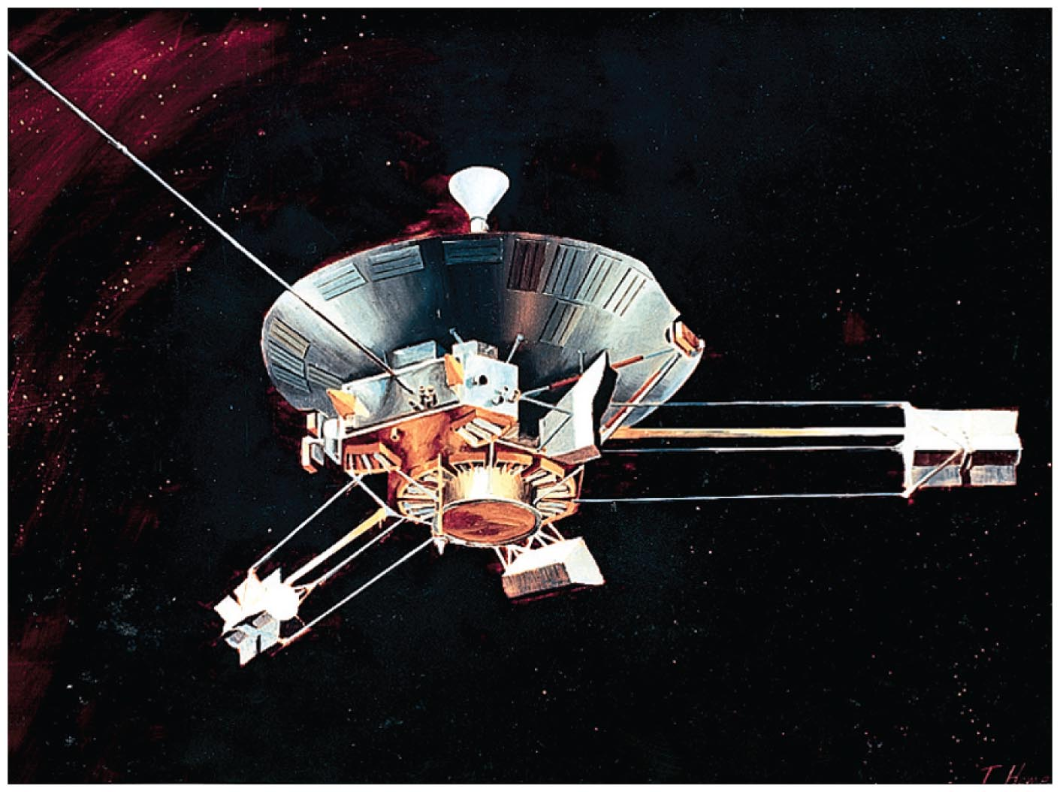
Escape Speed
First probe to escape the solar system is Pioneer 10, launched from Earth in 1972.
accomplished by directing the probe into the path of oncoming Jupiter

Slide 63
Escape Speed CHECK YOUR NEIGHBOR
When a projectile achieves escape speed from Earth, it
forever leaves Earth's gravitational field.
outruns the influence of Earth's gravity but is never beyond it.
comes to an eventual stop, eventually returning to Earth at some future time.
All of the above.
Notes:
B. outruns the influence of Earth's gravity, but is never beyond it.

Slide 64
Escape Speed CHECK YOUR ANSWER
When a projectile achieves escape speed from Earth, it
forever leaves Earth's gravitational field.
outruns the influence of Earth's gravity but is never beyond it.
comes to an eventual stop, eventually returning to Earth at some future time.
All of the above.
Notes:
B. outruns the influence of Earth's gravity, but is never beyond it.

