Slide 1
Chapter 3: Momentum and Energy

Slide 2
This lecture will help you understand:
Momentum and Impulse
Impulse Changes Momentum
Conservation of Momentum
Energy and Work
Power
Work-Energy Theorem
Conservation of Energy
Machines
Efficiency
Sources of Energy

Slide 3
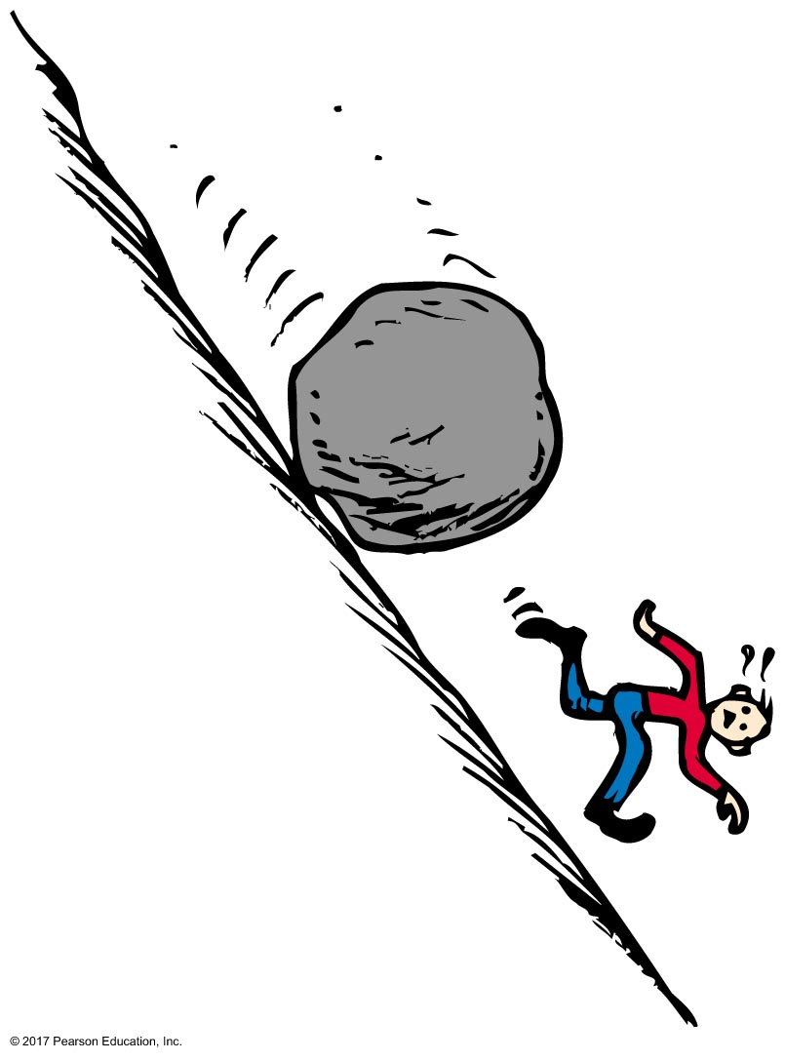
Momentum

Slide 4
Momentum
Momentum—is inertia in motion
defined as the product of mass and velocity:
momentum = mv

Slide 5
Momentum
Momentum
When direction is unimportant:
momentum = mass × speed
momentum = mv

Slide 6
Momentum
Momentum (continued)
high mass or high velocity high momentum
high mass and high velocity higher momentum
low mass or low velocity low momentum
low mass and low velocity lower momentum

Slide 7
Momentum CHECK YOUR NEIGHBOR
A moving object has
momentum.
energy.
speed.
All of the above.
Notes:
D. All of the above.

Slide 8
Momentum CHECK YOUR ANSWER
A moving object has
momentum.
energy.
speed.
All of the above.
Notes:
D. All of the above.

Slide 9
Momentum CHECK YOUR NEIGHBOR
When the speed of an object is doubled, its momentum
remains unchanged in accord with the conservation of momentum.
doubles.
quadruples.
decreases.
Notes:
B. doubles.

Slide 10
Momentum CHECK YOUR ANSWER
When the speed of an object is doubled, its momentum
remains unchanged in accord with the conservation of momentum.
doubles.
quadruples.
decreases.
Notes:
B. doubles.

Slide 11
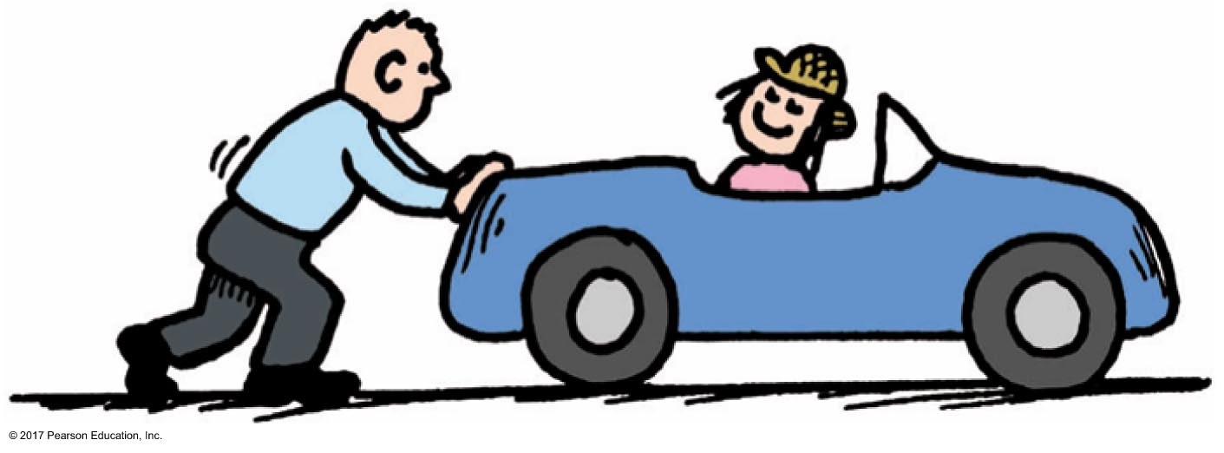
Impulse
Impulse
product of force and contact time
equation: impulse = force × time = Ft
great force for long time large impulse
same force for short time smaller impulse

Slide 12
Impulse CHECK YOUR NEIGHBOR
When the force that produces an impulse acts for twice as much time, the impulse is
not changed.
increased by two times.
increased by four times.
decreased by half.
Notes:
B. increased by two times.

Slide 13
Impulse CHECK YOUR ANSWER
When the force that produces an impulse acts for twice as much time, the impulse is
not changed.
increased by two times.
increased by four times.
decreased by half.
Notes:
B. increased by two times.

Slide 14
Impulse Changes Momentum
The change in momentum of an object is equal to the impulse applied to it (force multiplied by the time interval during which the force is applied)
Force × time = change in momentum
Ft = Δmv

Slide 15
Impulse Changes Momentum
Cases of momentum changes:
Increasing momentum
apply great force for long time produces great increase in momentum
Examples:
golfer follows through while teeing off
long barrels of long-range cannons

Slide 16
Impulse Changes Momentum CHECK YOUR NEIGHBOR
A cannonball shot from a cannon with a long barrel will emerge with greater speed, because the cannonball receives a greater
average force.
impulse.
Both of the above.
Neither of the above.
Notes:
B. impulse.

Slide 17
Impulse Changes Momentum CHECK YOUR ANSWER
A cannonball shot from a cannon with a long barrel will emerge with greater speed, because the cannonball receives a greater
average force.
impulse.
Both of the above.
Neither of the above.
Explanation:
The force on the cannonball will be the same for a short- or long-barreled cannon. The longer barrel provides for a longer time for the force to act and therefore a greater impulse. (The long barrel also provides a longer distance that the force acts, providing greater work and greater KE of the cannonball.)
Notes:
B. impulse.

Slide 18
Impulse Changes Momentum
Cases of momentum changes:
Decreasing momentum
over a longer time results in smaller force
Examples:
Driving into a haystack versus into a brick wall
Jumping in a safety net versus onto solid ground

Slide 19
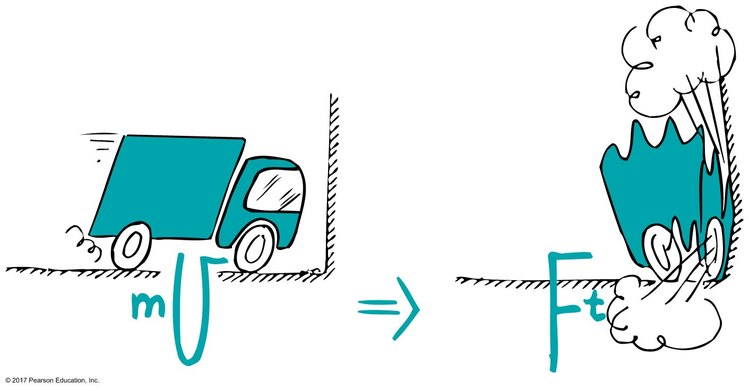
Impulse Changes Momentum
When a car is out of control, it is better to hit a haystack than a concrete wall. Common sense, but with a physics reason:
Same impulse occurs either way, but extension of hitting time reduces hitting force.

Slide 20
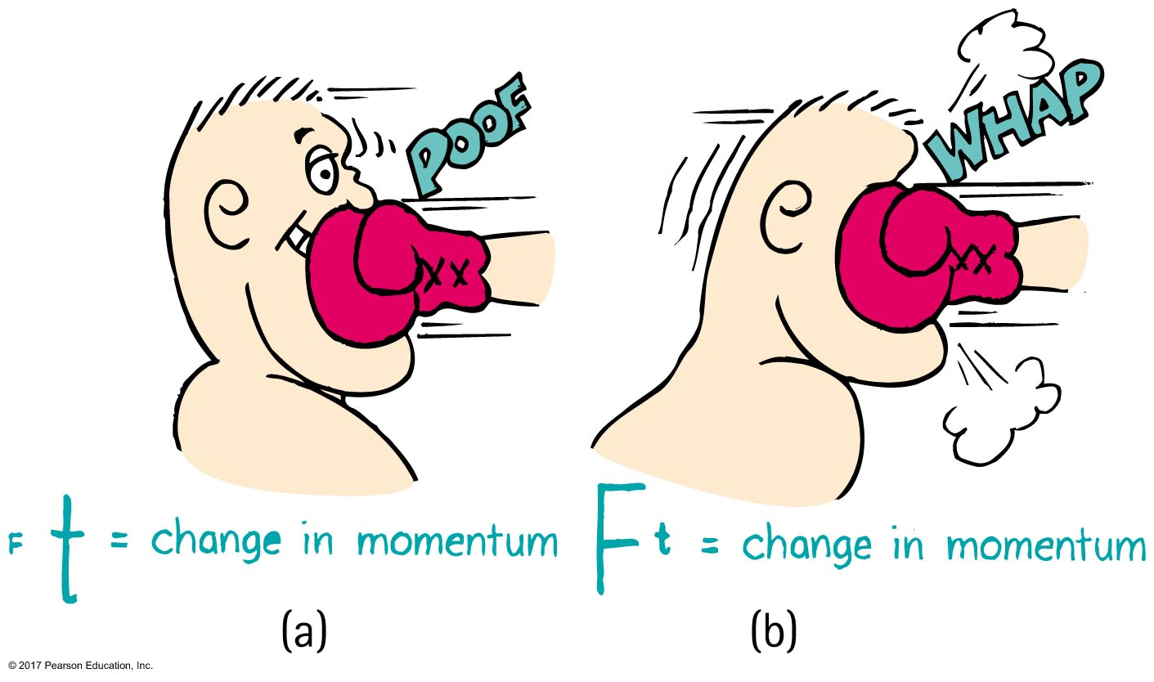
Impulse Changes Momentum
Examples (continued):
In jumping, bend your knees when your feet make contact with the ground because the extension of time during your momentum decrease reduces the force on you
In boxing, ride with the punch

Slide 21
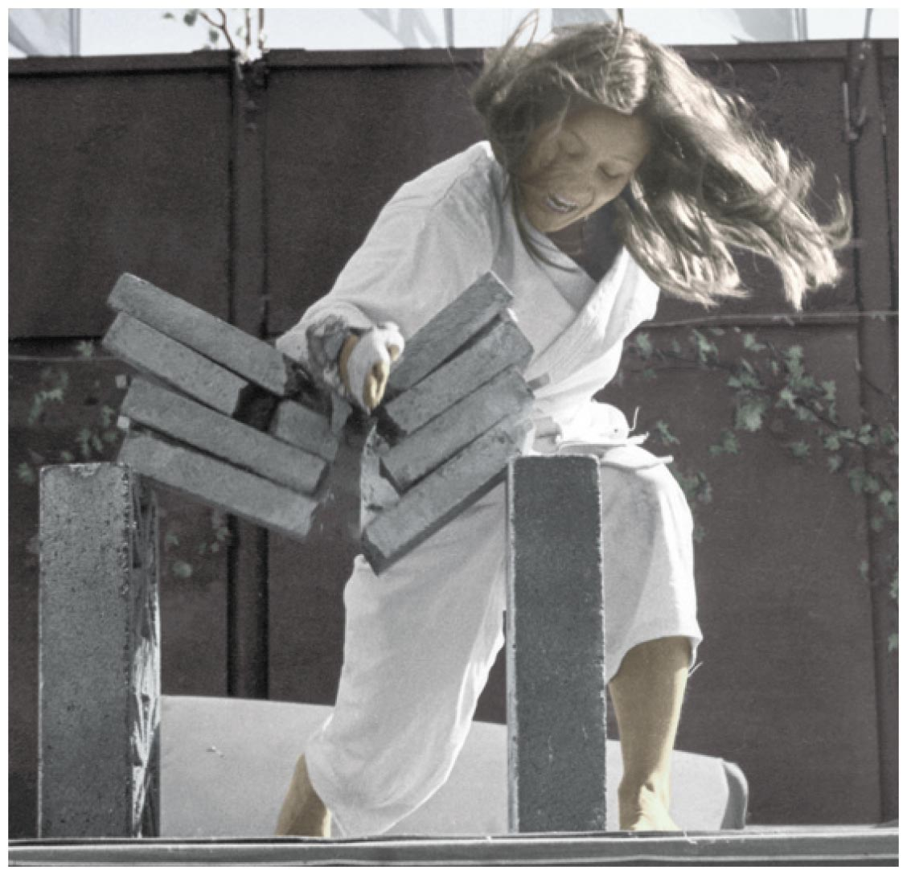
Impulse Changes Momentum
Cases of momentum changes:
Decreasing momentum over a short time
Short time interval produces a large force.
Example:
Cassy splits a stack of bricks by bringing her arm and hand swiftly against the bricks with considerable momentum. Brief contact and huge impact force.

Slide 22
Impulse Changes Momentum CHECK YOUR NEIGHBOR
A fast-moving car hitting a haystack or hitting a cement wall produces vastly different results. Both experience
the same change in momentum.
the same impulse.
the same force.
A and B.
Notes:
D. A and B.

Slide 23
Impulse Changes Momentum CHECK YOUR ANSWER
A fast-moving car hitting a haystack or hitting a cement wall produces vastly different results. Both experience
the same change in momentum.
the same impulse.
the same force.
A and B.
Explanation:
Although stopping the momentum is the same whether done slowly or quickly, the force is vastly different. Be sure to distinguish between momentum, impulse, and force.
Notes:
D. A and B.

Slide 24
Impulse Changes Momentum CHECK YOUR NEIGHBOR
When a dish falls, will the change in momentum be less if it lands on a carpet than if it lands on a hard floor? (Careful!)
No, both are the same.
Yes, less if it lands on the carpet.
No, less if it lands on a hard floor.
No, more if it lands on a hard floor.
Notes:
A. No, both are the same.

Slide 25
Impulse Changes Momentum CHECK YOUR ANSWER
When a dish falls, will the change in momentum be less if it lands on a carpet than if it lands on a hard floor? (Careful!)
No, both are the same.
Yes, less if it lands on the carpet.
No, less if it lands on a hard floor.
No, more if it lands on a hard floor.
Explanation:
The momentum becomes zero in both cases, so both change by the same amount. Although the momentum change and impulse are the same, the force is less when the time of momentum change is extended. Be careful to distinguish between force, impulse, and momentum.
Notes:
A. No, both are the same.

Slide 26
Conservation of Momentum
In every case, the momentum of a system cannot change unless it is acted on by external forces.
A system will have the same momentum both before and after any interaction occurs. When the momentum does not change, we say it is conserved.

Slide 27
Conservation of Momentum
Law of conservation of momentum:
In the absence of an external force, the momentum of a system remains unchanged.
Equation form:
(total momentum)_{before} = (total momentum)_{after}

Slide 28
Conservation of Momentum
Collisions
When objects collide in the absence of external forces,
net momentum before collision = net momentum after collision
Examples:
Elastic collisions
Inelastic collisions

Slide 29
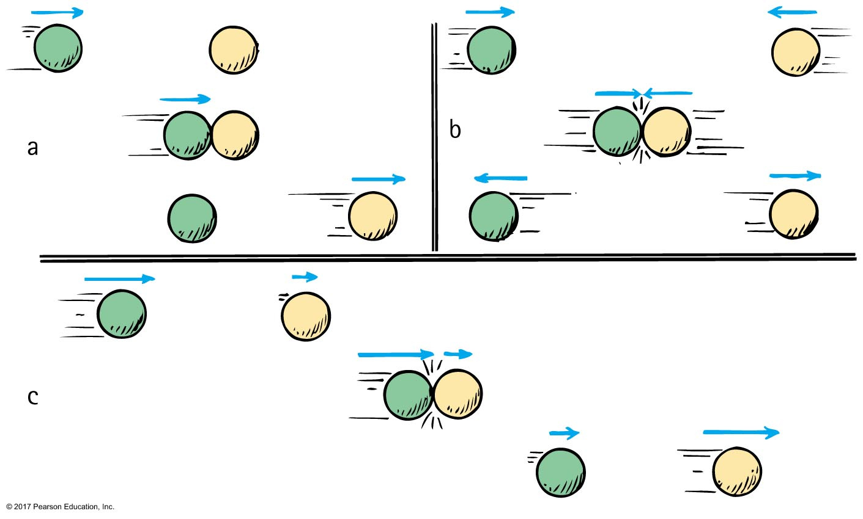
Conservation of Momentum
Elastic collision
is defined as a collision whereupon objects collide without permanent deformation or the generation of heat. (The elastic balls bounce!)

Slide 30
Conservation of Momentum
In Figure (a)
moving green ball hits yellow ball, initially at rest
green ball comes to rest, and yellow ball moves away with a velocity equal to the initial velocity of the green ball
In Figures (a) through (c)
momentum is simply transferred from one ball to the other.

Slide 31
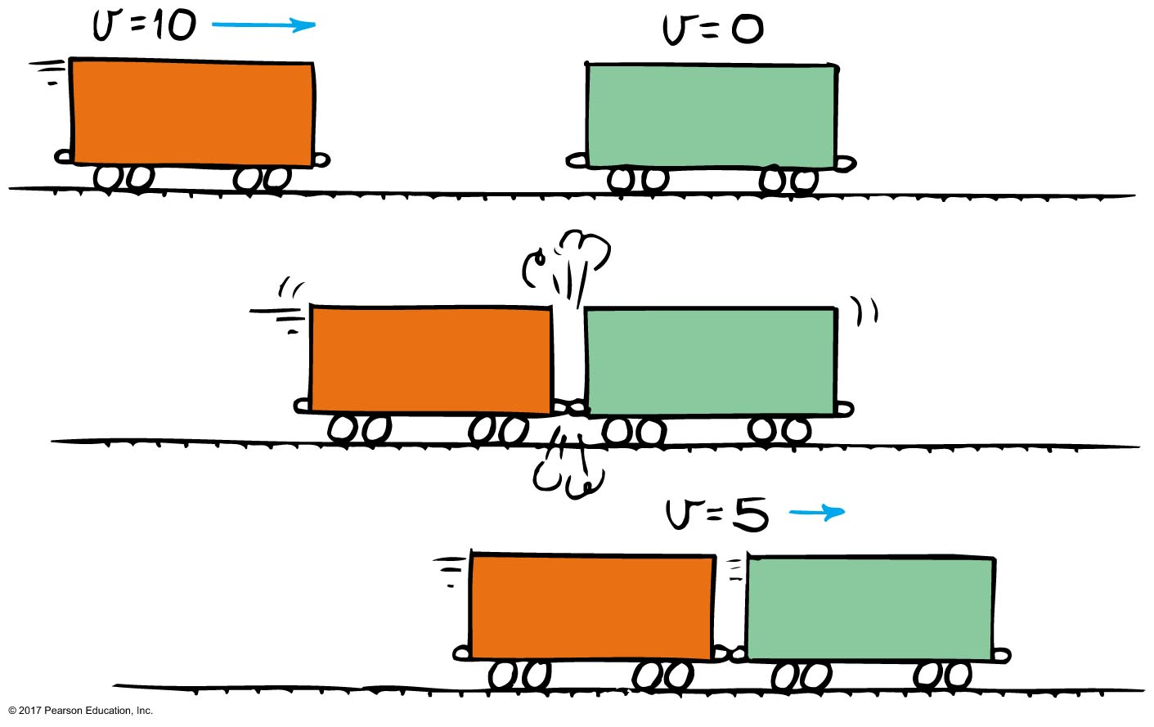
Conservation of Momentum
Inelastic collision
is defined as a collision whereupon colliding objects become tangled or coupled together, generating heat. (Inelastic collisions are often sticky.)

Slide 32
Conservation of Momentum CHECK YOUR NEIGHBOR
Freight Car A is moving toward identical Freight Car B that is at rest. When they collide, both freight cars couple together. Compared with the initial speed of Freight Car A, the speed of the coupled freight cars is
the same.
half.
twice.
None of the above.
Notes:
B. half.

Slide 33
Conservation of Momentum CHECK YOUR ANSWER
Freight Car A is moving toward identical Freight Car B that is at rest. When they collide, both freight cars couple together. Compared with the initial speed of Freight Car A, the speed of the coupled freight cars is
the same.
half.
twice.
None of the above.
Explanation:
After the collision, the mass of the moving freight cars has doubled. Can you see that their speed is half the initial velocity of Freight Car A?
Notes:
B. half.

Slide 34
Work
Work
defined as the product of force exerted on an object and the distance the object moves (in the same direction as the force)
is done only when the force succeeds in moving the body it acts upon
equation: work = force × distance

Slide 35
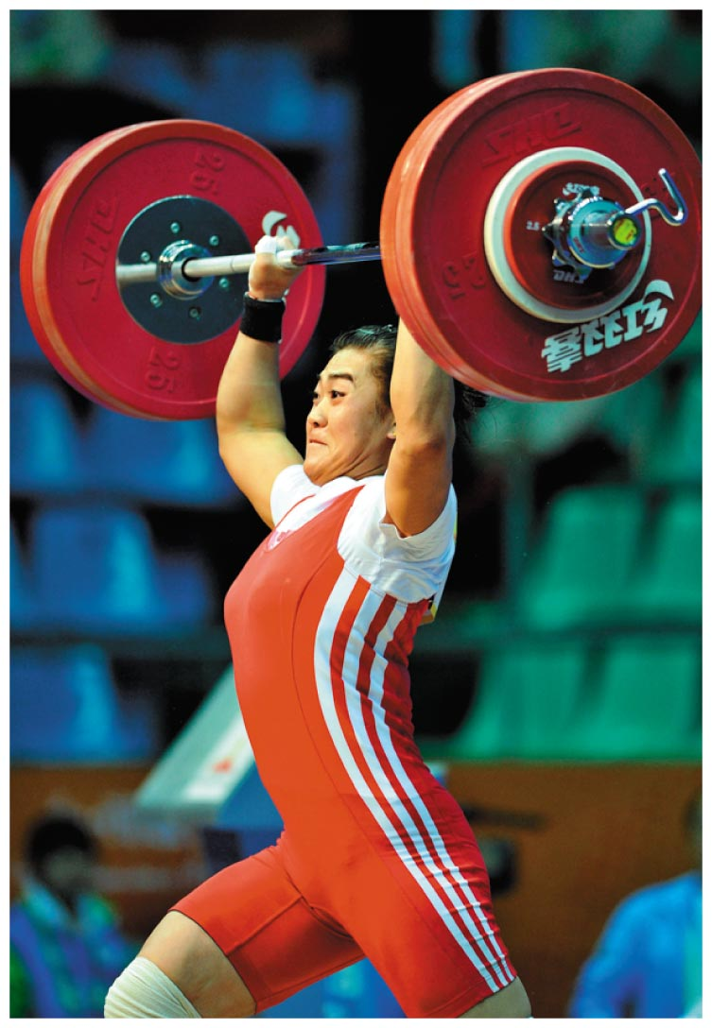
Work
Two things enter where work is done:
application of force
movement of something by that force
Work done on the barbell is the average force multiplied by the distance through which the barbell is lifted.

Slide 36
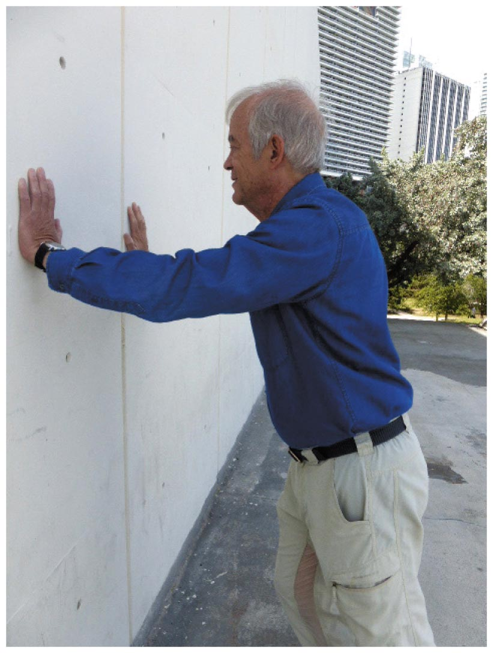
Work CHECK YOUR NEIGHBOR
If you push against a stationary wall for several minutes, you do no work
on the wall.
at all.
Both of the above.
None of the above.
Notes:
A. on the wall.

Slide 37
Work CHECK YOUR ANSWER
If you push against a stationary wall for several minutes, you do no work
on the wall.
at all.
Both of the above.
None of the above.
Explanation:
You may do work on your muscles, but not on the wall.
Notes:
A. on the wall.

Slide 38
Work
The quantity of work done is equal to the amount of force × the distance moved in the direction in which the force acts.
Work falls into two categories:
work done against another force
work done to change the speed of an object

Slide 39
Work CHECK YOUR NEIGHBOR
Work is done in lifting a barbell. How much work is done in lifting a twice-as-heavy barbell the same distance?
Twice as much.
Half as much.
The same.
Depends on the speed of the lift.
Notes:
A. Twice as much.

Slide 40
Work CHECK YOUR ANSWER
Work is done in lifting a barbell. How much work is done in lifting a twice-as-heavy barbell the same distance?
Twice as much.
Half as much.
The same.
Depends on the speed of the lift.
Explanation:
This is in accord with work = force × distance. Twice the force for the same distance means twice the work done on the barbell.
Notes:
A. Twice as much.

Slide 41
Work CHECK YOUR NEIGHBOR
You do work when pushing a cart. If you push the cart twice as far with the same constant force, then the work you do is
less than twice as much.
twice as much.
more than twice as much.
zero.
Notes:
B. twice as much.

Slide 42
Work CHECK YOUR ANSWER
You do work when pushing a cart. If you push the cart twice as far with the same constant force, then the work you do is
less than twice as much.
twice as much.
more than twice as much.
zero.
Notes:
B. twice as much.

Slide 43
Energy
Energy
defined as that which produces changes in matter
Effects of energy observed only when
it is being transferred from one place to another
or
it is being transformed from one form to another
Both work and energy are measured in joules.

Slide 44
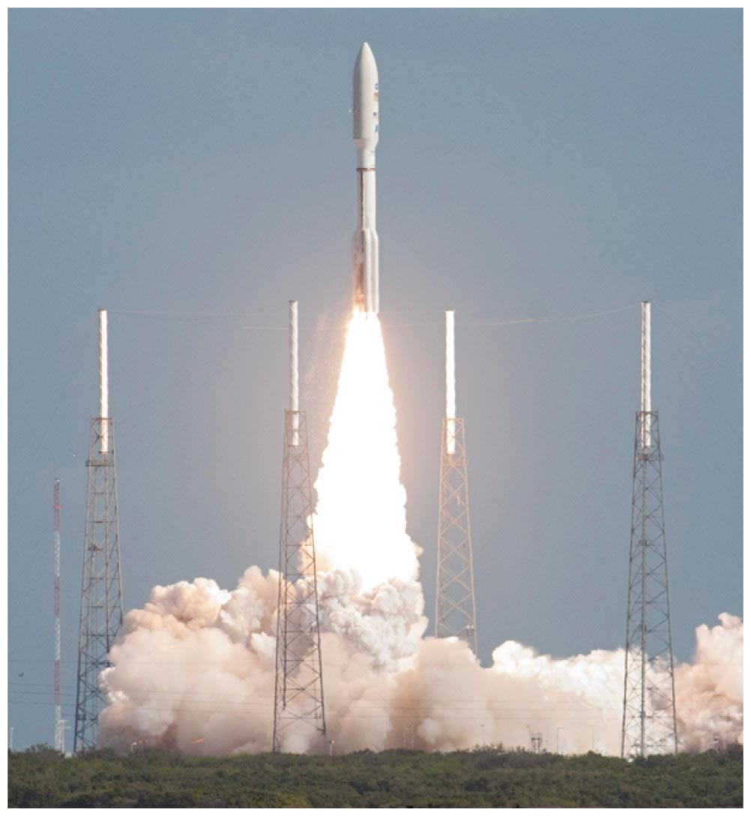
Power
Power
measure of how fast work is done
equation:
units in joule per second or watt (One watt = 1 joule of work per second)

Slide 45
Power CHECK YOUR NEIGHBOR
A job can be done slowly or quickly. Both may require the same amount of work, but different amounts of
energy.
momentum.
power.
impulse.
Notes:
C. power.

Slide 46
Power CHECK YOUR ANSWER
A job can be done slowly or quickly. Both may require the same amount of work, but different amounts of
energy.
momentum.
power.
impulse.
Explanation:
Power is the rate at which work is done.
Notes:
C. power.

Slide 47
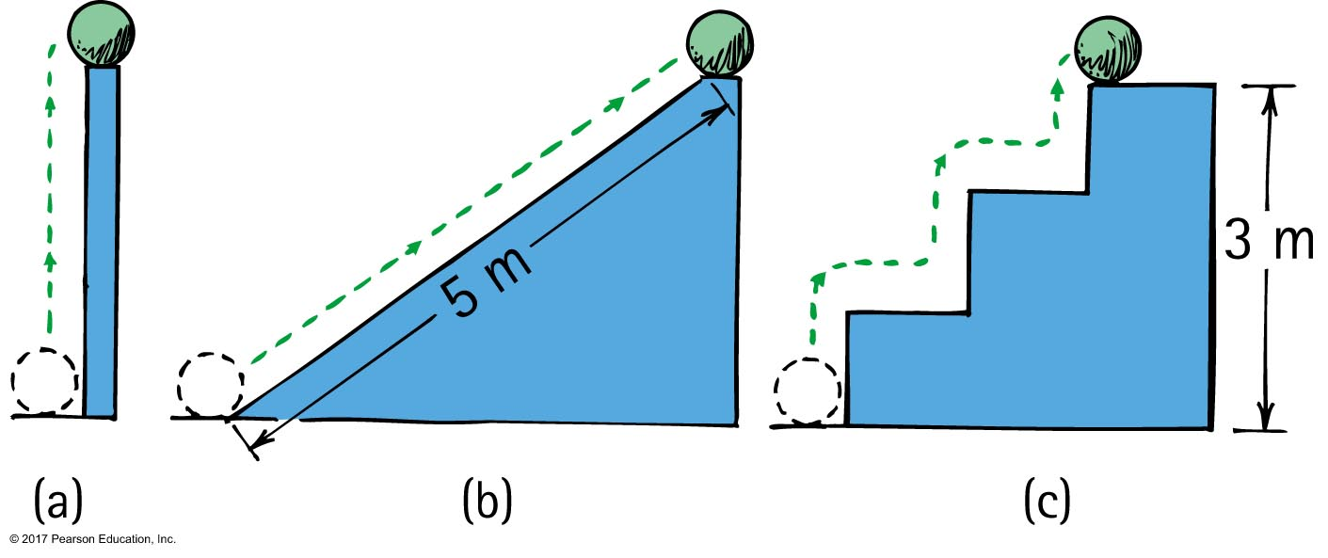
Potential Energy
Example: potential energy of 10-N ball is the same in all 3 cases because work done in elevating it is the same

Slide 48
Potential Energy
Potential energy
is defined as stored energy due to position, shape, or state. In its stored state, energy has the potential for doing work.
Examples:
Drawn bow
Stretched rubber band
Raised ram of a pile driver

Slide 49
Gravitational Potential Energy
The amount of gravitational potential energy possessed by an elevated object is equal to the work done against gravity in raising it.
Work done equals force required to move it upward × the vertical distance moved (W = Fd). The upward force when moved at constant velocity is the weight, mg, of the object. So the work done in lifting it through height h is the product mgh.

Slide 50
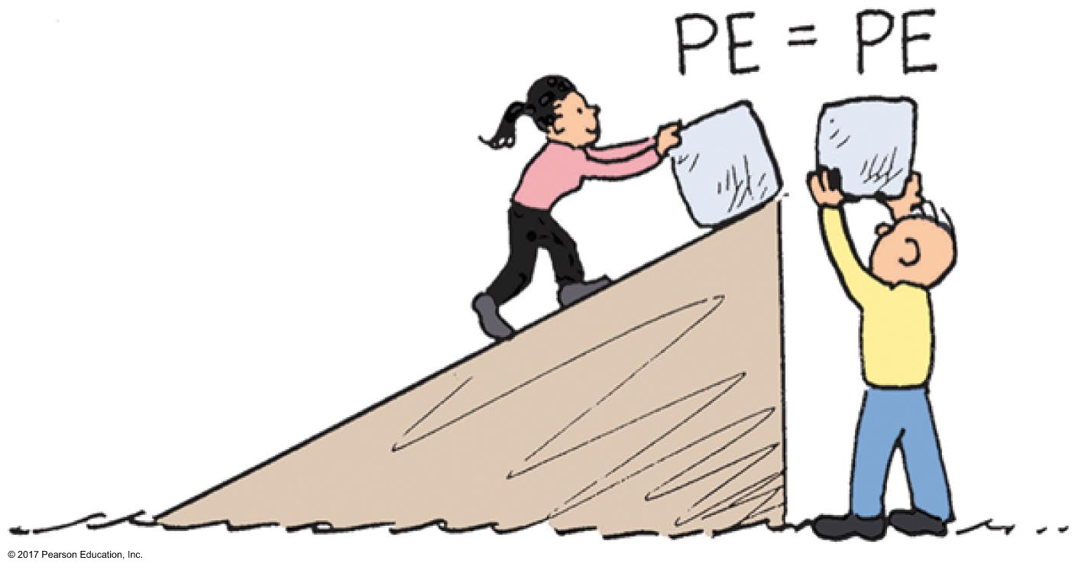
Gravitational Potential Energy
Equation for gravitational potential energy:
PE = weight × height
or
PE = mgh
Gravitational potential energy examples:
Water in an elevated reservoir
The elevated ram of a pile driver

Slide 51
Potential Energy CHECK YOUR NEIGHBOR
Does a car hoisted for repairs in a service station have increased potential energy relative to the floor?
Yes.
No.
Sometimes.
Not enough information.
Notes:
A. Yes.

Slide 52
Potential Energy CHECK YOUR ANSWER
Does a car hoisted for repairs in a service station have increased potential energy relative to the floor?
Yes.
No.
Sometimes.
Not enough information.
Explanation:
And if the car were twice as heavy, its increase in potential energy would be twice as much.
Notes:
A. Yes.

Slide 53
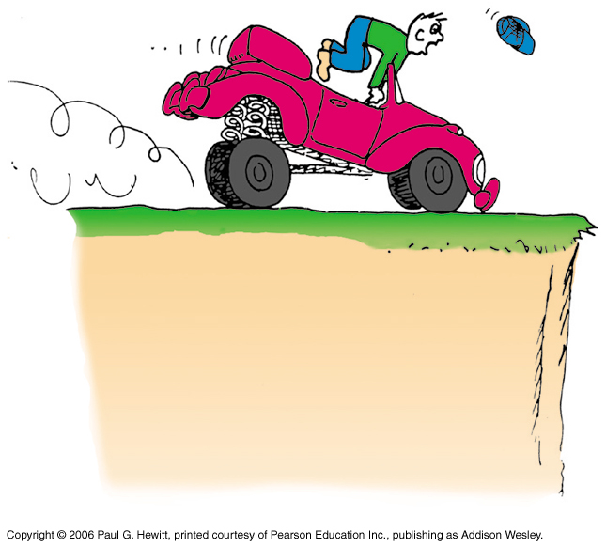
Work-Energy Theorem
Applies to decreasing speed
reducing the speed of an object or bringing it to a halt
Example:
Applying the brakes to slow a moving car. Work is done on it (the friction force supplied by the brakes × distance).

Slide 54
Kinetic Energy
Kinetic energy
is defined as the energy of a moving body
Equation for kinetic energy:
Kinetic energy = ¹/₂ mass × speed²
or
KE = ¹/₂ mv²
small changes in speed large changes in KE

Slide 55
Kinetic Energy CHECK YOUR NEIGHBOR
Must a car with momentum have kinetic energy?
Yes, due to motion alone.
Yes, when motion is nonaccelerated.
Yes, because speed is a scalar and velocity is a vector quantity.
No.
Notes:
A. Yes, due to motion alone.

Slide 56
Kinetic Energy CHECK YOUR ANSWER
Must a car with momentum have kinetic energy?
Yes, due to motion alone.
Yes, when motion is nonaccelerated.
Yes, because speed is a scalar and velocity is a vector quantity.
No.
Explanation:
Acceleration, speed being a scalar, and velocity being a vector quantity, are irrelevant. Any moving object has both momentum and kinetic energy.
Notes:
A. Yes, due to motion alone.

Slide 57
Work-Energy Theorem
When work is done on an object to change its KE, the amount of work done is equal to the change in KE.
Equation for work-energy theorem:
Net work = change in KE
If there is no change in object's energy, then no work is done on the object.
Applies to potential energy:
For a barbell held stationary, no further work is done no further change in energy.
Applies to decreasing energy:
The more kinetic energy something has the more work is required to slow it or stop it

Slide 58
The Work-Energy Theorem CHECK YOUR NEIGHBOR
Consider a problem that asks for the distance a fast-moving crate slides across a factory floor in coming to a stop. The most useful equation for solving this problem is
A. F = ma.
B. Ft = Δmv.
C. KE = ¹/₂mv².
D. Fd = Δ¹/₂mv².
Notes:
D. Fd = Δ¹/₂mv².

Slide 59
The Work-Energy Theorem CHECK YOUR ANSWER
Consider a problem that asks for the distance a fast-moving crate slides across a factory floor in coming to a stop. The most useful equation for solving this problem is
A. F = ma.
B. Ft = Δmv.
C. KE = ¹/₂mv².
D. Fd = Δ¹/₂mv².
Explanation:
The work-energy theorem is the physicist's favorite starting point for solving many motion-related problems.
Notes:
D. Fd = Δ¹/₂mv².

Slide 60
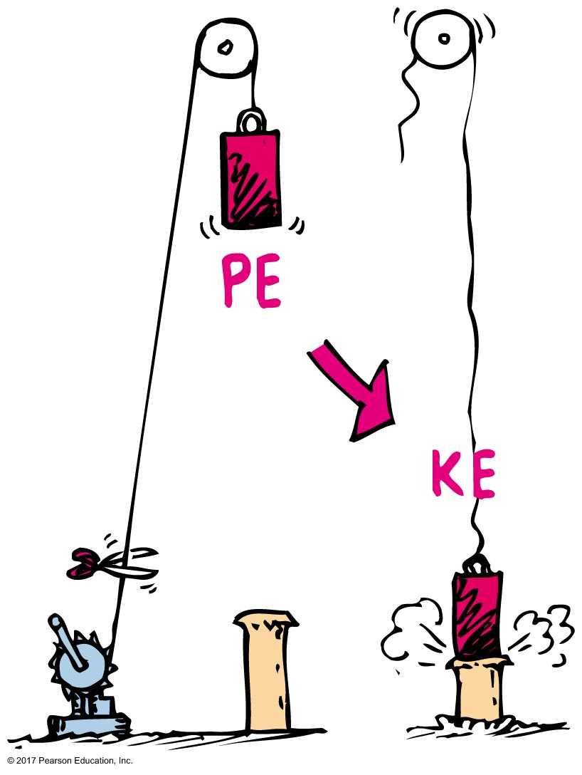
Conservation of Energy
Example: energy transforms without net loss or net gain in the operation of a pile driver

Slide 61
The Work-Energy Theorem CHECK YOUR NEIGHBOR
The work done in braking a moving car to a stop is the force of tire friction × stopping distance. If the initial speed of the car is doubled, the stopping distance is
actually less.
about the same.
twice.
None of the above.
Notes:
D. None of the above.

Slide 62
The Work-Energy Theorem CHECK YOUR ANSWER
The work done in braking a moving car to a stop is the force of tire friction × stopping distance. If the initial speed of the car is doubled, the stopping distance is
actually less.
about the same.
twice.
None of the above.
Explanation:
Twice the speed means four times the kinetic energy and four times the stopping distance.
Notes:
D. None of the above.

Slide 63
Machines
Principle of a machine
conservation of energy concept:
work input = work output
input force × input distance =
output force × output distance
(force × distance)_{input} = (force × distance)_{output}

Slide 64
Kinetic Energy and Momentum
Comparison of kinetic energy and momentum
Both depend on mass and velocity—Momentum depends on mass and velocity. KE depends on mass and the square of its velocity (or speed).
Momentum is a vector quantity. Kinetic energy is a scalar quantity.

Slide 65
Conservation of Energy
Conservation defined in
everyday language as " to save"
physics as to "remain unchanged"
Law of conservation of energy
In the absence of external work input or output, the energy of a system remains unchanged.
Energy cannot be created or destroyed.

Slide 66
Conservation of Energy A situation to ponder…
Consider the system of a bow and arrow. In drawing the bow, we do work on the system and give it potential energy.
When the bowstring is released, most of the potential energy is transferred to the arrow as kinetic energy and some as heat to the bow.

Slide 67
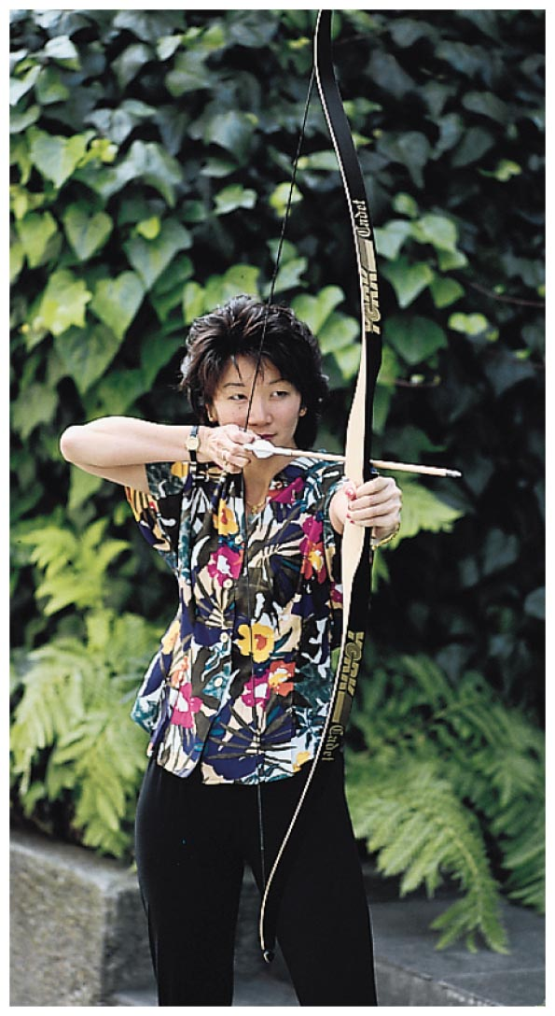
A situation to ponder… CHECK YOUR NEIGHBOR
Suppose the potential energy of a drawn bow is 50 joules, and the kinetic energy of the shot arrow is 40 joules. Then
energy is not conserved.
10 joules go to warming the bow.
10 joules go to warming the target.
10 joules is mysteriously missing.
Notes:
B. 10 joules go to warming the bow.

Slide 68
A situation to ponder… CHECK YOUR ANSWER
Suppose the potential energy of a drawn bow is 50 joules, and the kinetic energy of the shot arrow is 40 joules. Then
energy is not conserved.
10 joules go to warming the bow.
10 joules go to warming the target.
10 joules is mysteriously missing.
Explanation:
The total energy of the drawn bow, which includes the poised arrow, is 50 joules. The arrow gets 40 joules and the remaining 10 joules warms the bow—still in the initial system.
Notes:
B. 10 joules go to warming the bow.

Slide 69
Machines
Machine—a device for multiplying force or changing the direction of force.
No machine can
put out more energy than is put into it.
create energy; it can only transfer or transform energy.

Slide 70
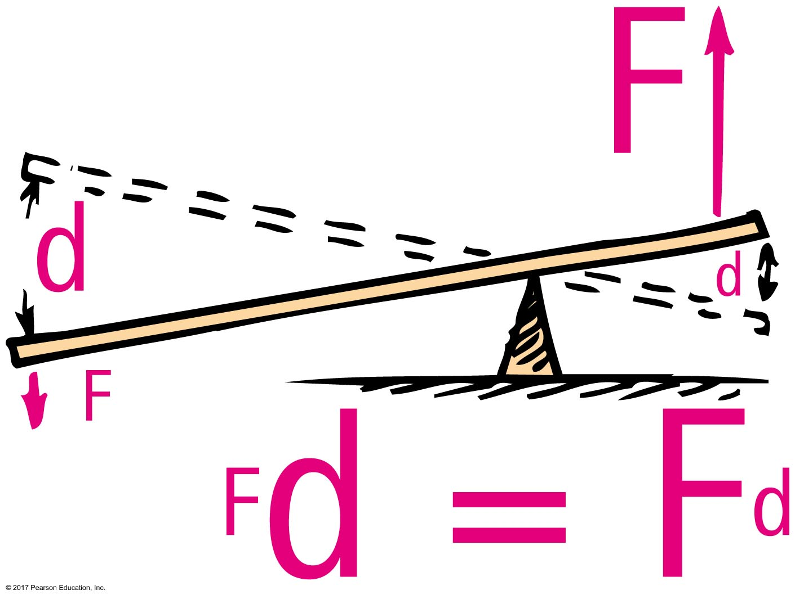
Machines
Equation:
work input = work output
(force × distance)_{input} = (force × distance)_{output}
Example: a simple lever
small input force over a long distance large output force over a short distance

Slide 71
Machines CHECK YOUR NEIGHBOR
In an ideal pulley system, a woman lifts a 100-N crate by pulling a rope downward with a force of 25 N. For every one-meter length of rope she pulls downward, the crate rises
50 centimeters.
45 centimeters.
25 centimeters.
None of the above.
Notes:
C. 25 centimeters.

Slide 72
Machines CHECK YOUR ANSWER
In an ideal pulley system, a woman lifts a 100-N crate by pulling a rope downward with a force of 25 N. For every one-meter length of rope she pulls downward, the crate rises
50 centimeters.
45 centimeters.
25 centimeters.
None of the above.
Explanation:
Work in = work out; Fd in = Fd out.
One-fourth of 1 m = 25 cm.
Notes:
C. 25 centimeters.

Slide 73
Efficiency
Efficiency
how effective a device transforms or transfers useful energy
equation:
a machine with low efficiency greater amount of energy wasted as heat
Some energy is always dissipated as heat, which means that no machine is ever 100% efficient.

Slide 74
Efficiency CHECK YOUR NEIGHBOR
A certain machine is 30% efficient. This means the machine will convert
30% of the energy input to useful work—70% of the energy input will be wasted.
70% of the energy input to useful work—30% of the energy input will be wasted.
As strange as it may seem, both of the above.
None of the above.
Notes:
A. 30% of the energy input to useful work—70% of the energy input will be wasted.

Slide 75
Efficiency CHECK YOUR ANSWER
A certain machine is 30% efficient. This means the machine will convert
30% of the energy input to useful work—70% of the energy input will be wasted.
70% of the energy input to useful work—30% of the energy input will be wasted.
As strange as it may seem, both of the above.
None of the above.
Notes:
A. 30% of the energy input to useful work—70% of the energy input will be wasted.

Slide 76
Sources of Energy
Energy sources
Sun
Examples:
Sunlight evaporates water; water falls as rain; rain flows into rivers and into generator turbines; then back to the sea to repeat the cycle.
Solar energy can transform into electricity by photovoltaic cells.
Solar energy indirectly produces wind that can power turbines and generate electricity.

Slide 77
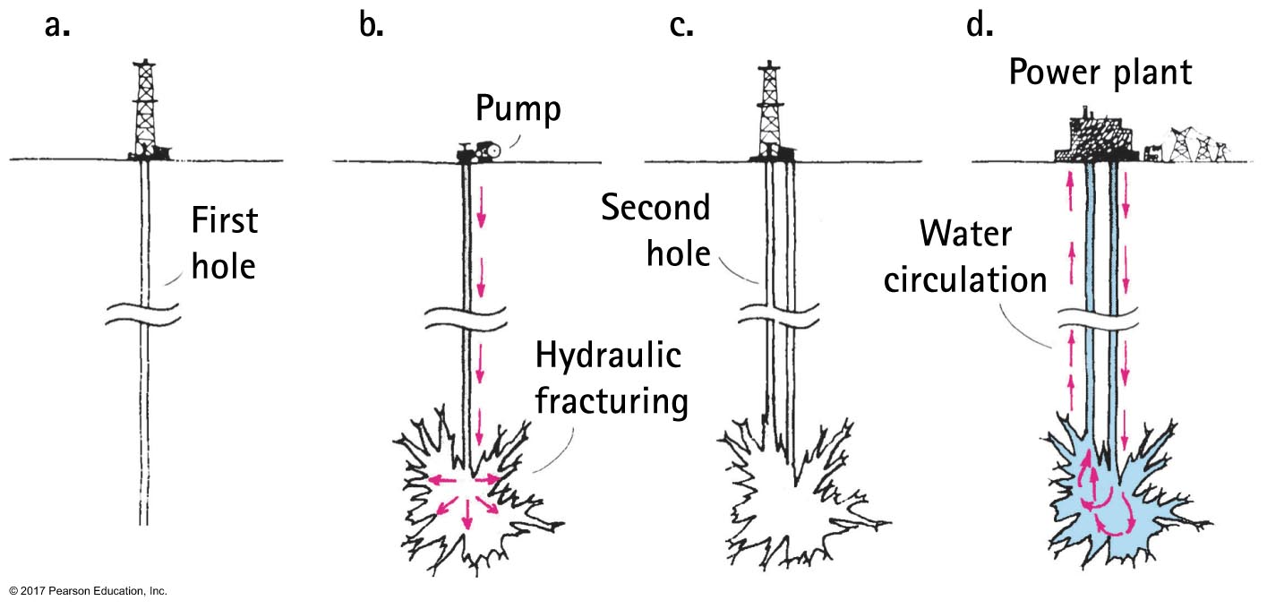
Sources of Energy
Dry-rock geothermal power is a producer of electricity
Water put into cavities in deep, dry, hot rock turns to steam and powers a turbine at the surface. After exiting the turbine, it returns to the cavity for reuse.

Slide 78
Solar Power
The power available in sunlight is about 1kW per square meter.
Examples:
Photovoltaic panels
Hydroelectric turbines
Wind turbines
Bio-based fuels

Slide 79
Energy Storage and Transfer
Electricity
Synthetic fuels
can be created from bio-based products
Hydrogen
not a source, but can be generated from multiple sources and is a good fuel for fuel-cells or internal combustion engines)

Slide 80
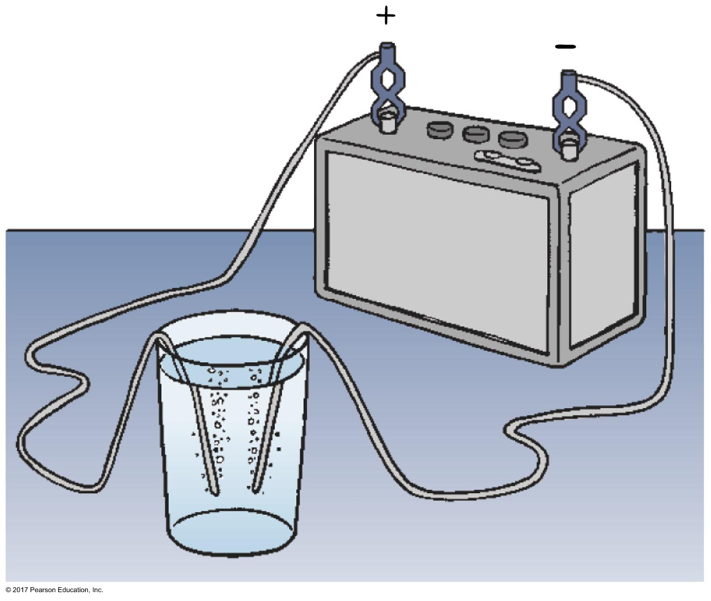
Hydrogen Creation
When electric current passes through conducting water, bubbles of hydrogen form at one wire and oxygen at the other wire.
This is called electrolysis.

Slide 81
Hydrogen Fuel
Energy in sunlight is converted to electric energy in photovoltaic solar cells.

