Slide 1
Chapter 7 THE UNIT CIRCLE: SINE AND COSINE FUNCTIONS
Section 7.1 - angles

Slide 2
Section 7.1 Learning Objectives
In this section students will:
Draw angles in standard position.
Convert between degrees and radians.
Find coterminal angles.
Find the length of a circular arc.
Use linear and angular speed to describe motion on a circular path.

Slide 3
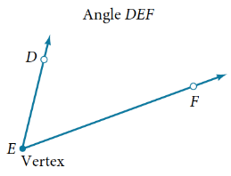
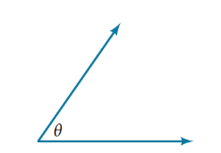
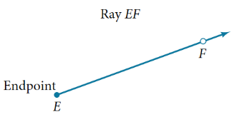
Angle definition
Properly defining an angle first requires that we define a ray. A ray consists of one point on a line and all points extending in one direction from that point. The first point is called the endpoint of the ray. We can refer to a specific ray by stating its endpoint and any other point on it.
An angle is the union of two rays having a common endpoint. The endpoint is called the vertex of the angle, and the two rays are the sides of the angle. Angles can be named using a point on each ray and the vertex, such as angle DEF, or in symbol form ∠DEF.
Greek letters are often used as variables for the measure of an angle. Angle theta, shown as $∠ θ$ below.

Slide 4
Drawing angles
Angle creation is a dynamic process.
We start with two rays lying on top of one another. We leave one fixed in place, and rotate the other. The fixed ray is the initial side, and the rotated ray is the terminal side.
In order to identify the different sides, we indicate the rotation with a small arc and arrow close to the vertex.
The measure of an angle is the amount of rotation from the initial side to the terminal side. Probably the most familiar unit of angle measurement is the degree.
One degree is 1/360 of a circular rotation, so a complete circular rotation contains 360 degrees. An angle measured in degrees should always include the unit “degrees” after the number, or include the degree symbol °.

Slide 5
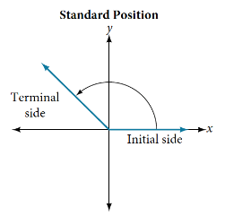
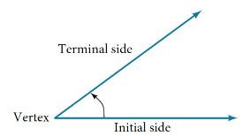
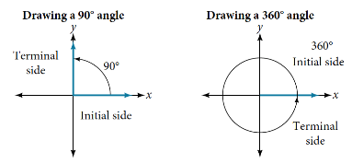
Drawing Angles in Standard Position
An angle is in standard position if its vertex is located at the origin, and its initial side extends along the positive x-axis.
If the angle is measured in a counterclockwise direction from the initial side to the terminal side, the angle is said to be a positive angle.
If the angle is measured in a clockwise direction, the angle is said to be a negative angle.

Slide 6
Quadrantal angles
QUADRANTAL ANGLES
An angle is a quadrantal angle if its terminal side lies on an axis, including 0°, 90°, 180°, 270°, or 360°.

Slide 7
Drawing Angles in Standard Position example
How To:
Given an angle measure in degrees, draw the angle in standard position.
Express the angle measure as a fraction of 360°.
Reduce the fraction to simplest form.
Draw an angle that contains that same fraction of the circle, beginning on the positive x-axis and moving counterclockwise for positive angles and clockwise for negative angles.
Example: Drawing an Angle in Standard Position Measured in Degrees
Sketch an angle of −120° in standard position.

Slide 8
Drawing Angles in Standard Position try it
Try It: Show an angle of 240° on a circle in standard position.

Slide 9
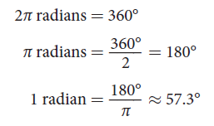
Converting Between Degrees and Radians
One radian is the measure of a central angle of a circle that intercepts an arc equal in length to the radius of that circle.
A central angle is an angle formed at the center of a circle by two radii. Because the total circumference equals 2π times the radius, a full circular rotation is 2π radians.
Note that when an angle is described without a
specific unit, it refers to radian measure.
For example, an angle measure of 3 indicates
3 radians.

Slide 10
Relating Arc Lengths to Radius
An arc length s is the length of the curve along the arc. Just as the full circumference of a circle always has a constant ratio to the radius, the arc length produced by any given angle also has a constant relation to the radius, regardless of the length of the radius. This ratio, called the radian measure, is the same regardless of the radius of the circle—it depends only on the angle. This property allows us to define a measure of any angle as the ratio of the arc length s to the radius r.

Slide 11
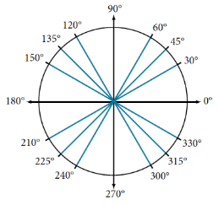
Special angles
Considering the most basic case, the unit circle (a circle with radius 1), we know that 1 rotation equals 360 degrees, 360°.
In addition to knowing the measurements in degrees and radians of a quarter revolution, a half revolution, and a full revolution, there are other frequently encountered angles in one revolution of a circle with which we should be familiar.
It is common to encounter multiples of 30, 45, 60, and 90 degrees. Memorizing these angles will be very useful as we study the properties associated with angles.

Slide 12
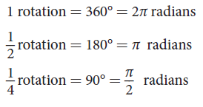
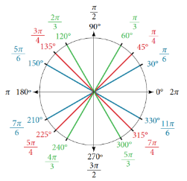
identifying special angles measured in radians
In addition to the degree measures of the common angles, you should understand the radian measure of these angles.
Memorizing these angles will be very useful as we study the properties associated with angles.
There are tricks to memorizing these if you focus on quadrant I and move around the unit circle.

Slide 13
Using radians
Example Finding a Radian Measure
Find the radian measure of one-third of a full rotation.
Try It: Find the radian measure of three-fourths of a full rotation.

Slide 14
converting between radians and degrees
Because degrees and radians both measure angles, we need to be able to convert between them. We can easily do so using a proportion where θ is the measure of the angle in degrees and θ_{R} is the measure of the angle in radians.
This proportion shows that the measure of angle θ in degrees divided by 180 equals the measure of angle θ in radians divided by π. Or, phrased another way, degrees is to 180 as radians is to π.

Slide 15
converting between radians and degrees example and try it
Example Converting Radians to Degrees
Convert $\frac{5π}{6}$ radians to degrees.
Try It: Convert − $\frac{3π}{4}$ radians to degrees.

Slide 16
converting between degrees and radians example and try it
Example Converting Degrees to Radians
Convert 330° to radians.
Try It: Convert 126° to radians.

Slide 17
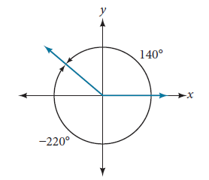
finding coterminal angles
Negative angles and angles greater than a full revolution are more awkward to work with than those in the range of 0° to 360°, or 0 to 2π. It would be convenient to replace those out-of-range angles with a corresponding angle within the range of a single revolution. It is possible for more than one angle to have the same terminal side.
If two angles in standard position have the same terminal side, they are coterminal angles.
Every angle greater than 360° or less than 0° is coterminal with an angle between 0° and 360°, and it is often more convenient to find the coterminal angle within the range of 0° to 360° than to work with an angle that is outside that range.
Any angle has infinitely many coterminal angles because each time we add 360° to that angle - or subtract 360° from it - the resulting value has a terminal side in the same location.

Slide 18
finding coterminal angles example
How To:
Given an angle greater than360°,find a coterminal angle between 0° and 360°
Subtract 360° from the given angle.
If the result is still greater than 360°, subtract 360° again till the result is between 0° and 360°.
The resulting angle is coterminal with the original angle.
Example Finding an Angle Coterminal with an Angle of Measure Greater Than 360°
Find the least positive angle θ that is coterminal with an angle measuring 420°, where 0° ≤ θ < 360°.

Slide 19
finding coterminal angles example 2
How To:
Given an angle with measure less than 0, find a coterminal angle having a measure between 0° and 360°.
Add 360° to the given angle.
If the result is still less than0°, add 360° again until the result is between 0° and 360°.
The resulting angle is coterminal with the original angle.
Example Finding an Angle Coterminal with an Angle Measuring Less Than 0°
Show the angle with measure −450° on a circle and find a positive coterminal angle α such that 0° ≤ α < 360°.

Slide 20
finding coterminal angles example 3
Given an angle greater than 2π, find a coterminal angle between 0 and 2π.
Subtract 2π from the given angle.
If the result is still greater than 2π, subtract 2π again until the result is between 0 and 2π.
The resulting angle is coterminal with the original angle.
Example Finding Coterminal Angles Using Radians
Find an angle β that is coterminal with $\frac{19π}{4}$, where 0 ≤ β < 2π.

Slide 21
finding coterminal angles try its
Try It: Find an angle α that is coterminal with an angle measuring 870°, where 0° ≤ α < 360°.
Try It: Find an angle β that is coterminal with an angle measuring −300° such that 0° ≤ β < 360°.
Try It: Find an angle of measure θ that is coterminal with an angle of measure $−\frac{17}{6}π$ where 0 ≤ θ < 2π.

Slide 22
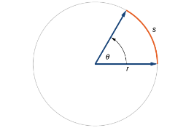
Determining the length of an arc
ARC LENGTH ON A CIRCLE
In a circle of radius r, the length of an arc s subtended by an angle with measure θ in radians, shown in Figure, is
s=r θ
How To:
Given a circle of radius r, calculate the length s of the arc subtended by a given angle of measure θ.
If necessary, convert θ to radians.
Multiply the radius r θ : s = r θ.

Slide 23
Determining the length of an arc try it
Try It: Find the arc length along a circle of radius 10 units subtended by an angle of 215°.

Slide 24
Determining the length of an arc example
Example Finding the Length of an Arc
Find the distance along an arc on the surface of Earth that subtends a central angle of 5°. The radius of Earth is 3,960 mi.

Slide 25
Determining the length of an arc example 2
Example Finding the Length of an Arc
Assume the orbit of Mercury around the sun is a perfect circle. Mercury is approximately 36 million miles from the sun.
a. In one Earth day, Mercury completes 0.0114 of its total revolution. How many miles does it travel in one day?
b. Use your answer from part (a) to determine the radian measure for Mercury’s movement in one Earth day.

Slide 26
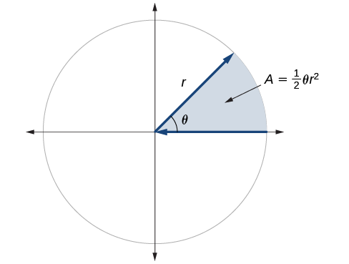
Finding the area of a sector of a circle
AREA OF A SECTOR
The area of a sector of a circle with radius r subtended by an angle θ, measured in radians, is
A = ½ θr²
See Figure.
The area of the sector equals half the square of the radius times the central angle measured in radians.
How To:
Given a circle of radius r, find the area of a sector defined by a given angle θ.
If necessary, convert θ to radians.
Multiply half the radian measure of θ by the square of the radius r :
A= ½ θ r².

Slide 27
Finding the area of a sector of a circle example
Example Finding the Area of a Sector
A sector of a circle with diameter 10 feet and an angle of 90°. Find the area of the sector.

Slide 28
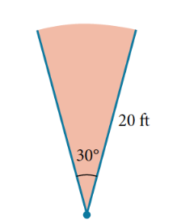
Finding the area of a sector of a circle example 2
Example Finding the Area of a Sector
An automatic lawn sprinkler sprays a distance of 20 feet while rotating 30 degrees, as shown in Figure 23. What is the area of the sector of grass the sprinkler waters?

Slide 29
Finding the area of a sector of a circle try it
Try It: In central pivot irrigation, a large irrigation pipe on wheels rotates around a center point. A farmer has a central pivot system with a radius of 400 meters. If water restrictions only allow her to water 150 thousand square meters a day, what angle should she set the system to cover? Write the answer in radian measure to two decimal places.

Slide 30
linear and angular speed
ANGULAR AND LINEAR SPEED
As a point moves along a circle of radius r, its angular speed ,ω, is the angular rotation θ per unit time, t.
$$ω=\frac{θ}{t}$$
The linear speed, v, of the point can be found as the distance traveled, arc length s, per unit time, t.
v = $\frac{s}{t}$
When the angular speed is measured in radians per unit time, linear speed and angular speed are related by the equation
v = r ω
This equation states that the angular speed in radians, ω, representing the amount of rotation occurring in a unit of time, can be multiplied by the radius r r to calculate the total arc length traveled in a unit of time, which is the definition of linear speed.

Slide 31
Use linear and angular speed to describe motion on a circular path
Given the amount of angle rotation and the time elapsed, calculate the angular speed.
If necessary, convert the angle measure to radians.
Divide the angle in radians by the number of time units elapsed: $ω=\frac{θ}{t}$
The resulting speed will be in radians per time unit.

Slide 32
Use linear and angular speed to describe motion on a circular path example
Example Finding Angular Speed
A water wheel, shown in Figure 24, completes 1 rotation every 5 seconds. Find the angular speed in radians per second.

Slide 33
Use linear and angular speed to describe motion on a circular path try it
Try It: An old vinyl record is played on a turntable rotating clockwise at a rate of 45 rotations per minute. Find the angular speed in radians per second.

Slide 34
Use linear and angular speed to describe motion on a circular path (2)
How To:
Given the radius of a circle, an angle of rotation, and a length of elapsed time, determine the linear speed.
Convert the total rotation to radians if necessary.
Divide the total rotation in radians by the elapsed time to find the angular speed: apply $ω=\frac{θ}{t}$
Multiply the angular speed by the length of the radius to find the linear speed, expressed in terms of the length unit used for the radius and the time unit used for the elapsed time: apply v = rω.

Slide 35
Use linear and angular speed to describe motion on a circular path example 2
Example Finding a Linear Speed
A bicycle has wheels 28 inches in diameter. A tachometer determines the wheels are rotating at 180 RPM (revolutions per minute). Find the speed the bicycle is traveling down the road.

Slide 36
Use linear and angular speed to describe motion on a circular path try it 2
Try It: A satellite is rotating around Earth at 0.25 radian per hour at an altitude of 242 km above Earth. If the radius of Earth is 6378 kilometers, find the linear speed of the satellite in kilometers per hour.

Slide 37
Chapter 7 THE UNIT CIRCLE: SINE AND COSINE FUNCTIONS
Section 7.2 – right triangle trigonometry

Slide 38
Section 7.2 Learning Objectives
In this section students will:
Use right triangles to evaluate trigonometric functions.
Find function values for 30° (π/6), 45° (π/4), and 60° (π/3).
Use equal cofunctions of complementary angles.
Use the deﬁnitions of trigonometric functions of any angle.
Use right-triangle trigonometry to solve applied problems.

Slide 39
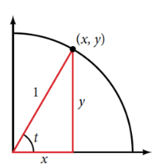
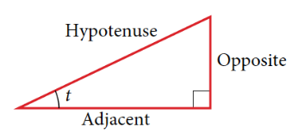
Right triangles
Below shows a right triangle with a vertical side of length y and a horizontal side has length x. Notice that the triangle is inscribed in a circle of radius 1. Such a circle, with a center at the origin and a radius of 1, is known as a unit circle.
We can define the trigonometric functions in terms an angle t and the lengths of the sides of the triangle.
The adjacent side is the side closest to the angle, x. (Adjacent means “next to.”)
The opposite side is the side across from the angle, y.
The hypotenuse is the side of the triangle opposite the right angle, 1.

Slide 40
Using Right Triangles to Evaluate Trigonometric Functions
Given a right triangle with an acute angle of t, the first three trigonometric functions are listed.
A common mnemonic for remembering these relationships is SohCahToa, formed from the first letters of “Sine is opposite over hypotenuse, Cosine is adjacent over hypotenuse, Tangent is opposite over adjacent.”
Sine sin t = $\frac{\text{opposite}}{\text{hypotenuse}}$ Cosine cos t = $\frac{\text{adjacent}}{\text{hypotenuse}}$ Tangent tan t = $\frac{\text{opposit}\text{e}}{\text{adjacent}}$
An alternate definition using a right triangle with a vertical side of length y and a horizontal side has length x inscribed in a circle of radius 1:
$\sin{t= \frac{y}{1}}$ $\cos{t= \frac{x}{1}}$ $\tan{t= \frac{y}{x}}$

Slide 41
Using Right Triangles to Evaluate Trigonometric Functions (2)
How To:
Given the side lengths of a right triangle and one of the acute angles, find the sine, cosine, and tangent of that angle.
Find the sine as the ratio of the opposite side to the hypotenuse.
Find the cosine as the ratio of the adjacent side to the hypotenuse.
Find the tangent as the ratio of the opposite side to the adjacent side.

Slide 42
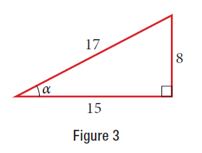
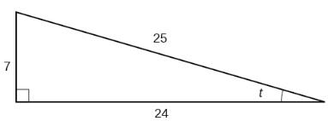
Using Right Triangles to Evaluate Trigonometric Functions example
Example Evaluating a Trigonometric Function of a Right Triangle
Given the triangle shown in Figure 3, find the value of tan α.
Try It: Given the triangle shown in below, find the value of sin t.

Slide 43
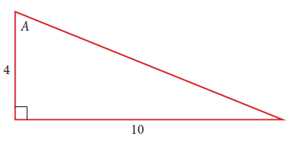
Using Right Triangles to Evaluate Trigonometric Functions example 2
Example Evaluating a Trigonometric Function of a Right Triangle
Given the triangle shown below, find the value of cos A.

Slide 44
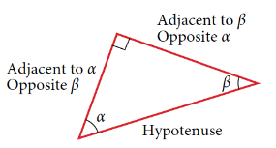
Reciprocal functions
In addition to sine, cosine, and tangent, there are three more functions. These too are defined in terms of the sides of the triangle. These functions are the reciprocals of the first three functions.
When working with right triangles, keep in mind that the same rules apply regardless of the orientation of the triangle. The side opposite one acute angle is the side adjacent to the other acute angle, and vice versa.
Secant sec t = $\frac{\text{hypotenuse}}{\text{adjacent}}$ Cosecant csc t = $\frac{\text{hypotenuse}}{\text{opposite}}$ Cotangent cot t = $\frac{\text{adjacent}}{\text{opposite}}$
$\sin{t= \frac{1}{\csc{t}}}$ $\csc{t= \frac{1}{\sin{t}}}$
$\cos{t= \frac{1}{\sec{t}}}$ $\sec{t= \frac{1}{\cos{t}}}$
$\tan{t= \frac{1}{\cot{t}}}$ $\cot{t= \frac{1}{\tan{t}}}$

Slide 45
Reciprocal functions (2)
How To:
Given the side lengths of a right triangle, evaluate the six trigonometric functions of one of the acute angles.
If needed, draw the right triangle and label the angle provided.
Identify the angle, the adjacent side, the side opposite the angle, and the hypotenuse of the right triangle.
Find the required function:
sine as the ratio of the opposite side to the hypotenuse
cosine as the ratio of the adjacent side to the hypotenuse
tangent as the ratio of the opposite side to the adjacent side
secant as the ratio of the hypotenuse to the adjacent side
cosecant as the ratio of the hypotenuse to the opposite side
cotangent as the ratio of the adjacent side to the opposite side

Slide 46
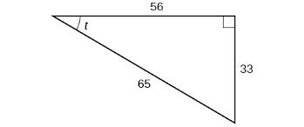
Reciprocal functions try it
Try It:
Using the triangle shown in Figure, evaluate sin t, cos t, tan t, sec t, csc t, and cot t.

Slide 47
Using Right Triangles to Evaluate Trigonometric Functions example 3
Example Evaluating a Trigonometric Function of a Right Triangle
Using the triangle shown below, find sin A, cos A, tan A, sec A, csc A, and cot A.

Slide 48
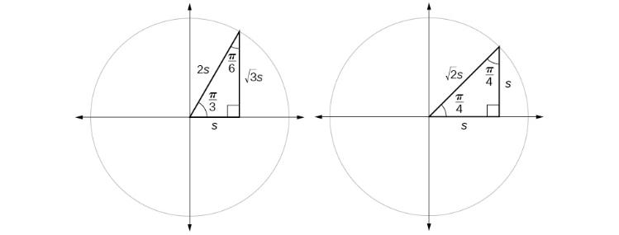
Finding Trigonometric Functions of Special Angles Using Side Lengths
Suppose we have a 30°, 60°, 90° triangle, which can also be described as a π/6, π/3, π/2 triangle. The sides have lengths in the relation 1s, √3s, 2s.
The sides of a 45°, 45°, 90° triangle, which can also be described as a π/4, π/4, π/2 triangle, have lengths in the relation 1s, 1s, √2s.
We can then use the ratios of the side lengths to evaluate trigonometric functions of special angles.
Memorize these relationships. Hint: It will be important later on when s = 1.

Slide 49
Finding Trigonometric Functions of Special Angles Using Side Lengths example
How To:
Given trigonometric functions of a special angle, evaluate using side lengths.
Use the side lengths shown in Figure for the special angle you wish to evaluate.
Use the ratio of side lengths appropriate to the function you wish to evaluate.
Example Evaluating Trigonometric Functions of Special Angles Using Side Lengths
Find the exact value of the trigonometric functions of $\frac{π}{3}$, using side lengths.

Slide 50
Finding Trigonometric Functions of Special Angles Using Side Lengths try it
Try It:
Find the exact value of the trigonometric functions of $\frac{π}{4}$, using side lengths.

Slide 51
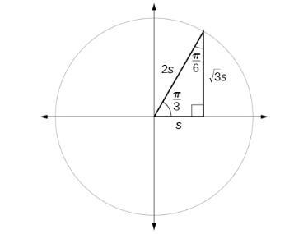
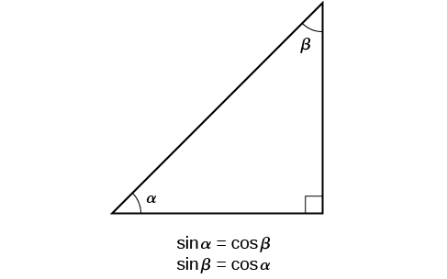
Cofunction identity
A right triangle can be formed with any two other angles that add to 90 degrees, or π/2.
In other words, any two complementary angles.
So we may state a cofunction identity: If any two angles are complementary, the sine of one is the cosine of the other, and vice versa.
For example, the sine of π/3 equals the cosine of π/6 and vice versa.

Slide 52
Using Equal Cofunction of Complements
COFUNCTION IDENTITIES
Cofunction Identities in radians:
cos t = sin($\frac{π}{2}$ − t) | sin t = cos($\frac{π}{2}$ − t)
tan t = cot($\frac{π}{2}$ − t) | cot t = tan($\frac{π}{2}$ − t)
sec t = csc($\frac{π}{2}$ − t) | csc t = sec($\frac{π}{2}$ − t)
How To:
Given the sine and cosine of an angle, find the sine or cosine of its complement.
To find the sine of the complementary angle, find the cosine of the original angle.
To find the cosine of the complementary angle, find the sine of the original angle.

Slide 53
Using Equal Cofunction of Complements example and try it
Example Using Cofunction Identities
If sin t = 5/12, find cos(π/2 − t)
Try It: If csc ($\frac{π}{6}$) = 2, find sec($\frac{π}{3}$).

Slide 54
Using Trigonometric Functions
How To:
Given a right triangle, the length of one side, and the measure of one acute angle, find the remaining sides.
For each side, select the trigonometric function that has the unknown side as either the numerator or the denominator. The known side will in turn be the denominator or the numerator.
Write an equation setting the function value of the known angle equal to the ratio of the corresponding sides.
Using the value of the trigonometric function and the known side length, solve for the missing side length.
Be aware: To find the cosine and sine of angles other than the special angles, we turn to a computer or calculator.
Most calculators can be set into “degree” or “radian” mode, which tells the calculator the units for the input value.
Given an angle in radians, use a graphing calculator to find the cosine.
If the calculator has degree mode and radian mode, set it to radian mode.
Press the COS key.
Enter the radian value of the angle and press the close-parentheses key ")".
Press ENTER.

Slide 55
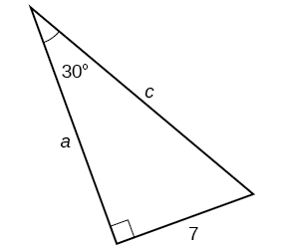
Using Trigonometric Functions example
Example Finding Missing Side Lengths Using Trigonometric Ratios
Find the unknown sides of the triangle in Figure 11.

Slide 56
Using Trigonometric Functions try it
Try It: A right triangle has one angle of $\frac{π}{3}$ and a hypotenuse of 20. Find the unknown sides and angle of the triangle.

Slide 57
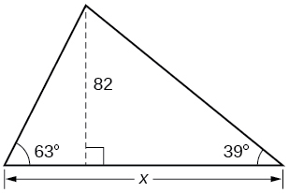
Using Trigonometric Functions example 2
Example Finding Missing Side Lengths Using Trigonometric Ratios
Find x.

Slide 58
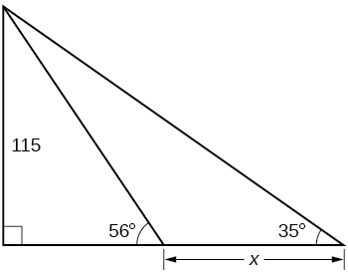
Using Trigonometric Functions example 3
Example Finding Missing Side Lengths Using Trigonometric Ratios
Find x.

Slide 59
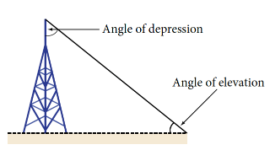
Using Right Triangle Trigonometry to Solve Applied Problems
The angle of elevation of an object above an observer relative to the observer is the angle between the horizontal and the line from the object to the observer's eye.
The right triangle this position creates has sides that represent the unknown height, the measured distance from the base, and the angled line of sight from the ground to the top of the object. Knowing the measured distance to the base of the object and the angle of the line of sight, we can use trigonometric functions to calculate the unknown height.
Similarly, we can form a triangle from the top of a tall object by looking downward. The angle of depression of an object below an observer relative to the observer is the angle between the horizontal and the line from the object to the observer's eye.

Slide 60
Using Right Triangle Trigonometry to Solve Applied Problems (2)
How To:
Given a tall object, measure its height indirectly.
Make a sketch of the problem situation to keep track of known and unknown information.
Lay out a measured distance from the base of the object to a point where the top of the object is clearly visible.
At the other end of the measured distance, look up to the top of the object. Measure the angle the line of sight makes with the horizontal.
Write an equation relating the unknown height, the measured distance, and the tangent of the angle of the line of sight.
Solve the equation for the unknown height.

Slide 61
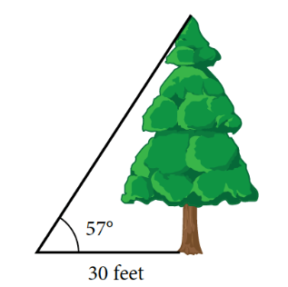
Using Right Triangle Trigonometry to Solve Applied Problems example
Example Measuring a Height Indirectly
To find the height of a tree, a person walks to a point 30 feet from the base of the tree. She measures an angle of 57° between a line of sight to the top of the tree and the ground, as shown in Figure 13. Find the height of the tree.

Slide 62
Using Right Triangle Trigonometry to Solve Applied Problems try it
Try It: How long a ladder is needed to reach a windowsill 50 feet above the ground if the ladder rests against the building making an angle of $\frac{5π}{12}$ with the ground? Round to the nearest foot.

Slide 63
Using Right Triangle Trigonometry to Solve Applied Problems example 2
Example Measuring a Distance Indirectly
A 400-foot tall monument is located in the distance. From a window in a building, a person determines that the angle of elevation to the top of the monument is 18°, and that the angle of depression to the bottom of the tower is 3°. How far is the person from the monument?

Slide 64
Chapter 7 THE UNIT CIRCLE: SINE AND COSINE FUNCTIONS
Section 7.3 – unit circle

Slide 65
Section 7.3 Learning Objectives
In this section students will:
Find function values for the sine and cosine of 30° or (π/6), 45° or (π/4), and 60° or (π/3).
Identify the domain and range of sine and cosine functions.
Find reference angles.
Use reference angles to evaluate trigonometric functions.

Slide 66
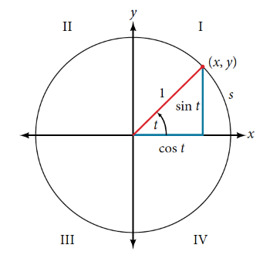
Finding Trigonometric Functions Using the Unit Circle
Recall that a unit circle is a circle centered at the origin with radius 1. The x- and y-axes divide the coordinate plane into four quarters called quadrants.
For any angle t, we can label the intersection of the terminal side and the unit circle as by its coordinates, (x, y).
The coordinates x and y will be the outputs of the trigonometric functions f (t) = cos t and f (t) = sin t, respectively. This means x = cos t and y = sin t.
UNIT CIRCLE
A unit circle has a center at (0,0) and radius 1. In a unit circle, the length of the intercepted arc is equal to the radian measure of the central angle t.
Let (x , y) be the endpoint on the unit circle of an arc of arc length s. The (x , y) coordinates of this point can be described as functions of the angle.

Slide 67
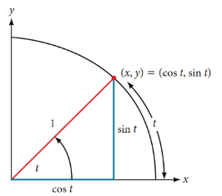
Defining sine and cosine functions from the unit circle
Like all functions, the sine function has an input and an output; its input is the measure of the angle; its output is the y-coordinate of the corresponding point on the unit circle.
The cosine function of an angle t equals the x-value of the endpoint on the unit circle of an arc of length t.
SINE AND COSINE FUNCTIONS
If t is a real number and a point (x,y) on the unit circle corresponds to a central angle t, then
cos t = x
sin t = y

Slide 68
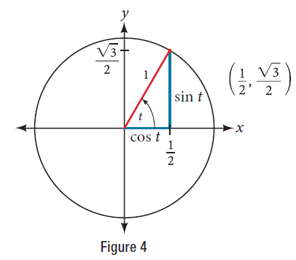
Defining sine and cosine functions from the unit circle example
How To:
Given a point P (x,y) on the unit circle corresponding to an angle of t, find the sine and cosine.
The sine of t is equal to the y-coordinate of point P: sin t = y.
The cosine of t is equal to the x-coordinate of point P: cos t = x.
Example Finding Function Values for Sine and Cosine
Point P is a point on the unit circle corresponding to an angle of t, as shown in Figure 4. Find cos(t) and sin(t).

Slide 69
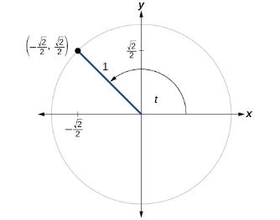
Defining sine and cosine functions from the unit circle try it
Try It: A certain angle t corresponds to a point on the unit circle at ($−\frac{2\sqrt{2}}{2},\frac{2\sqrt{2}}{2}$) as shown in Figure. Find cos t and sin t.

Slide 70
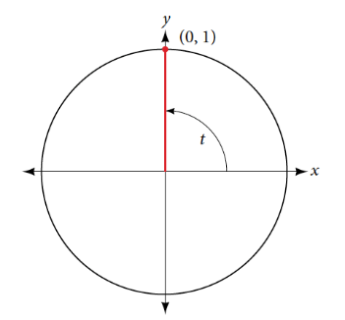
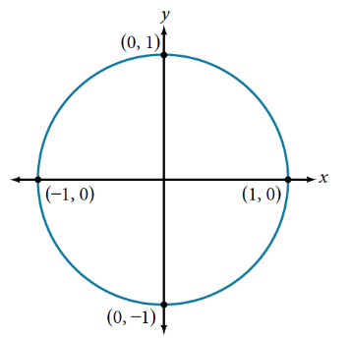
Finding Sine and Cosine of Angles on an Axis
For quadrantral angles, the corresponding point on the unit circle falls on the x- or y-axis. In that case, we can easily calculate cosine and sine from the values of x and y.

Slide 71
Finding Sine and Cosine of Angles on an Axis example and try it
Example Calculating Sines and Cosines along an Axis
Find cos(90°) and sin(90°).
Try It: Find cosine and sine of the angle π.

Slide 72
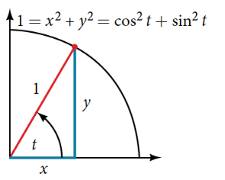
The Pythagorean Identity
PYTHAGOREAN IDENTITY
The Pythagorean Identity states that, for any real number t,
cos² t + sin² t = 1

Slide 73
The Pythagorean Identity example
How To:
Given the sine of some angle t and its quadrant location, find the cosine of t.
Substitute the known value of sin t into the Pythagorean Identity.
Solve for cos t.
Choose the solution with the appropriate sign for the x-values in the quadrant where t is located
Example Finding a Cosine from a Sine or a Sine from a Cosine
If sin(t) = 3/7 and t is in the second quadrant, find cos(t).

Slide 74
The Pythagorean Identity try it
Try It: If cos(t) = $\frac{24}{25}$ and t is in the fourth quadrant, find sin(t).

Slide 75
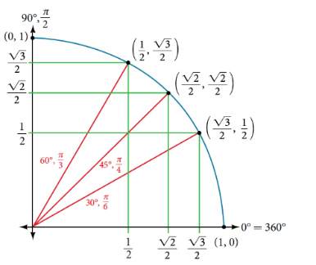
Finding Sine and Cosines of special angles
The image shows the ordered pairs of the cosine and sine values for all of the most commonly encountered angles in the first quadrant of the unit circle.
Table 1 summarizes these values.
Angle | 0 | $\frac{π}{6}$, or 30° | $\frac{π}{4}$, or 45° | $\frac{π}{3}$, or 60° | $\frac{π}{2}$, or 90°
Cosine | 1 | √3/2 | √2/2 | 1/2 | 0
Sine | 0 | 1/2 | √2/2 | √3/2 | 1

Slide 76
Finding Sine and Cosine of special angles examples
Note: Sine and cosine of the quadrantal and special angles will require an exact answer.
Using your calculator for these angles is not the proper approach.
Use the side length relationship with s = 1.
Example Evaluate with Sine and Cosine of Special Angles
Evaluate cos(45°).
Example Evaluate with Sine and Cosine of Special Angles
Evaluate sin(π/6).

Slide 77
Finding Sine and Cosine of special angles example and try it
Example Evaluate with Sine and Cosine of Special Angles
Evaluate cos(60°).
Try It: Evaluate sin($\frac{π}{3}$)

Slide 78
Finding Sine and Cosine of special angles
Example Evaluate with Sine and Cosine of Special Angles
Evaluate cos(π/4)sin(π/6).

Slide 79
Using a Calculator to Find Sine and Cosine
Most calculators can be set into “degree” or “radian” mode, which tells the calculator the units for the input value.
How To:
Given an angle in radians, use a graphing calculator to find the cosine.
If the calculator has degree mode and radian mode, set it to radian mode.
Press the COS key.
Enter the radian value of the angle and press the close-parentheses key ")".
Press ENTER.
Be aware: We only use a calculator to find the cosine and sine of angles other than quadrantal and the special angles.

Slide 80
Using a Calculator to Find Sine and Cosine examples
Example Using a Graphing Calculator to Find Sine and Cosine
Evaluate cos(7π/5).
Example Using a Graphing Calculator to Find Sine and Cosine
Evaluate sin(114°).
Example Using a Graphing Calculator to Find Sine and Cosine
Evaluate sin(π/5).

Slide 81
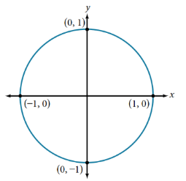
Identifying the Domain of Sine and Cosine Functions
What are the domains of the sine and cosine functions? That is, what are the smallest and largest numbers that can be inputs of the functions?
Because angles smaller than 0 and angles larger than 2π can still be graphed on the unit circle and have real values of x, y, and r, there is no lower or upper limit to the angles that can be inputs to the sine and cosine functions.
The input to the sine and cosine functions is the rotation from the positive x-axis, and that may be any real number.

Slide 82
Identifying the Range of Sine and Cosine Functions
What are the ranges of the sine and cosine functions? What are the least and greatest possible values for their output?
We can see the answers by examining the unit circle, as shown below. The bounds of the x-coordinate are [−1, 1]. The bounds of the y-coordinate are also [−1, 1]. Therefore, the range of both the sine and cosine functions is [−1, 1].

Slide 83
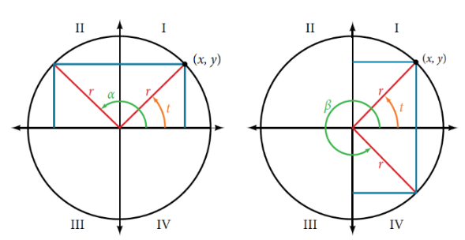
Finding Reference Angles
We have discussed finding the sine and cosine for angles in the first quadrant, but what if our angle is in another quadrant? As shown in the figure below, angle α has the same sine value as angle t, because of the unit circle; while the cosine values are opposites. Angle β has the same cosine value as angle t; the sine values are opposites.
sin(t) = sin(α) and cos(t) = − cos(α)
sin(t) = − sin(β) and cos(t) = cos(β)

Slide 84
Finding Reference Angles (2)
An angle’s reference angle is the measure of the smallest, positive, acute angle t’ formed by the terminal side of the angle t and the horizontal axis.
Thus positive reference angles have terminal sides that lie in the first quadrant and can be used as models for angles in other quadrants.

Slide 85
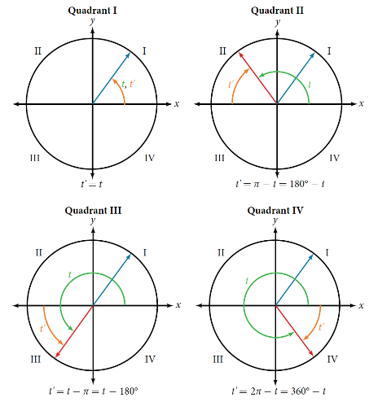
Finding Reference Angles (3)
A reference angle is always an angle between 0 and 90°, or 0 and π/2 radians.
As we can see from the image, for any angle in quadrants II, III, or IV, there is a reference angle in quadrant I.

Slide 86
Finding Reference Angles example
How To:
Given an angle between 0 and 2π, find its reference angle.
An angle in the first quadrant is its own reference angle.
For an angle in the second or third quadrant, the reference angle is|π−t| or |180°−t|.
For an angle in the fourth quadrant, the reference angle is 2π−t or 360°−t.
If an angle is less than 0 or greater than 2π, add or subtract 2π as many times as needed to find an equivalent angle between 0 and 2π.
Example Finding a Reference Angle
Find the reference angle of 120°.

Slide 87
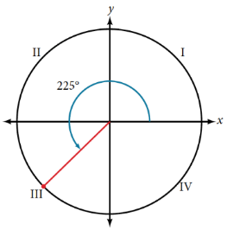
Finding Reference Angles try it
Example Finding a Reference Angle
Find the reference angle of 225° as shown in Figure 18.
Try It: Find the reference angle of $\frac{\text{5}\text{π}}{\text{3}}$.

Slide 88
Using Reference Angles to Evaluate Trigonometric Functions
We can find the cosine and sine of any angle in any quadrant if we know the cosine or sine of its reference angle.
The cosine will be positive or negative depending on the sign of the x-values in that quadrant. The sine will be positive or negative depending on the sign of the y-values in that quadrant.
USING REFERENCE ANGLES TO FIND COSINE AND SINE
Angles have cosines and sines with the same absolute value as their reference angles. The sign (positive or negative) can be determined from the quadrant of the angle.

Slide 89
Using Reference Angles to Evaluate Trigonometric Functions example
How To:
Given an angle in standard position, find the reference angle, and the cosine and sine of the original angle.
Measure the angle between the terminal side of the given angle and the horizontal axis. That is the reference angle.
Determine the values of the cosine and sine of the reference angle.
Give the cosine the same sign as the x-values in the quadrant of the original angle.
Give the sine the same sign as the y-values in the quadrant of the original angle.
Example Using Reference Angles to Find Sine and Cosine
Using a reference angle, find the exact value of cos(150°) and sin(150°).

Slide 90
Using Reference Angles to Evaluate Trigonometric Functions example 2
Example Using Reference Angles to Find Sine and Cosine
Using the reference angle, find cos 5π/4 and sin 5π/4.

Slide 91
Using Reference Angles to Evaluate Trigonometric Functions try it
Try It:
Use the reference angle of 315° to find cos (315°) and sin(315°).
Use the reference angle of − $\frac{π}{6}$ − to find cos(− $\frac{π}{6}$) and sin(− $\frac{π}{6}$).

Slide 92
Finding Sine and Cosine of special angles (2)
Example Evaluate with Sine and Cosine of Special Angles
Evaluate cos(7π/6)sin(3π/2).

Slide 93
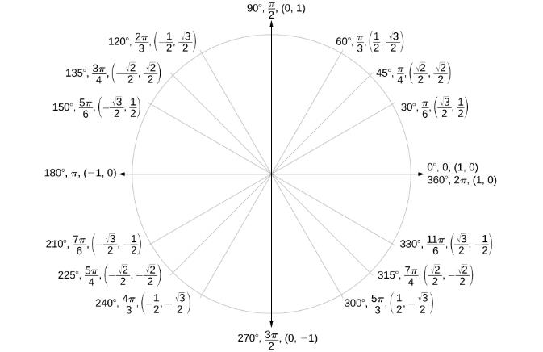
Using Reference Angles to Find Coordinates
Now that we have learned how to find the cosine and sine values for special angles in the first quadrant, we can use symmetry and reference angles to fill in cosine and sine values for the rest of the special angles on the unit circle.

Slide 94
Using Reference Angles to Find Coordinates Example
How To:
Given the angle of a point on a circle and the radius of the circle, find the (x , y) coordinates of the point.
Find the reference angle by measuring the smallest angle to the x-axis.
Find the cosine and sine of the reference angle.
Determine the appropriate signs for x and y in the given quadrant.
Example Using the Unit Circle to Find Coordinates
Find the coordinates of the point on the unit circle at an angle of 7π/6 .

Slide 95
Using Reference Angles to Find Coordinates Try it
Try It: Find the coordinates of the point on the unit circle at an angle of $\frac{\text{5}\text{π}}{\text{3}}$.

Slide 96
Chapter 7 THE UNIT CIRCLE: SINE AND COSINE FUNCTIONS
Section 7.4 – the other trigonometric functions

Slide 97
Section 7.4 Learning Objectives
In this section students will:
Find exact values of the trigonometric functions secant, cosecant, tangent, and cotangent of π/3, π/4, and π/6.
Use reference angles to evaluate the trigonometric functions secant, tangent, and cotangent.
Use properties of even and odd trigonometric functions.
Recognize and use fundamental identities.
Evaluate trigonometric functions with a calculator.

Slide 98
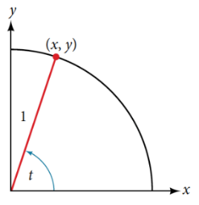
Finding Exact Values of the Trigonometric Functions Secant, Cosecant, Tangent, and Cotangent
TANGENT, SECANT, COSECANT, AND COTANGENT FUNCTIONS
If t is a real number and(x , y) is a point where the terminal side of an angle of t radians intercepts the unit circle, then
tan t = $\frac{y}{x}$, $x≠0$ sec t = $\frac{1}{x}$, $x≠0$
csc t = $\frac{1}{y}, y≠0$ cot t = $\frac{x}{y}$ $, y≠0$

Slide 99
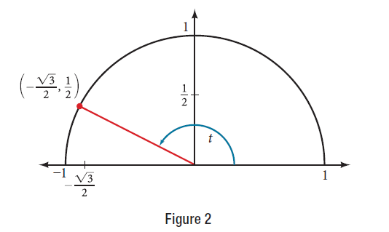
Finding Exact Values of the Trigonometric Functions example
Example Finding Trigonometric Functions from a Point on the Unit Circle
The point on the unit circle, as shown in Figure 2. Find sin t, cos t, tan t, sec t, csc t, and cot t.

Slide 100
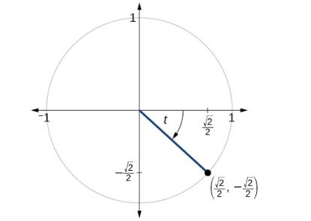
Finding Exact Values of the Trigonometric Functions try it
Try It: The point($\frac{√2}{2},−\frac{√2}{2}$) is on the unit circle, as shown in Figure. Find sin t , cos t, tan t, sec t, csc t, and cot t.

Slide 101
Finding Exact Values of the Trigonometric Functions try it 2
Try It: Find sin t, cos t, tan t, sec t, csc t, and cot t when t = $\frac{π}{3}$.

Slide 102
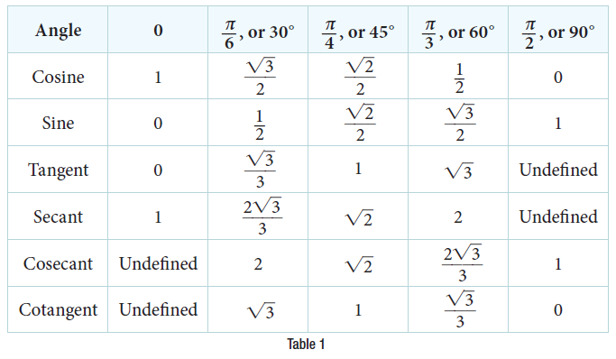
Finding Exact Values of the Trigonometric Functions (2)
Because we know the sine and cosine values for the common first-quadrant angles, we can find the other function values for those angles as well by setting x equal to the cosine and y equal to the sine and then using the definitions of tangent, secant, cosecant, and cotangent. The results are shown in Table 1.

Slide 103
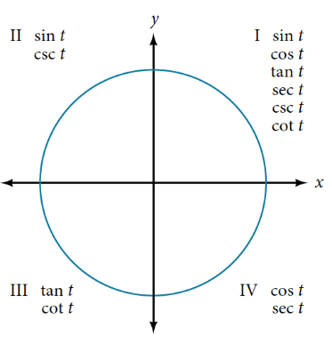
Using Reference Angles to Evaluate Tangent, Secant, Cosecant, and Cotangent
We can evaluate trigonometric functions of angles outside the first quadrant using reference angles as we have already done with the sine and cosine functions.
The procedure is the same: Find the reference angle formed by the terminal side of the given angle with the horizontal axis.
The trigonometric function values for the original angle will be the same as those for the reference angle, except for the positive or negative sign, which is determined by x- and y-values in the original quadrant.
The figure shows which functions are
positive in which quadrant.

Slide 104
Using Reference Angles to Evaluate Tangent, Secant, Cosecant, and Cotangent (2)
To help us remember which of the six trigonometric functions are positive in each quadrant, we can use the mnemonic phrase “A Smart Trig Class.” Each of the four words in the phrase corresponds to one of the four quadrants, starting with quadrant I and rotating counterclockwise.
In quadrant I, which is “A,” all of the six trigonometric functions are positive.
In quadrant II, “Smart,” only sine and its reciprocal function, cosecant, are positive.
In quadrant III, “Trig,” only tangent and its reciprocal function, cotangent, are positive.
Finally, in quadrant IV, “Class,” only cosine and its reciprocal function, secant, are positive.

Slide 105
Using Reference Angles to Evaluate Tangent, Secant, Cosecant, and Cotangent Example
How To:
Given an angle not in the first quadrant, use reference angles to find all six trigonometric functions.
Measure the angle formed by the terminal side of the given angle and the horizontal axis. This is the reference angle.
Evaluate the function at the reference angle.
Observe the quadrant where the terminal side of the original angle is located. Based on the quadrant, determine whether the output is positive or negative.
Example Using Reference Angles to Find Trigonometric Functions
Use reference angles to find all six trigonometric functions of 5π/6 .

Slide 106
Using Reference Angles to Evaluate Tangent, Secant, Cosecant, and Cotangent Try it
Try It: Use reference angles to find all six trigonometric functions of − $\frac{\text{7}\text{π}}{\text{4}}$.

Slide 107
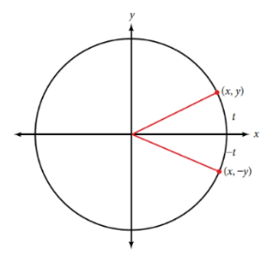
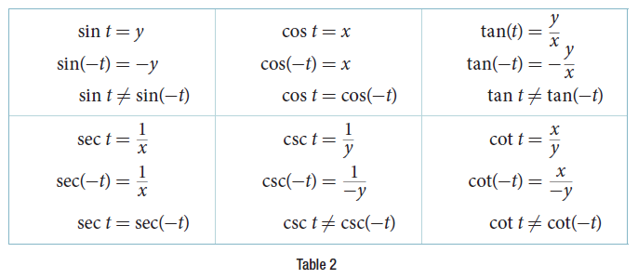
Using Even and Odd Trigonometric Functions
We can test whether a trigonometric function is even or odd by drawing a unit circle with a positive and a negative angle, as in the figure below. We can test each of the six trigonometric functions in this fashion. The results are shown in Table 2.

Slide 108
Using Even and Odd Trigonometric Functions (2)
EVEN AND ODD TRIGONOMETRIC FUNCTIONS
An even function is one in which f(−x) = f(x).
An odd function is one in which f(−x) = −f(x).
Cosine and secant are even:
cos(−t) = cos t
sec(−t) = sec t
Sine, tangent, cosecant, and cotangent are odd:
sin(−t) = −sin t
tan(−t) = −tan t
csc(−t) = −csc t
cot(−t) = −cot t

Slide 109
Using Even and Odd Trigonometric Functions example
Example Using Even and Odd Properties of Trigonometric Functions
If the secant of angle t is 2, what is the secant of −t ?
Try It: If the cotangent of angle t is √3, what is the cotangent of−t?

Slide 110
Recognizing and Using Fundamental Identities
Identities are statements that are true for all values of the input on which they are defined.
Usually, identities can be derived from definitions and relationships we already know.
FUNDAMENTAL IDENTITIES
We can derive some useful identities from the six trigonometric functions. The other four trigonometric functions can be related back to the sine and cosine functions using these basic relationships:
tan t = $\frac{\text{sin} \text{t}}{\text{cos} \text{t}}$
sec t = $\frac{1}{\text{cos} \text{t}}$
csc t = $\frac{1}{\text{sin} \text{t}}$
cot t = $\frac{1}{\text{tan} \text{t}}$ = $\frac{\text{cos} \text{t}}{\text{sin} \text{t}}$

Slide 111
Recognizing and Using Fundamental Identities examples
Example Using Identities to Simplify Trigonometric Expressions
Simplify sec(t)/tan(t).
Try It: Simplify(tan t)(cos t).

Slide 112
Recognizing and Using Fundamental Identities examples 2
Example Using Identities to Evaluate Trigonometric Functions
Given cos (5π/6) = −√3/2, evaluate sec(5π/6).
Example Using Identities to Evaluate Trigonometric Functions
Given sin (45°) = √2/2, cos (45°) = √2/2, evaluate tan(45°).

Slide 113
Alternate Forms of the Pythagorean Identity
We can use these fundamental identities to derive alternative forms of the Pythagorean Identity. One form is obtained by dividing both sides by cos²t. The other form is obtained by dividing both sides by sin²t.
PYTHAGOREAN IDENTITY
The Pythagorean Identity states that, for any real number t,
cos² t + sin² t = 1
ALTERNATE FORMS OF THE PYTHAGOREAN IDENTITY
1 + tan² t = sec² t
cot² t + 1 = csc² t
PERIOD OF A FUNCTION
The period P of a repeating function f is the number representing the interval such that f(x + P) = f(x) for any value of x.
The period of the cosine, sine, secant, and cosecant functions is 2π.
The period of the tangent and cotangent functions is π.

Slide 114
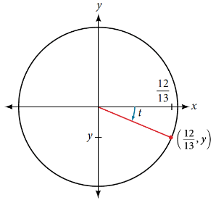
Alternate Forms of the Pythagorean Identity example
Example Using Identities to Relate Trigonometric Functions
If cos(t) = 12/13 and t is in quadrant IV, as shown in Figure 8, find the values of the other five trigonometric functions.

Slide 115
Alternate Forms of the Pythagorean Identity try it
Try It: If sec(t) = − $\frac{17}{8}$ and 0 < t < π, find the values of the other five functions.

Slide 116
Alternate Forms of the Pythagorean Identity try it 2
Try It:
Find the values of the six trigonometric functions of angle t based on Figure.

Slide 117
Evaluating Trigonometric Functions with a Calculator
To evaluate trigonometric functions of other angles, we use a scientific or graphing calculator or computer software. If the calculator has a degree mode and a radian mode, confirm the correct mode is chosen before making a calculation.
Evaluating a tangent function with a scientific calculator as opposed to a graphing calculator or computer algebra system is like evaluating a sine or cosine: Enter the value and press the TAN key.
For the reciprocal functions, there may not be any dedicated keys that say CSC, SEC, or COT. In that case, the function must be evaluated as the reciprocal of a sine, cosine, or tangent.
How To:
Given an angle measure in radians, use a scientific calculator to find the cosecant.
If the calculator has degree mode and radian mode, set it to radian mode.
Enter: 1/
Enter the value of the angle inside parentheses.
Press the SIN key.
Press the = key.

Slide 118
Evaluating Trigonometric Functions with a Calculator examples
Example Evaluating Using Technology
Evaluate the cosecant of 5π/7
Example Evaluating Using Technology
Evaluate sec(125°)

Slide 119
Evaluating Trigonometric Functions with a Calculator example and try it
Example Evaluating Using Technology
Evaluate the tan(312°)
Try It: Evaluate the cotangent of − $\frac{π}{8}$.

Slide 120
Acknowledgments
The original PowerPoint file is copyright 2015, Rice University. All Rights Reserved.
This work is a derivative of a text by OpenStax, which is licensed under a Creative Commons Attribution License 4.0 license.
Material on this PowerPoint was adapted from Abramson, Jay. “Chapter 7. The Unit Circle: Sine and Cosine.” Algebra and Trigonometry. OpenStax CAT, Algebra and Trigonometry. OpenStax CNX. May 30, 2019 http://cnx.org/contents/13ac107a-f15f-49d2-97e8-60ab2e3b519c@13.63.
This document has been reviewed for accessibility.

