Slide 1
APHY 102
Reproductive Models

Slide 2
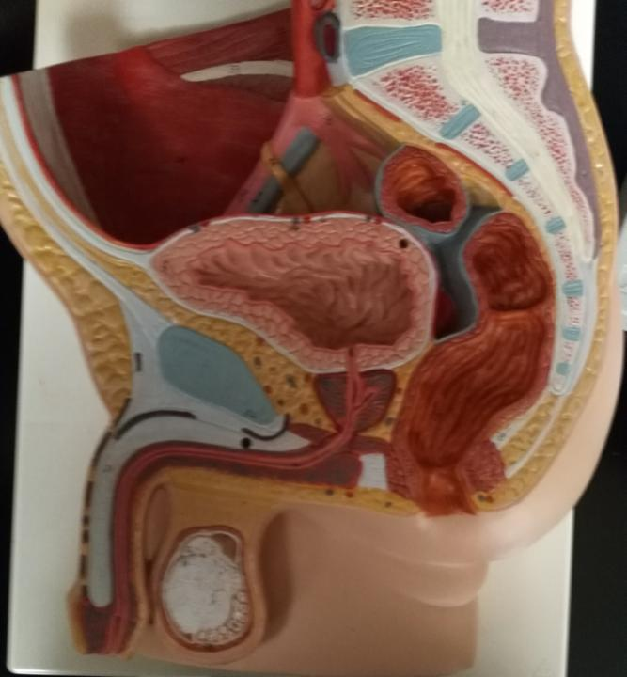

Slide 3
Ureter
Urinary bladder
Pubic symphysis
Prostate gland
Ejaculatory duct
Corpus cavernosum
Urogenital diaphragm
Prostatic urethra
Intermediate part of urethra
Spongy urethra
Corpus spongiosum
Testis
Epididymis
Cremaster muscle
Scrotum
Glans of penis

Slide 4
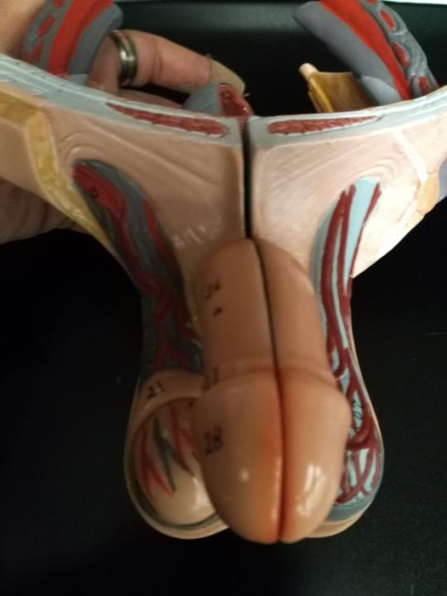

Slide 5
Shaft of penis
Glans of penis
Testicular artery
Pampiniform (venous) plexus
Epididymis
Testis
Scrotum
Spermatic cord
(whole)
Cremaster muscle

Slide 6
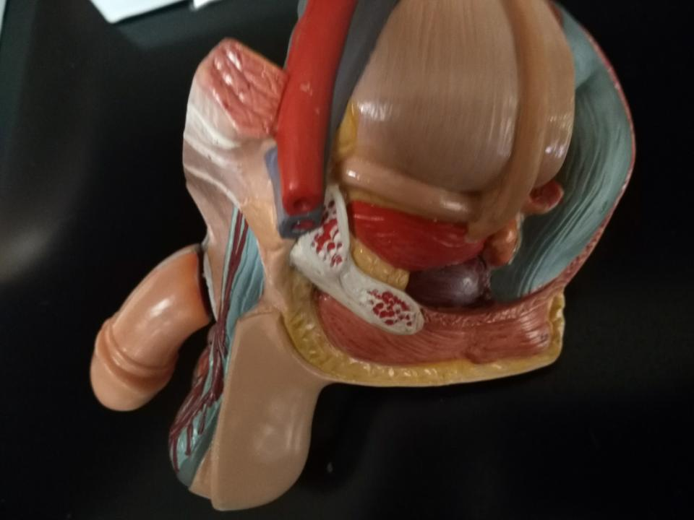

Slide 7
Ureter
Ductus (vas) deferens
Shaft of penis
Glans of penis
Seminal gland (vescicle)
Urinary bladder
Prostate
Cremaster muscle
Scrotum

Slide 8
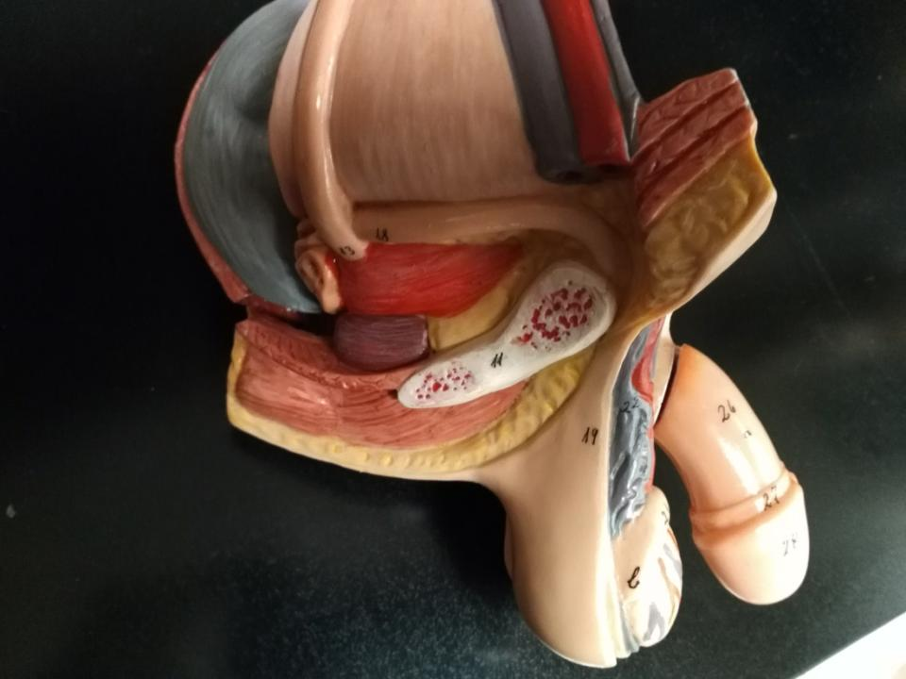

Slide 9
Ureter
Urinary bladder
Ampulla of ductus deferens
Seminal gland
Prostate
Ductus deferens
Shaft of penis
Glans of penis
Spermatic cord
Scrotum

Slide 10
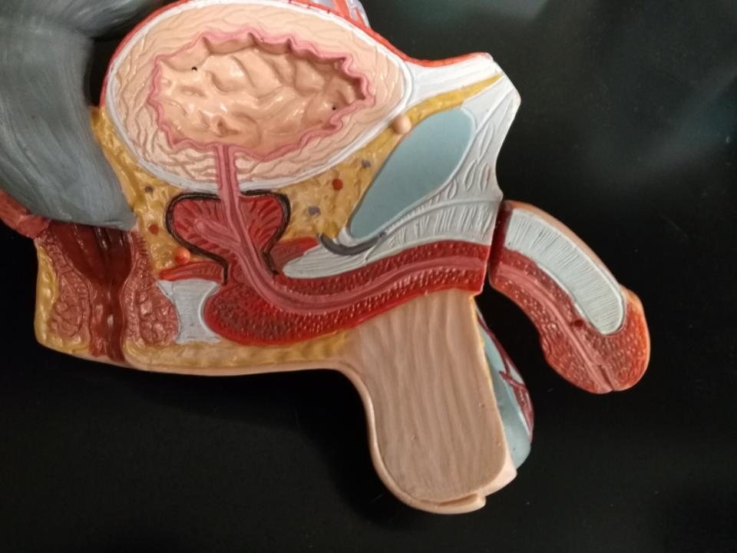

Slide 11
Urinary bladder
Corpus cavernosum
Prostate
Prostatic urethra
Ejaculatory duct
Urogenital diaphragm
Intermediate part of urethra
Corpus spongiosum
Spongy urethra
Glans of penis

Slide 12
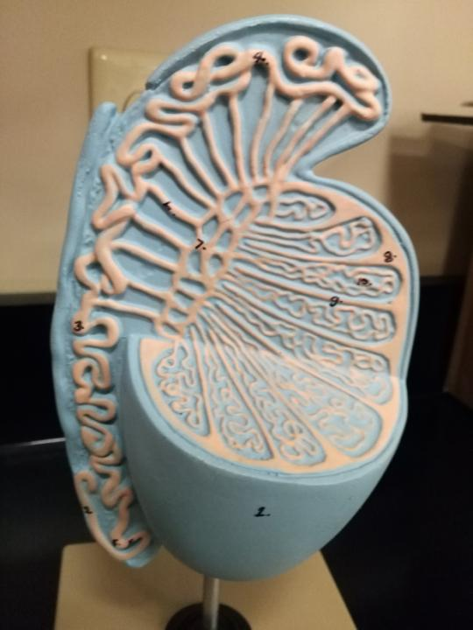

Slide 13
Ductus (vas) deferens
Efferent ductules
Epididymis:
Head
Body
Tail
Rete testis
Seminiferous tubules
Testis

Slide 14
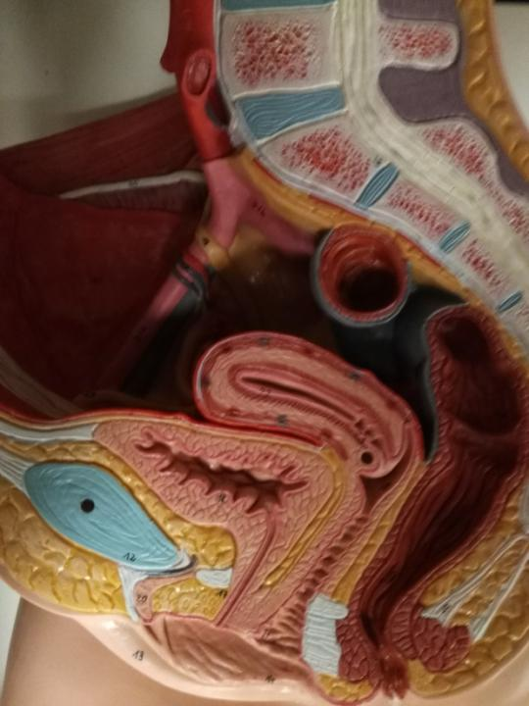

Slide 15
Ureter
Uterus
Perimetrium
Myometrium
Endometrium
Internal os
Cervix of uterus
Urinary bladder
External os
Pubic symphysis
Vagina
Mons pubis
Urethra
Vulval vestibule (space)
Clitoris
Labia majora
Labia minora

Slide 16
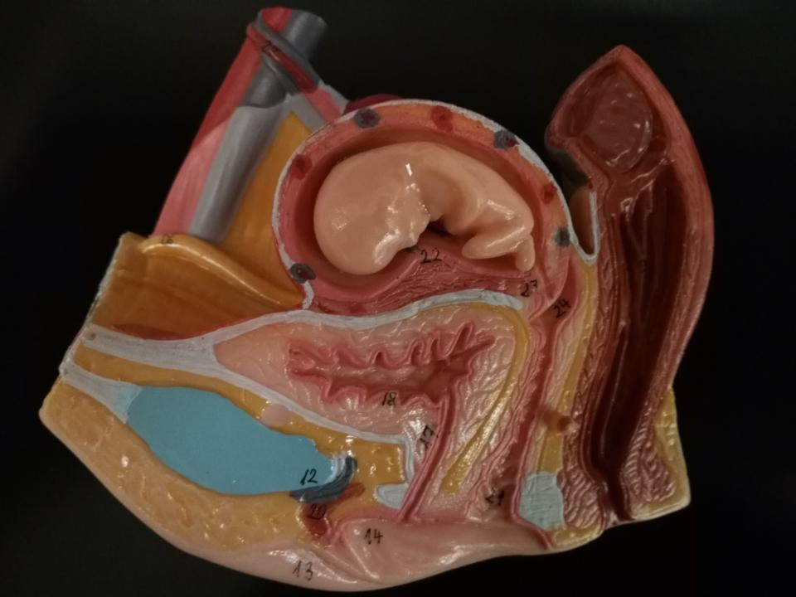

Slide 17
Embryo/Fetus
Cervix of uterus
Uterus
Broad ligament
Urinary bladder
Pubic symphysis
Vagina
Urethra
Clitoris
Labia minora
Vulval vestibule (space)

Slide 18
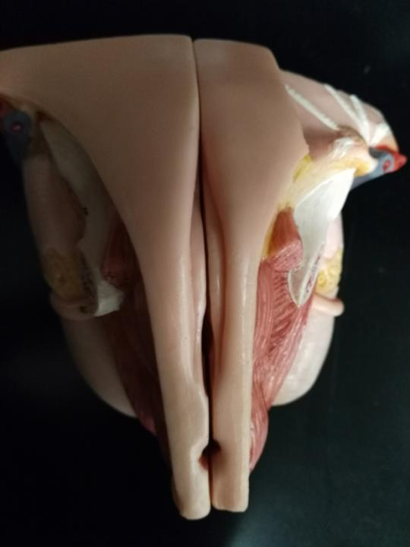

Slide 19
Mons pubis
Vulva: external female genitals. Includes the mons pubis, labia majora, labia minora, clitoris, vulval vestibule, urethral opening, greater and lesser vestibular glands, and the vaginal opening.
Labia majora
Labia minora
Anus

Slide 20
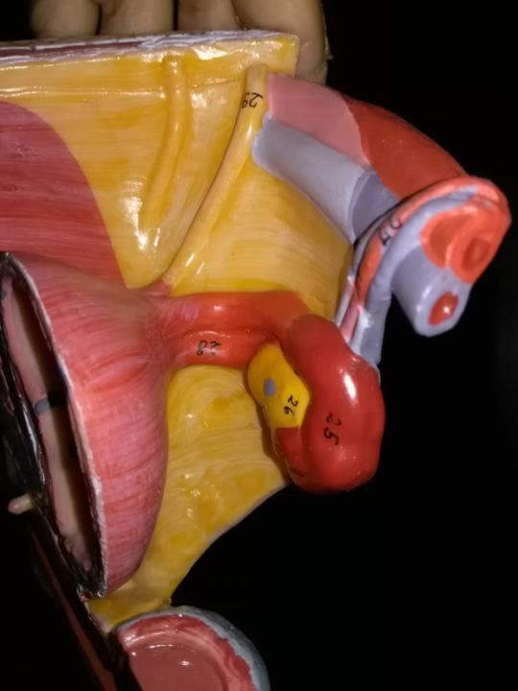

Slide 21
Round ligament of uterus (29)
Broad ligament
of uterus
Suspensatory ligament of ovary (27)
Uterus
Uterine (fallopian) tube (25)
Ovary (26)
Ovarian ligament (28)

Slide 22
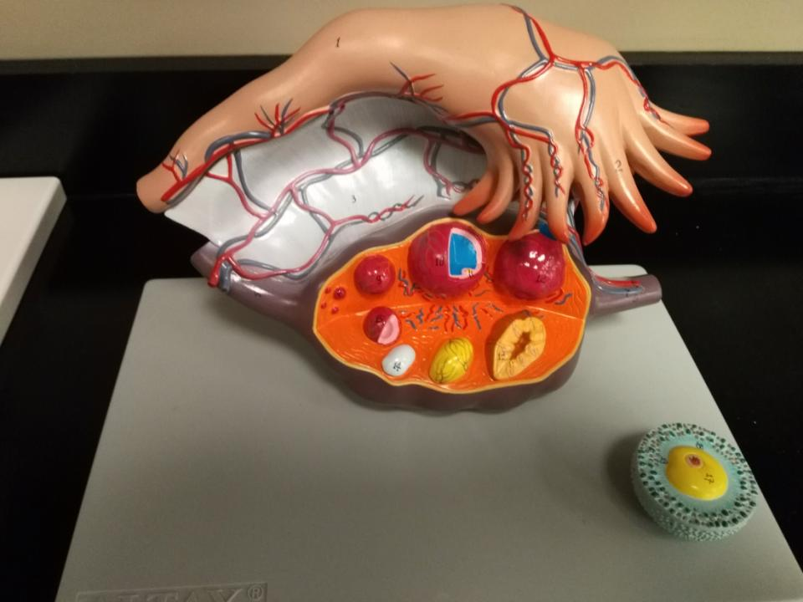

Slide 23
Ampulla of uterine tube
Infundibulum of uterine tube
Fimbrae
Broad ligament
Antrum within follicle
Ovarian ligament
Suspensatory ligament of ovary
Primordial follicle
Primary follicle
Secondary follicle
Tertiary (Graafian) follicle
Corpus luteum
Ovarian cortex
Ovarian medulla
Corpus albicans
Secondary oocyte
Corona radiate

Slide 24
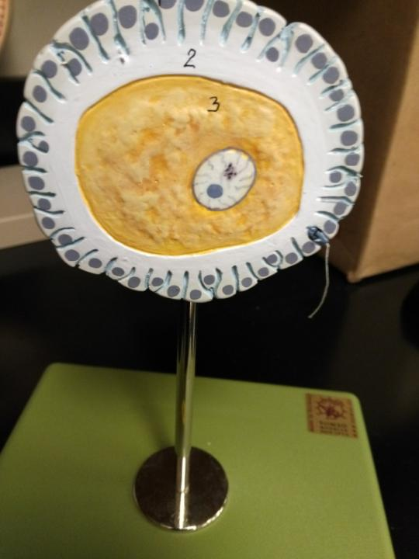

Slide 25
Corona radiate
Secondary oocyte
Sperm

Slide 26
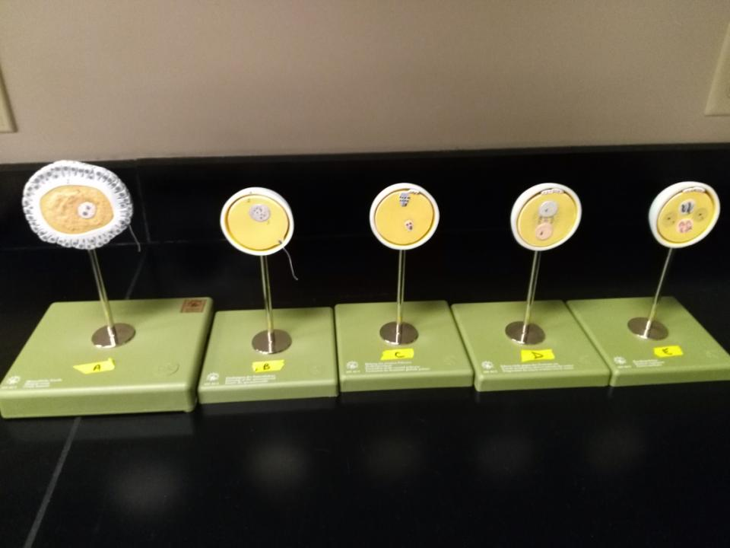

Slide 27
Polar bodies
Zona pellucida
Male
Pronucleus
Female Pronucleus
Sperm
Secondary oocyte being fertilized by a sperm. Fertilization triggers completion of Meiosis II by the secondary oocyte to form additional polar bodies. Once the male and female pronuclei are fused, then it is a zygote.

Slide 28
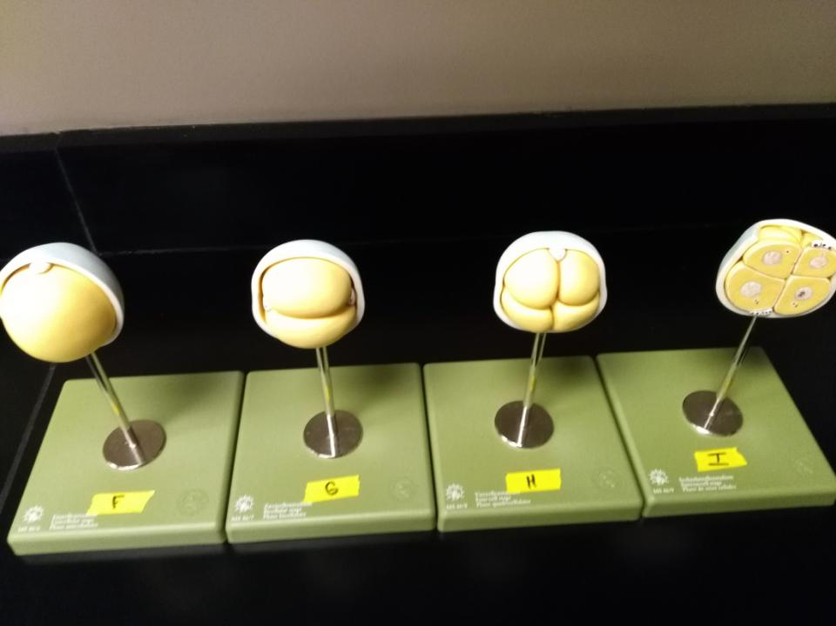

Slide 29
Zona pellucida
Polar bodies
Morula
Zygote
The zygote divides by cleavage (mitosis with no cellular growth between divisons). Once there are 16 or more cells, it is called a morula.

Slide 30
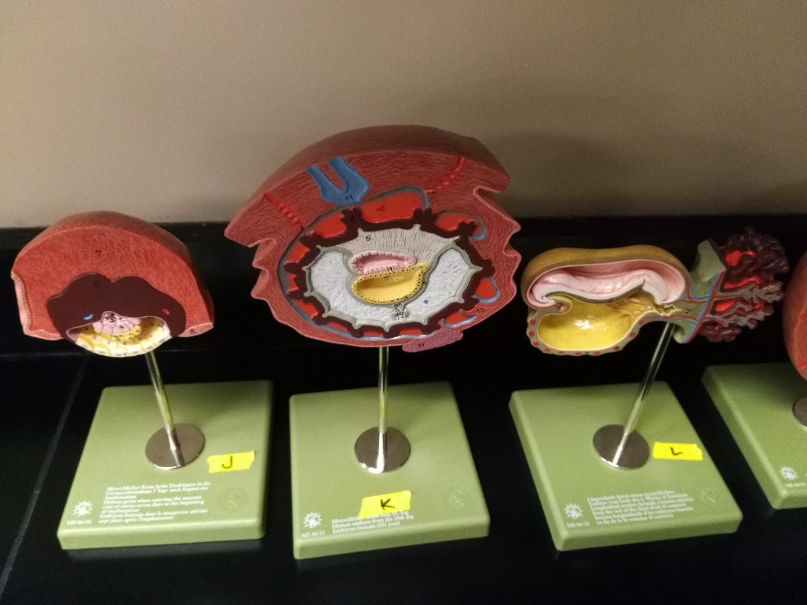

Slide 31
The morula continues to divide to form a blastocyst (100 or more cells will a hollow, fluid-filled cavity). The blastocyst will implant into the uterus. The trophoblast cells form the placenta, while the inner cell mass will undergo gastrulation to form an embryo.
Inner cell mass
Gastrulation
Trophoblast cells forming placenta
Blastocyst implanting in uterus.
Chorionic villi

Slide 32
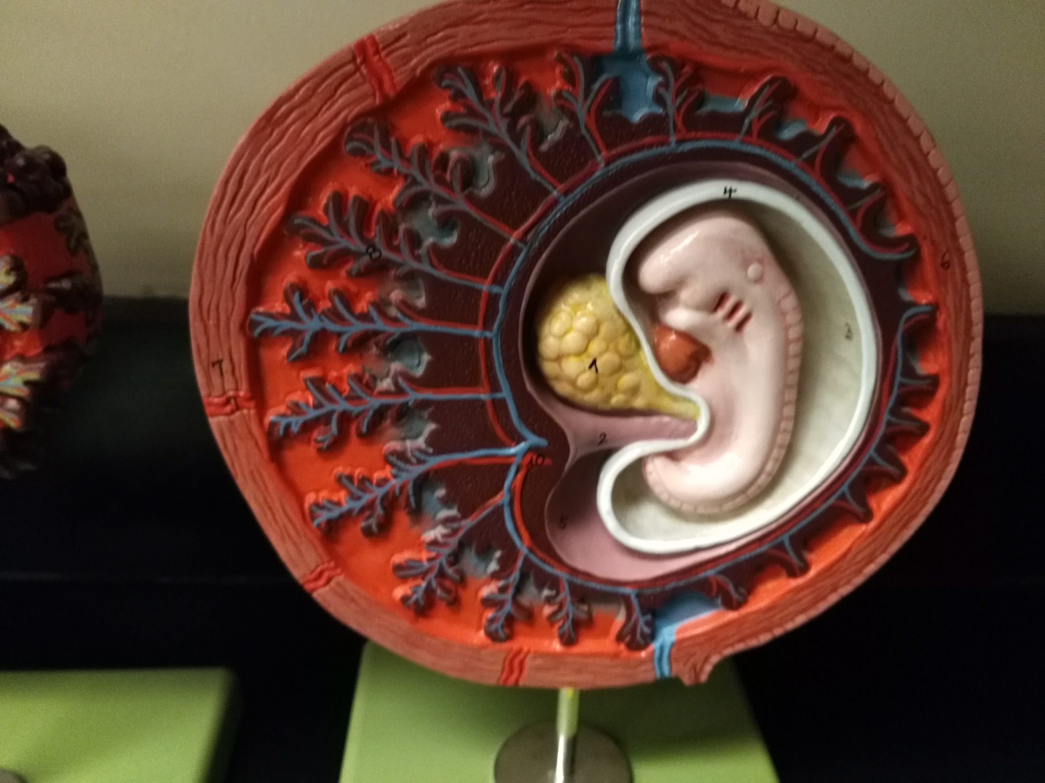

Slide 33
Uterus
Decidua (mother’s part of placenta)
Chorion (child’s part of placenta)
Chorionic villi
Yolk sac
Amnion
Amnionic cavity
Embryo
Umbilical cord

Slide 34
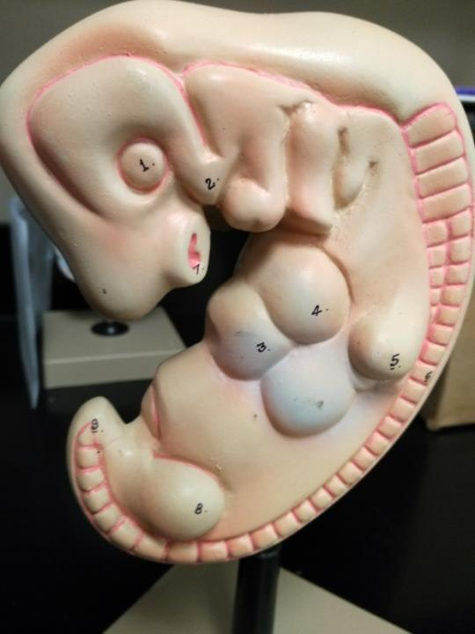

Slide 35
Rudimentary eye
Rudimentary ear
Rudimentary mouth
Arm bud
Heart bulge
Rudimentary liver
Rudimentary vertebrae
Tail bud
Leg bud

Slide 36
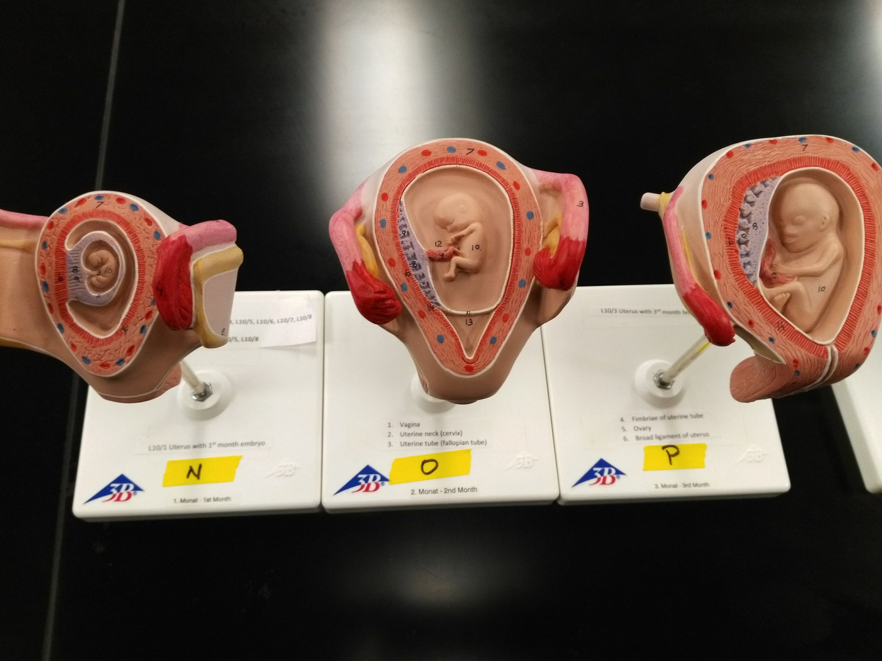

Slide 37
Round ligament of uterus
Child’s part of placenta
Mother’s part of placenta
Uterus
Amnion
Broad ligament
of the uterus
Uterine tube
Embryo/Fetus
Ovary
Cervical canal
Umbilical cord

Slide 38
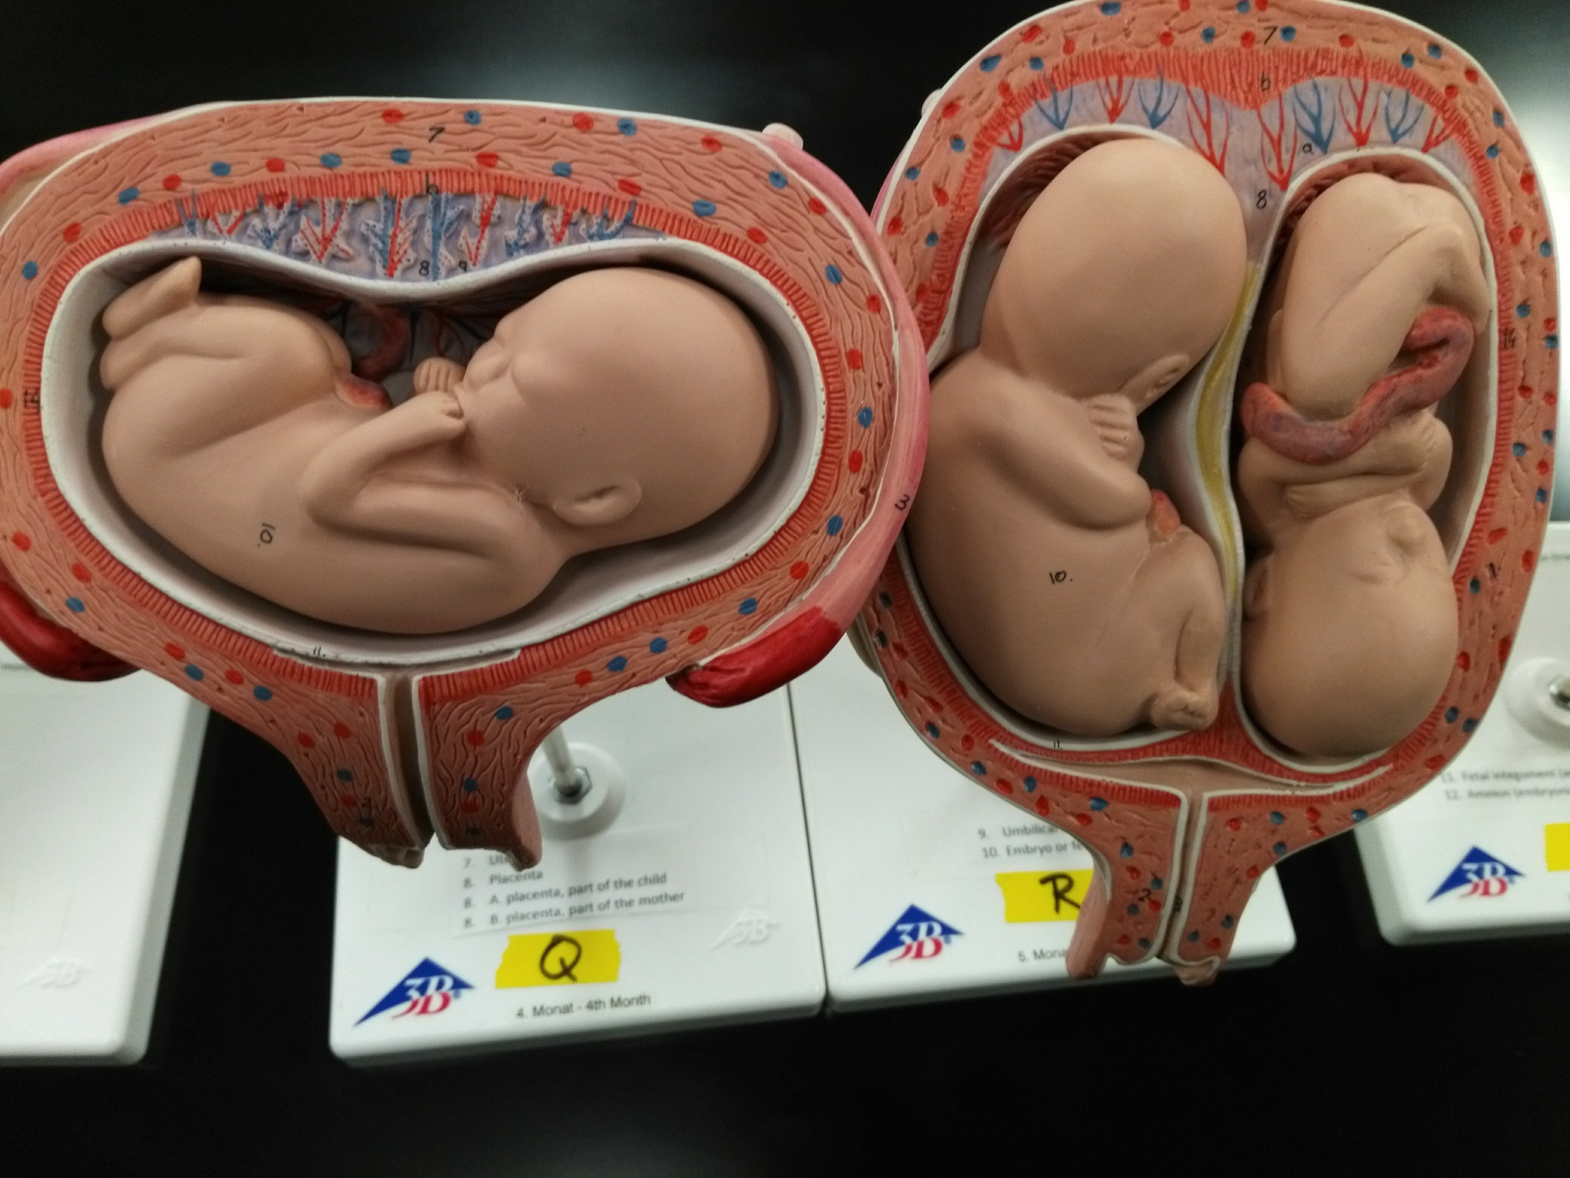
Twins
Transverse presentation

Slide 39
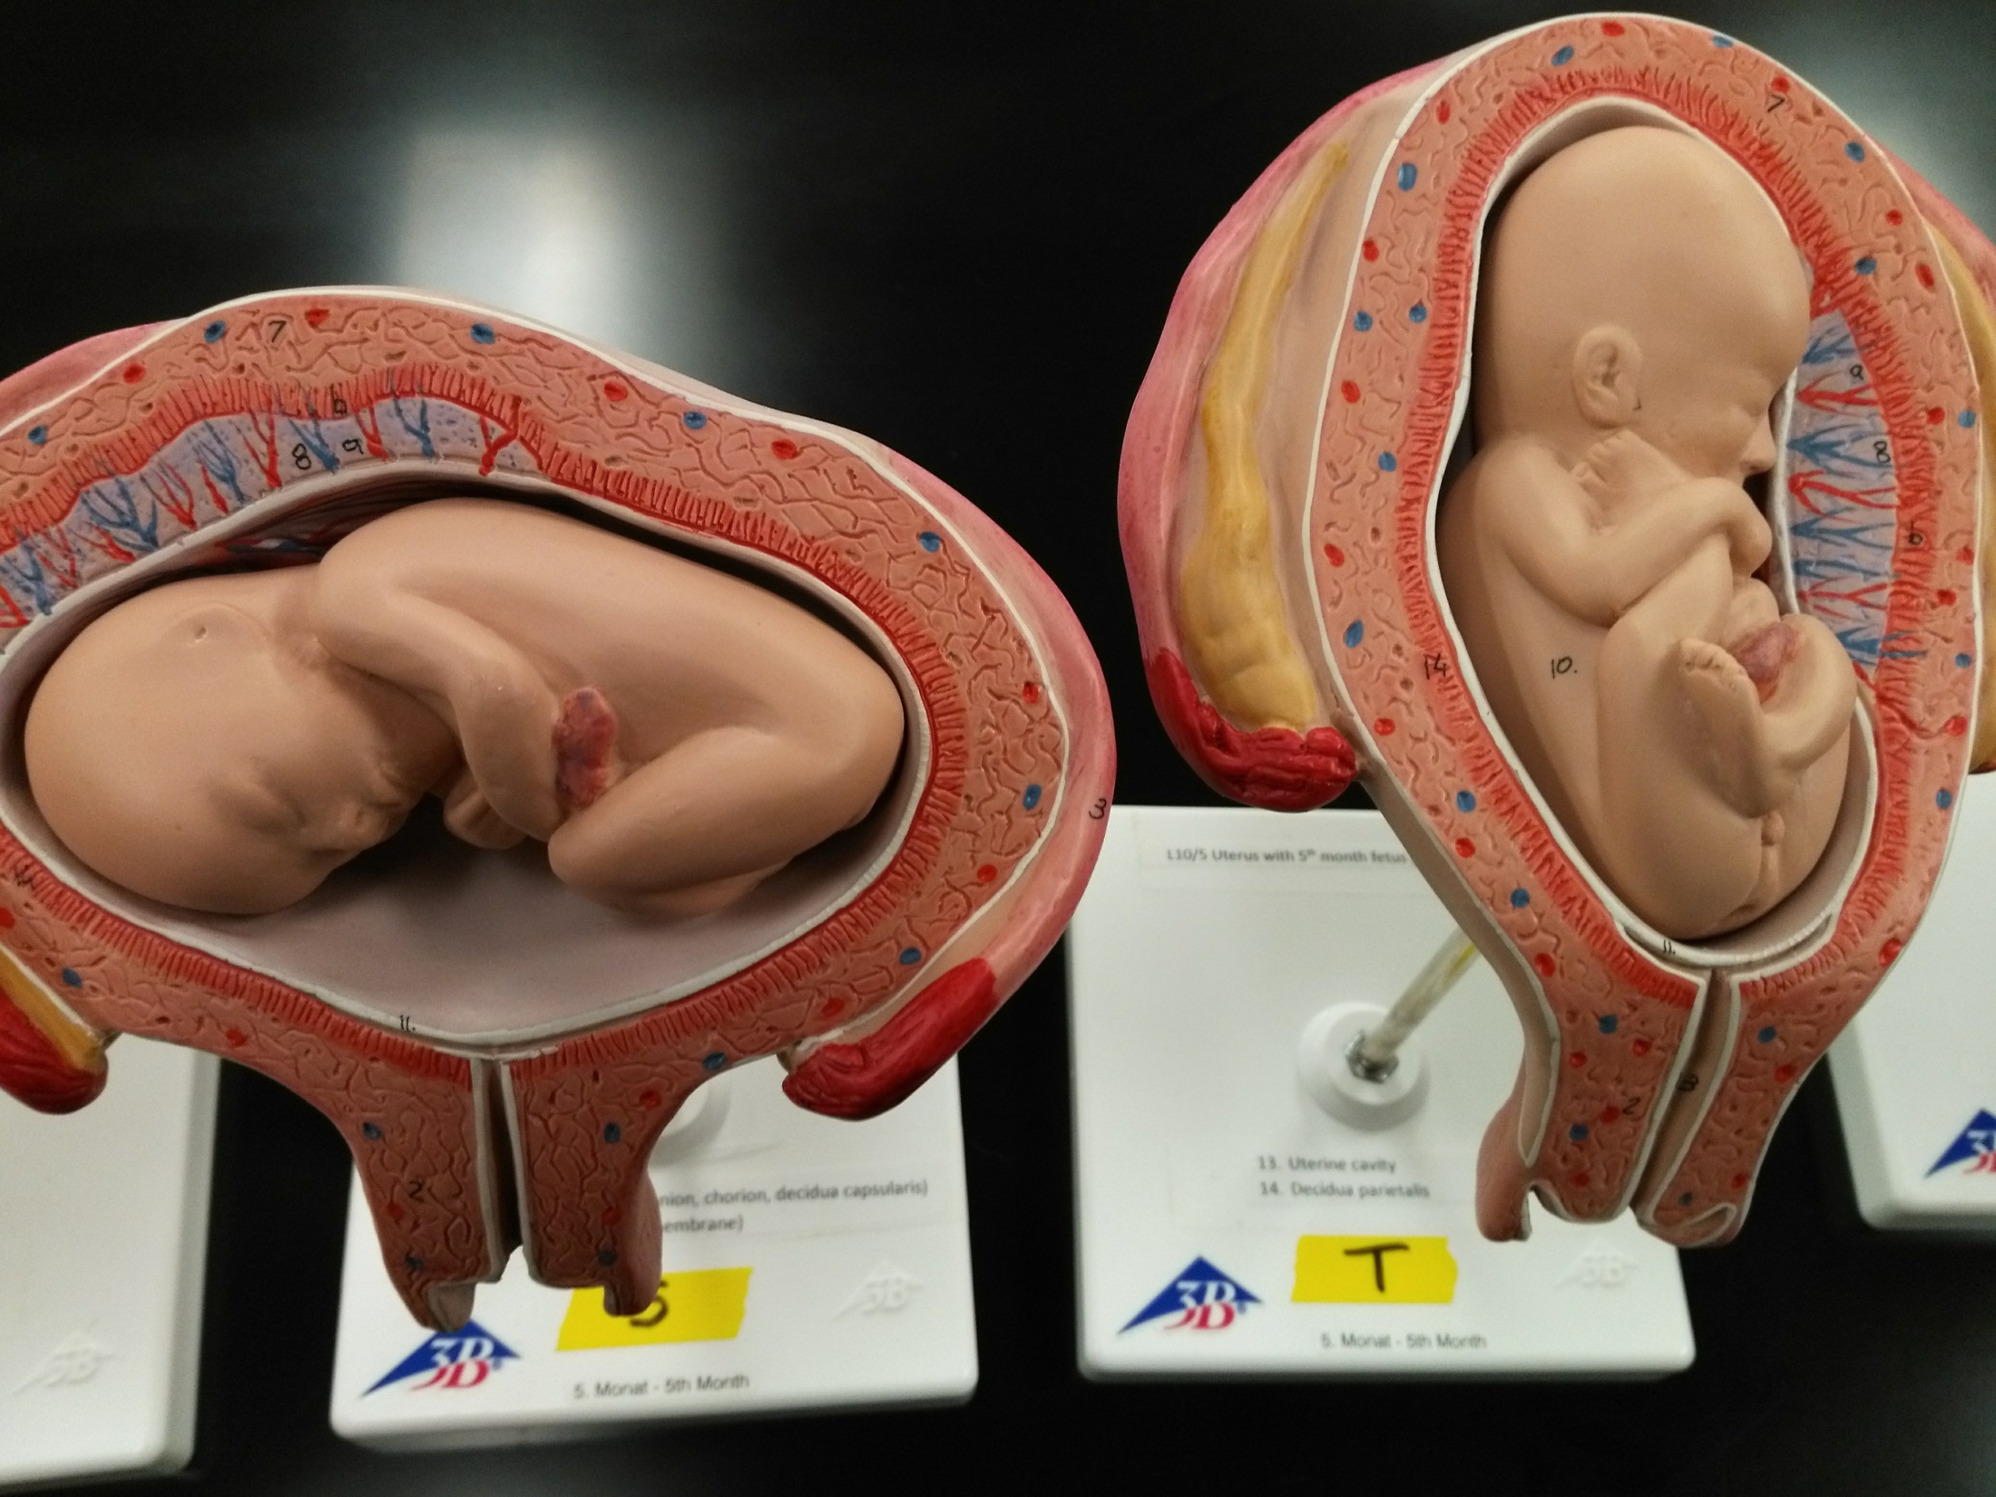
Transverse presentation
Breech presentation

Slide 40
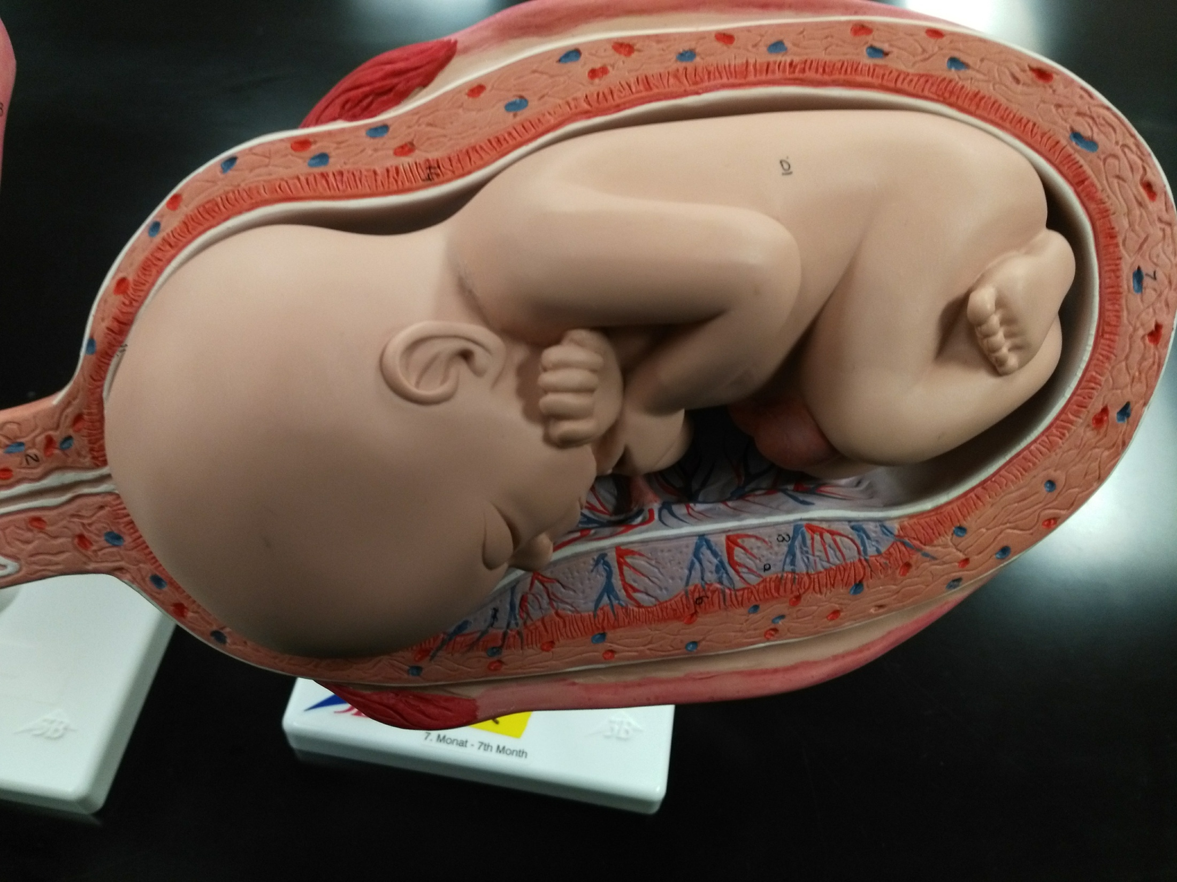
Vertex (normal) presentation

Slide 41
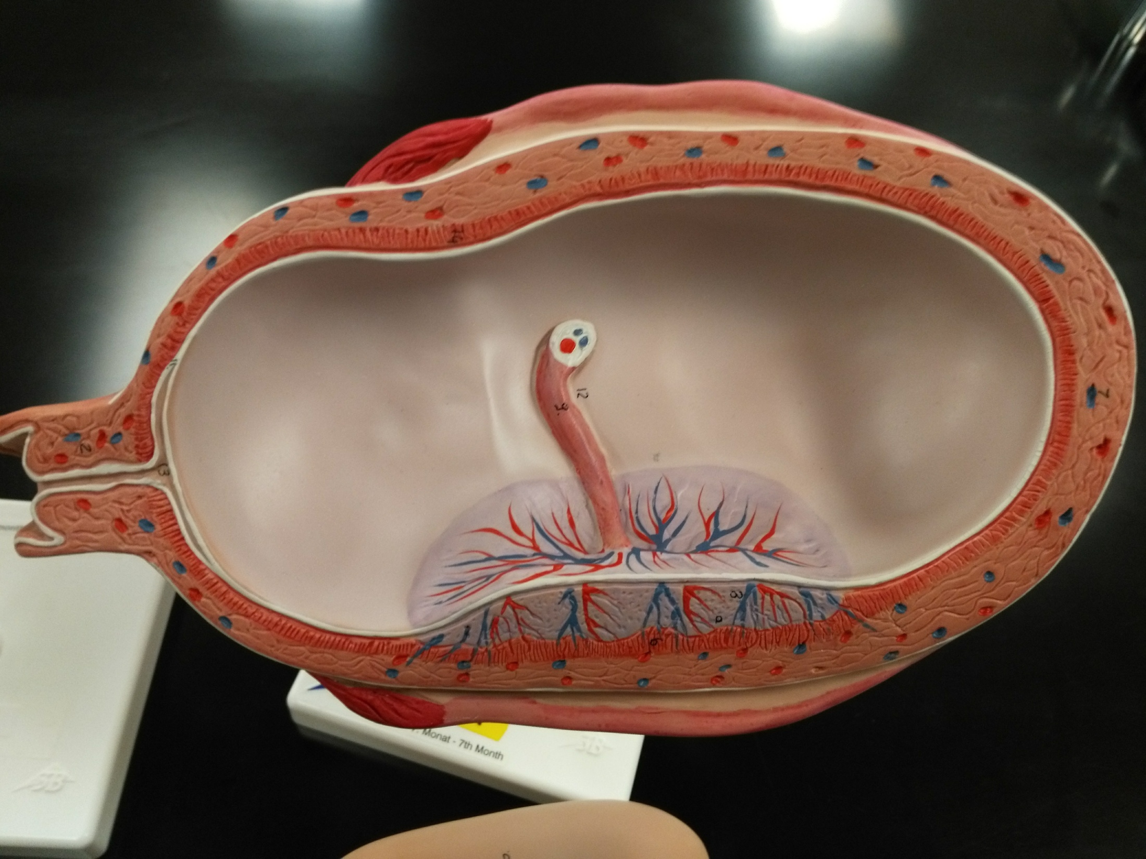

Slide 42
Fimbrae Uterine tube Uterus
Vagina
Cervix of uterus
Cervical canal
Umbilical cord
Fetal integument (amnion, chorion, decidua capsularis)
Child’s part of placenta
Mother’s part of placenta

