Slide 1
102 Urinary, Lymphatic, Immune, Endocrine

Slide 2
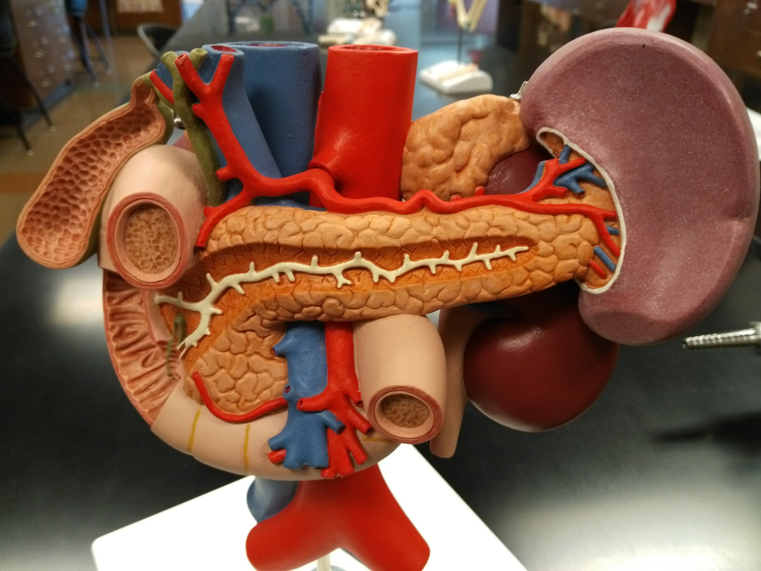

Slide 3
Inferior vena cava
Abdominal aorta
Celiac trunk
Adrenal gland
Bile duct
Hepatic portal vein
Spleen
Gallbladder
Pancreas
Duodenum
Pancreatic duct
Circular folds of duodenum
Hepatopancreatic sphincter and ampulla
Kidney
Ureter
Superior mesenter artery and vein

Slide 4
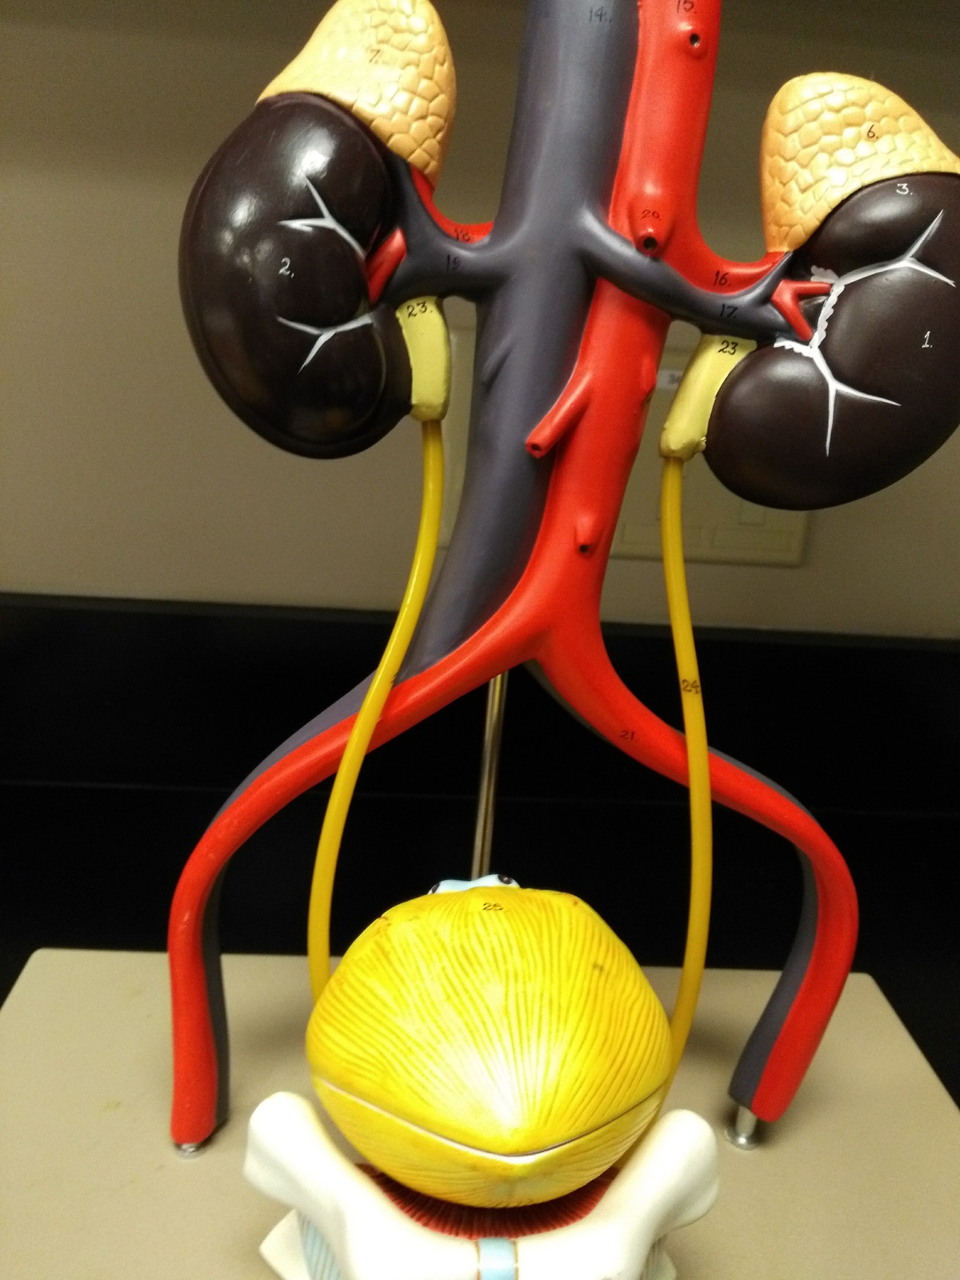

Slide 5
Adrenal gland
Renal artery
Renal vein
Inferior vena cava
Ureter
Abdominal aorta
Common iliac artery
Urinary bladder

Slide 6
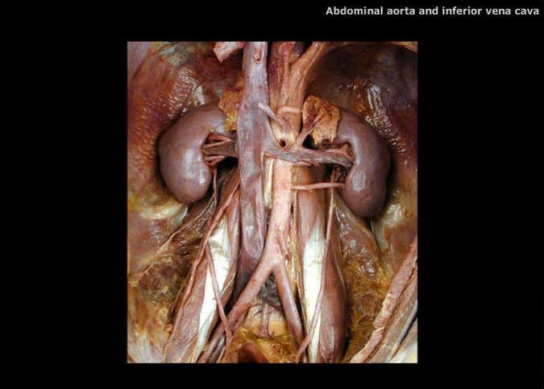
Spleen
Adrenal gland
Kidney
Celiac trunk
Renal artery
Superior mesenteric artery
Inferior vena cava
Renal vein
Abdominal aorta
Inferior mesenteric artery
Ureter
Ureter
Common iliac artery

Slide 7
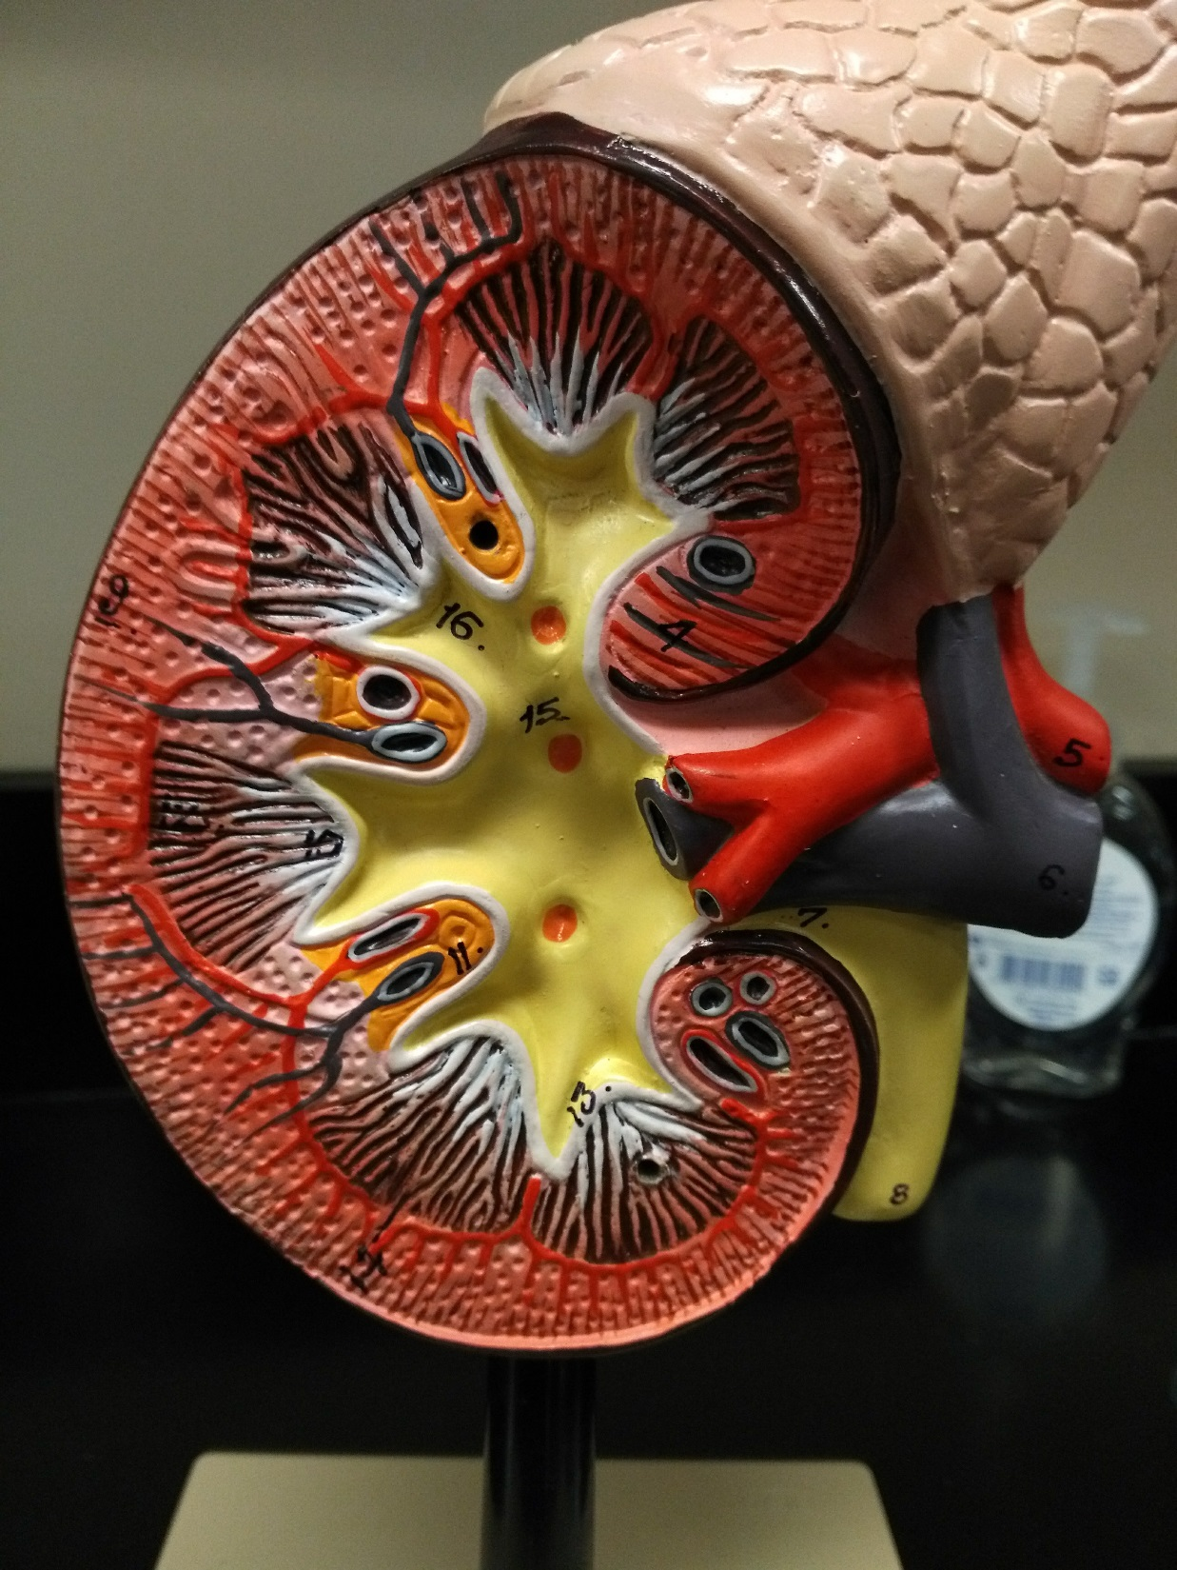

Slide 8
Adrenal gland
Renal cortex
Renal pyramid
Major calyx
Renal column
Renal artery
Renal vein
Renal papilla
Renal pelvis
Minor calyx
Ureter

Slide 9
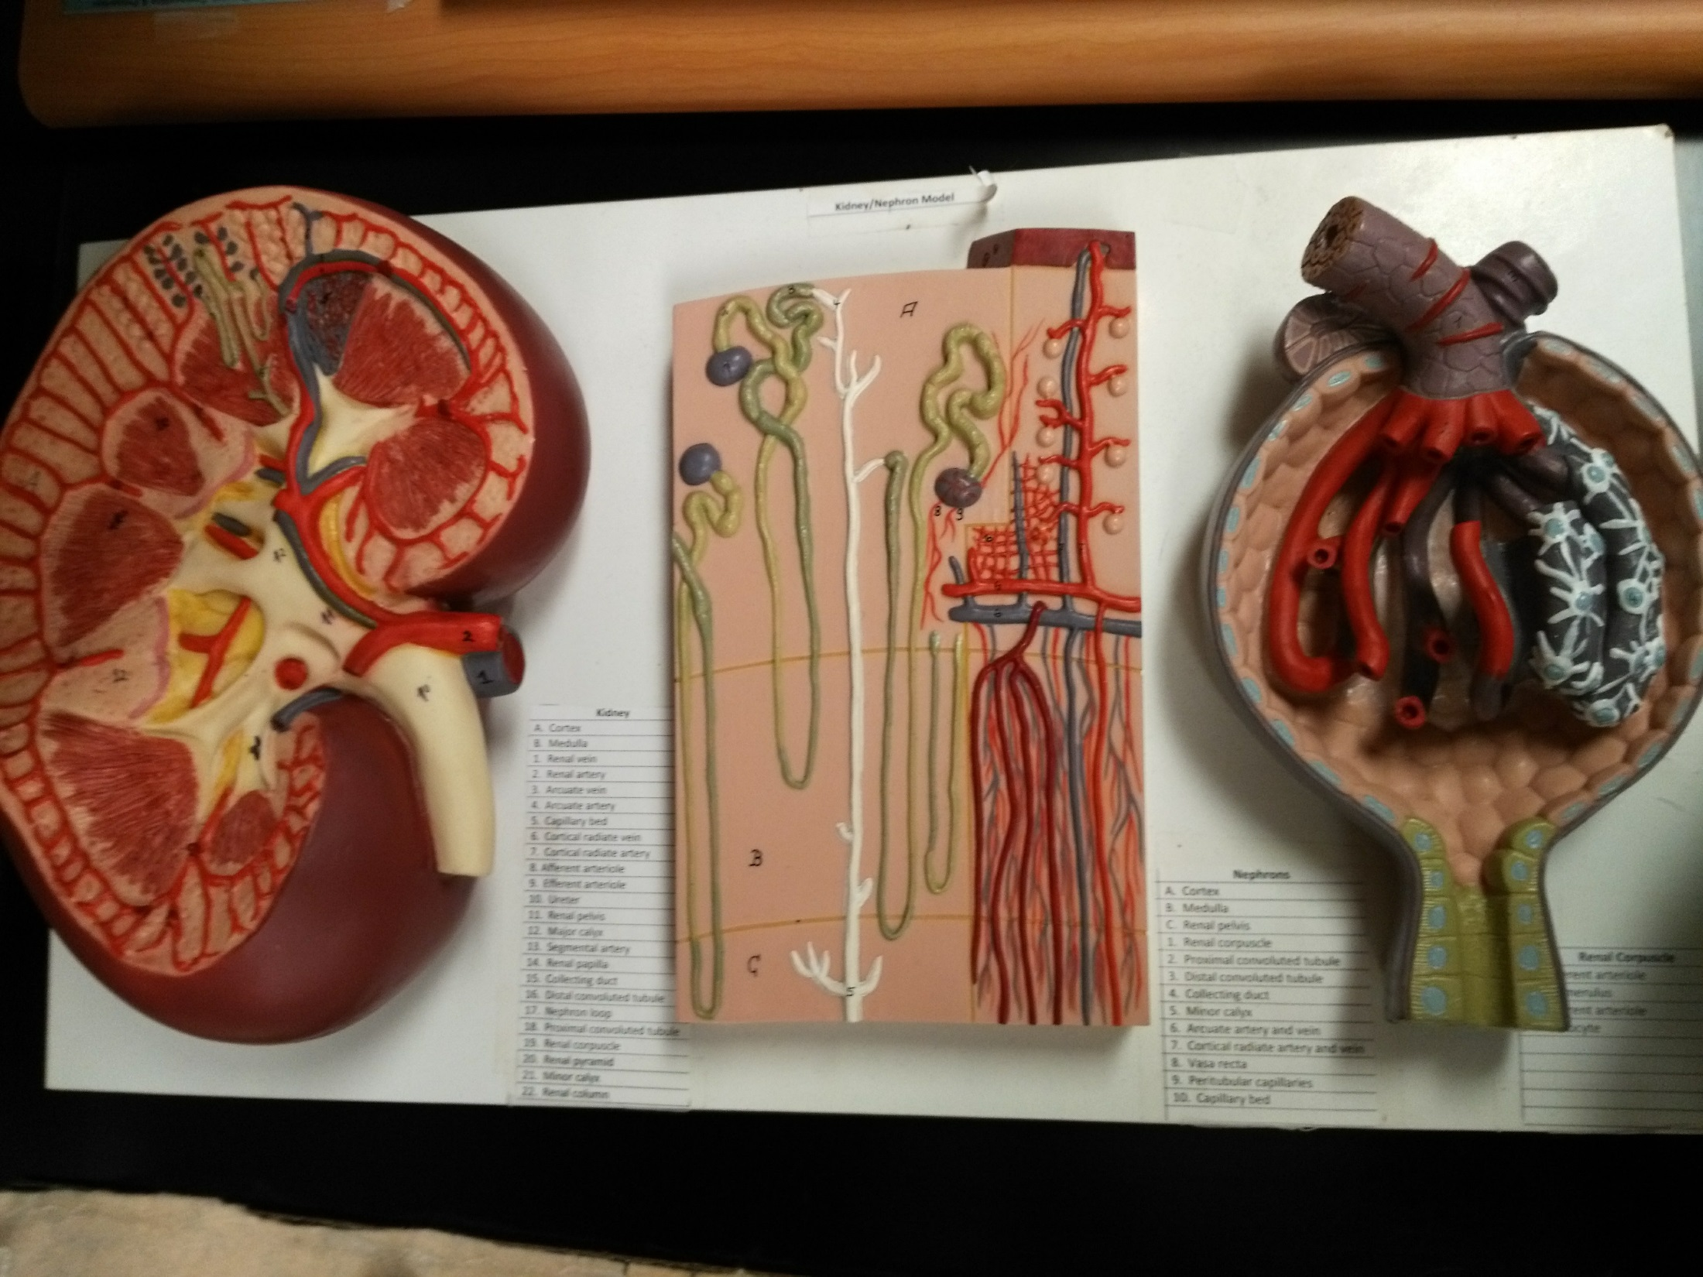

Slide 10
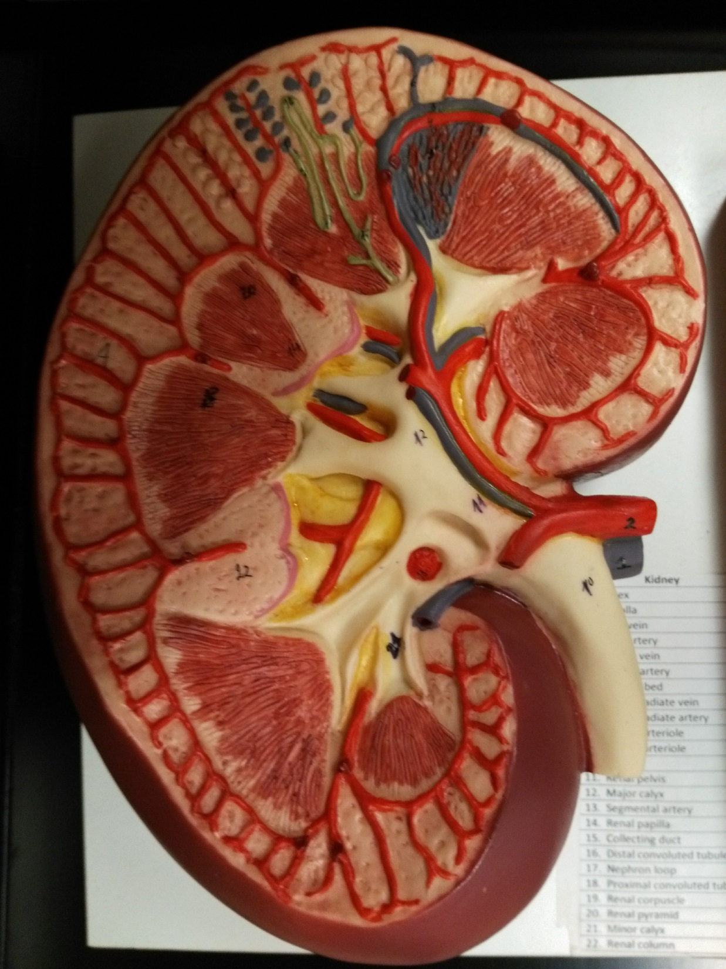

Slide 11
Renal cortex
Cortical radiate artery
Arcuate artery
Renal column
Interlobar artery
Segmental artery
Renal pyramid
Renal artery
Renal vein
Renal papilla
Renal pelvis
Ureter
Minor calyx
Major calyx

Slide 12
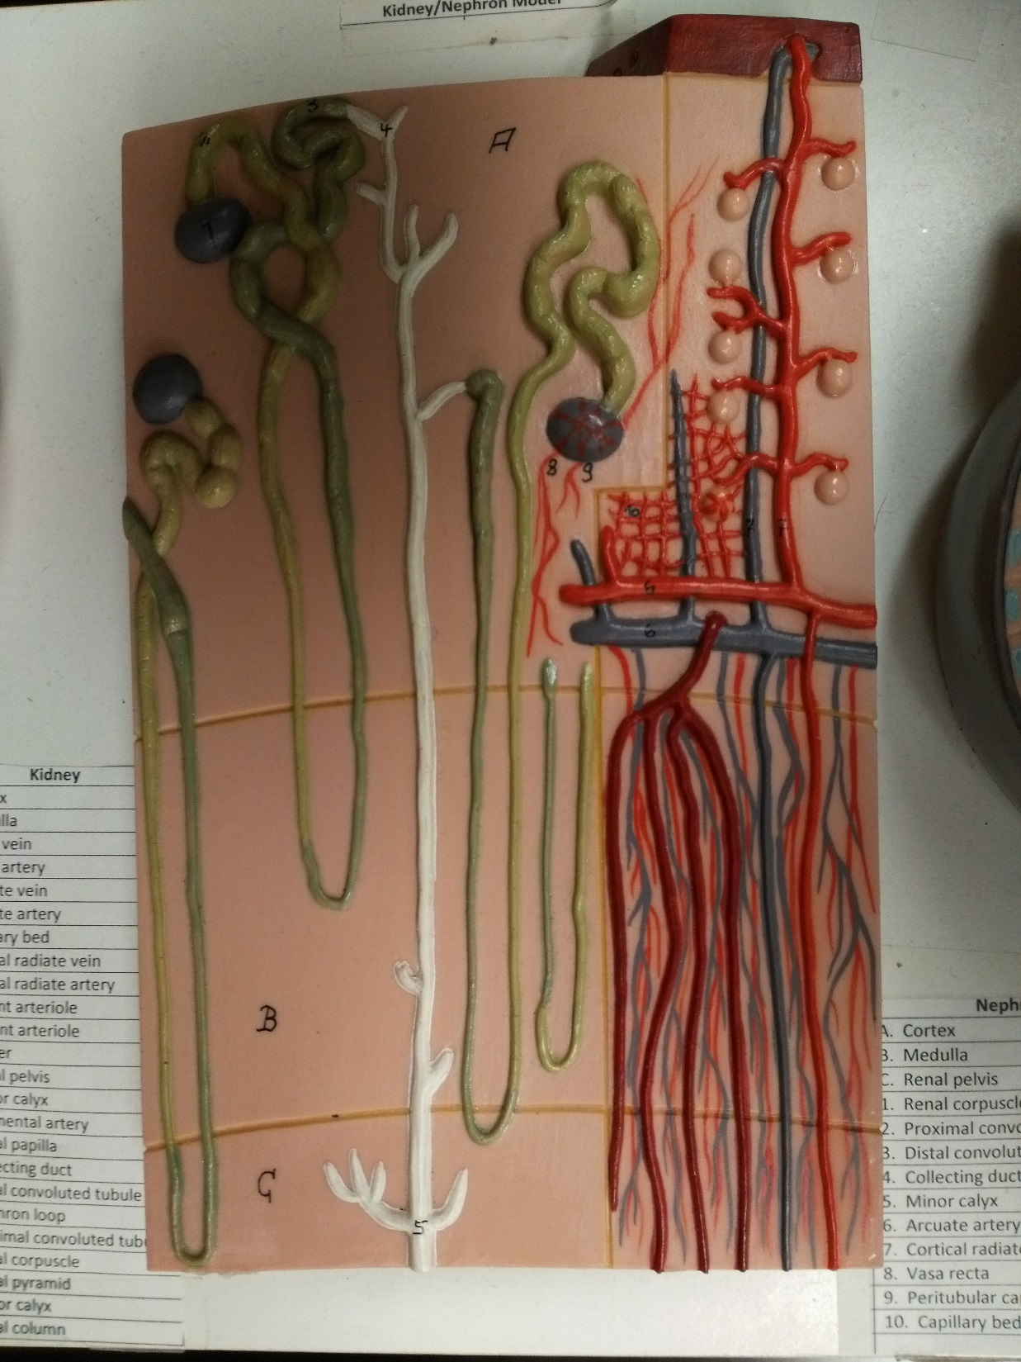

Slide 13
Proximal convoluted tubule
Renal corpuscle
Glomerulus
Afferent arteriole
Cortical radiate artery
Peritubular capillaries
Arcuate artery
Vasa recta
Distal convoluted tubule
Nephron loop
Collecting duct

Slide 14
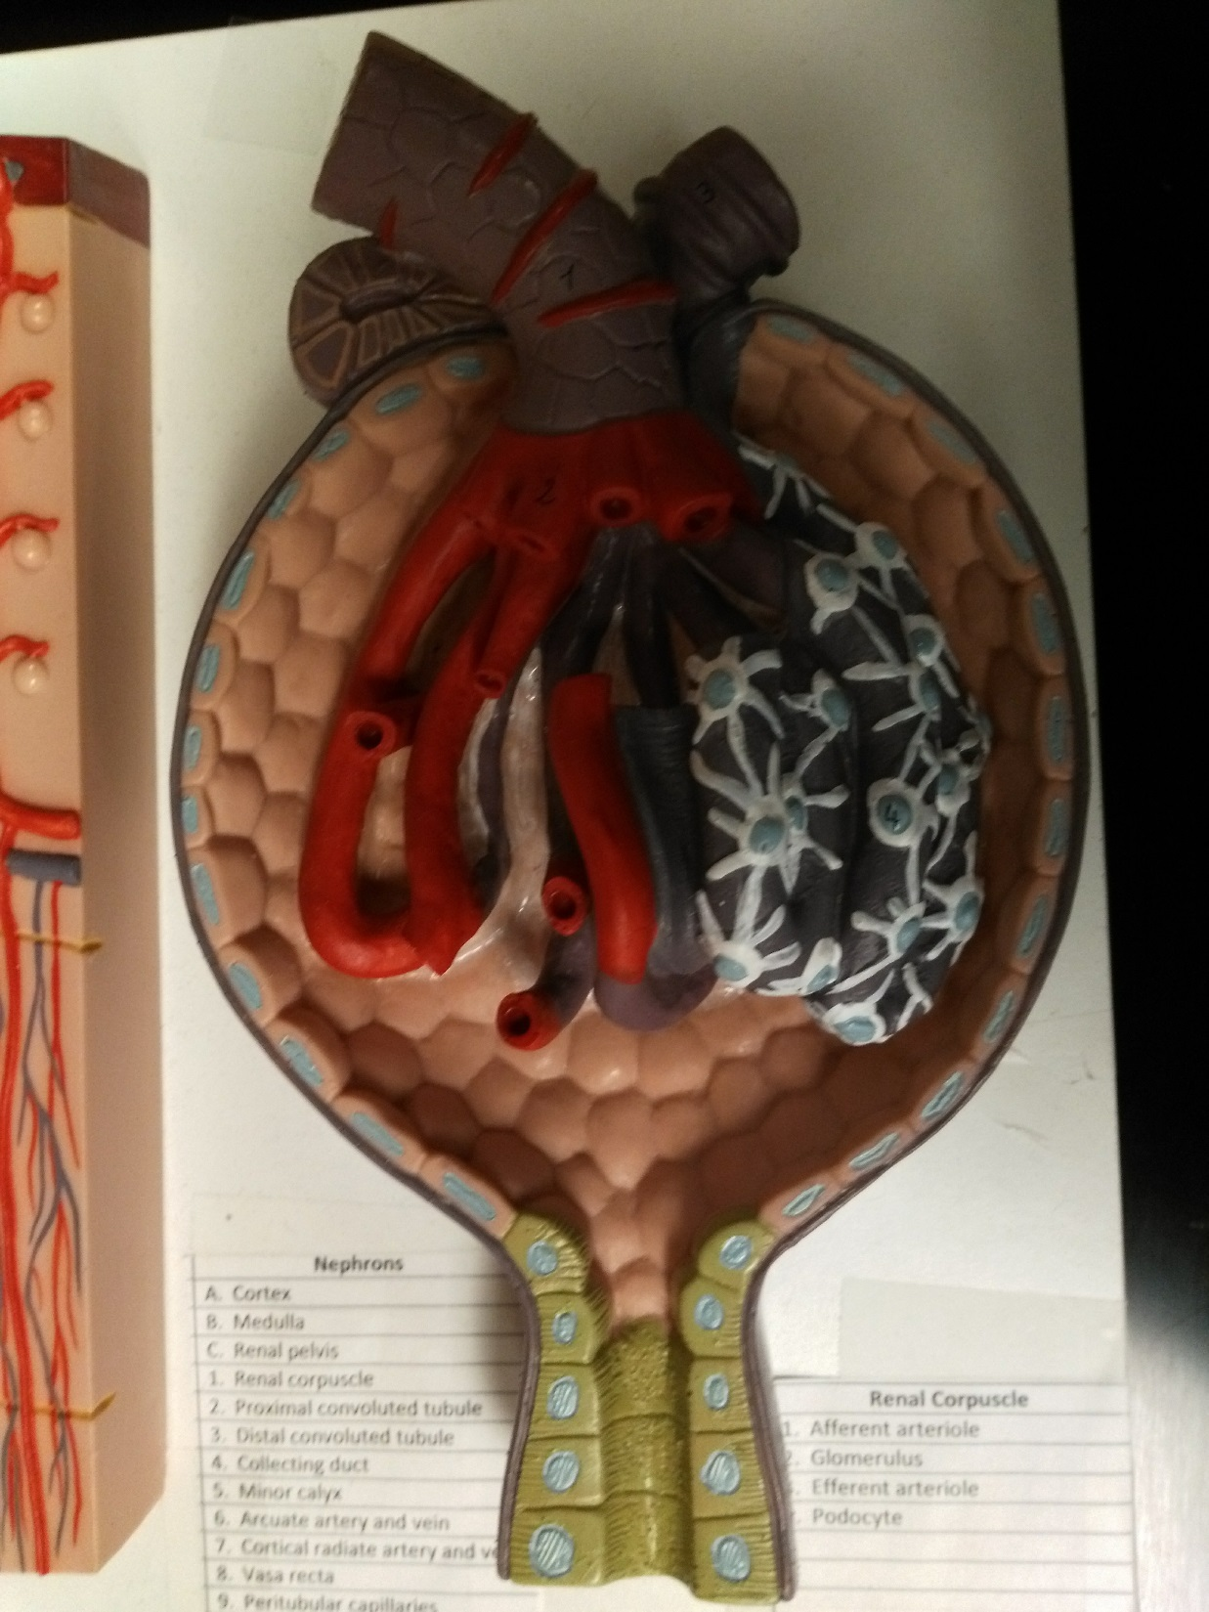

Slide 15
Renal corpuscle is glomerulus and Bowman’s capsule.
Efferent arteriole
Afferent arteriole
Juxtaglomerular apparatus
Bowman’s capsule/Glomerular capsule
Podocyte/Visceral layer of Bowman’s capsule
Glomerulus
Filtration membrane:
Fenestrations of endothelia
Basement membrane
Filtration slits of podocytes.
Proximal convoluted tubule

Slide 16
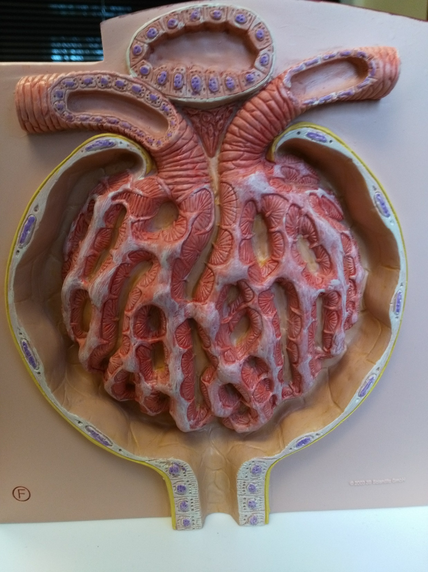

Slide 17
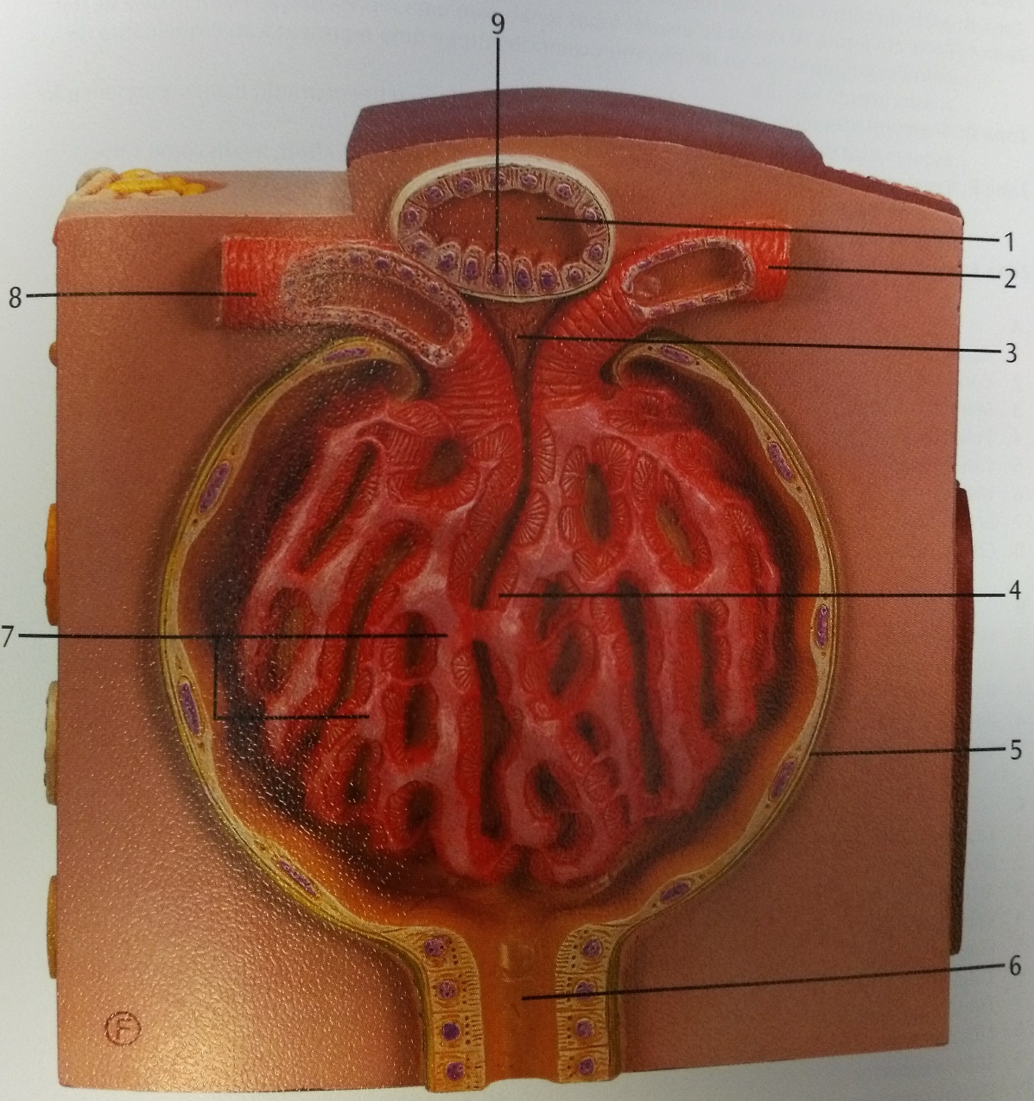
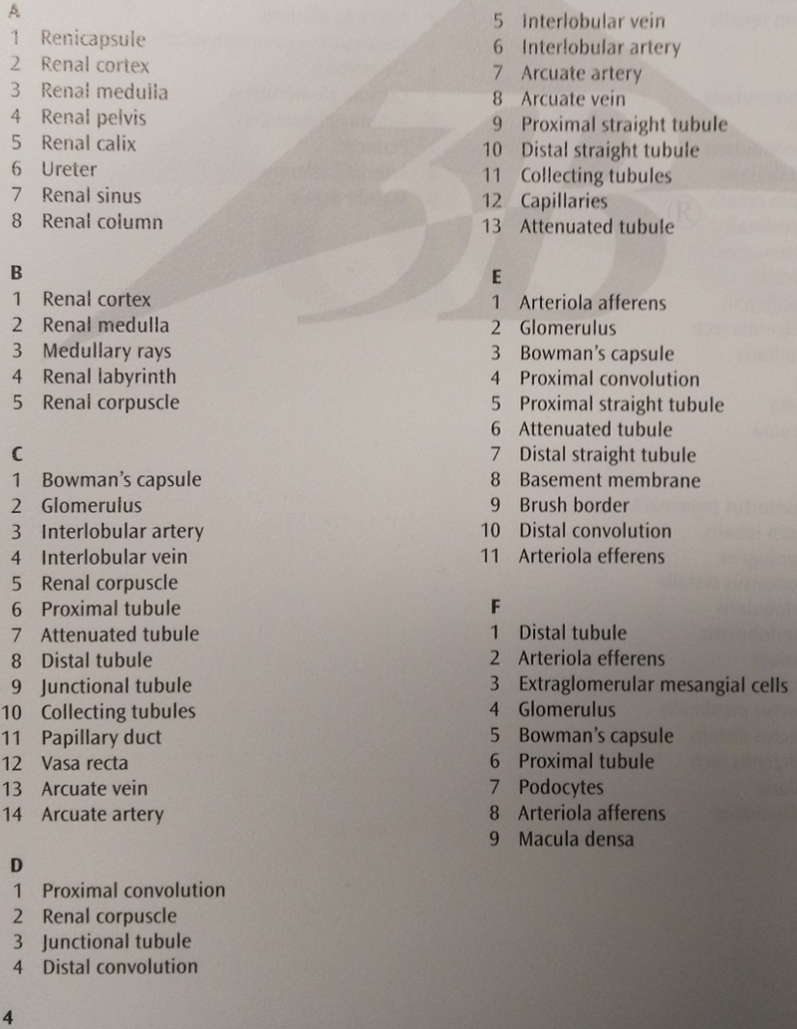

Slide 18
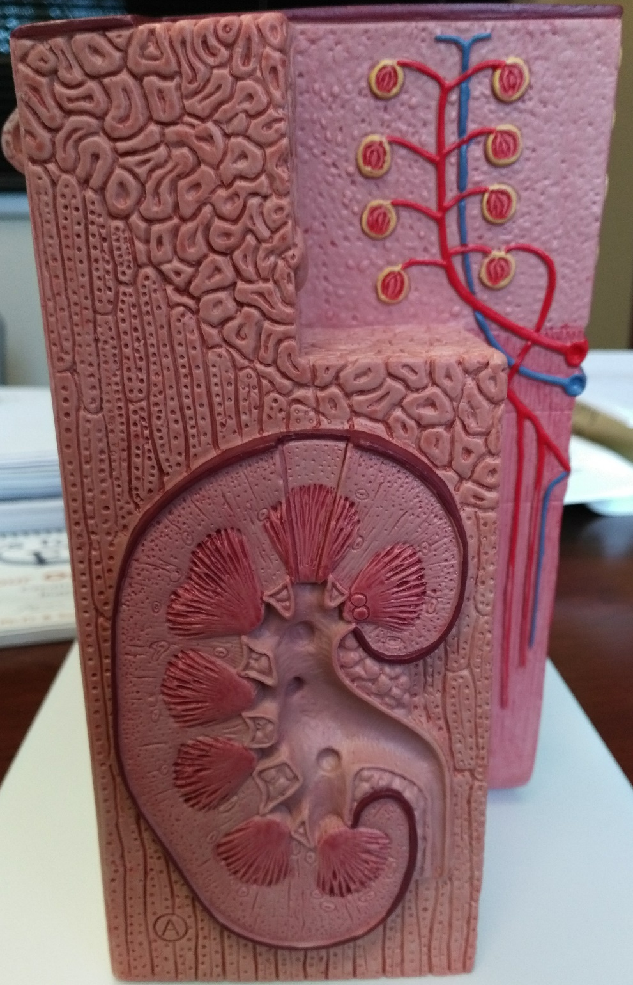

Slide 19
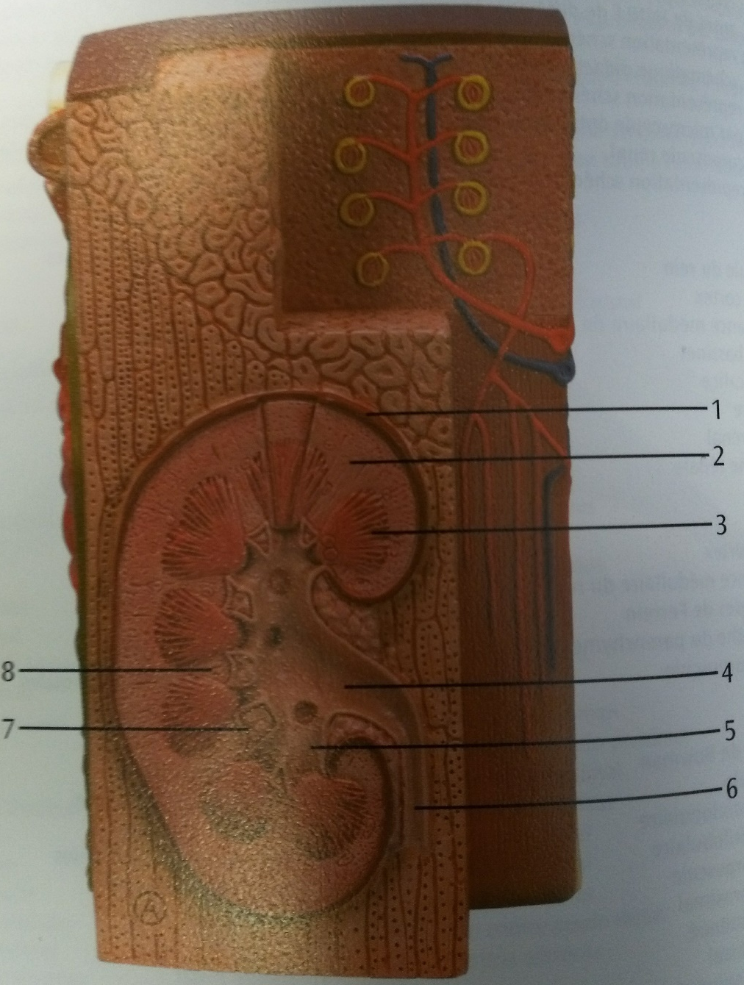

Slide 20
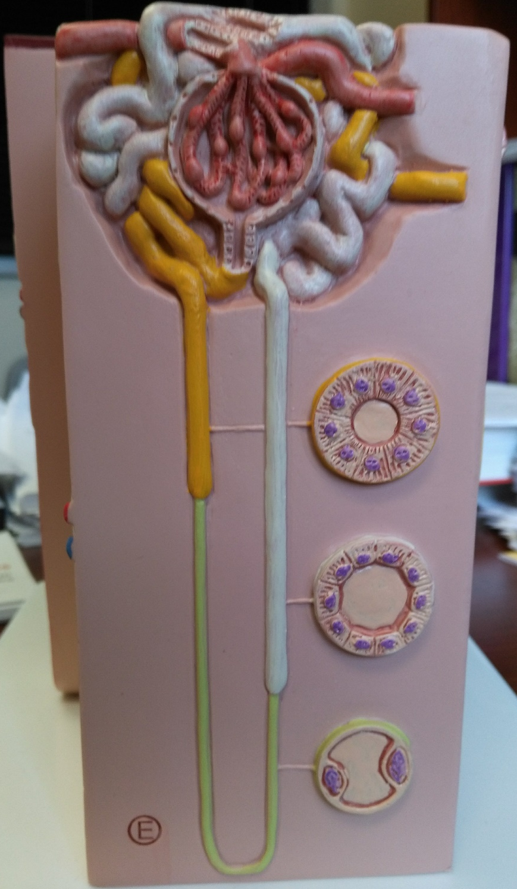

Slide 21
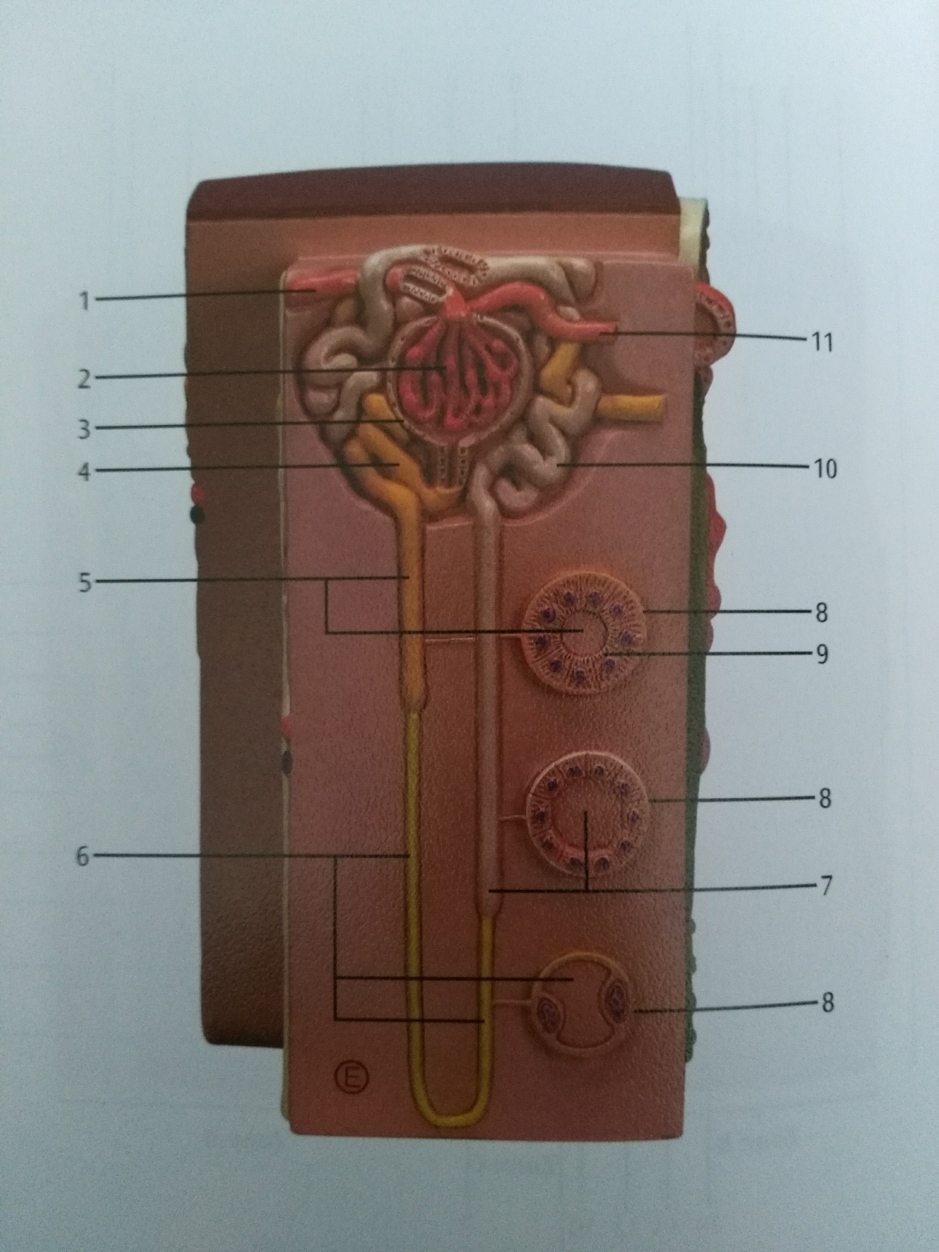

Slide 22
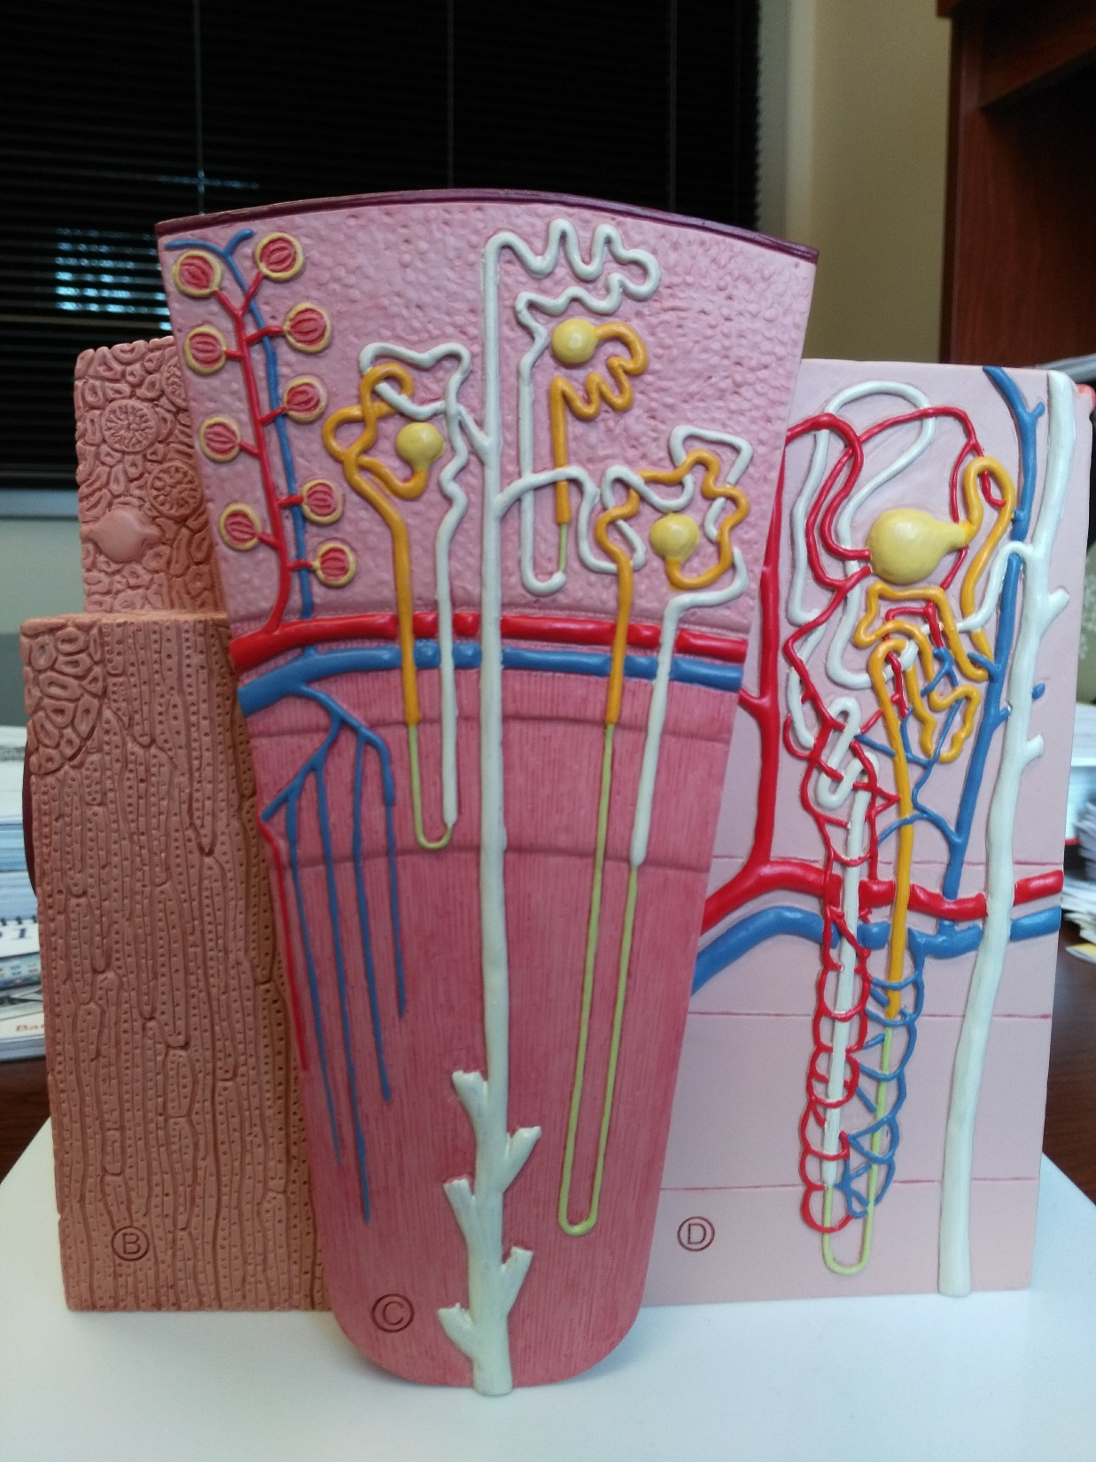

Slide 23
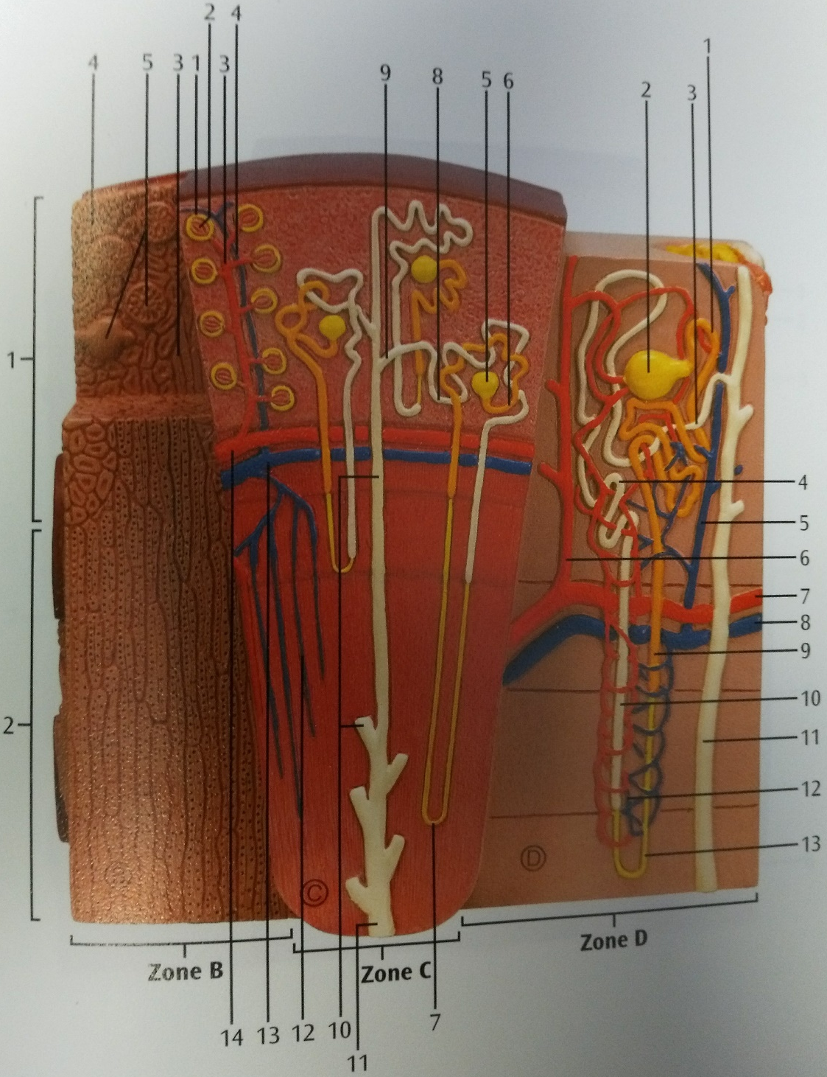

Slide 24
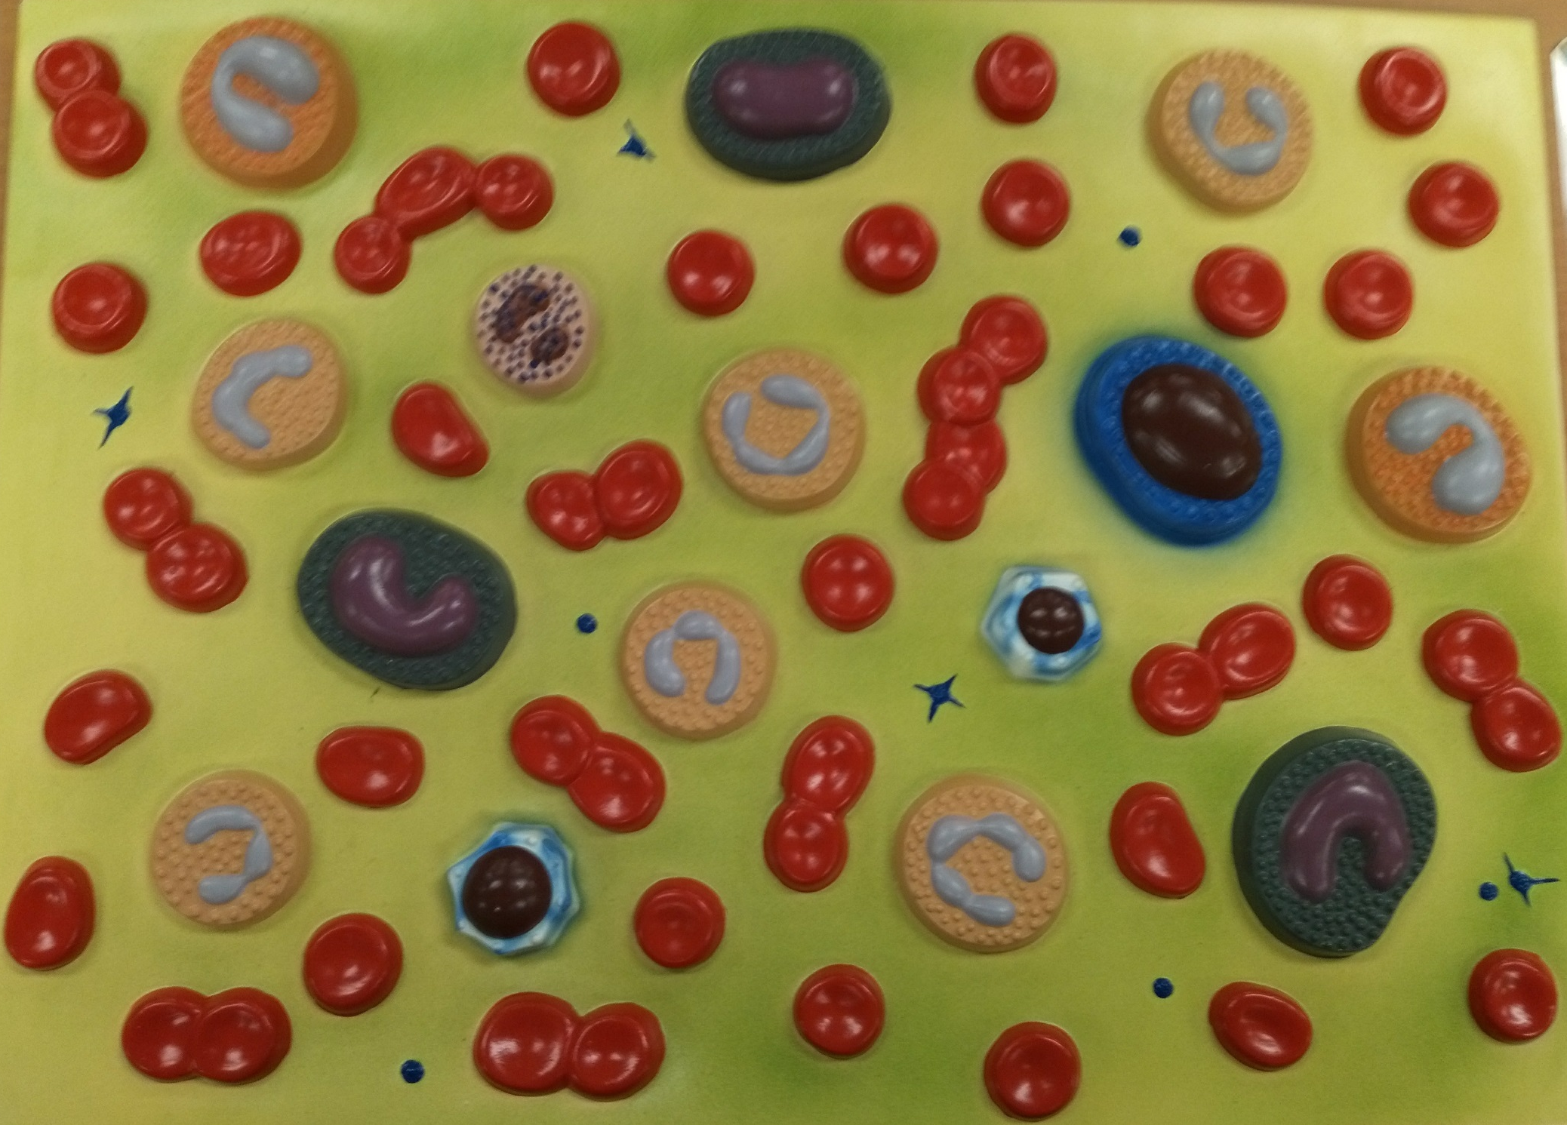

Slide 25
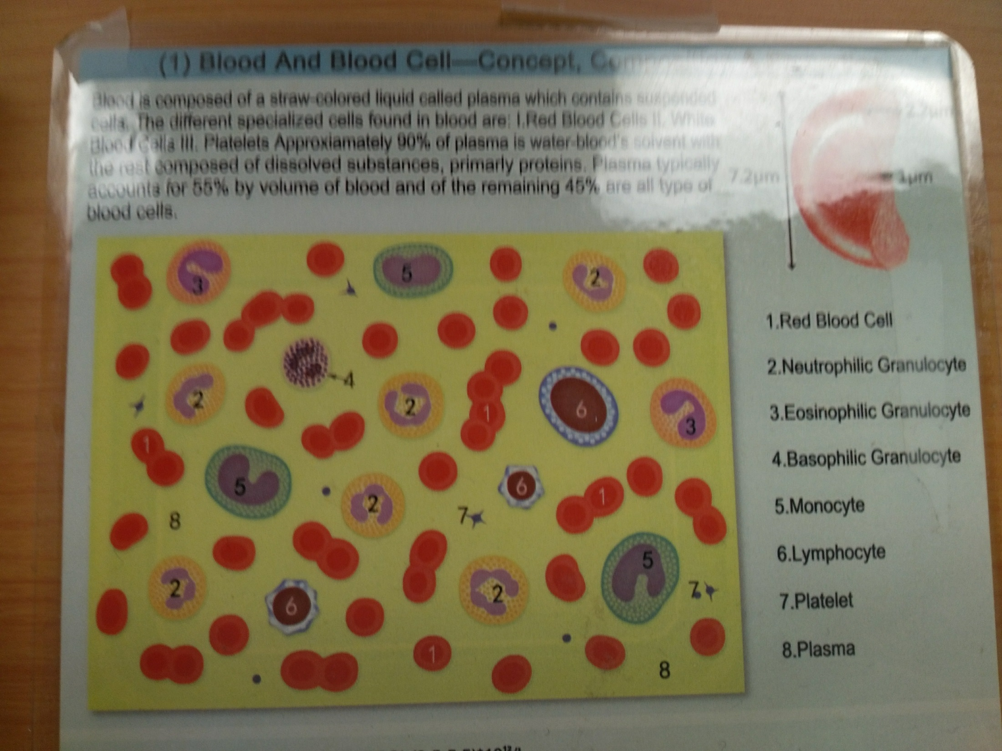

Slide 26
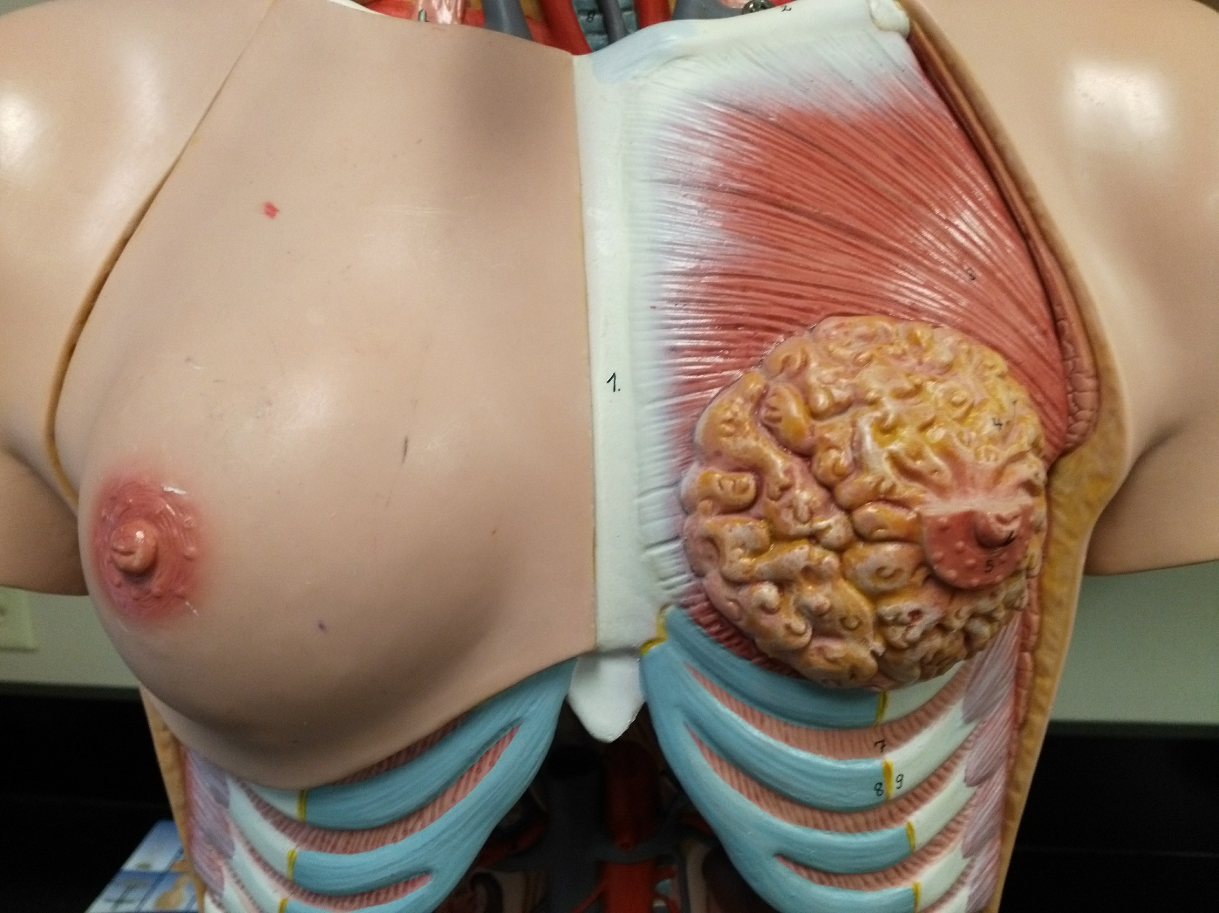

Slide 27
Mammary gland
Nipple
Areola

Slide 28
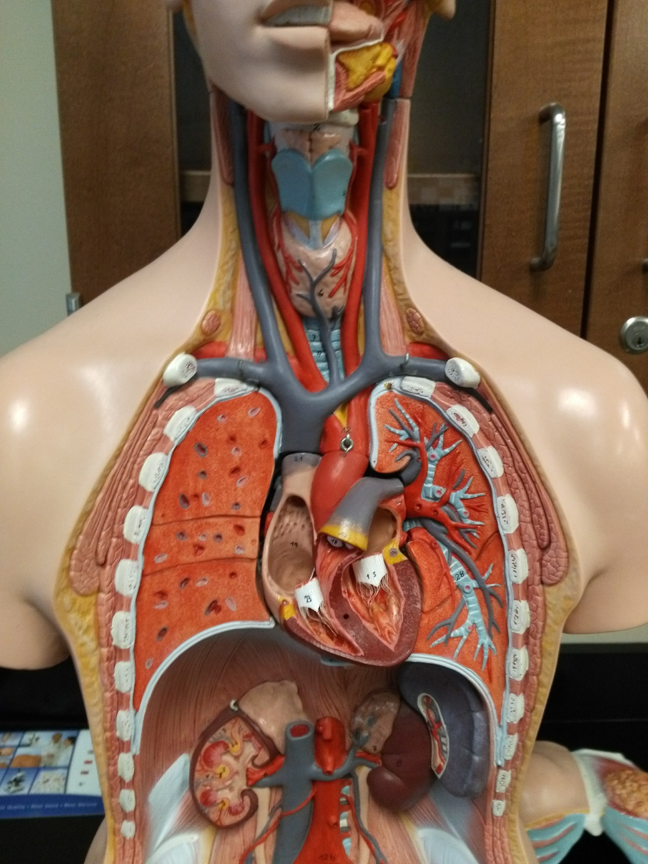

Slide 29
Thyroid gland

Slide 30
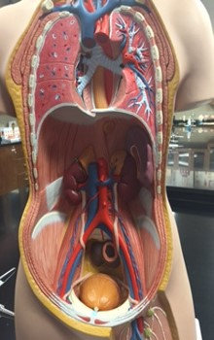

Slide 31
Adrenal gland
Spleen
Kidney
Inferior vena cava
Ureter
Abdominal aorta
Urinary bladder
Lymph node

Slide 32
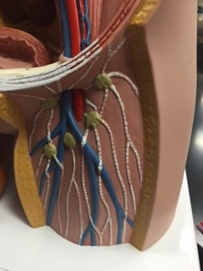

Slide 33
External iliac artery
External iliac vein
Femoral artery
Urinary bladder
Femoral vein
Lymph node
Lymph vessel

Slide 34
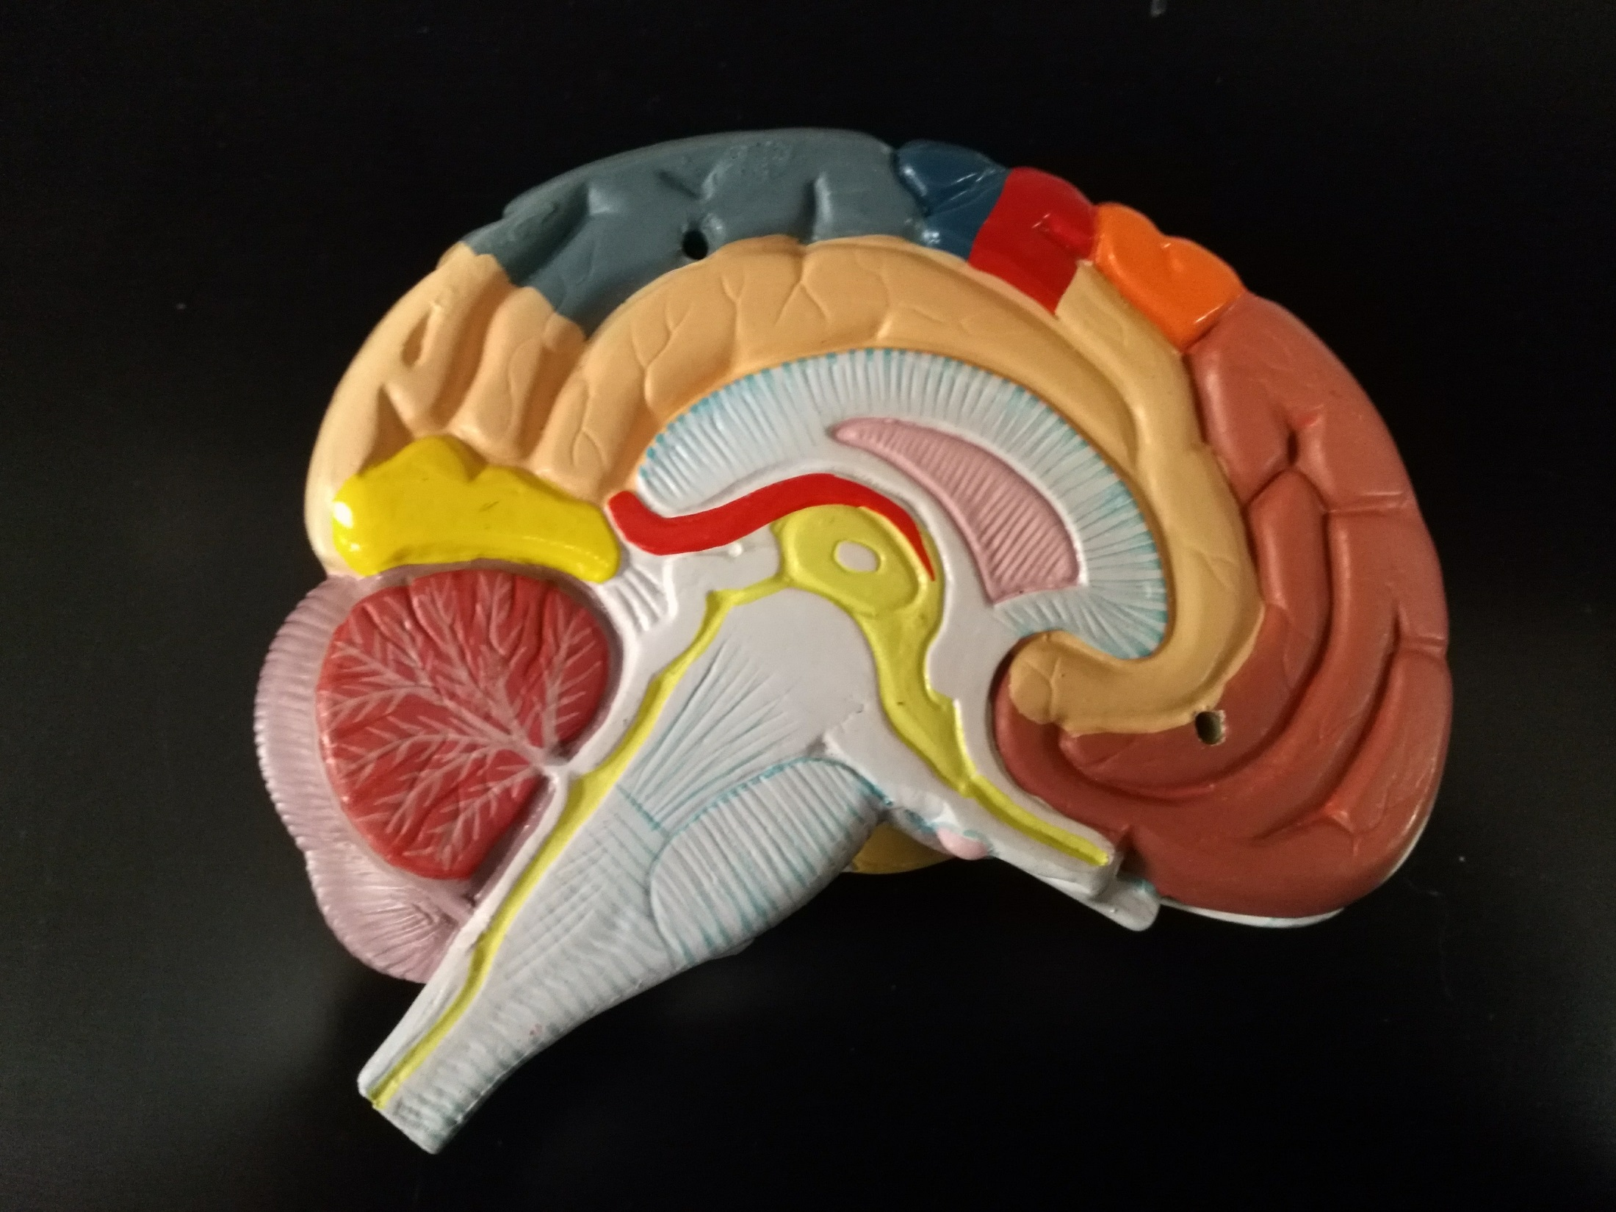

Slide 35
Hypothalamus
Pituitary gland

Slide 36
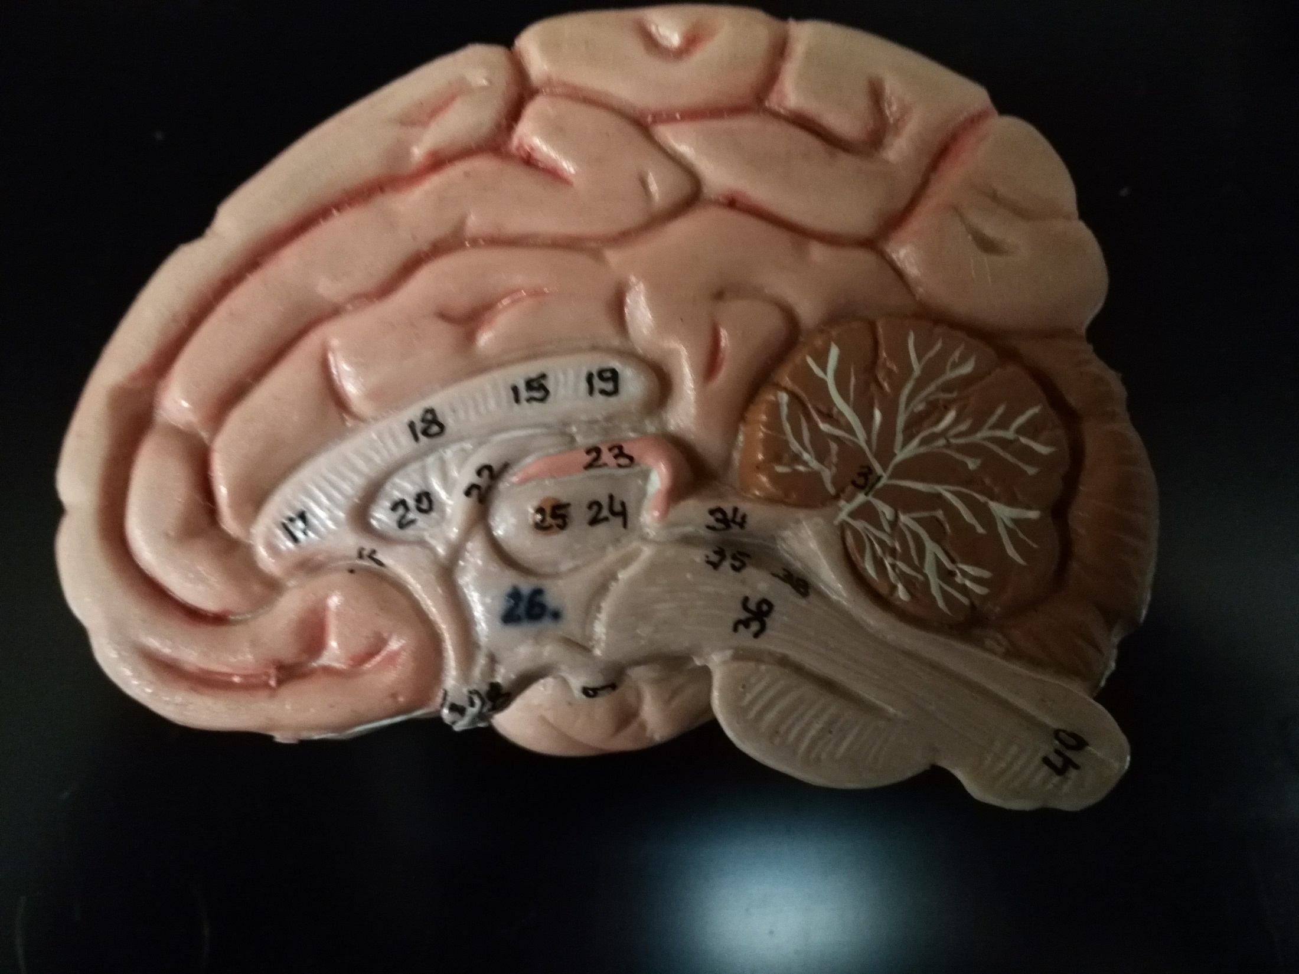

Slide 37
Pineal gland
Hypothalamus
Pituitary gland

Slide 38
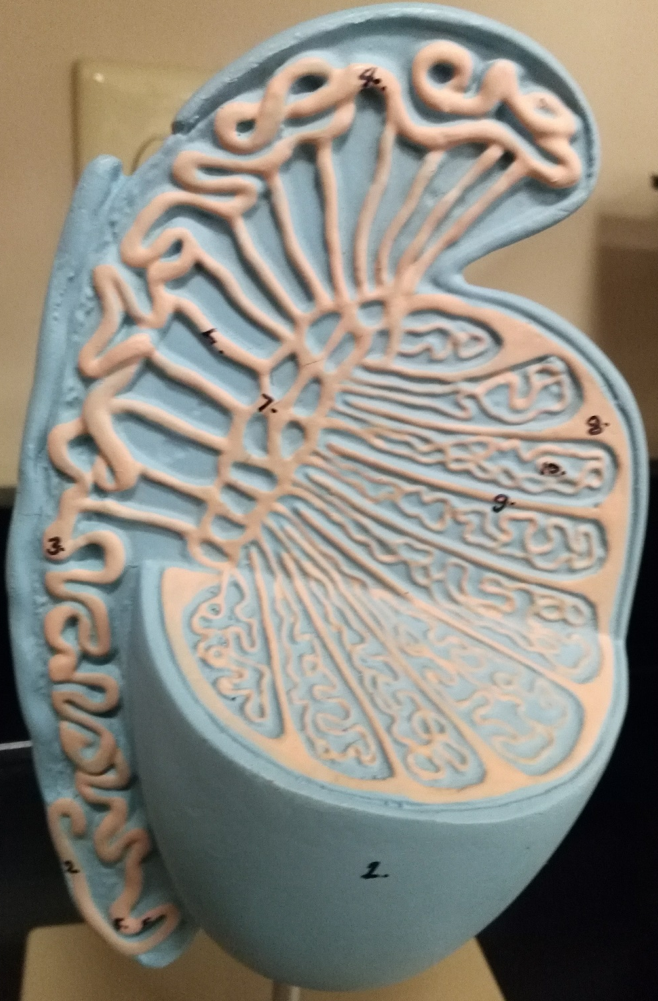
Testis

Slide 39
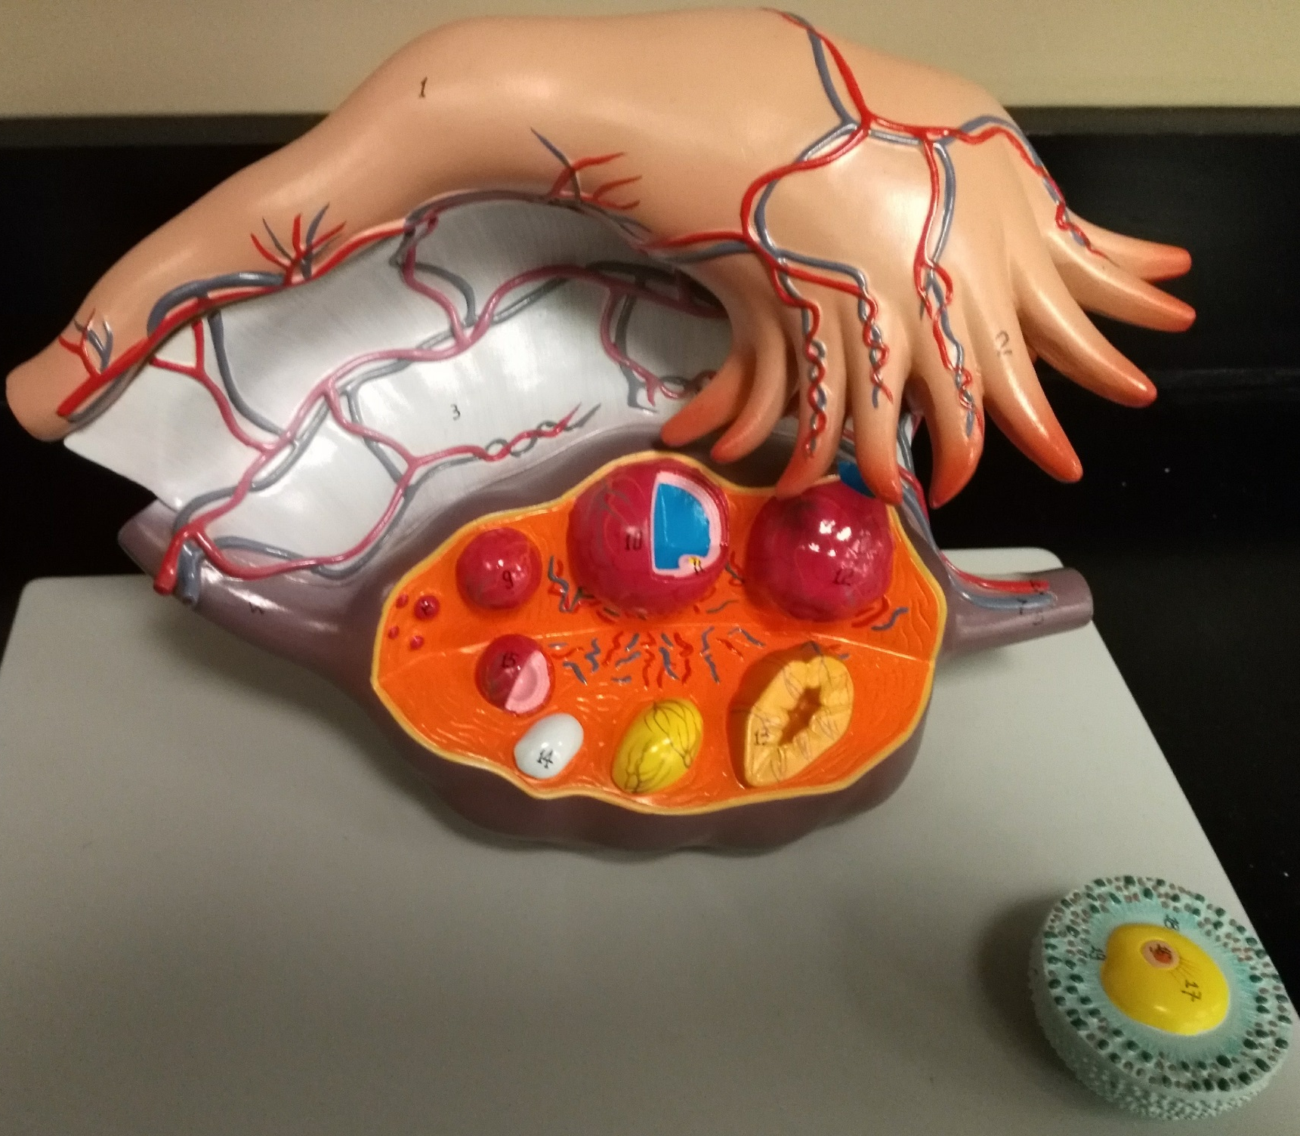
Ovary

