Slide 1
102 Digestion and Respiration Models

Slide 2
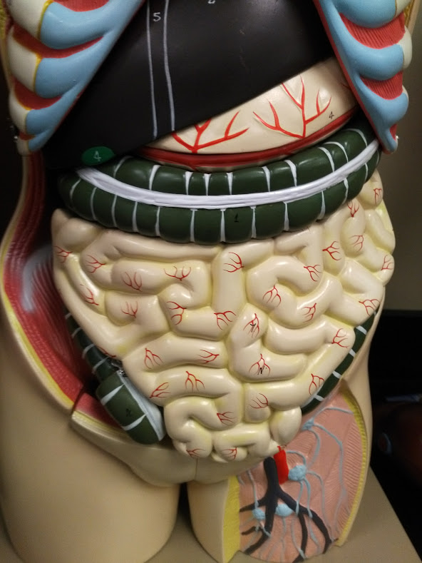

Slide 3
Falciform ligament
Left lobe of liver
Right lobe of liver
Stomach
Gallbladder
Teniae coli
Transverse colon
Small intestine
Ascending colon
Cecum
Sigmoid colon
Femoral artery
Femoral vein
Lymph node

Slide 4
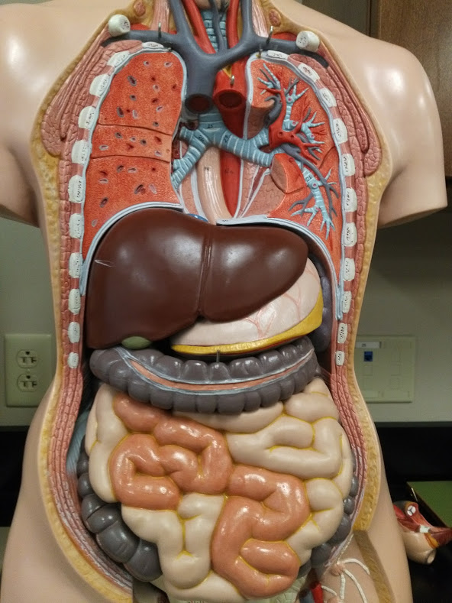

Slide 5
Trachea
Bronchus
Thoracic aorta
Diaphragm
Esophagus
Right lobe of liver
Left lobe of liver
Stomach
Greater omentum (cut)
Gallbladder
Transverse colon
Teniae coli
Small intestine
Ascending colon
Cecum
Sigmoid colon

Slide 6
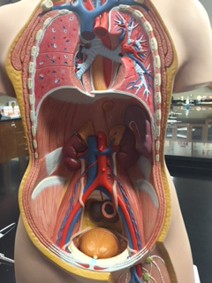

Slide 7
Jugular vein
Common carotid arteries
Subclavian vein
Brachiocephalic veins
Brachiocephalic trunk
Superior vena cava
Primary bronchus
Trachea
Thoracic aorta
Right lung
Esophagus
Left lung
Diaphragm
Celiac trunk
Inferior vena cava
Superior mesenteric artery
Abdominal aorta
Renal vein
Inferior mesenteric artery
Common iliac vein
Common iliac artery
Ureter
Internal iliac artery
External iliac vein
External iliac artery
Urinary bladder
Femoral vein
Femoral artery
Lymph node

Slide 8
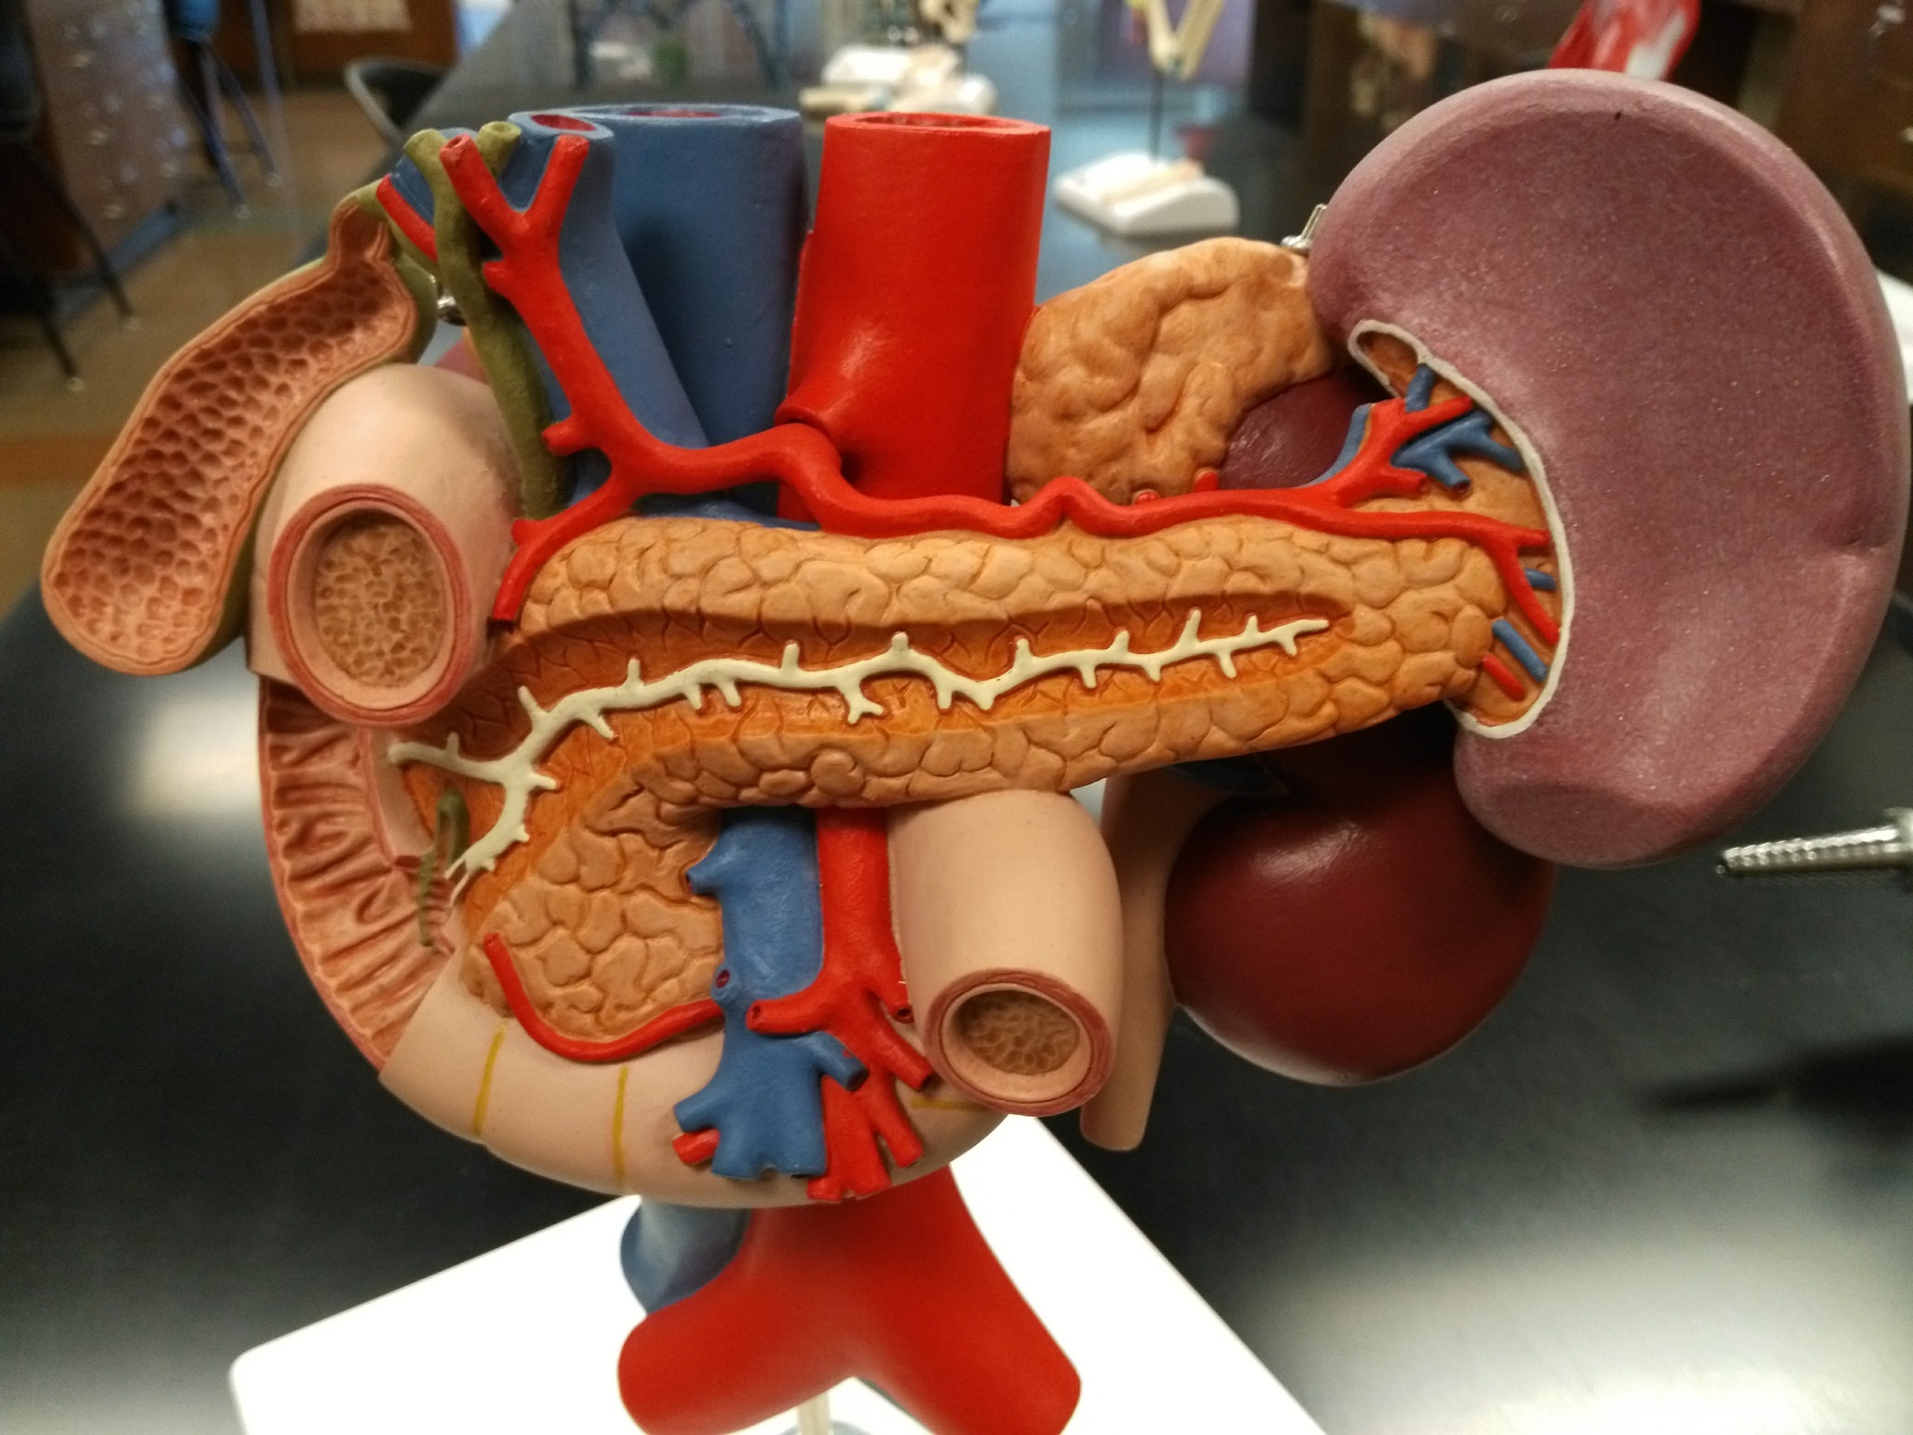

Slide 9
Inferior vena cava
Abdominal aorta
Celiac trunk
Adrenal gland
Bile duct
Hepatic portal vein
Spleen
Gallbladder
Pancreas
Duodenum
Pancreatic duct
Circular folds of duodenum
Hepatopancreatic sphincter and ampulla
Kidney
Ureter
Superior mesenteric artery and vein

Slide 10
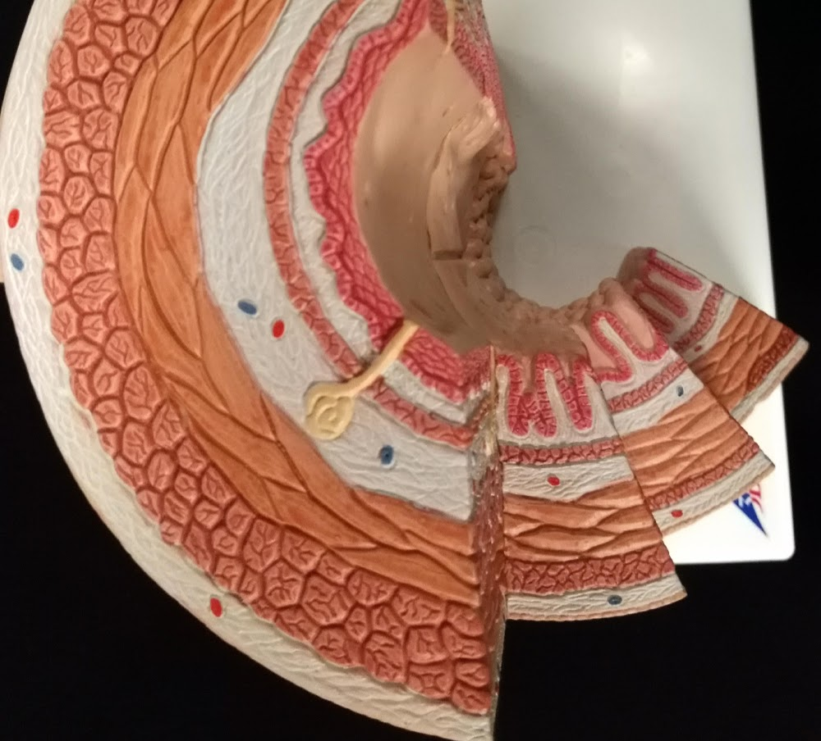

Slide 11
Circular layer
Mucosa
Longitudinal layer
Large intestine
Submucosa
Small intestine
Muscularis externa
Esophagus
Stomach
Adventia/Serosa

Slide 12
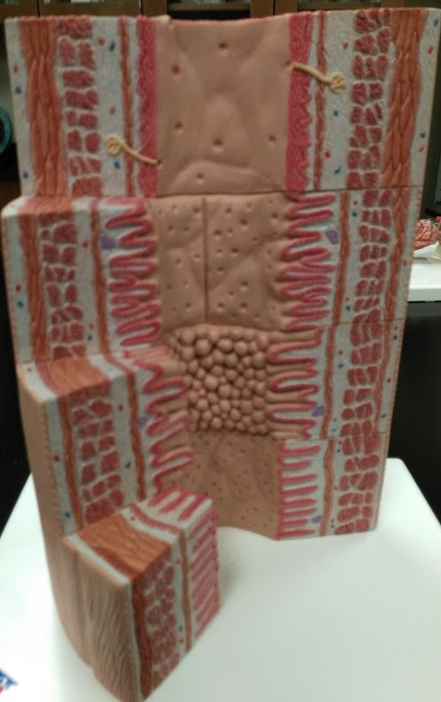
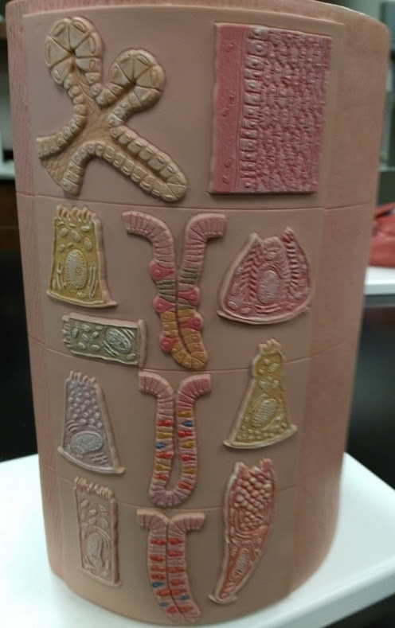

Slide 13
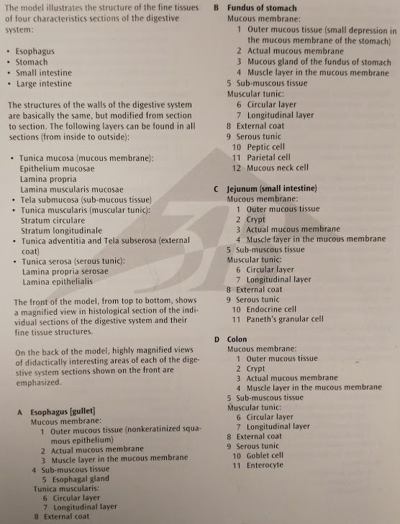
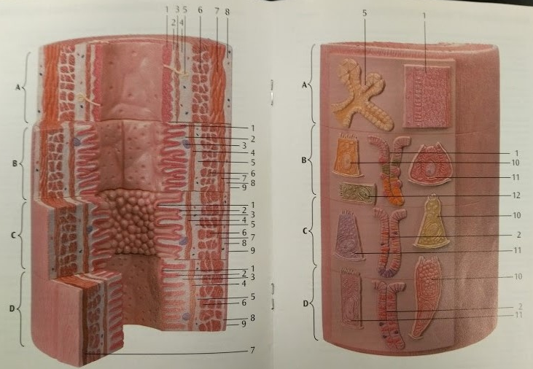

Slide 14
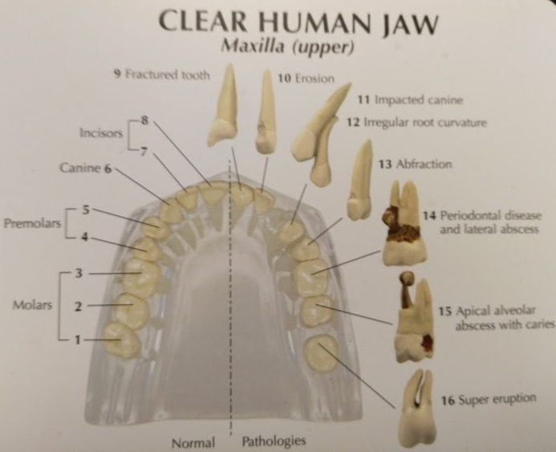

Slide 15
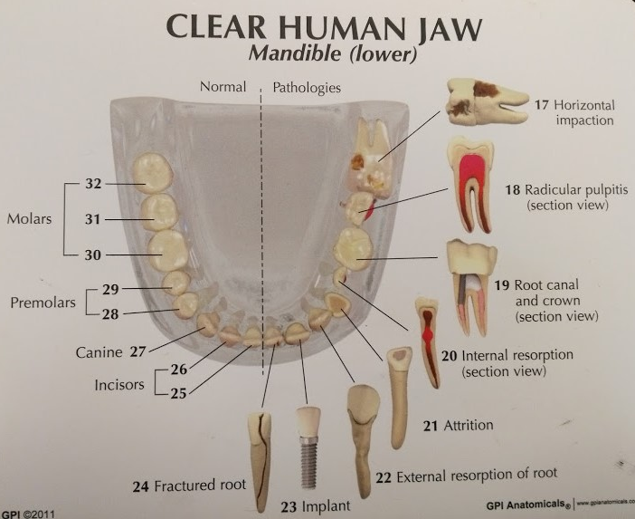

Slide 16
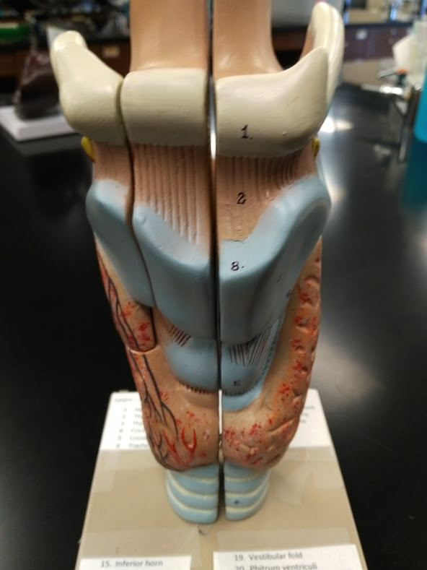
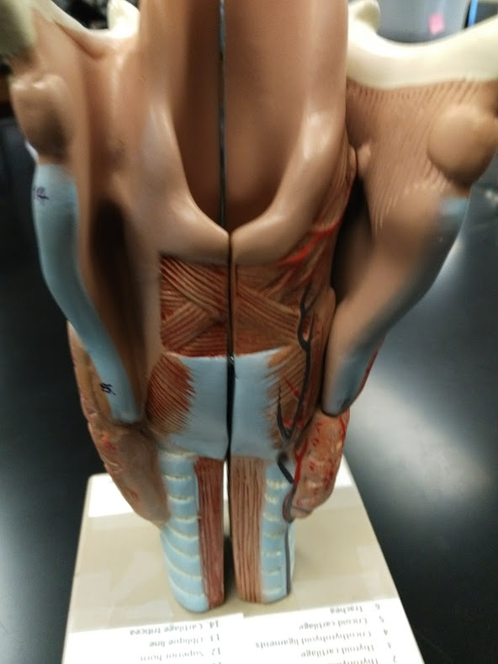
Epiglottis
Thyroid cartilage
Cricoid cartilage
Thyroid gland
Trachea
Trachealis muscle

Slide 17
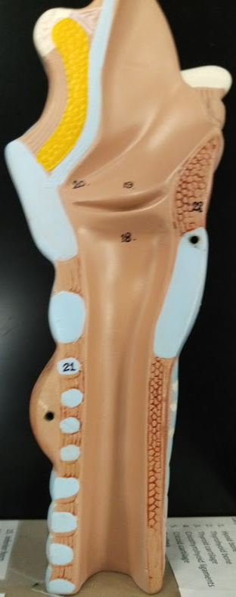
Larynx Model
1. Hyoid bone
2. Thyrohyoid membrane
3. Thyroid cartilage
4. Cricothyroihyoid ligaments
5. Cricoid cartilage
6. Trachea
7. Epiglottis
8. Laryngeal prominence of thyroid cartilage
9. Lateral thyrohyoid ligament
10. Superior laryngeal artery
11. Interior laryngeal nerve
12. Inferior cornu of thyroid cartilage
13. Oblique line of thyroid cartilage
14. Superior cornu of thyroid cartilage
15. Posterior of thyroid cartilage
16. Inferior tubercle of thyroid cartilage
17. Ventricle of larynx
18. Vocal fold (true vocal cord)
19. Vestibular fold (false vocal cord)
20. Phitrum ventriculi
21. Tracheal cartilage
22. Lamina of cricoid cartilage
23. Trachealis muscle
24. Thyroid gland

Slide 18
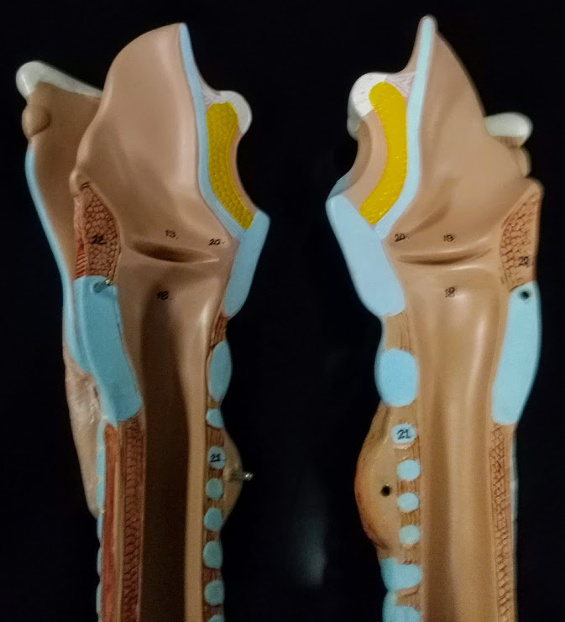
Larynx Model
1. Hyoid bone
2. Thyrohyoid membrane
3. Thyroid cartilage
4. Cricothyroihyoid ligaments
5. Cricoid cartilage
6. Trachea
7. Epiglottis
8. Laryngeal prominence of thyroid cartilage
9. Lateral thyrohyoid ligament
10. Superior laryngeal artery
11. Interior laryngeal nerve
12. Inferior cornu of thyroid cartilage
13. Oblique line of thyroid cartilage
14. Superior cornu of thyroid cartilage
15. Posterior of thyroid cartilage
16. Inferior tubercle of thyroid cartilage
17. Ventricle of larynx
18. Vocal fold (true vocal cord)
19. Vestibular fold (false vocal cord)
20. Phitrum ventriculi
21. Tracheal cartilage
22. Lamina of cricoid cartilage
23. Trachealis muscle
24. Thyroid gland

Slide 19
Epiglottis
Vestibular fold
Thyroid cartilage
Vocal fold
Cricoid cartilage
Trachea

Slide 20
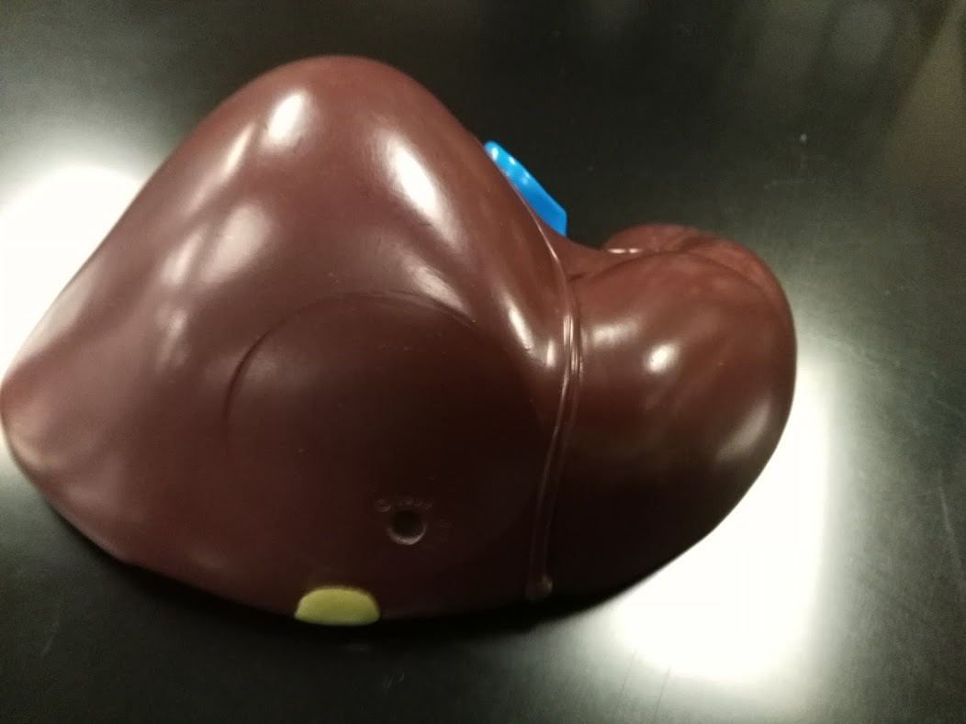

Slide 21
Inferior vena cava
Falciform ligament
Right lobe of liver
Left lobe of liver
Gallbladder

Slide 22
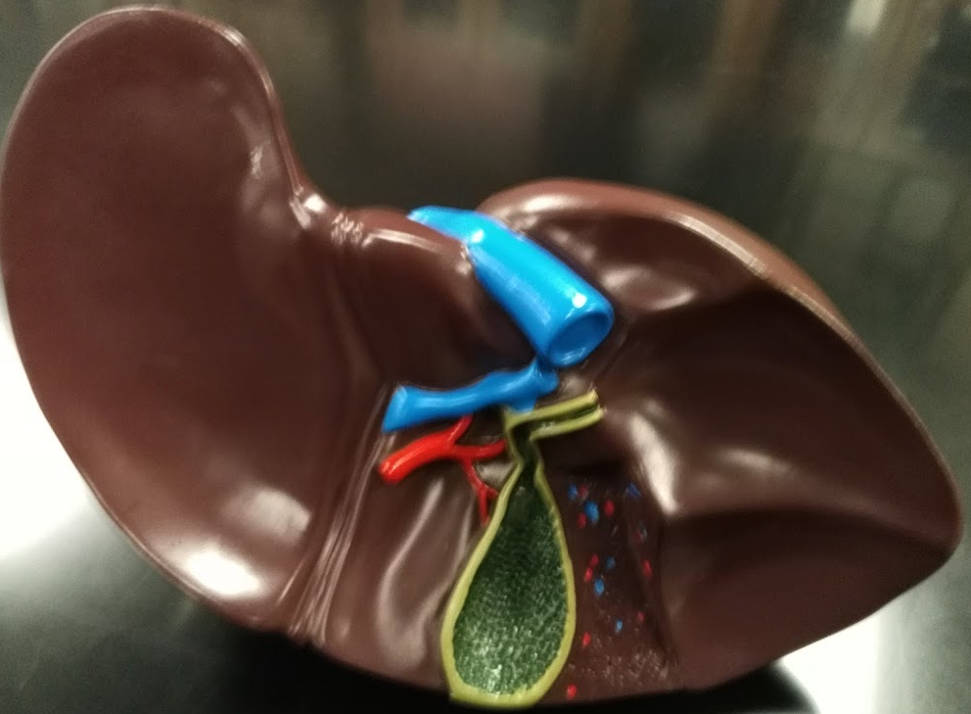

Slide 23
Left lobe of liver
Inferior vena cava
Caudate lobe of liver
Hepatic portal vein
Hepatic artery
Cystic duct
Right lobe of liver
Quadrate lobe of liver
Gallbladder

Slide 24
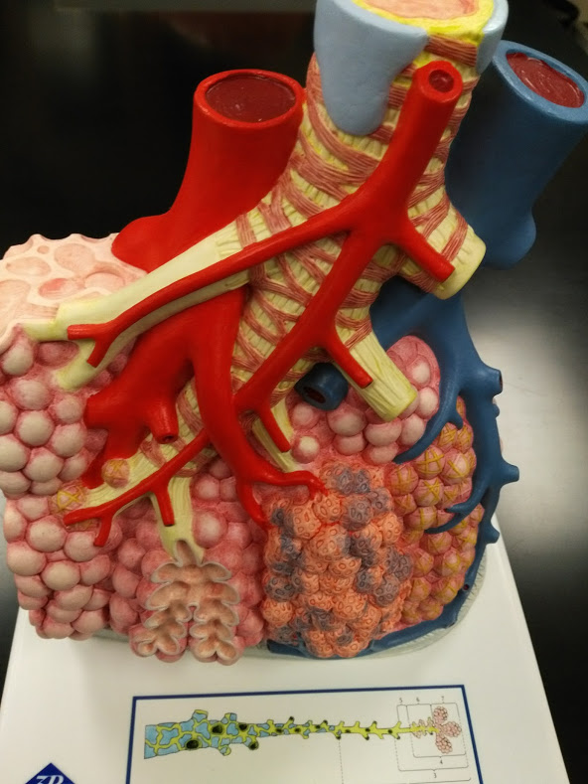
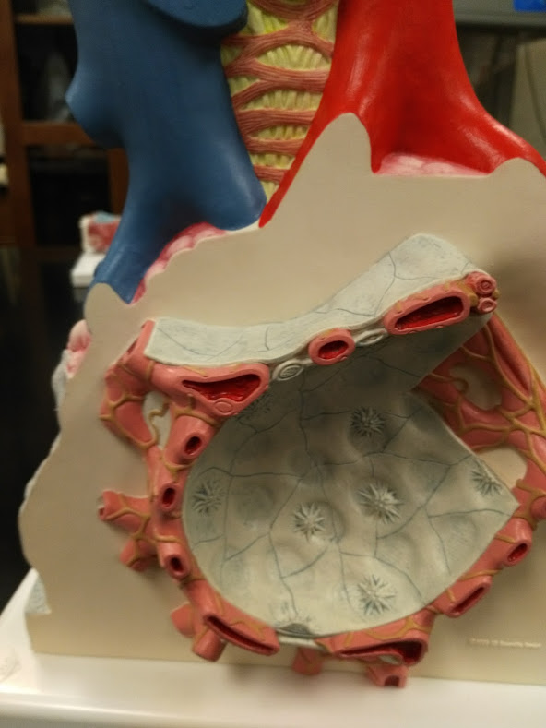

Slide 25
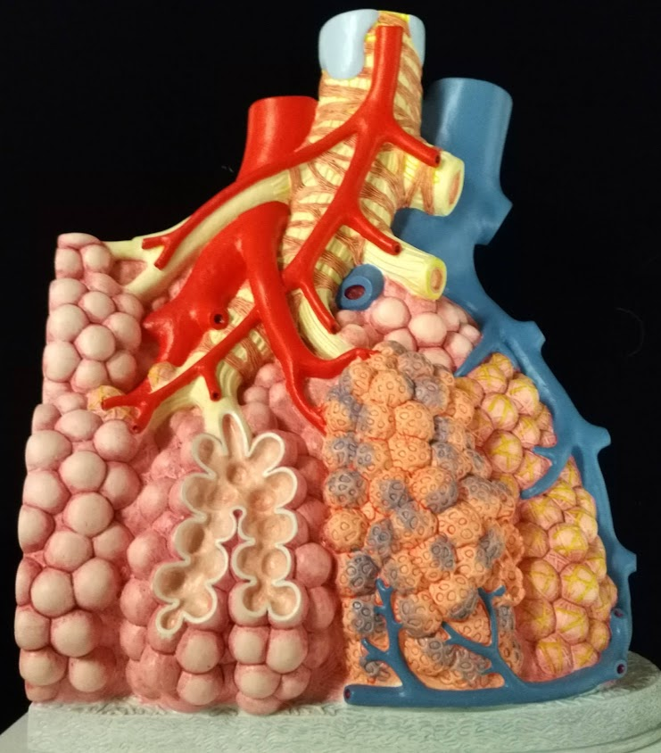
Bronchiole
with smooth muscle
Pulmonary vein, branch
Pulmonary artery, branch
Terminal bronchiole
Respiratory bronchiole
Alveoli
Pulmonary capillaries

Slide 26
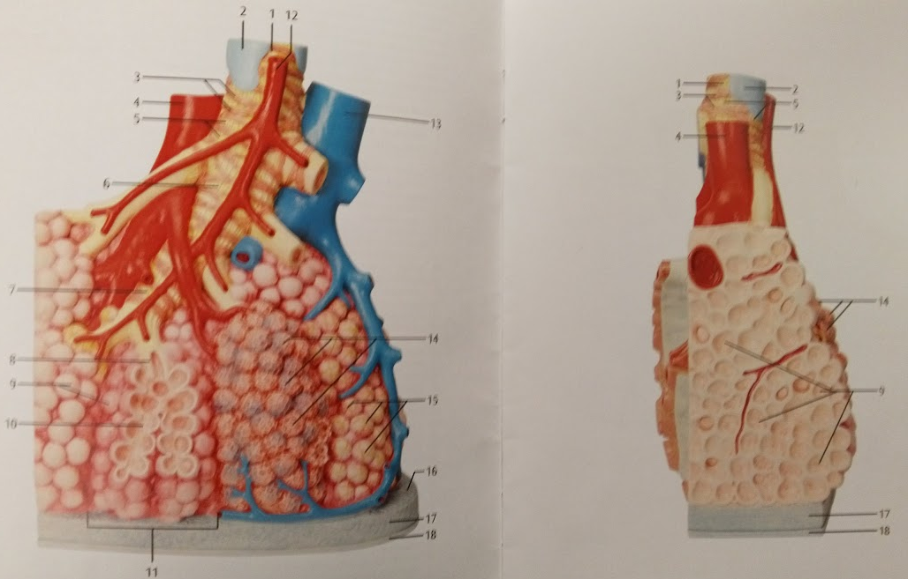

Slide 27
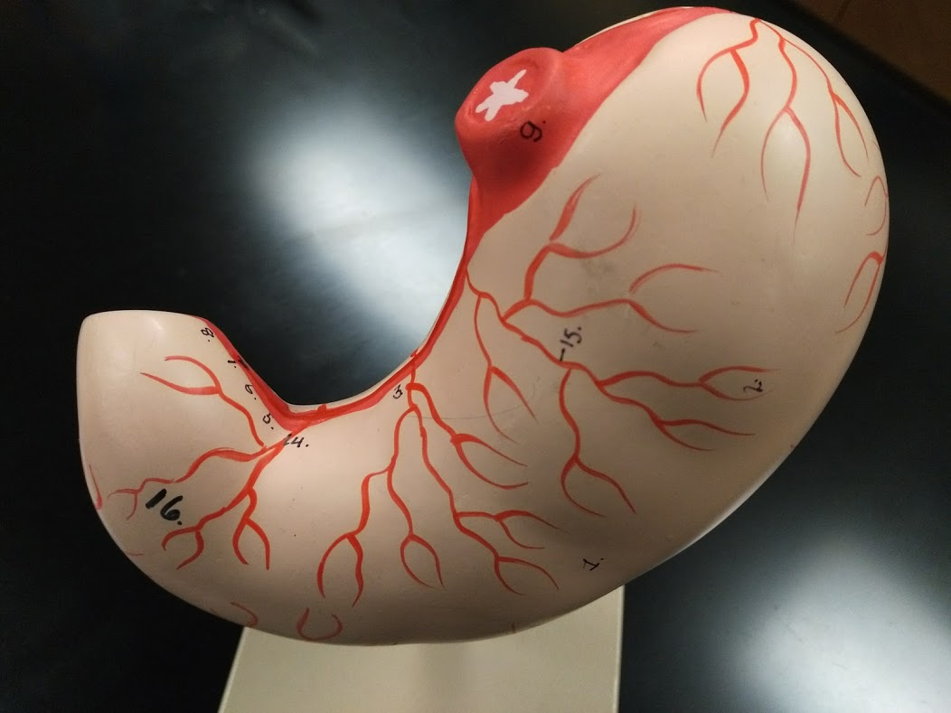

Slide 28
Cardiac (lower esophageal) sphincter
Cardia
of stomach
Fundus of stomach
Body of stomach
Pyloric sphincter
Lesser curvature of stomach
Greater curvature of stomach
Pyloric antrum

Slide 29
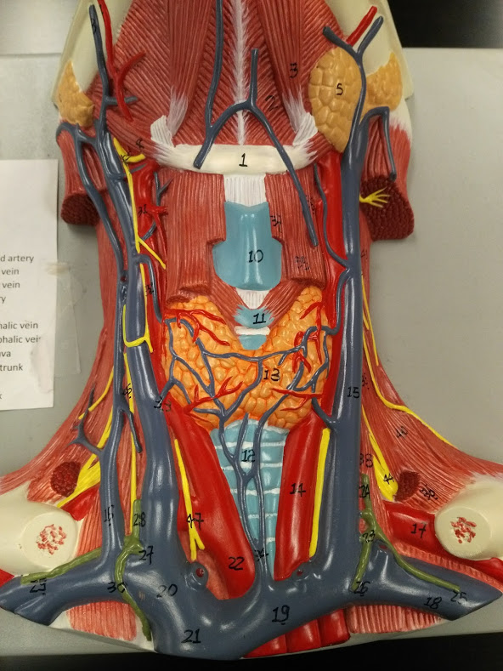

Slide 30
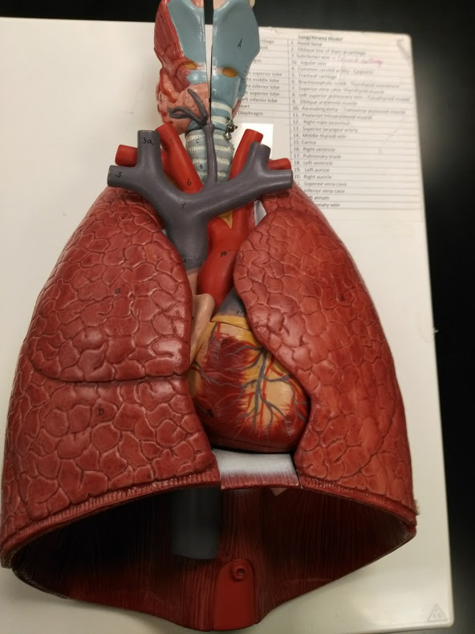
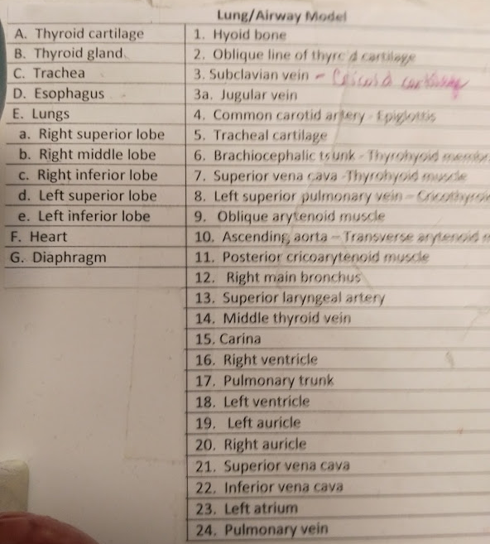

Slide 31
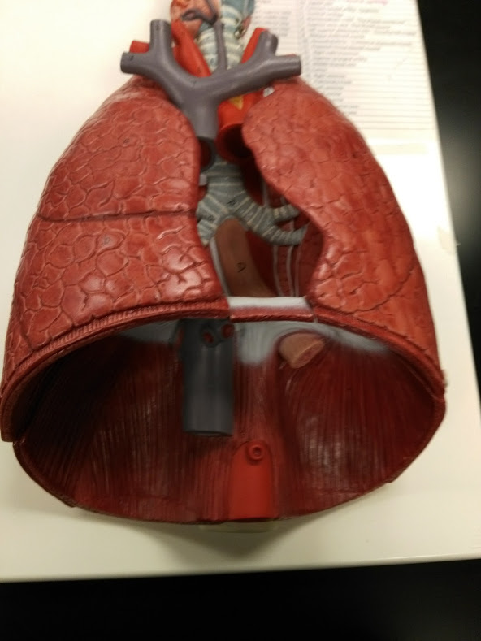

Slide 32
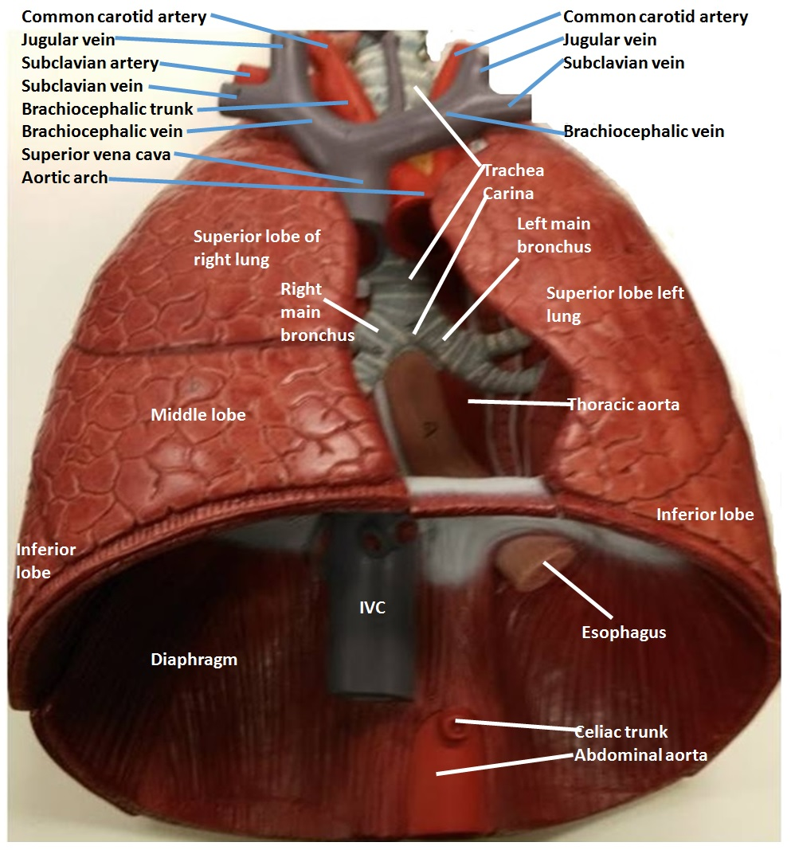

Slide 33
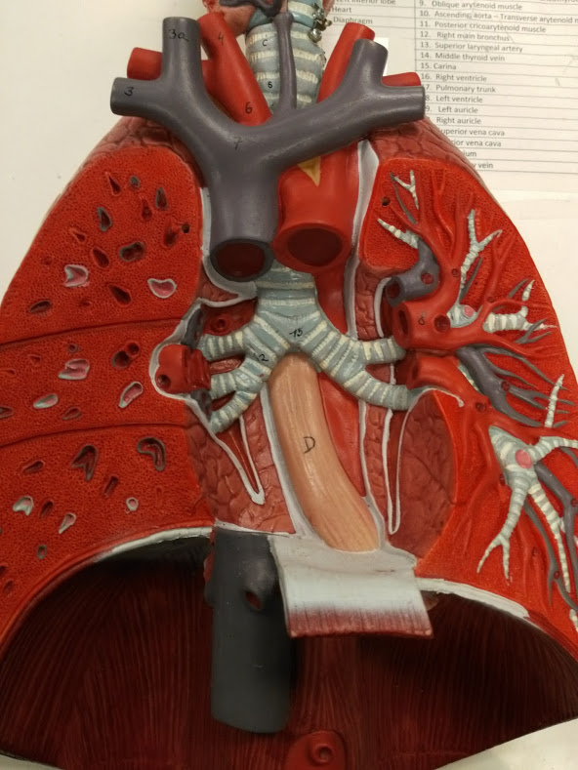

Slide 34
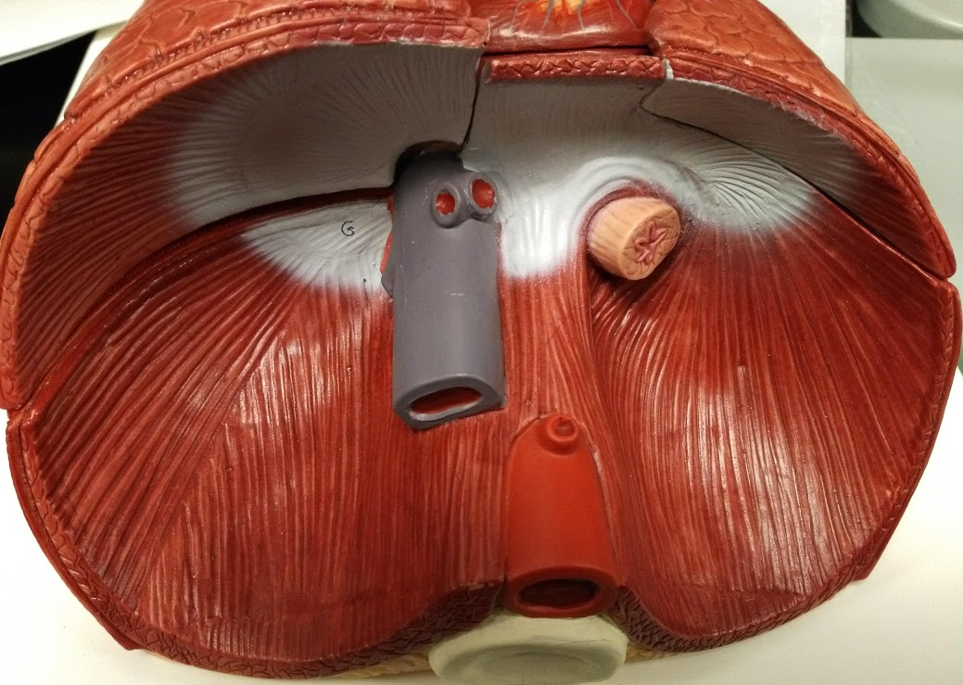

Slide 35
Esophagus
Inferior vena cava
Diaphragm
Celiac Trunk
Abdominal aorta

