Slide 1
102 Urinary, Lymphatic, Immune, Endocrine

Slide 2
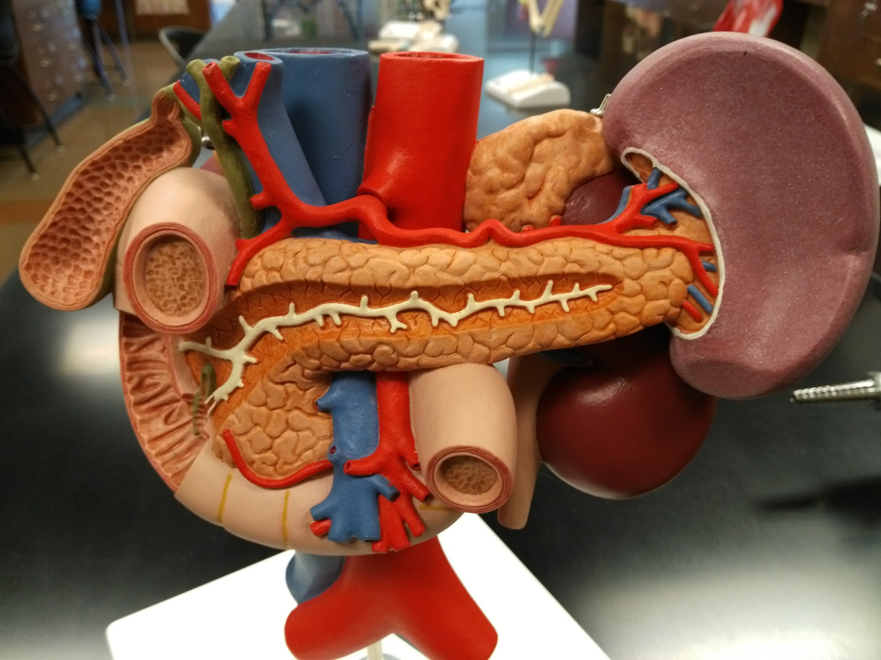

Slide 3
Inferior vena cava
Abdominal aorta
Celiac trunk
Adrenal gland
Bile duct
Hepatic portal vein
Spleen
Gallbladder
Pancreas
Duodenum
Pancreatic duct
Circular folds of duodenum
Hepatopancreatic sphincter and ampulla
Kidney
Ureter
Superior mesenter artery and vein

Slide 4
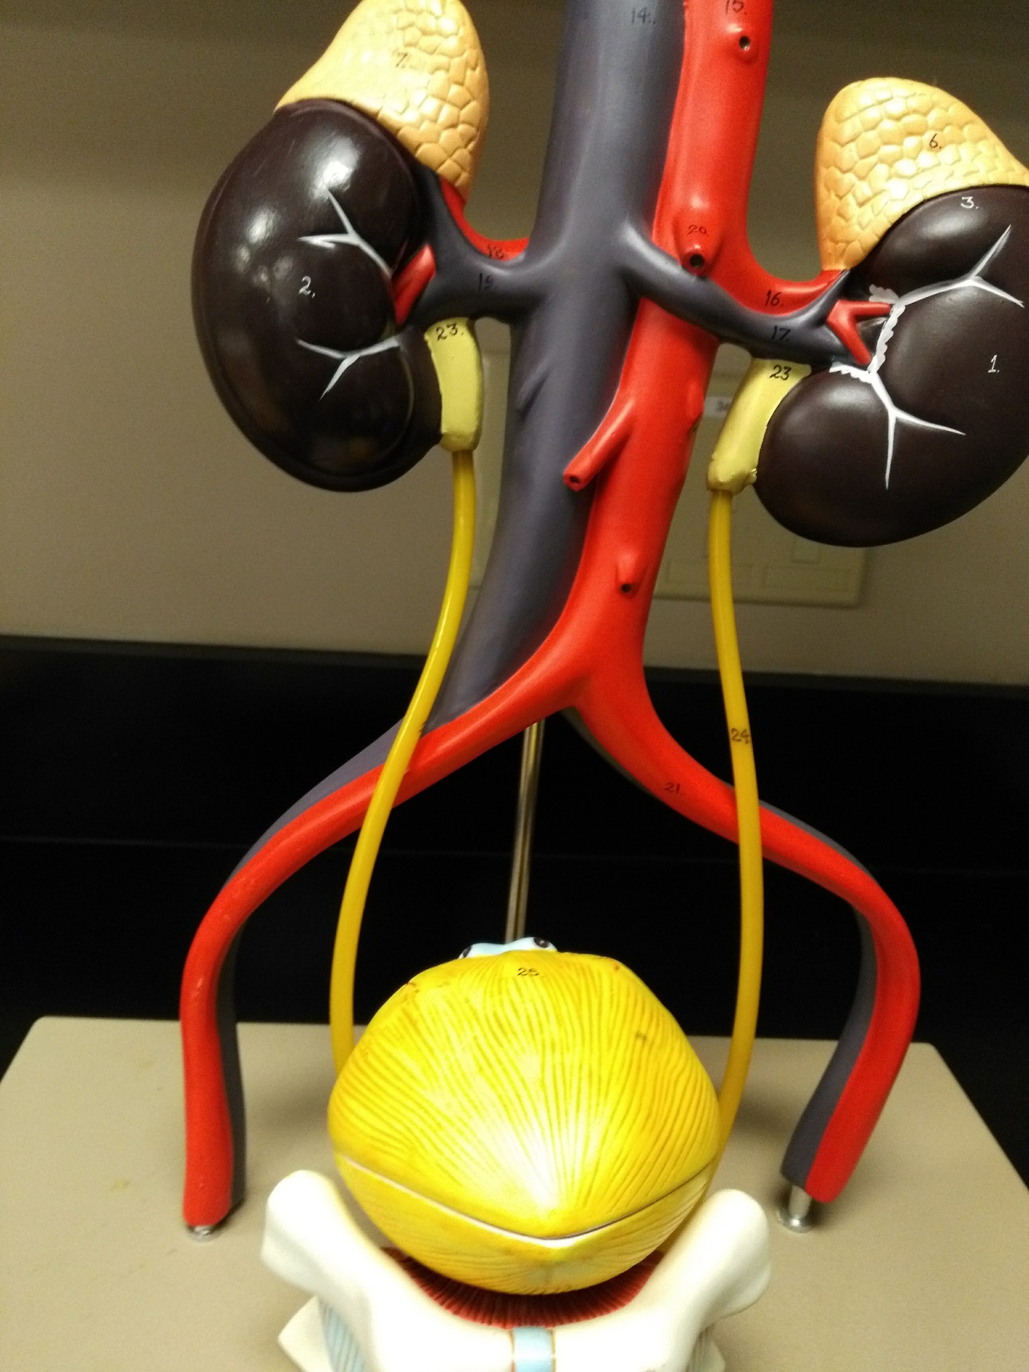

Slide 5
Adrenal gland
Renal artery
Renal vein
Inferior vena cava
Ureter
Abdominal aorta
Common iliac artery
Urinary bladder

Slide 6
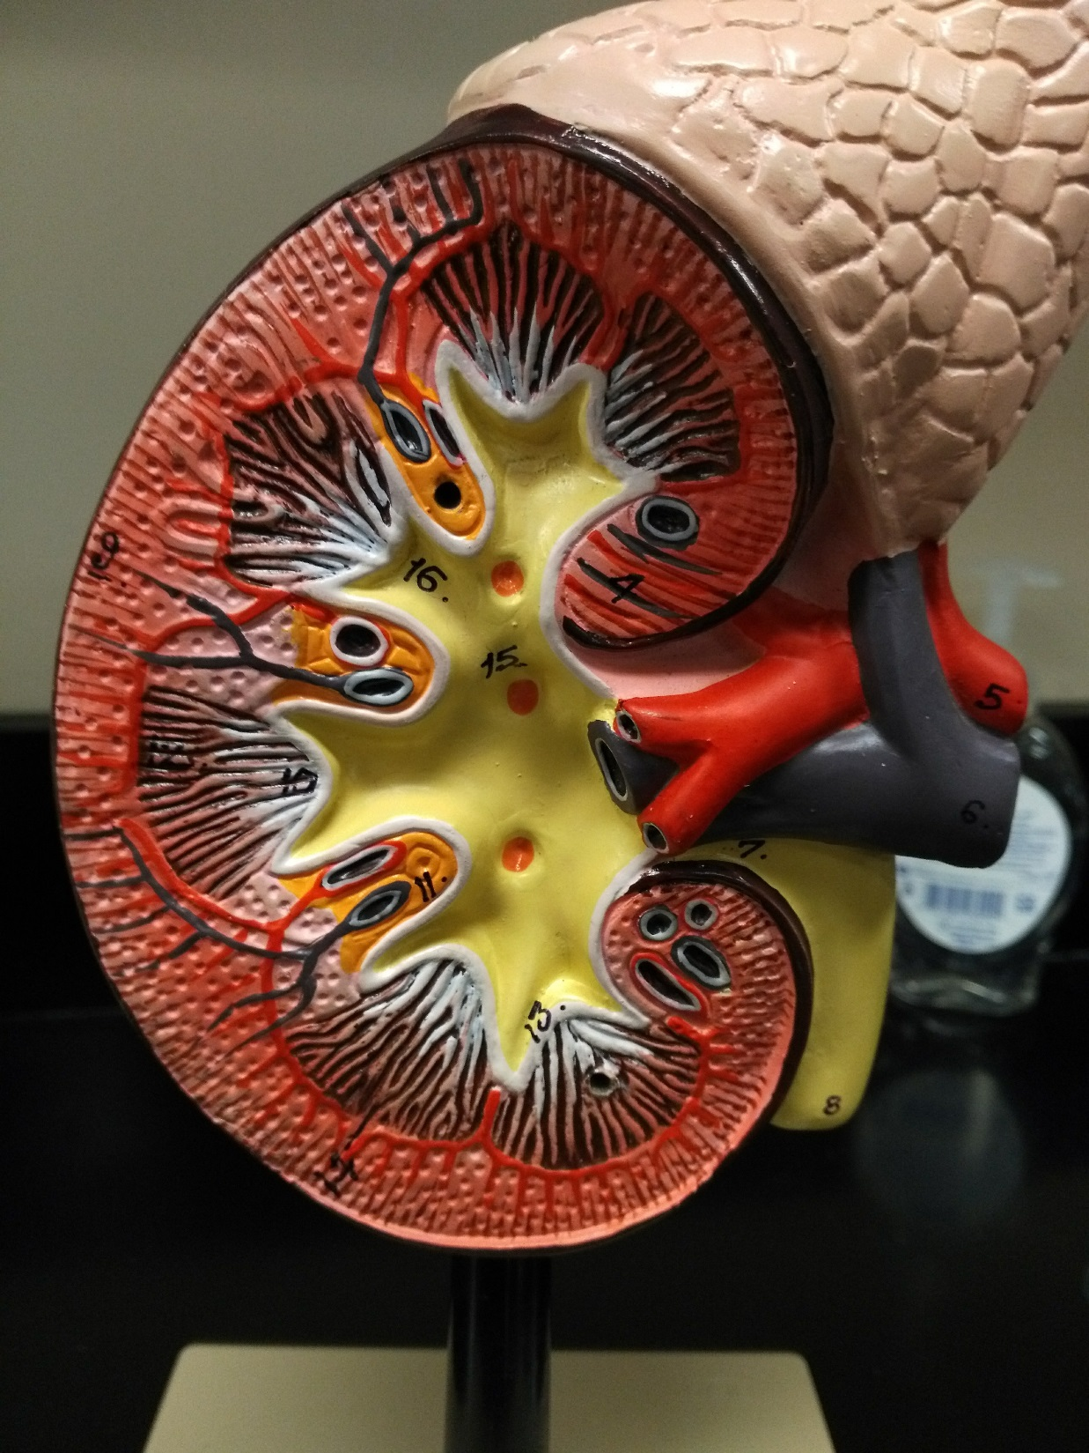

Slide 7
Adrenal gland
Renal cortex
Renal pyramid
Major calyx
Renal column
Renal artery
Renal vein
Renal papilla
Renal pelvis
Minor calyx
Ureter

Slide 8
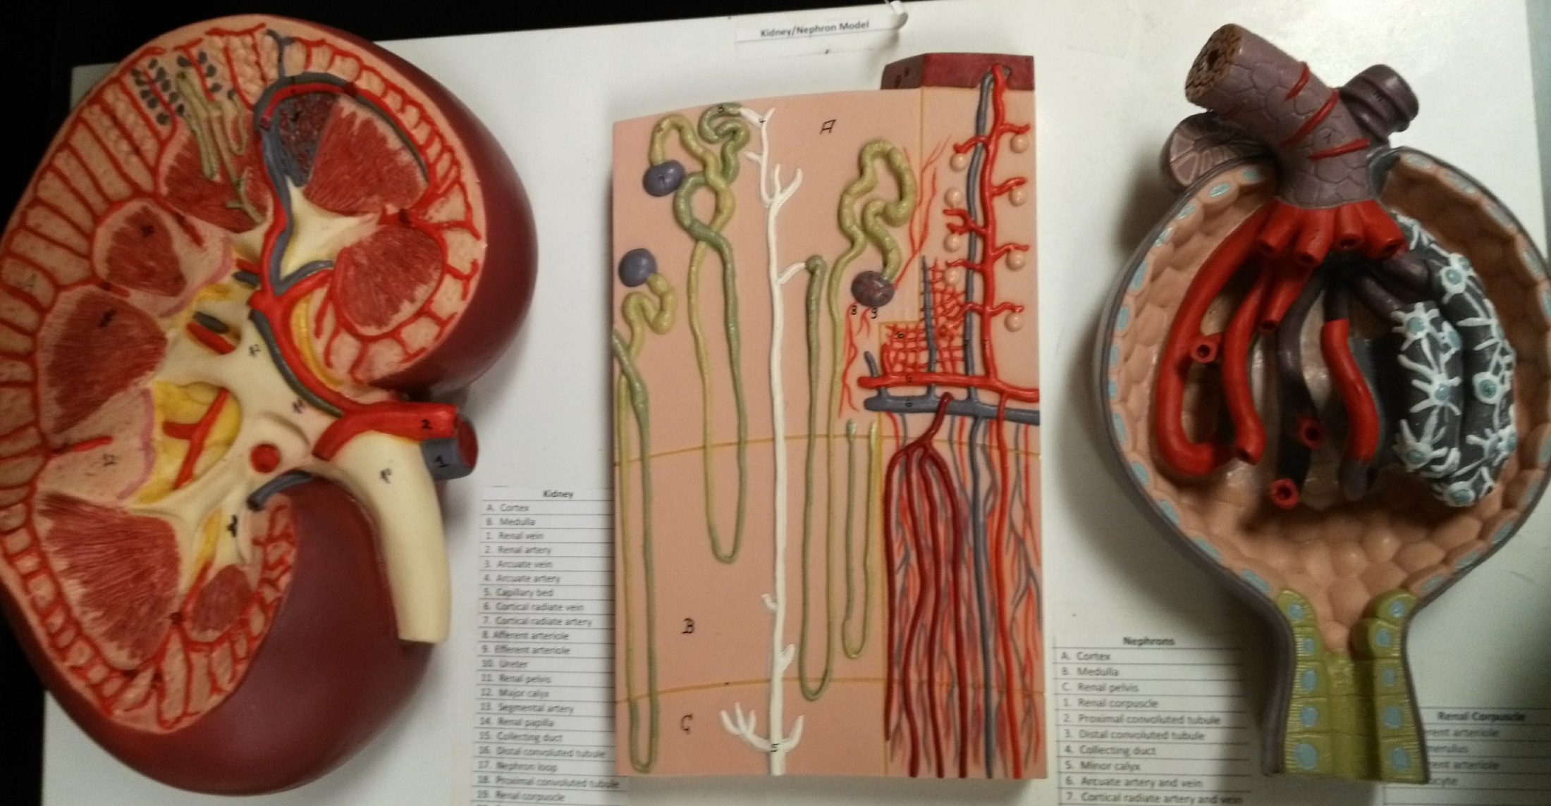

Slide 9
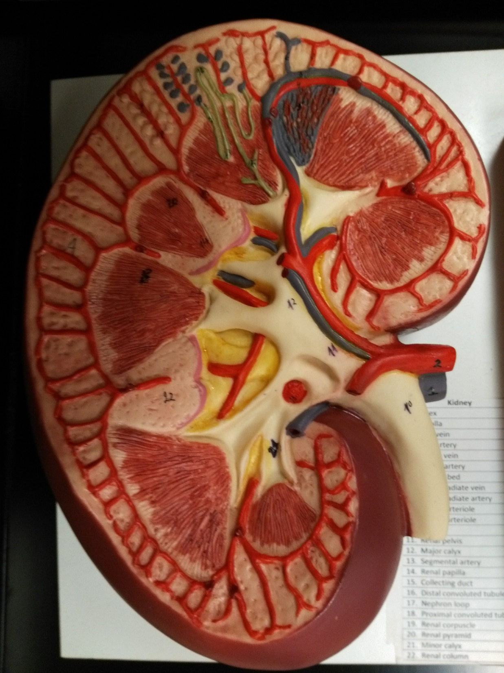

Slide 10
Renal cortex
Cortical radiate artery
Arcuate artery
Renal column
Interlobar artery
Segmental artery
Renal pyramid
Renal artery
Renal vein
Renal papilla
Renal pelvis
Ureter
Minor calyx
Major calyx

Slide 11
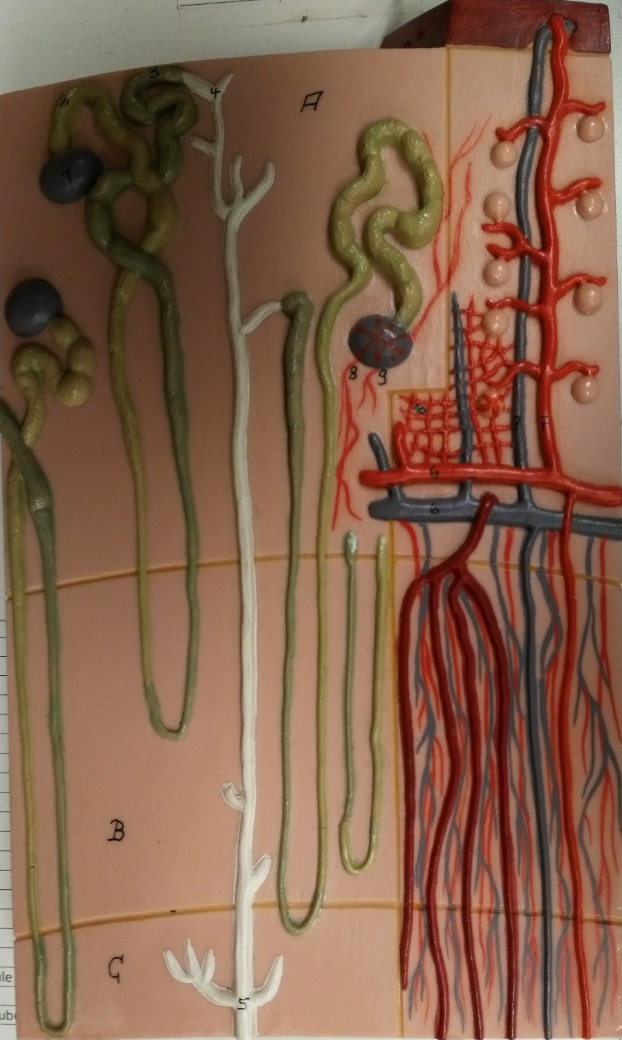

Slide 12
Proximal convoluted tubule
Renal corpuscle
Glomerulus
Afferent arteriole
Cortical radiate artery
Peritubular capillaries
Arcuate artery
Vasa recta
Distal convoluted tubule
Nephron loop
Collecting duct

Slide 13
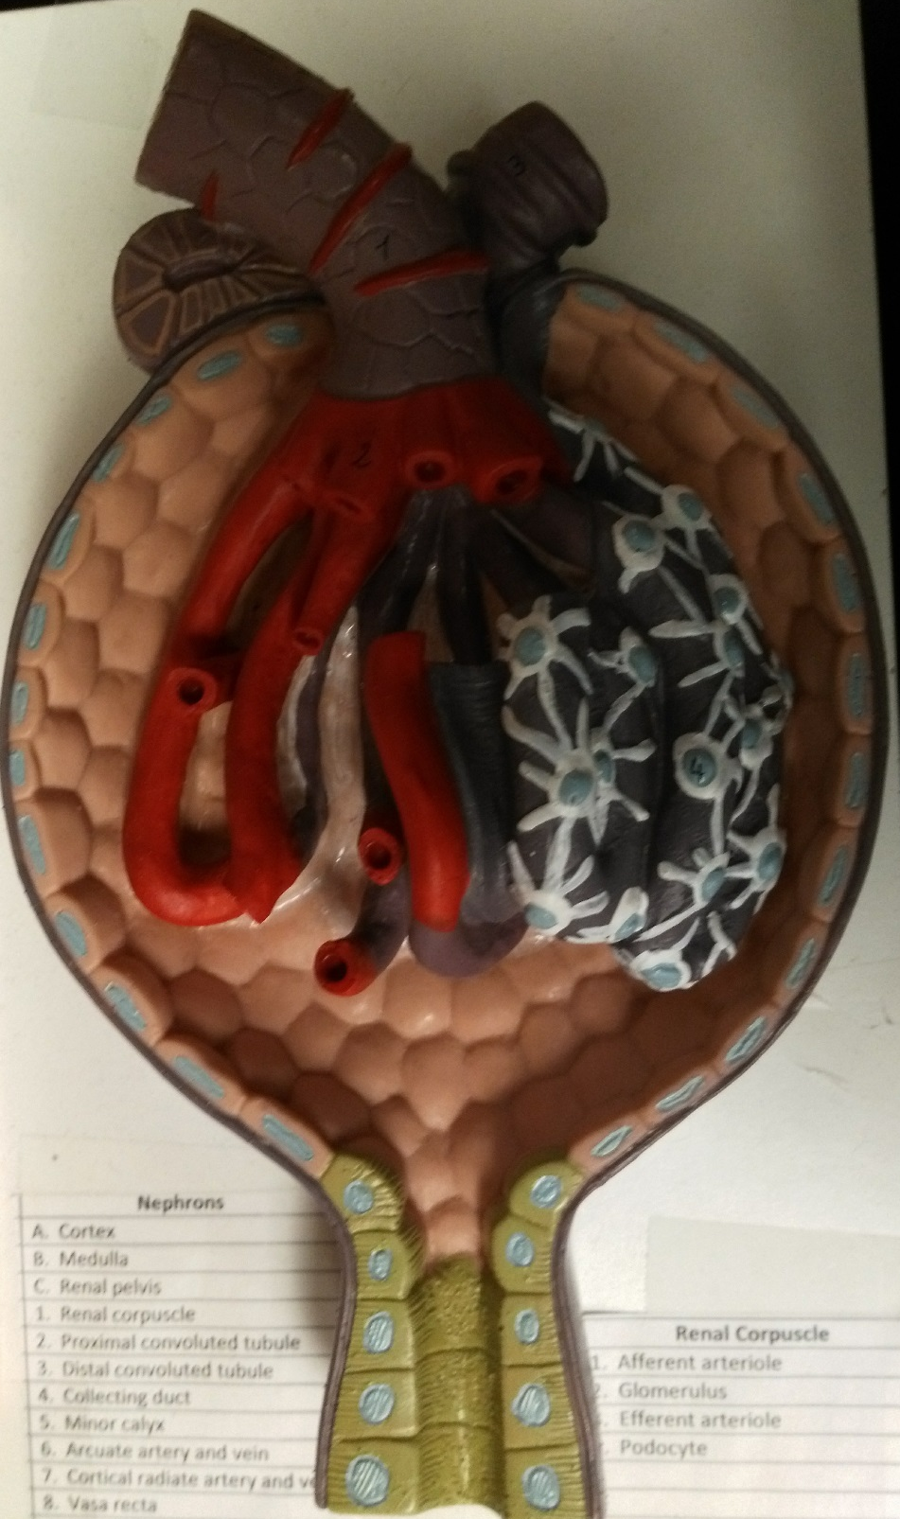

Slide 14
Renal corpuscle is glomerulus and Bowman’s capsule.
Efferent arteriole
Afferent arteriole
Juxtaglomerular apparatus
Bowman’s capsule/Glomerular capsule
Podocyte/Visceral layer of Bowman’s capsule
Glomerulus
Filtration membrane:
Fenestrations of endothelia
Basement membrane
Filtration slits of podocytes.
Proximal convoluted tubule

Slide 15
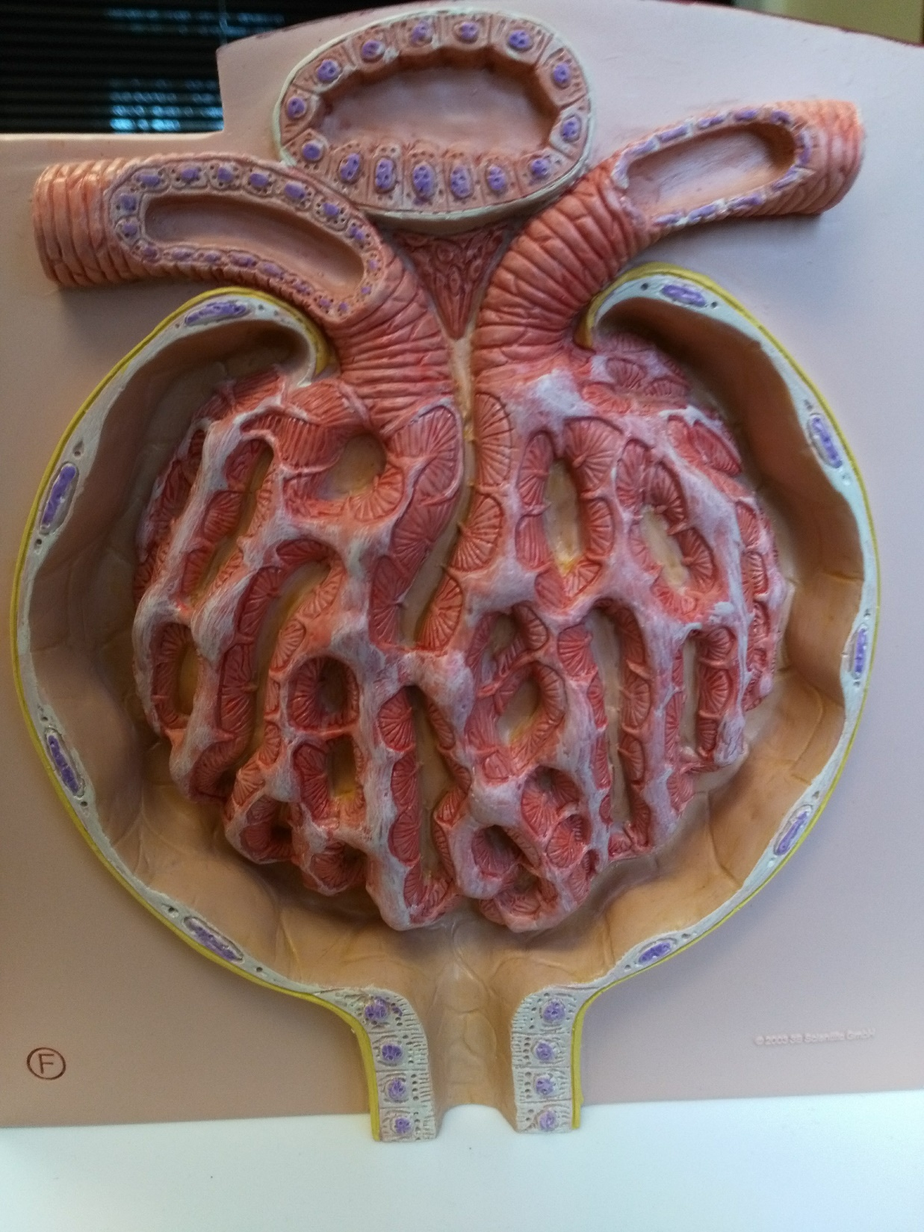

Slide 16
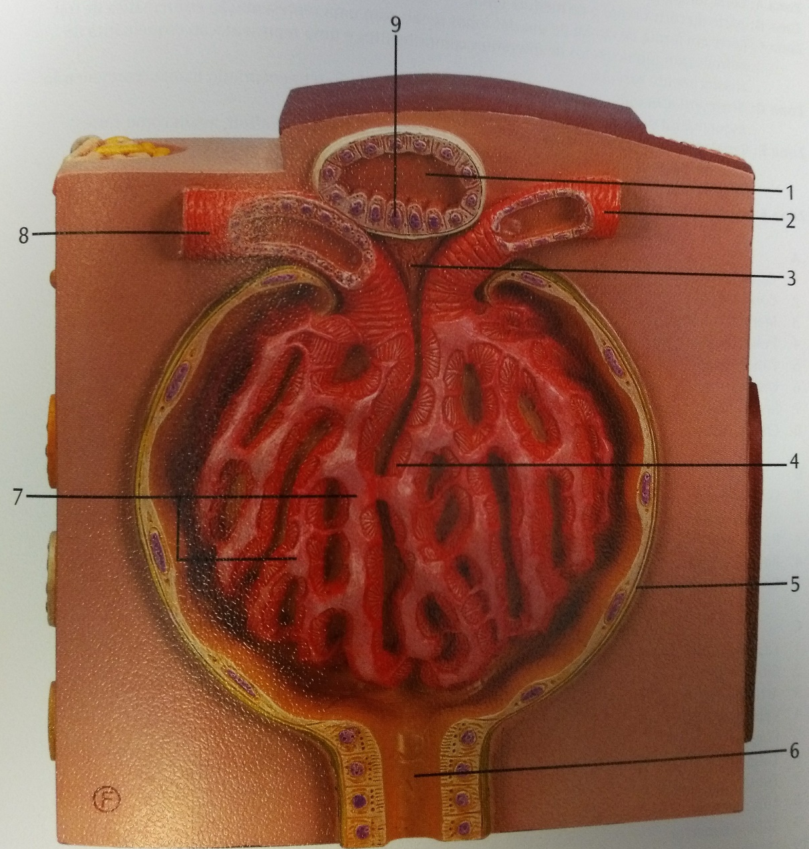
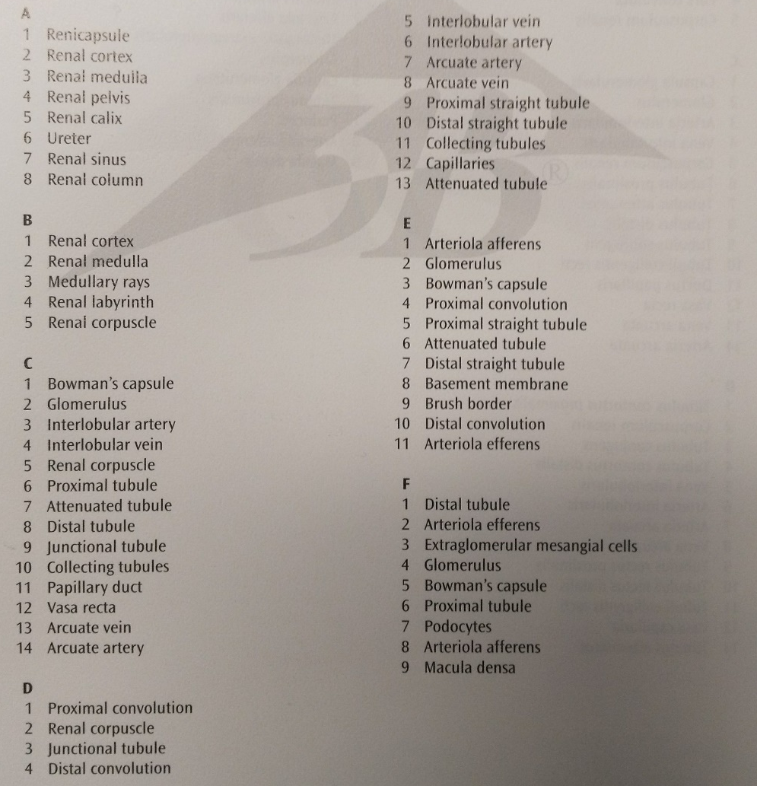
F

Slide 17
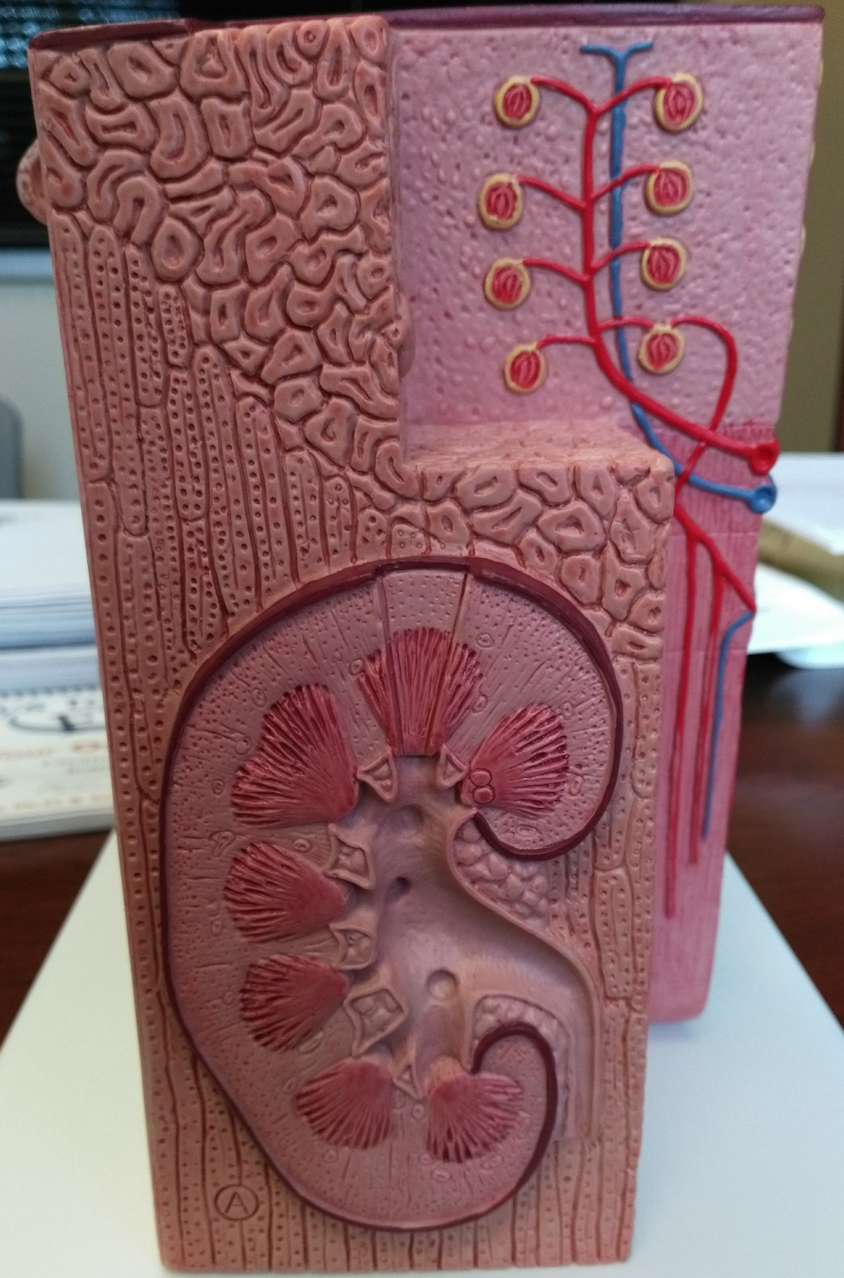

Slide 18
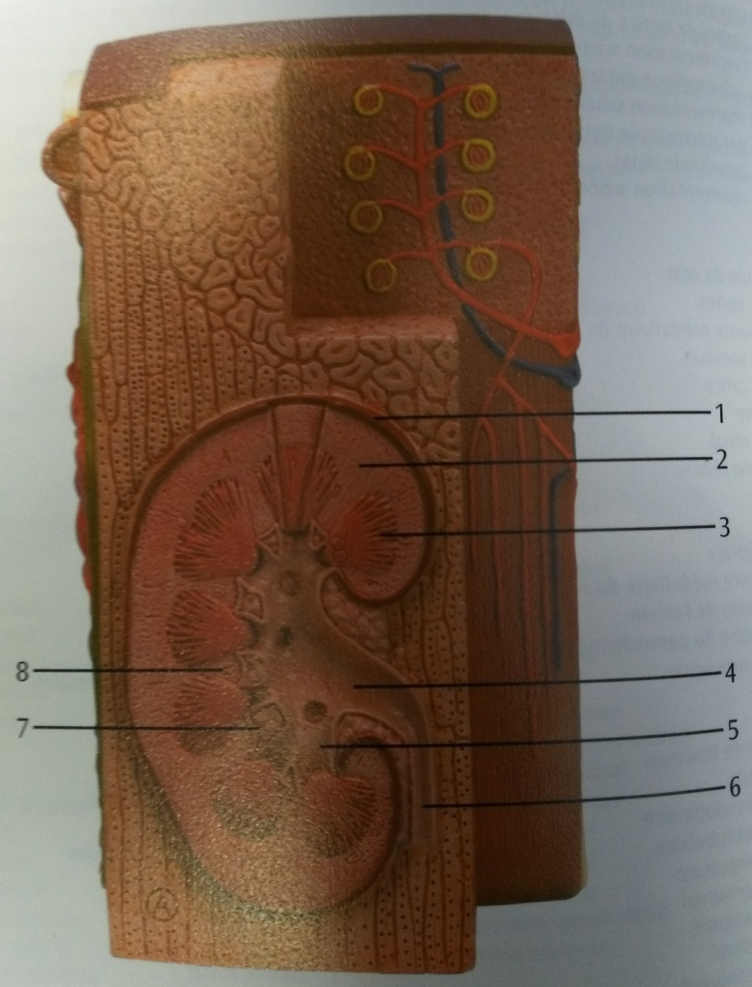
A

Slide 19
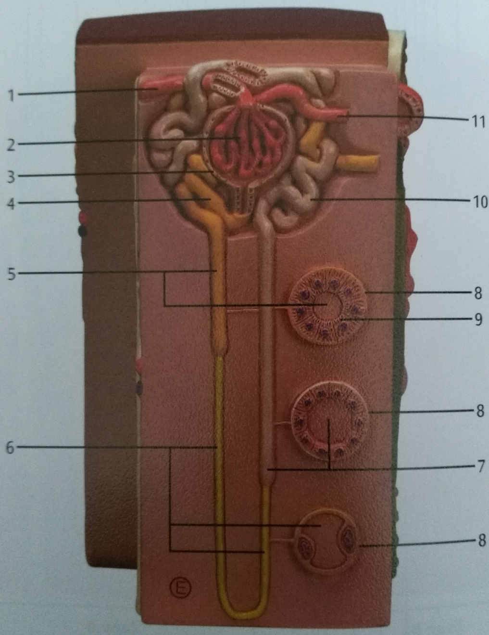
E

Slide 20
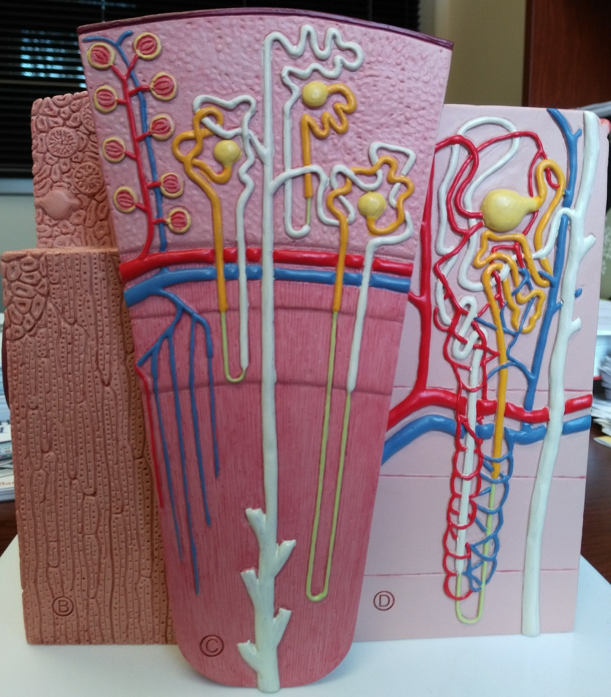

Slide 21
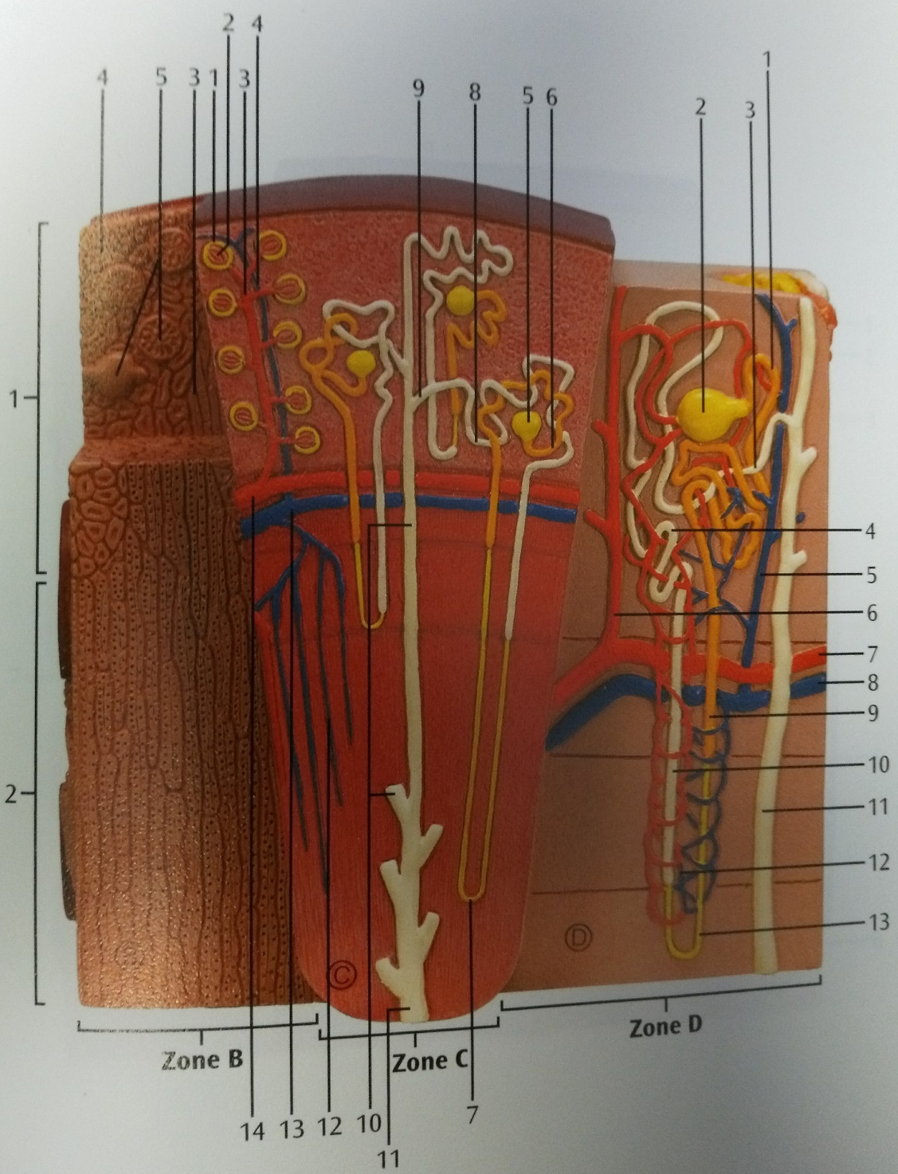
D

Slide 22
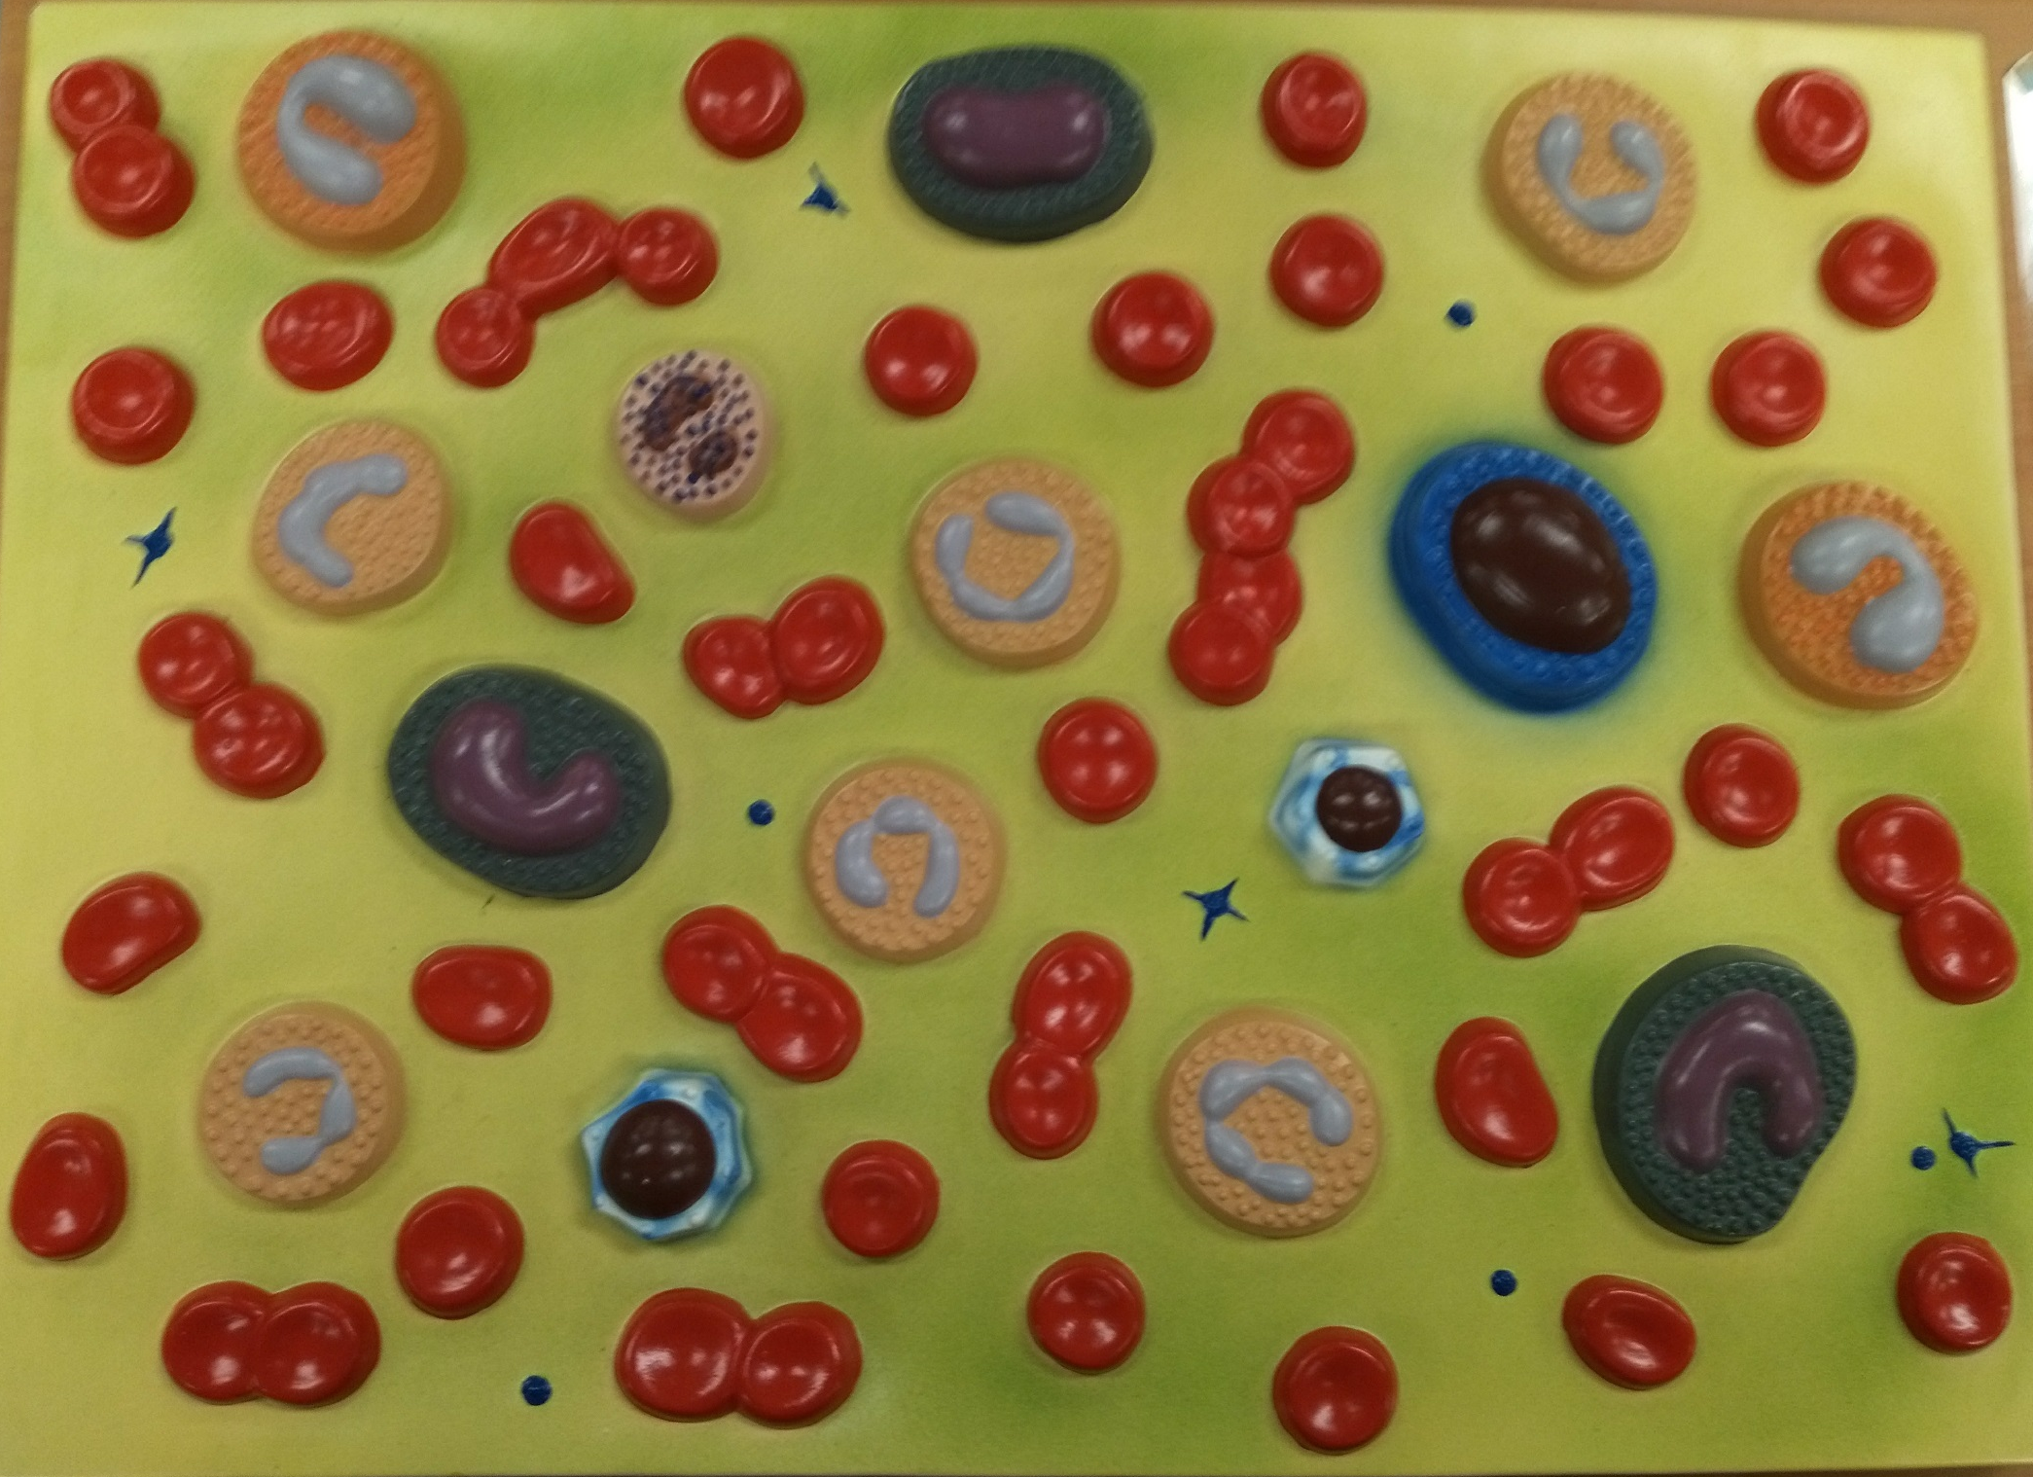

Slide 23
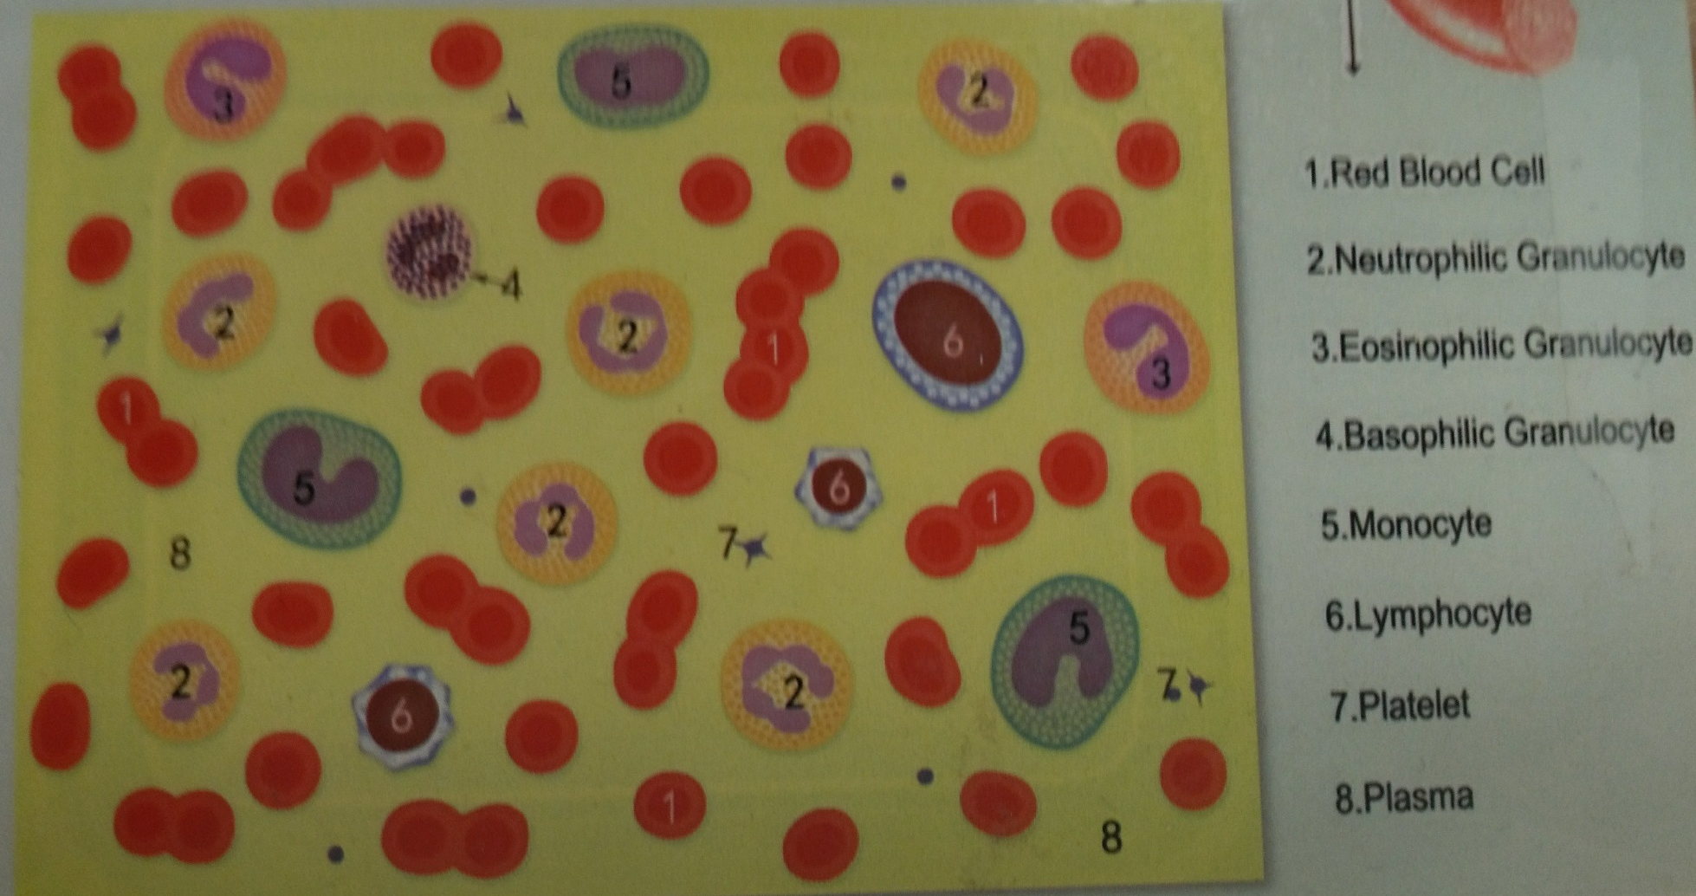

Slide 24
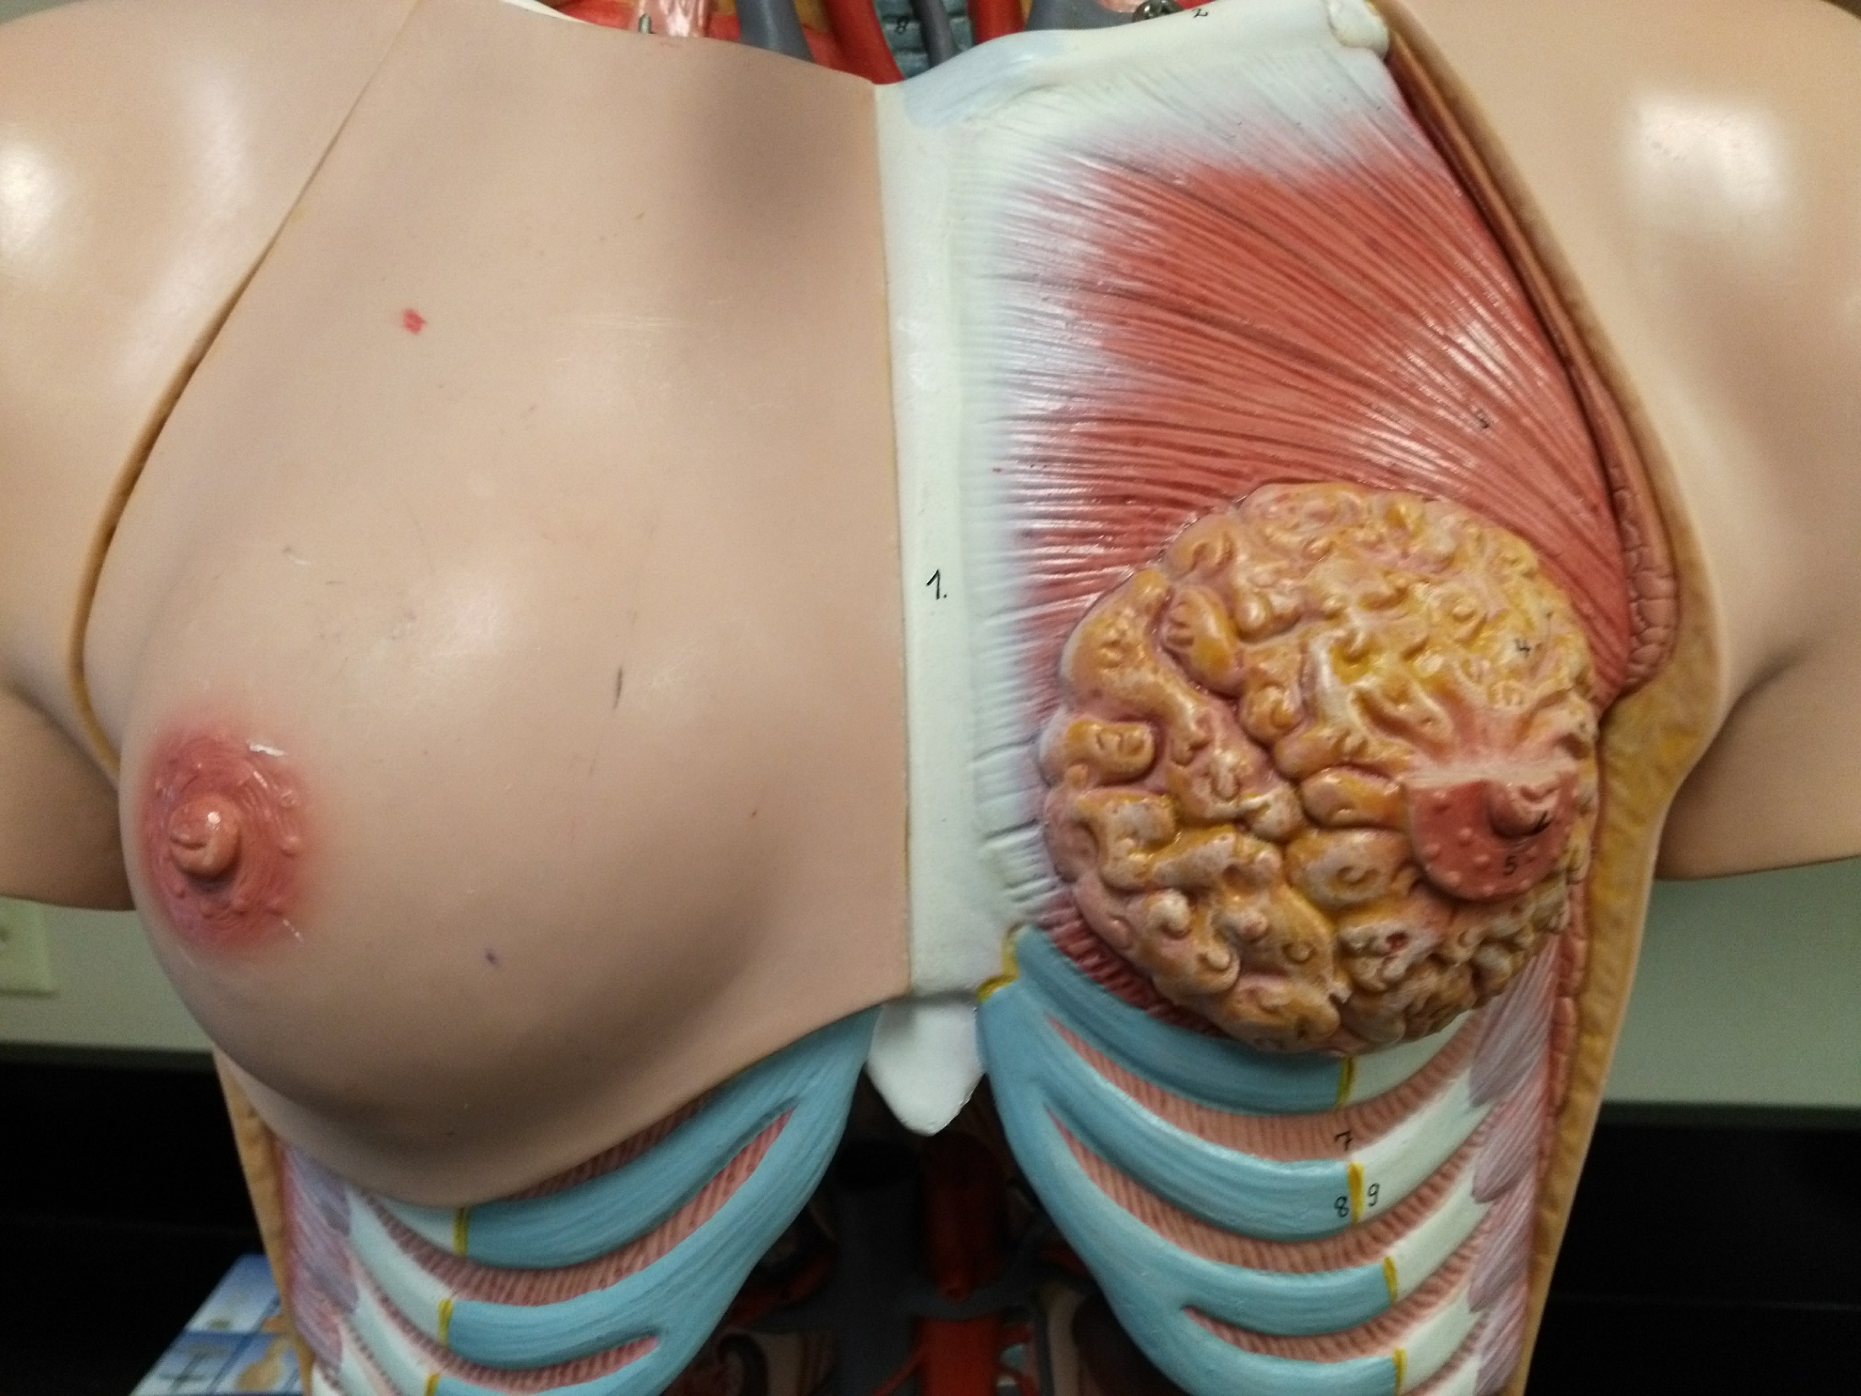

Slide 25
Mammary gland
Nipple
Areola

Slide 26
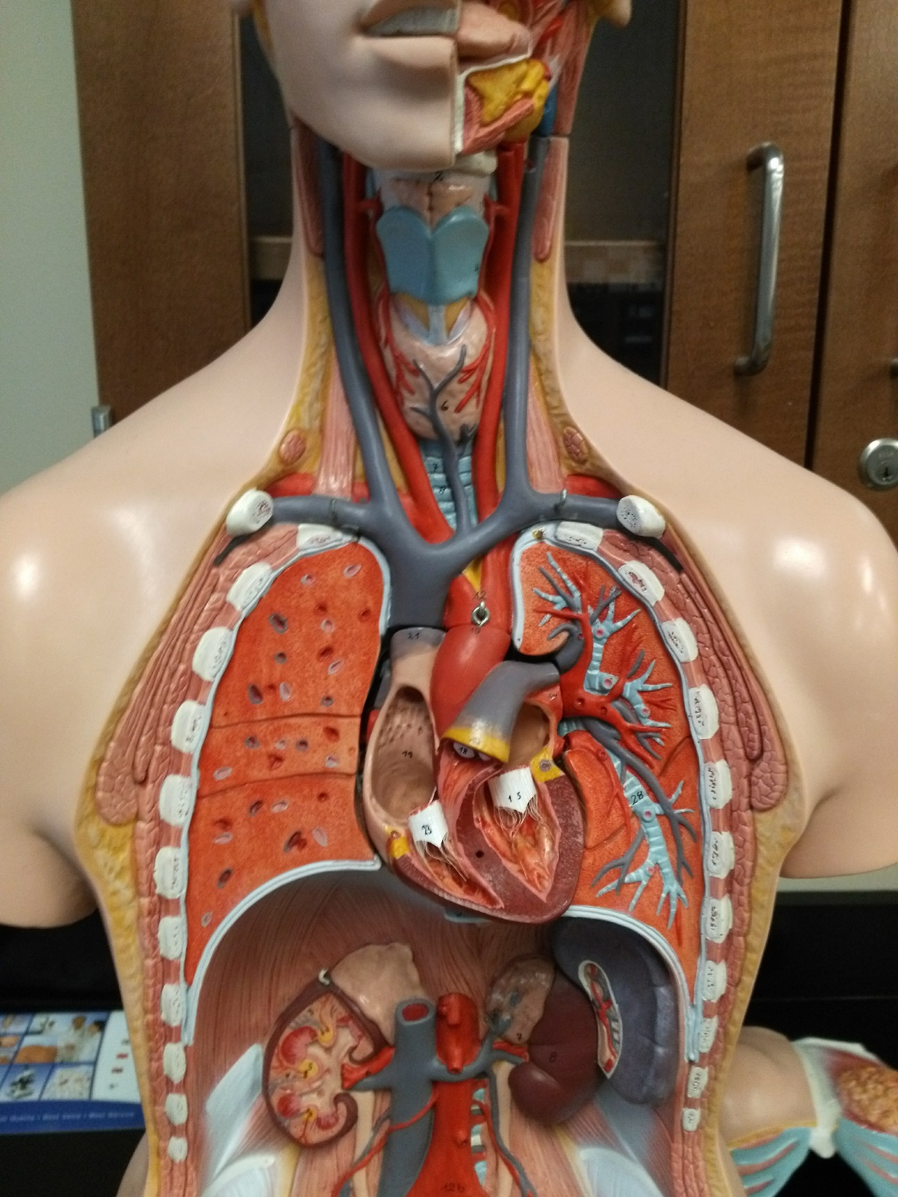

Slide 27
Thyroid gland
Spleen
Adrenal gland
Kidney
Ureter

Slide 28
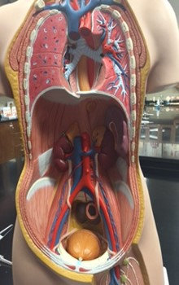

Slide 29
Adrenal gland
Spleen
Kidney
Inferior vena cava
Ureter
Abdominal aorta
Urinary bladder
Lymph node

Slide 30
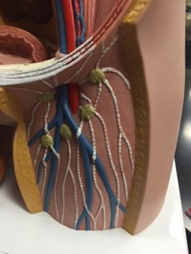

Slide 31
External iliac artery
External iliac vein
Femoral artery
Urinary bladder
Femoral vein
Lymph node
Lymph vessel

Slide 32
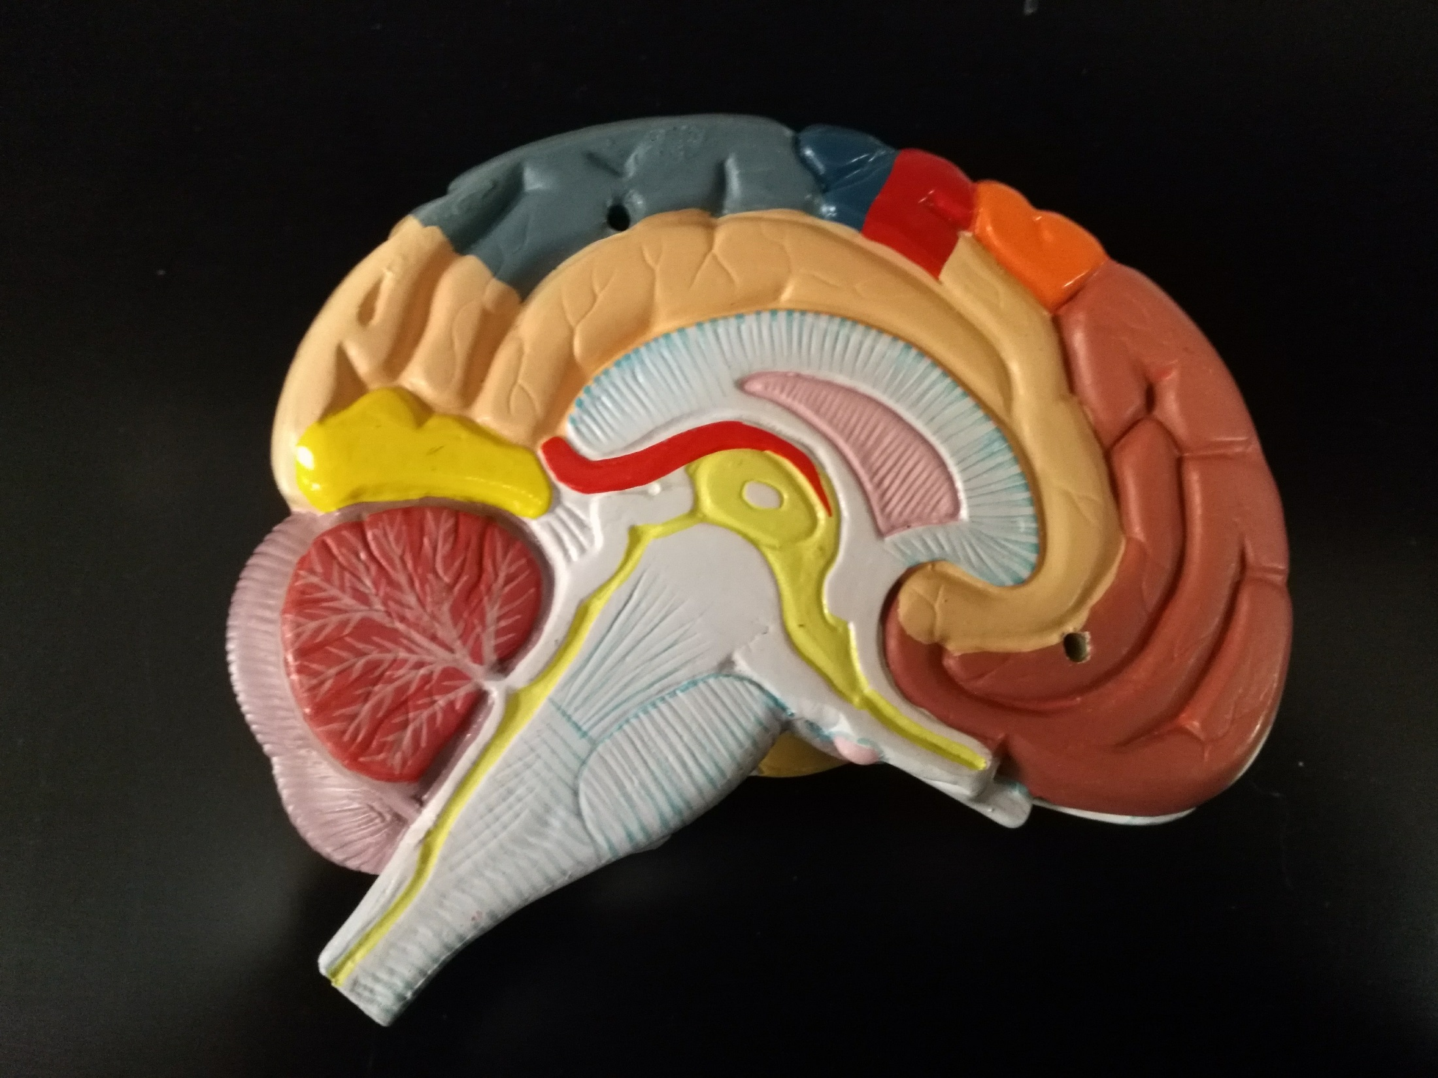

Slide 33
Hypothalamus
Pituitary gland

Slide 34
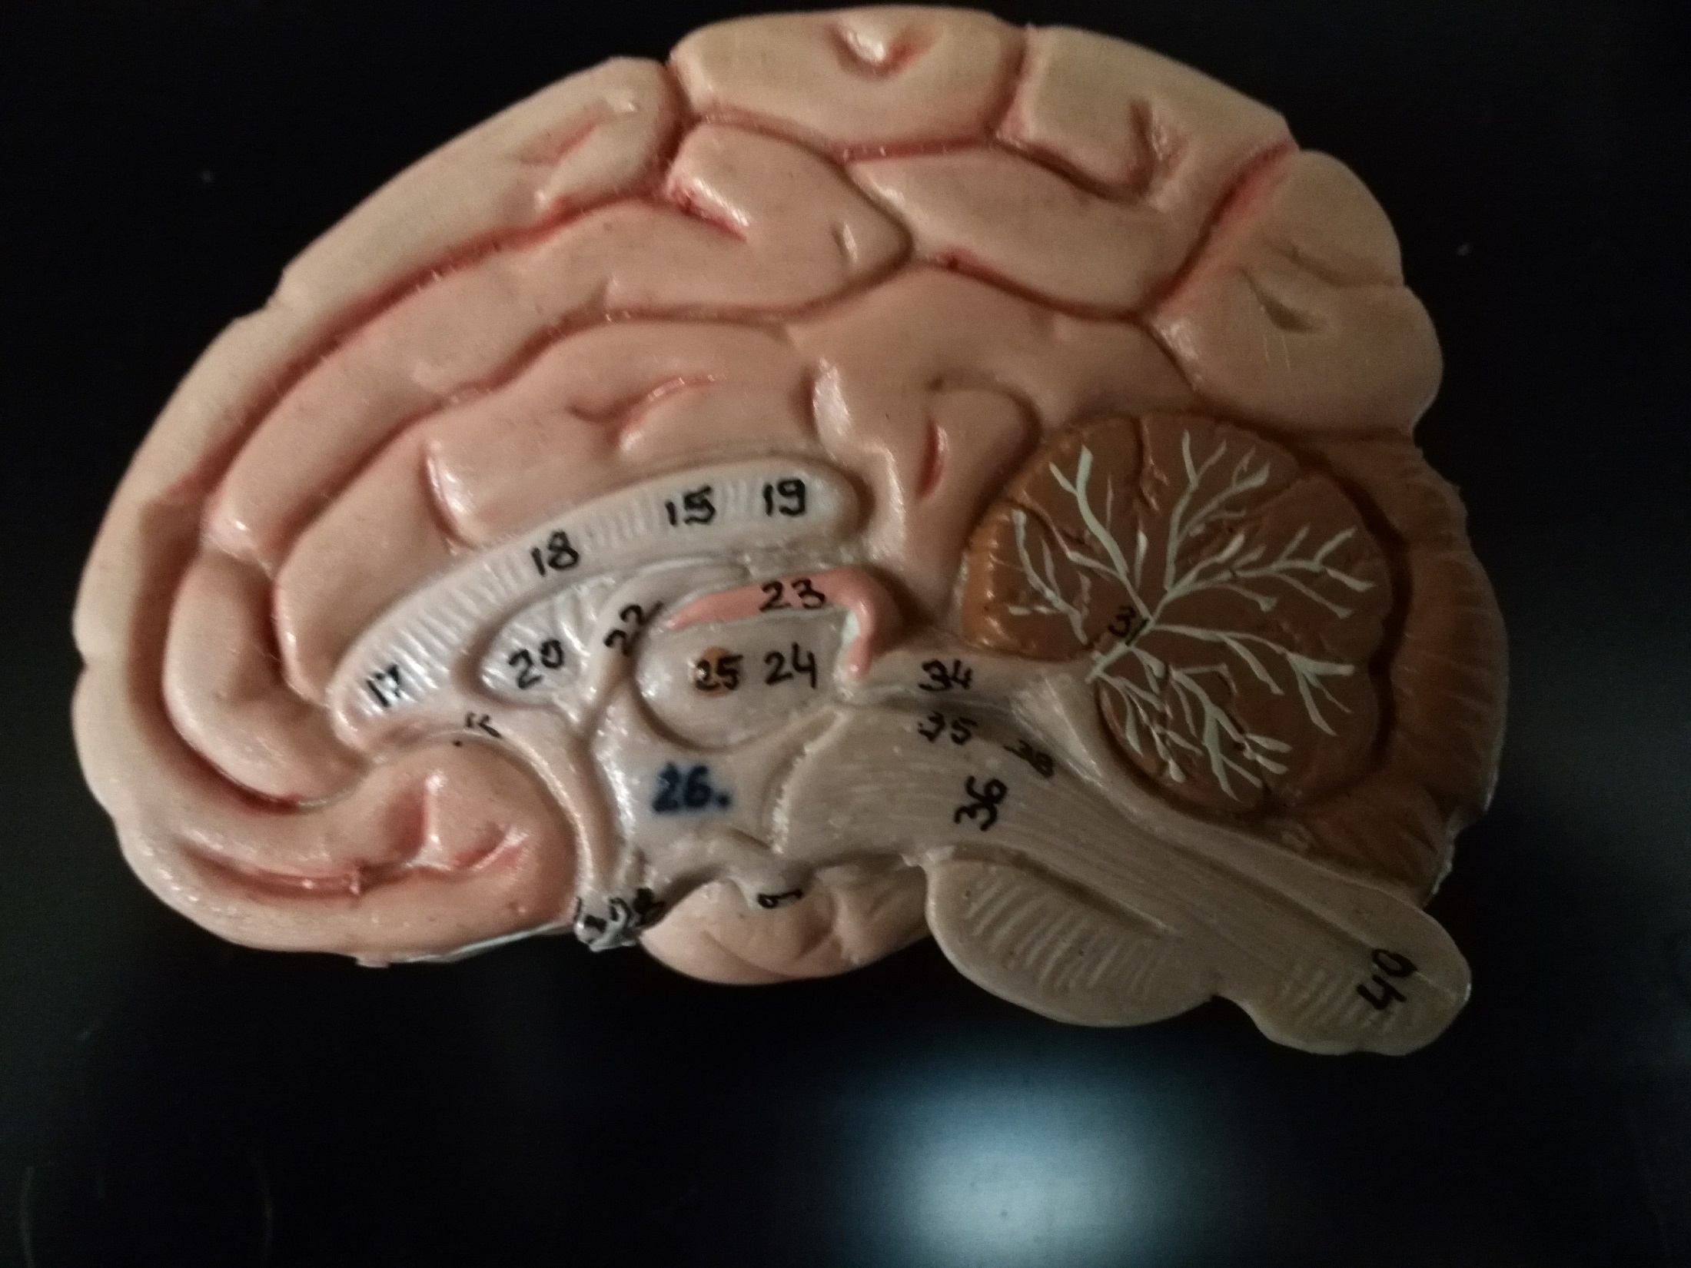

Slide 35
Pineal gland
Hypothalamus
Pituitary gland

Slide 36
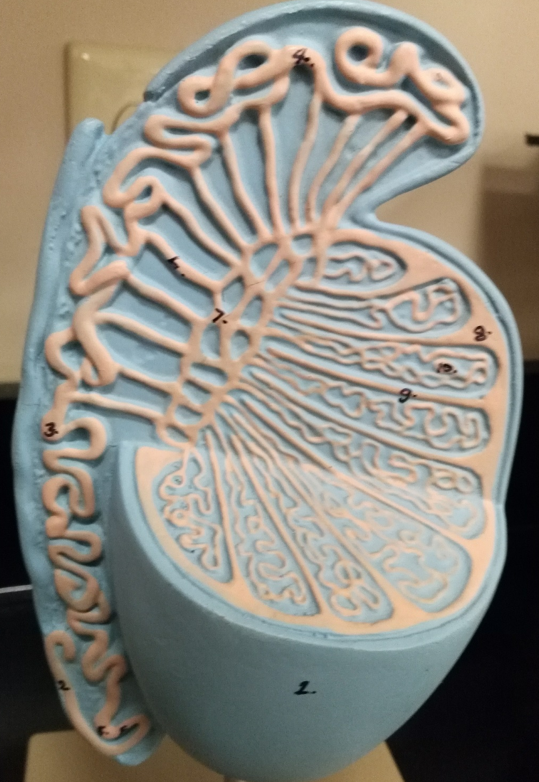
Testis

Slide 37
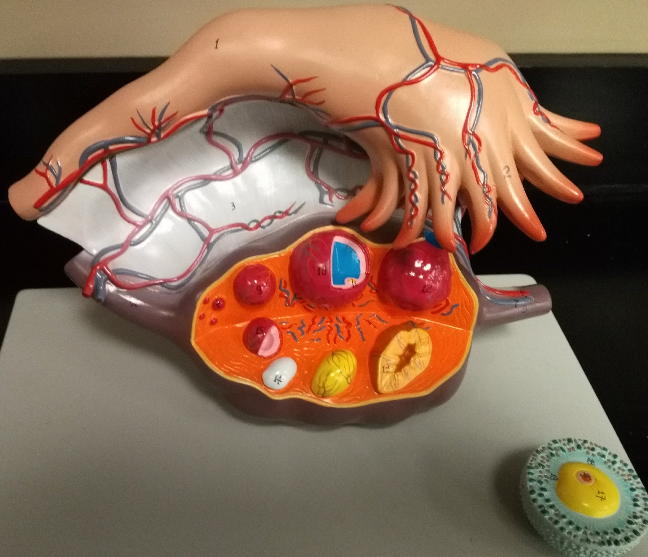
Ovary

