Slide 1
Endocrine Glands

Slide 2
Approach to studying endocrine glands
Endocrine vs. Exocrine glands
Lipid soluble vs. Water soluble
Hypothalamic hormones vs Pituitary
Ant. Pituitary vs. Post. Pituitary
Tropic vs. Non-tropic
Tropic means it causes a gland to secrete another hormone
Ex: CRH is tropic to the anterior pituitary causing it to secrete ACTH, ACTH is tropic to the adrenal gland causing it to secrete cortisol
Antagonistic, synergistic, permissive hormones
Humeral vs. Hormonal vs. Neuroendocrine
Hormones – origin, cause of secretion, target tissue, action

Slide 3
Pineal gland
Hypothalamus
Pituitary gland (in sella turcica)

Slide 4
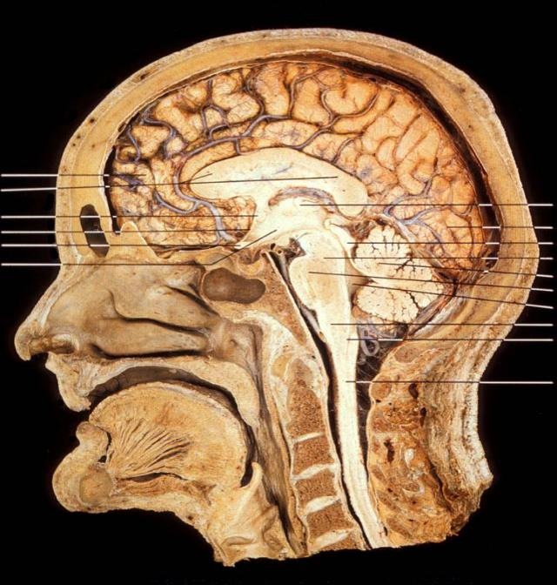

Slide 5
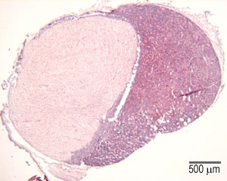
Pituitary gland tissue
Anterior pituitary
Posterior
pituitary

Slide 6
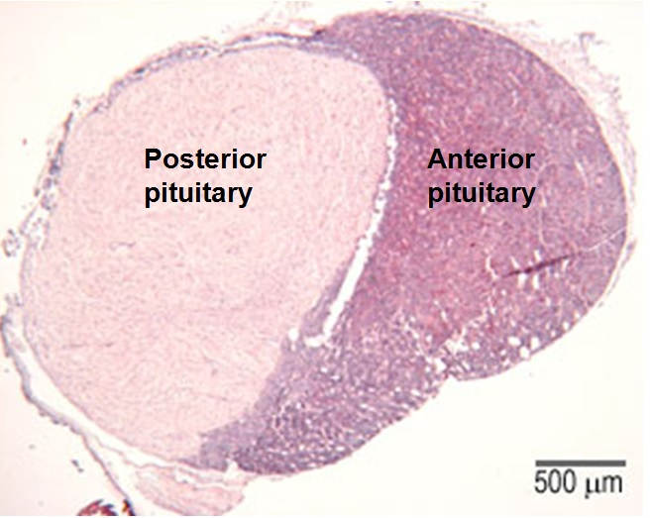

Slide 7
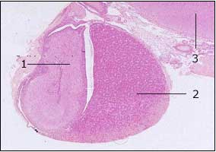
1. posterior pituitary gland, 2. anterior pituitary gland, 3. hypothalamus

Slide 8
Pineal gland
Brain sand
Pineal cells (pinealocytes)

Slide 9
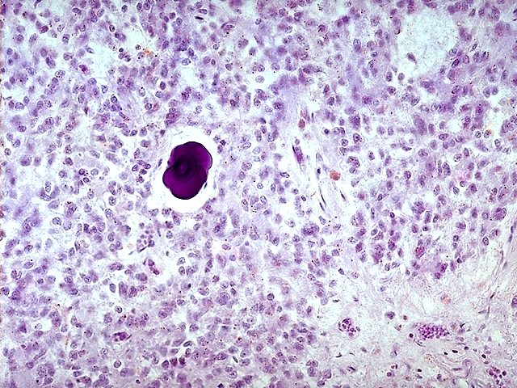

Slide 10
Thyroid gland
Thymus

Slide 11
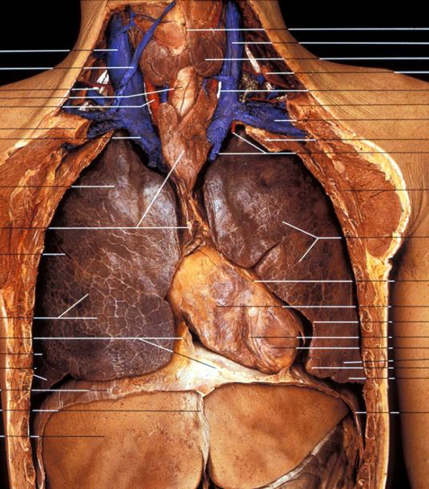

Slide 12
Thyroid tissue
colloid
colloid
colloid
colloid
Follicle cells
C-cells (Parafollicle cells)

Slide 13
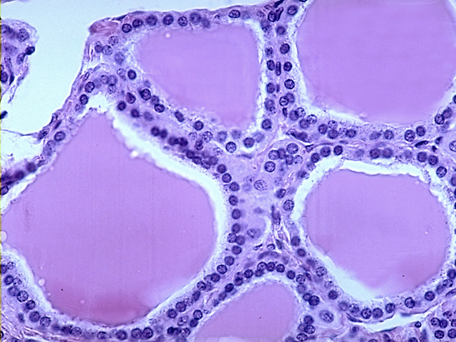

Slide 14
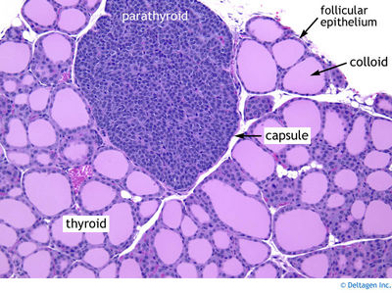

Slide 15
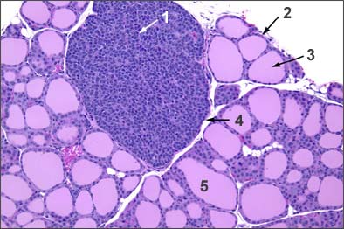

Slide 16
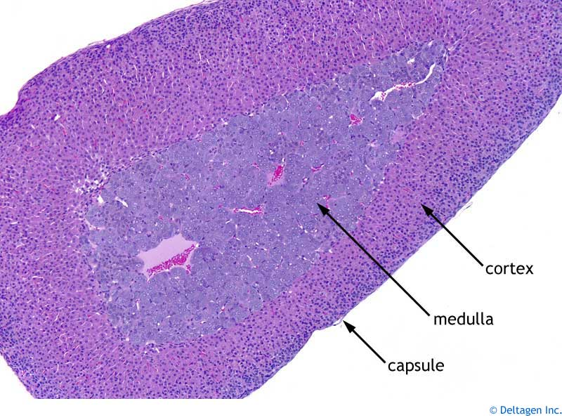
Adrenal gland

Slide 17
A
B
C

Slide 18
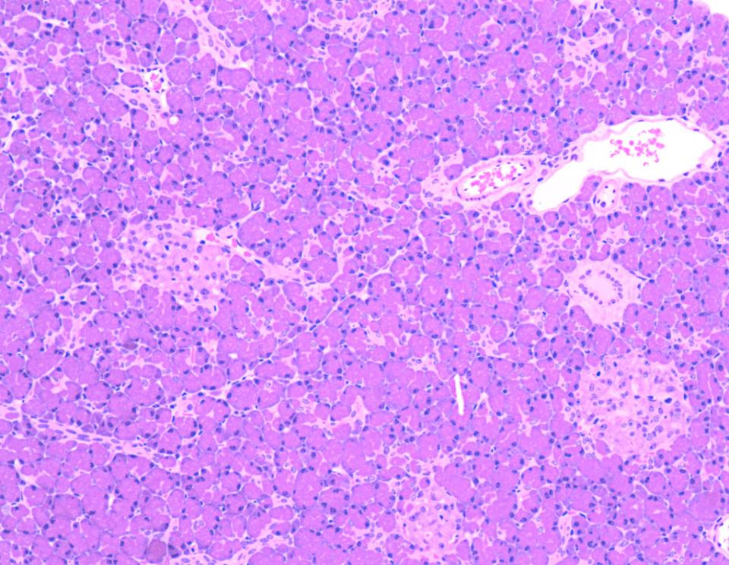

Slide 19
