Slide 1
Heart, Blood, Blood Vessels
APHY 102

Slide 2
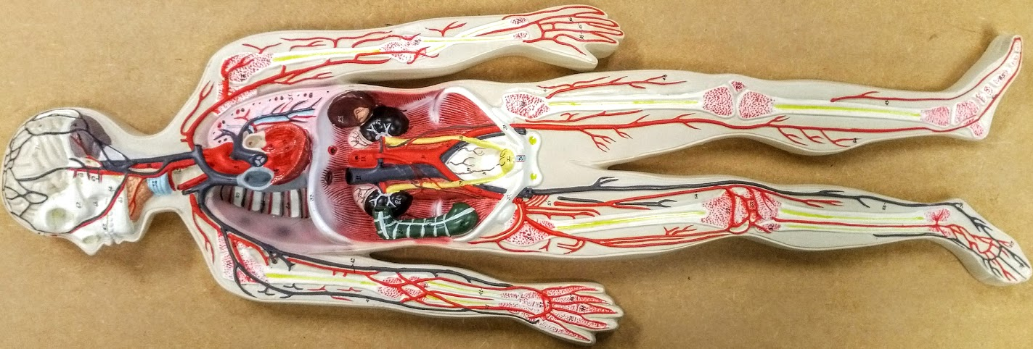

Slide 3
Ulnar a.
Brachial a.
Axillary a.
Radial a.
Superior mesenteric a.
Anterior tibial a.
Subclavian a.
Abdominal aorta
Jugular v.
Brachiocephalic v.
Internal iliac a.
External iliac a.
Femoral a.
Celiac trunk
Popliteal a.
Posterior tibial a.
Femoral v.
Great saphenous v.
Dorsal venous arch
Common carotid a.
Brachiocephalic trunk
Common iliac a.
Brachiocephalic v.
Basilic v.
Superior vena cava
Inferior vena cava
Subclavian v.
Ulnar a.
Anterior tibial a.
Small saphenous v.
Axillary v.
Cephalic v.
Radial a.
Palmar arch a.

Slide 4
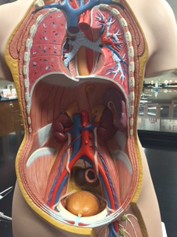

Slide 5
Jugular vein
Common carotid arteries
Subclavian vein
Brachiocephalic veins
Brachiocephalic trunk
Superior vena cava
Primary bronchus
Trachea
Thoracic aorta
Right lung
Esophagus
Left lung
Diaphragm
Celiac trunk
Inferior vena cava
Superior mesenteric artery
Abdominal aorta
Renal vein
Inferior mesenteric artery
Common iliac vein
Common iliac artery
Ureter
Internal iliac artery
External iliac vein
External iliac artery
Urinary bladder
Femoral vein
Femoral artery
Lymph node

Slide 6
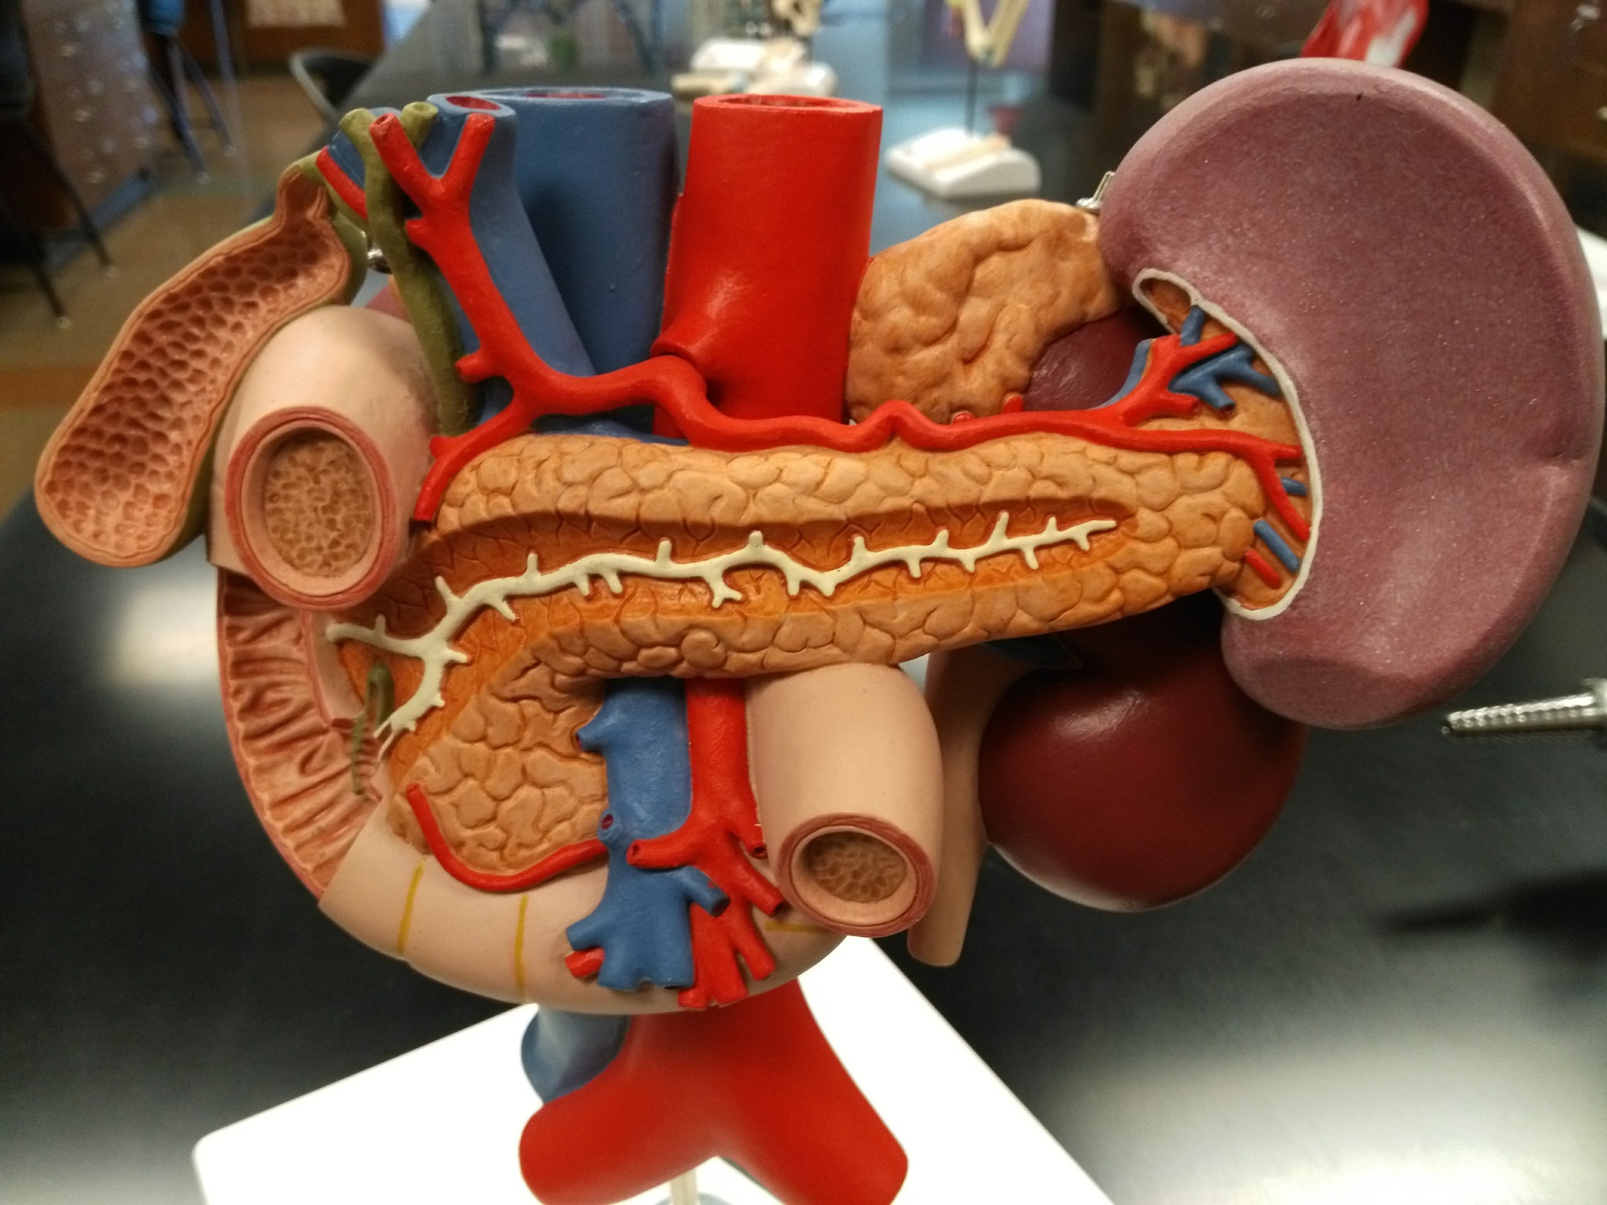

Slide 7
Inferior vena cava
Abdominal aorta
Celiac trunk
Adrenal gland
Bile duct
Hepatic portal vein
Spleen
Gallbladder
Pancreas
Duodenum
Pancreatic duct
Circular folds of duodenum
Hepatopancreatic sphincter and ampulla
Kidney
Ureter
Superior mesenteric artery and vein

Slide 8
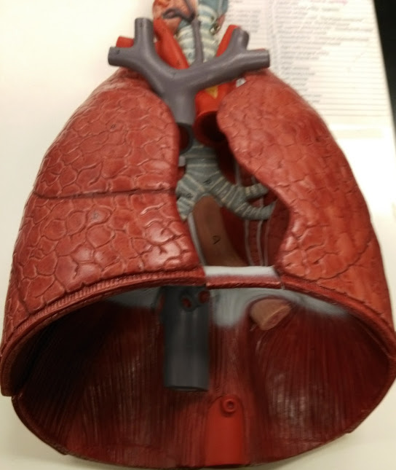

Slide 9
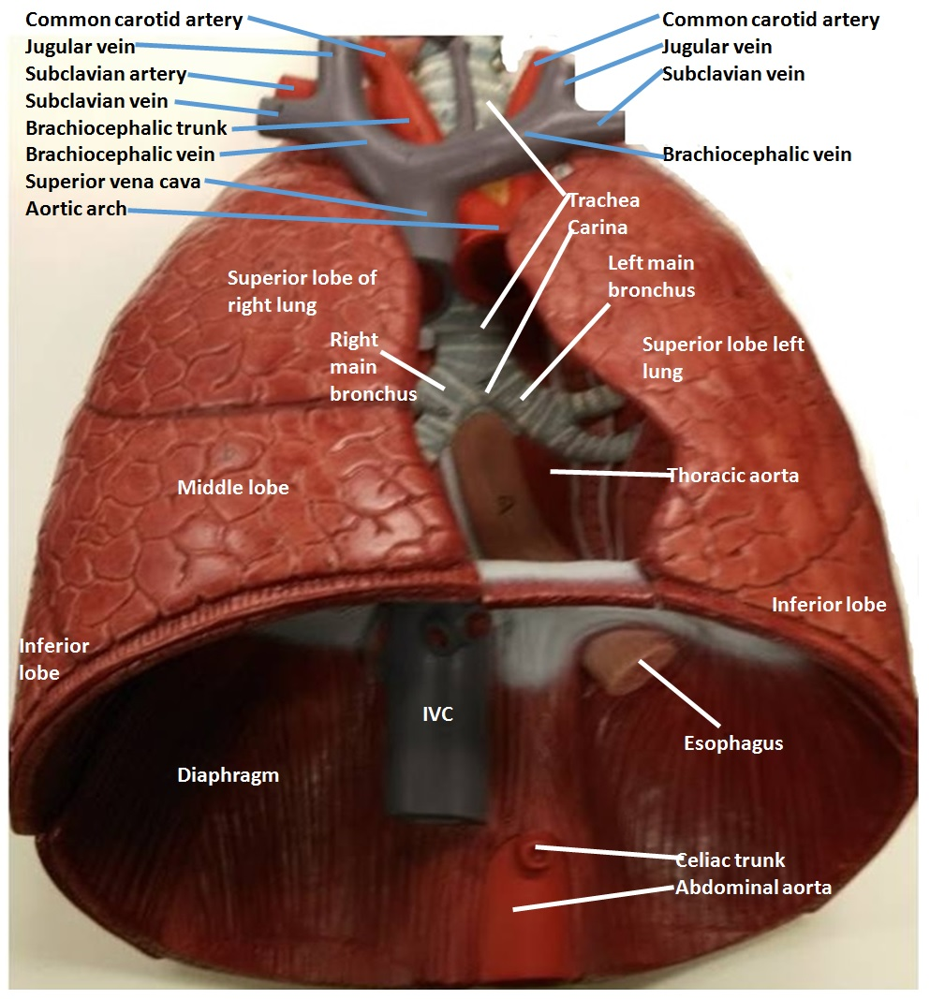

Slide 10
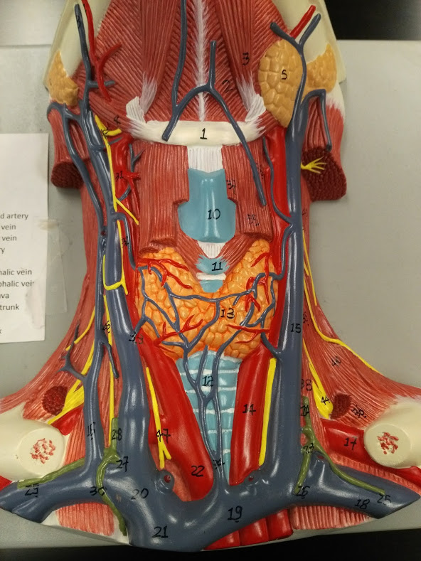

Slide 11
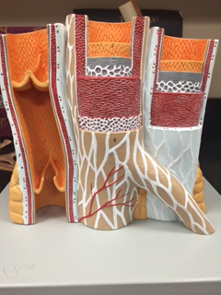

Slide 12
Endothelium
(Lines lumen)
Subendothelial layer
(Basement membrane)
Valve
Internal elastic lamina
Tunica media
(Smooth muscle)
External elastic tissue
Tunica externa
Vasa vasorum
Adipose
Vein
Artery
Arteriole

Slide 13
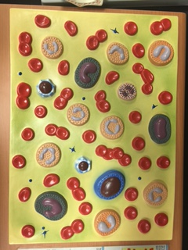
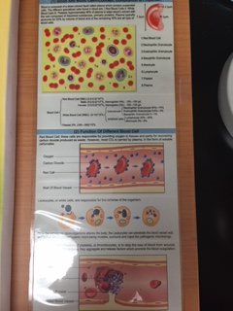
Eosinophil
Basophil
Monocyte
Lymphocyte
Erythrocyte
Thrombocyte
(Platelet)
Neutrophil

Slide 14
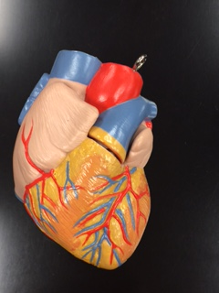
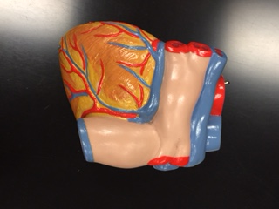

Slide 15
Superior
vena
cava
Superior
vena
cava
Aorta
Pulmonary arteries
Aorta
Pulmonary veins
Pulmonary arteries
Right
atrium
Pulmonary artery
Left atrium
Pulmonary veins
Pulmonary trunk
Coronary sinus
Left atrium
(auricle)
Auricle
Circumflex artery
Left ventricle
Right atrium
Right coronary
artery
Right ventricle
Left ventricle
Inferior vena cava
Anterior interventricular artery
Posterior interventricular artery
Anterior view
Posterior view

Slide 16
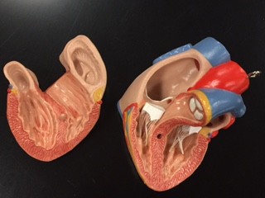

Slide 17
Pectinate muscles
Superior vena cava
Right atrium
Aorta
Left atrium
Pulmonary trunk
Pulmonary valve
Trabeculae carnae
Left atrium
Bicuspid
Mitral
(L AV) valve
Tricuspid
(R AV) valve
Chordae tendinae
Right ventricle
Papillary muscles
Interventricular septum
Left ventricle

Slide 18
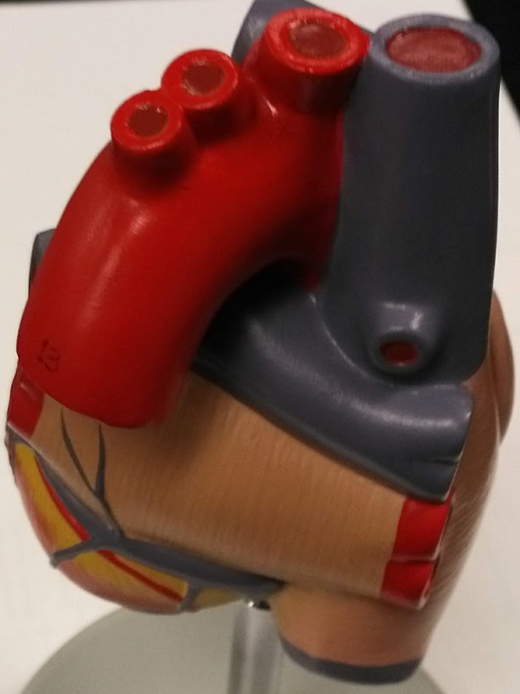
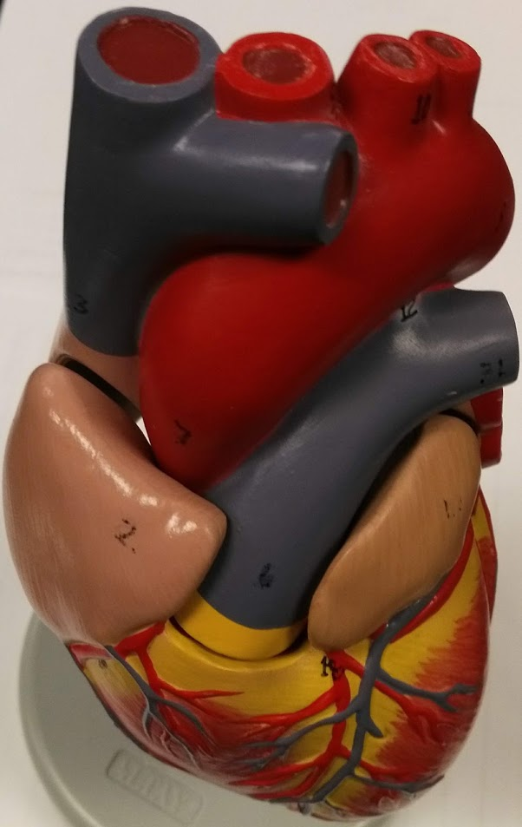

Slide 19
Brachiocephalic trunk
Left common carotid artery
Left subclavian artery
Superior
vena
cava
Aortic arch
Pulmonary vein
Pulmonary artery
Right atrium
Left atrium
Pulmonary veins
Coronary sinus
Inferior vena cava

Slide 20
Brachiocephalic trunk
Left common carotid artery
Left subclavian artery
Superior vena cava
Aortic arch
Pulmonary artery
Ascending aorta
Pulmonary veins
Pulmonary trunk
Auricle of right atrium
Auricle of left atrium
Circumflex artery
Left ventricle
Anterior interventricular artery
Right coronary artery
Right ventricle

Slide 21
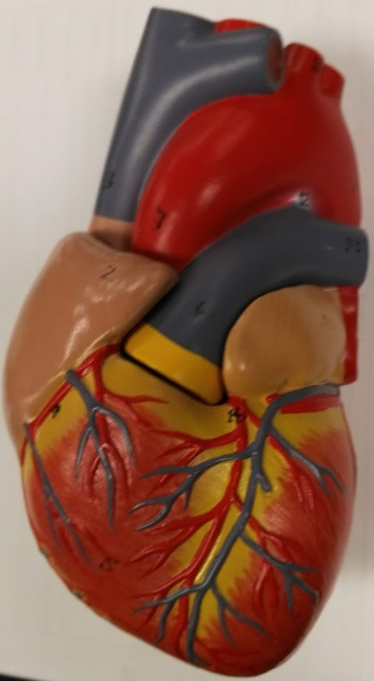
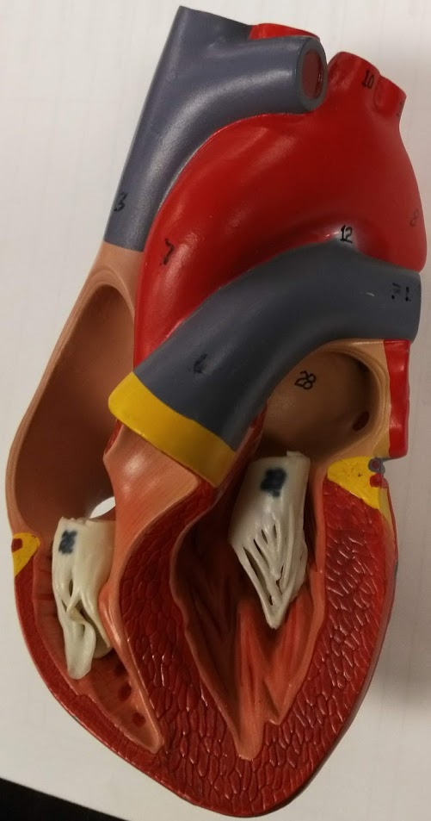

Slide 22
Superior vena cava
Aortic arch
Ligamentum arteriorsum
Ascending aorta
Pulmonary artery
Right atrium
Pulmonary trunk
Left atrium
Pulmonary veins
Circumflex artery
Right coronary artery
Anterior interventricular artery
Left ventricle
Right ventricle

Slide 23
Superior vena cava
Aortic arch
Ligamentum arteriorsum
Ascending aorta
Pulmonary artery
Pulmonary trunk
Left atrium
Pulmonary veins
Right atrium
Mitral valve
with chordae tendinae
Tricuspid valve
with chordae tendinae
Inter-ventricular septum
Papillary muscle
Trabeculae carnae
Left ventricle
Right ventricle

Slide 24
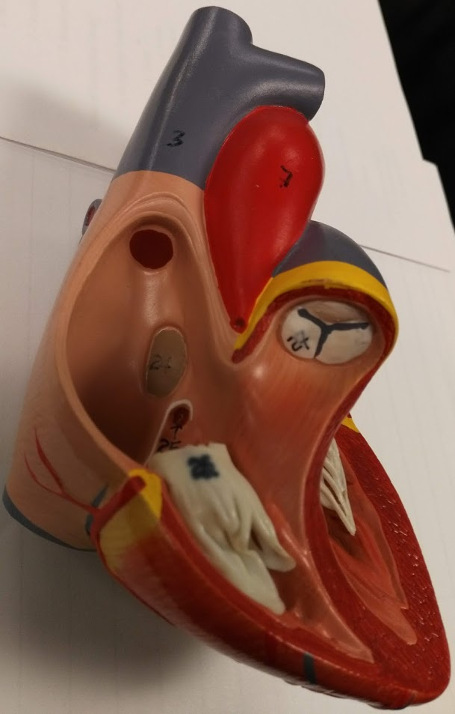
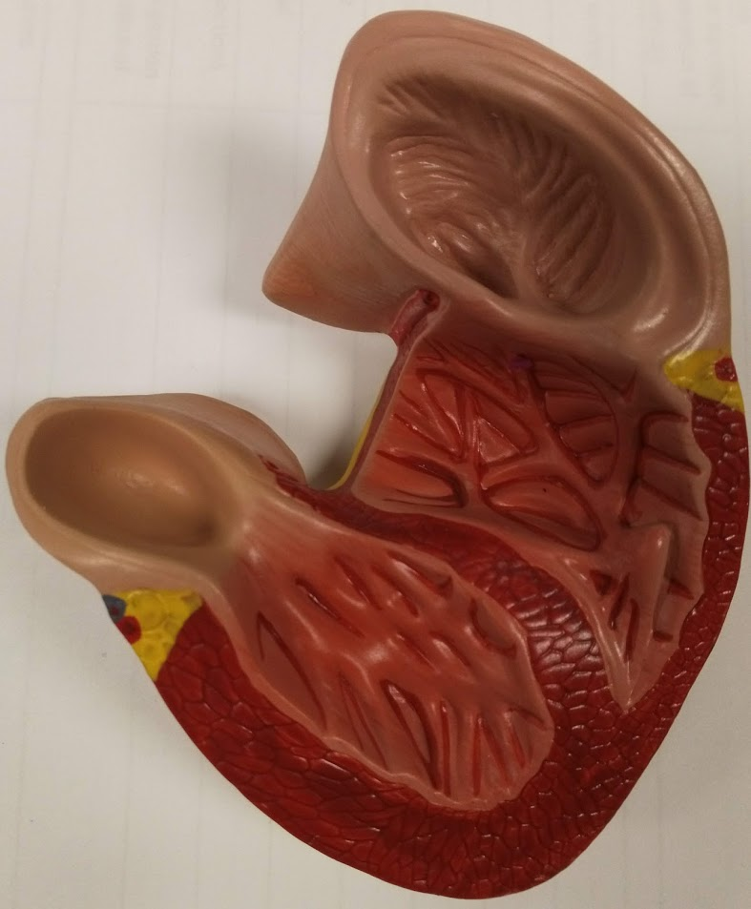

Slide 25
Superior vena cava
Ascending aorta
Right atrium
Fossa ovale
Coronary sinus opening
Pulmonary semilunar vale
Tricuspid valve in right ventricle
Inferior vena cava

Slide 26
Pectinate muscle in right atrium
Trabeculae carnae in right ventricle
Inter-ventricular septum
Trabeculae carnae in left ventricle

Slide 27
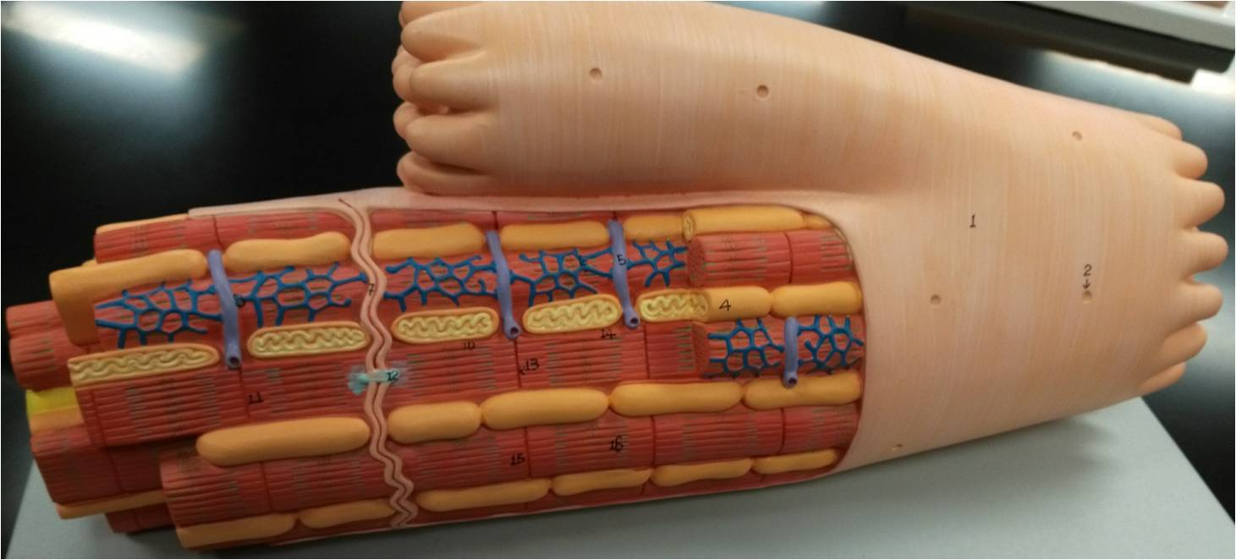

Slide 28
Intercalated disc
Sarcoplasmic reticulum
T-tubule
Sarcomeres
Mitochondria
Gap junction
Cardiac Muscle Cell

