Slide 1
Female Reproductive System

Slide 2
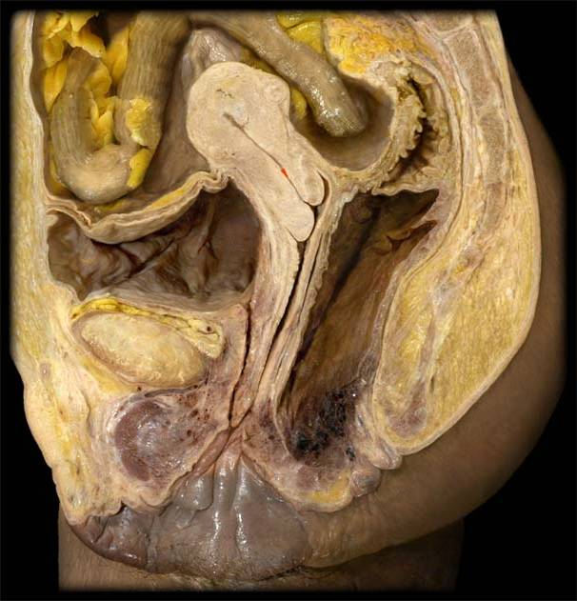
Uterus
Urinary bladder
Vagina
Pubic symphysis
Urethra
Mons pubis
Rectum
Clitoris
Labia minora
Labia majora

Slide 4
Vaginal mucosa stratified squamous epithelium

Slide 5
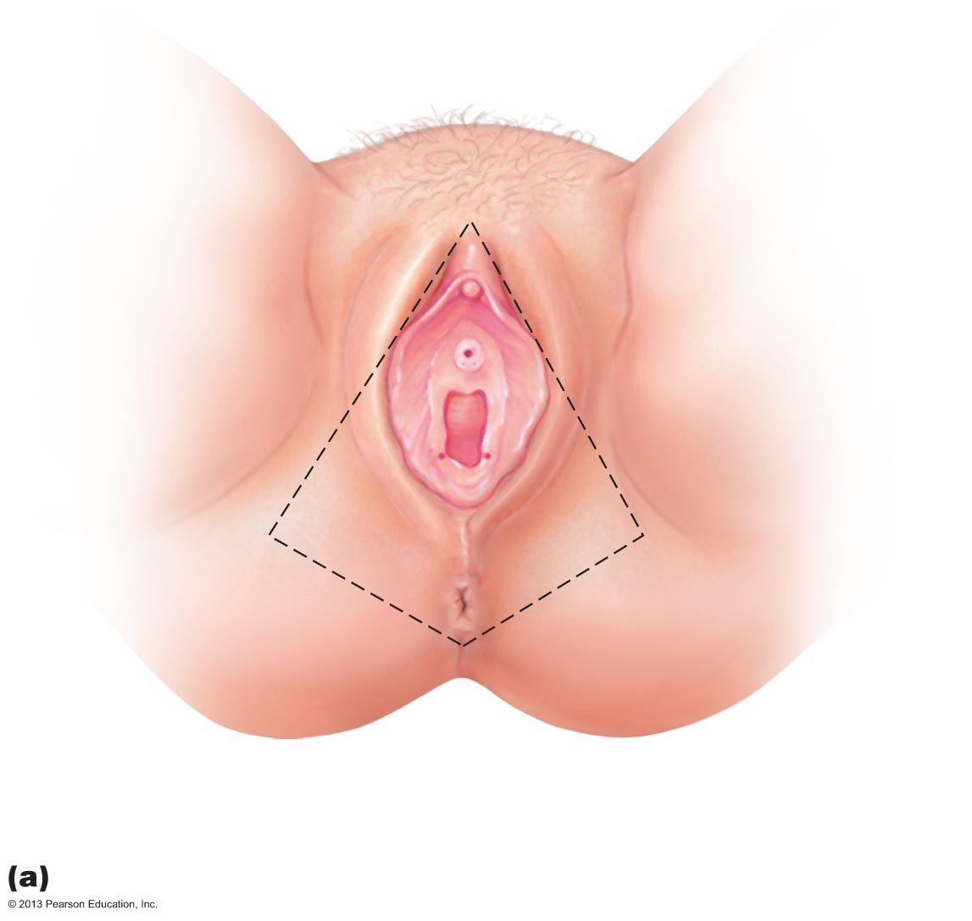
The external genitalia (vulva) of the female.
Mons
pubis
Labia
majora
Prepuce
of clitoris
Labia
minora
Clitoris
(glans)
External
urethral
orifice
Vestibule
Hymen
(ruptured)
Vaginal
orifice
Anus
Opening of the duct
of the greater
vestibular gland

Slide 7
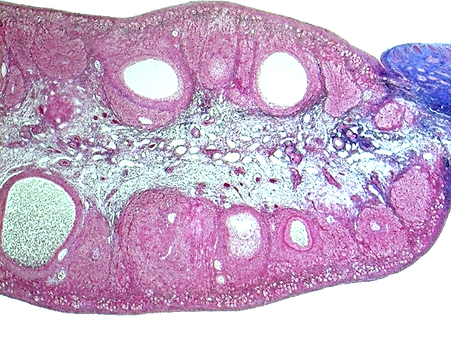
Tunica
albuginea
Cortex
Medulla
Antrum of a vesicular
(antral) follicle
Cortex
Germinal epithelium in primordial and primary follicles
Secondary
follicle

Slide 9
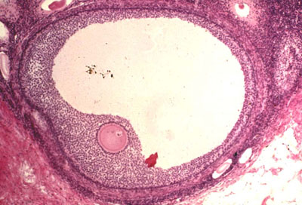
Mature (Graafian) follicle
Secondary oocyte

Slide 11
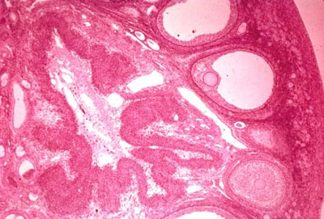
Ovary
Graafian follicle
Corpus luteum
Secondary follicle

Slide 13
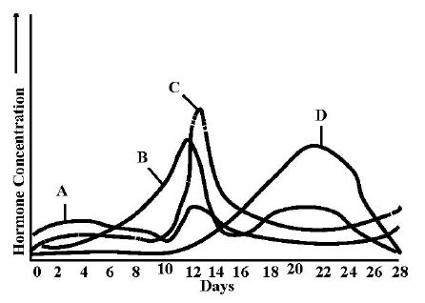
Anterior pituitary hormones: A. follicle-stimulating hormone, C. luteinizing hormone. Ovarian hormones: B. estrogen, D. progesterone.

Slide 14
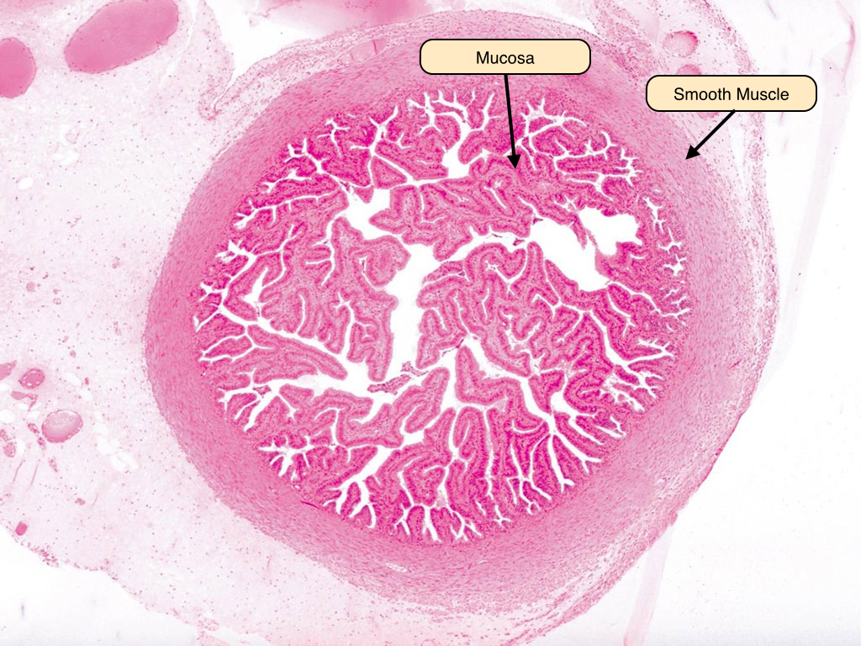
Uterine tube

Slide 15
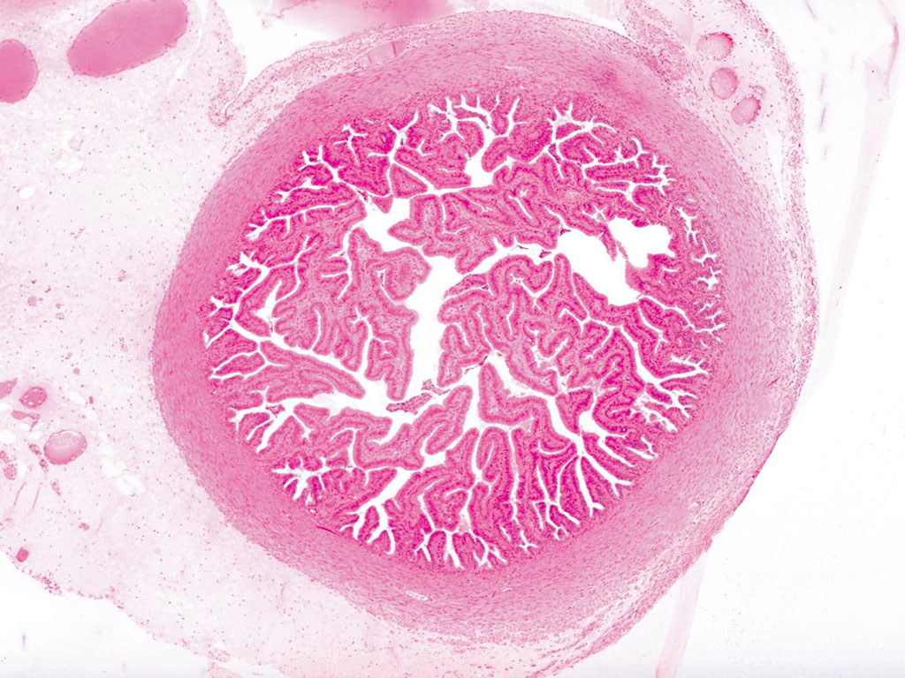

Slide 16
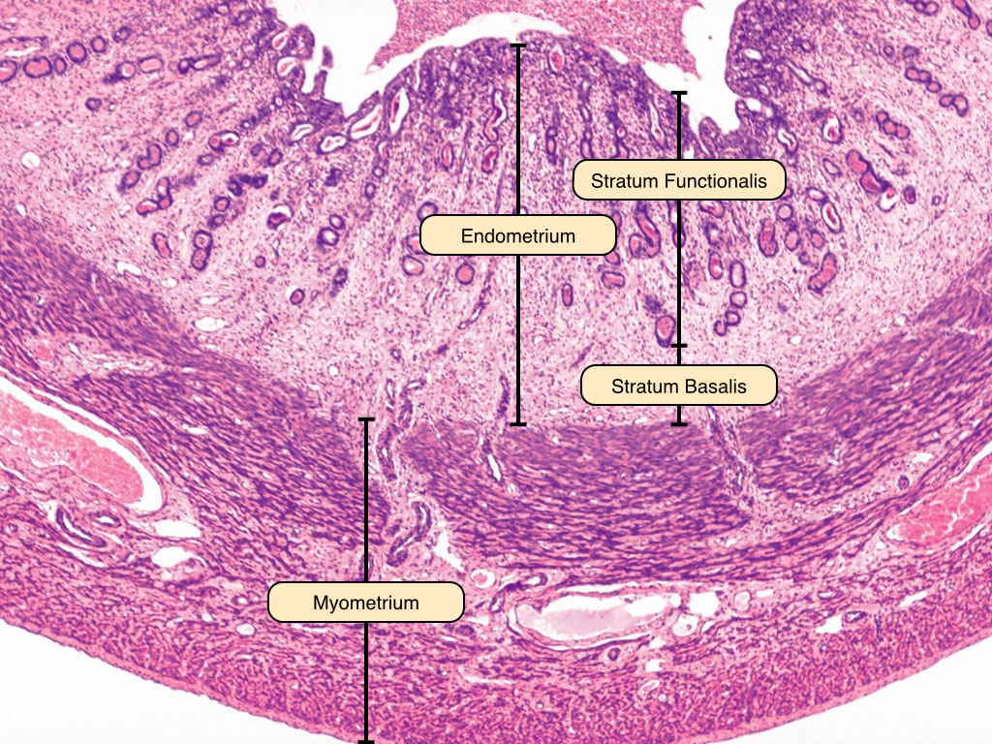
Uterus
Perimetrium

Slide 17
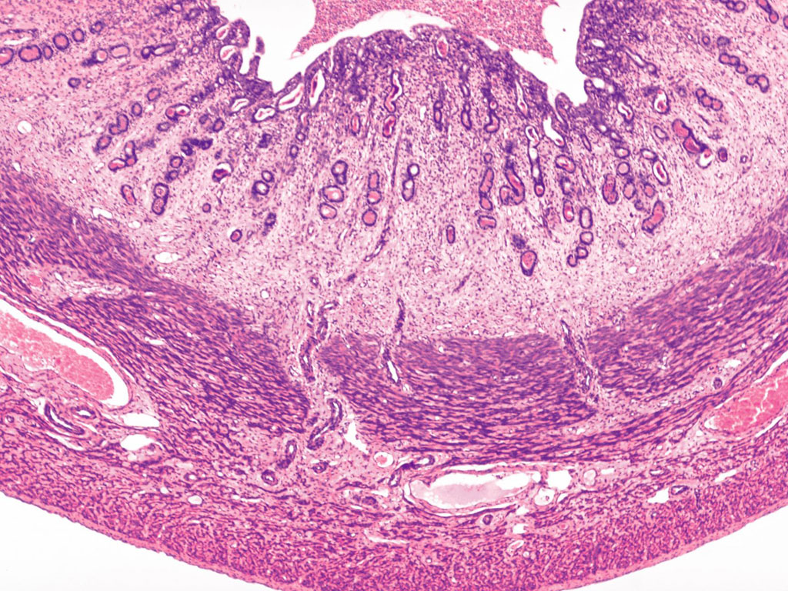

Slide 18
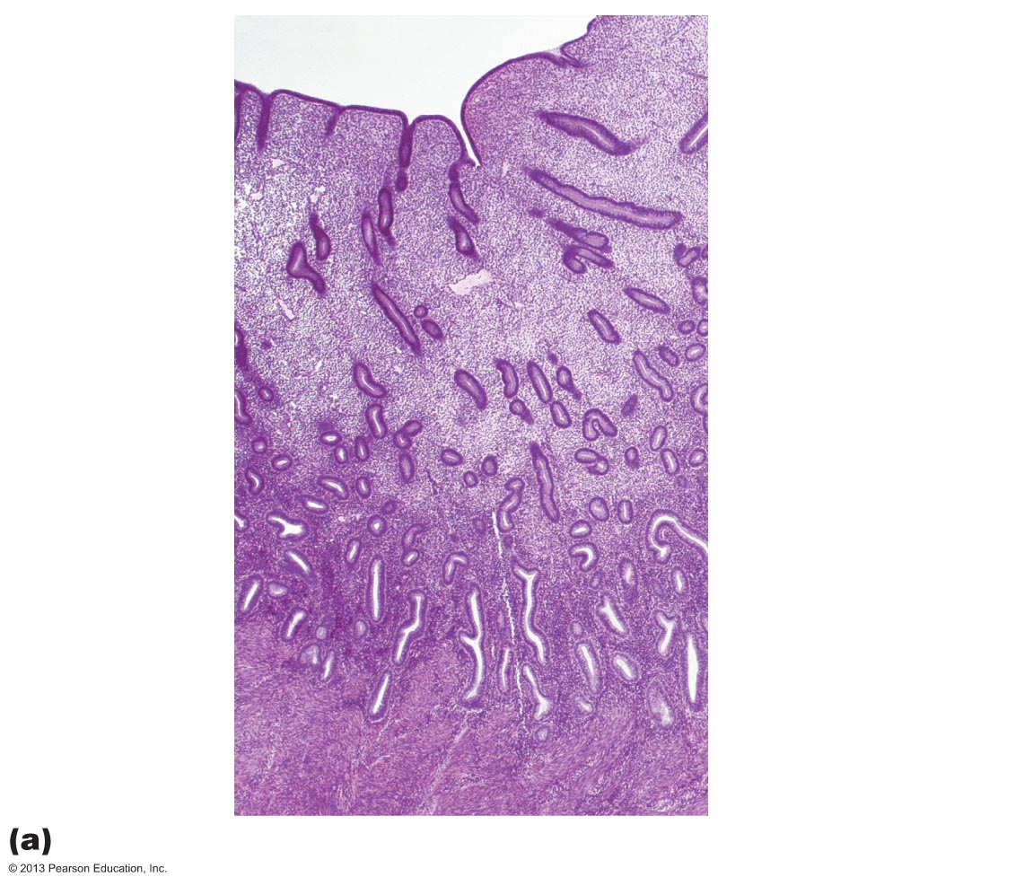
Lumen of uterus
Epithelium
Uterine glands
Stratum
functionalis
of the
endometrium
Lamina propria of
connective tissue
Stratum
basalis
of the
endometrium
Portion
of the
myometrium
Smooth muscle
fibers

Slide 20
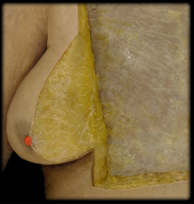
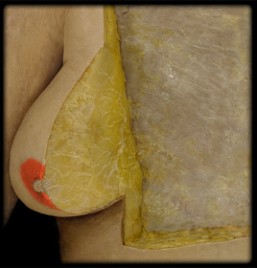
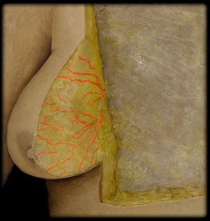
Mammary Gland Anatomy
Mammary gland
lactiferous sinus
nipple
areola
retromammillaryspace
suspensory ligaments
28-20

Slide 21
Inactive mammary gland

Slide 22
Active mammary gland

